Slide 1
Financial Report
Karen Kelly, Treasurer
17th October 2022
Notes:
ALL TO BE REVIEWED AT BARCELONA

Slide 2
Co-Chairs’ Report
Transforming Cochrane for the future
Tracey Howe and Catherine Marshall October 2022

Slide 3
Hurray!
Our first in-person and hybrid meeting in three years!
This AGM is a great opportunity to:
Reconnect with friends and colleagues
Reconsider what has changed in the world
Reflect on what we have learned in the last three years
Report on plans the Board has to build on our strengths to make sure we are relevant and resilient for our next 30 years.

Slide 4
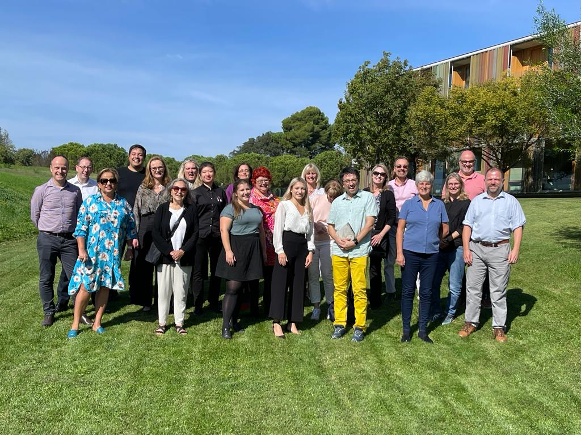

Slide 5
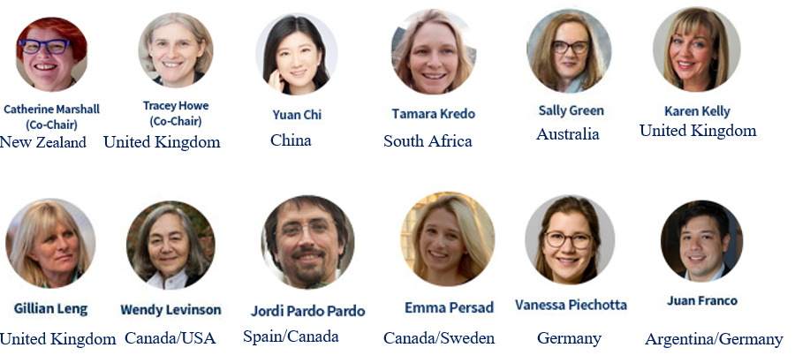
The Governing Board
Cochrane's governing body is the Board, with some members elected by Cochrane’s members and some appointed by the Board. Cochrane is a registered charity in the United Kingdom and the Board serves as our Board of Trustees.

Slide 6


Slide 7



Slide 8


Thanks to Judith Brodie and Welcome Catherine Spencer
Thanks to Judith and the CET
Welcome to Catherine and new members of the ELT

Slide 9
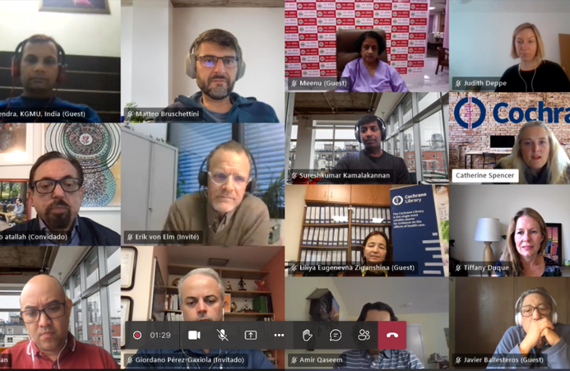


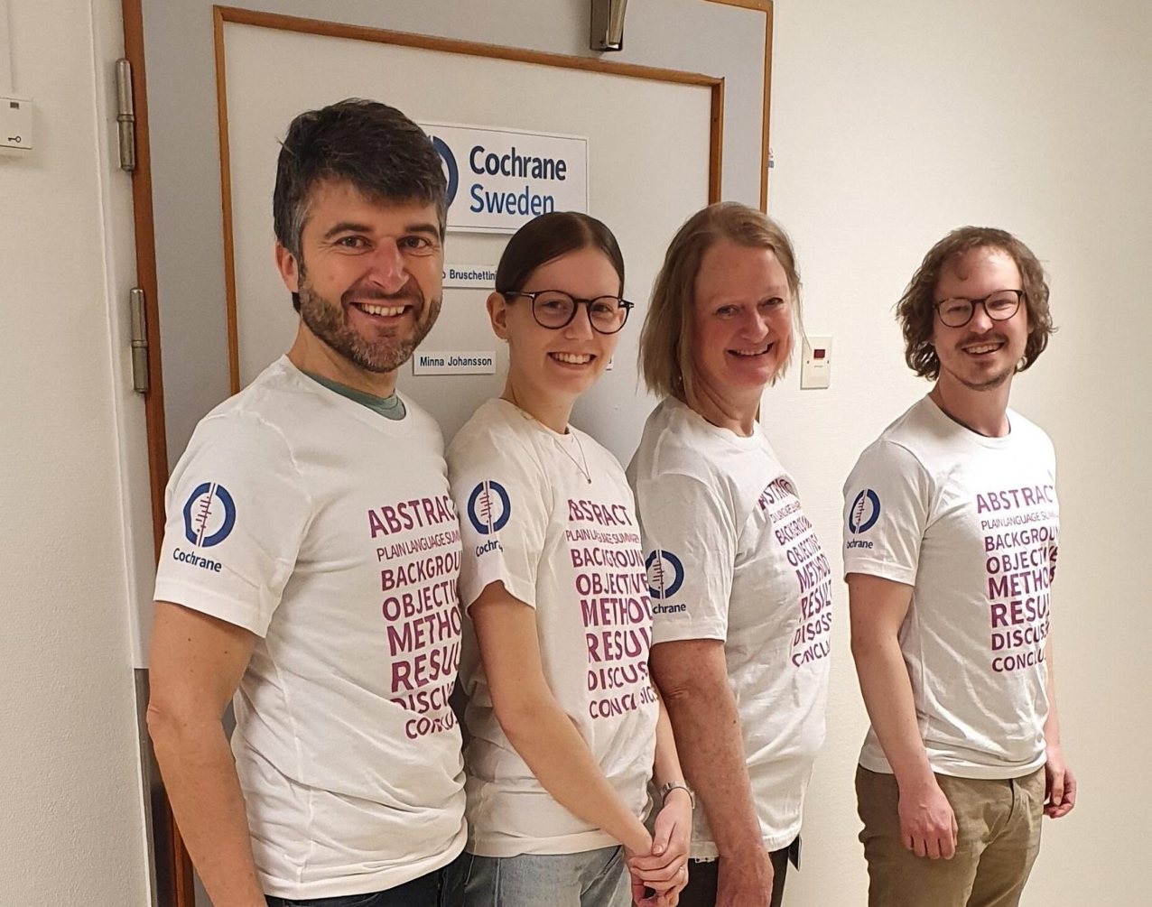
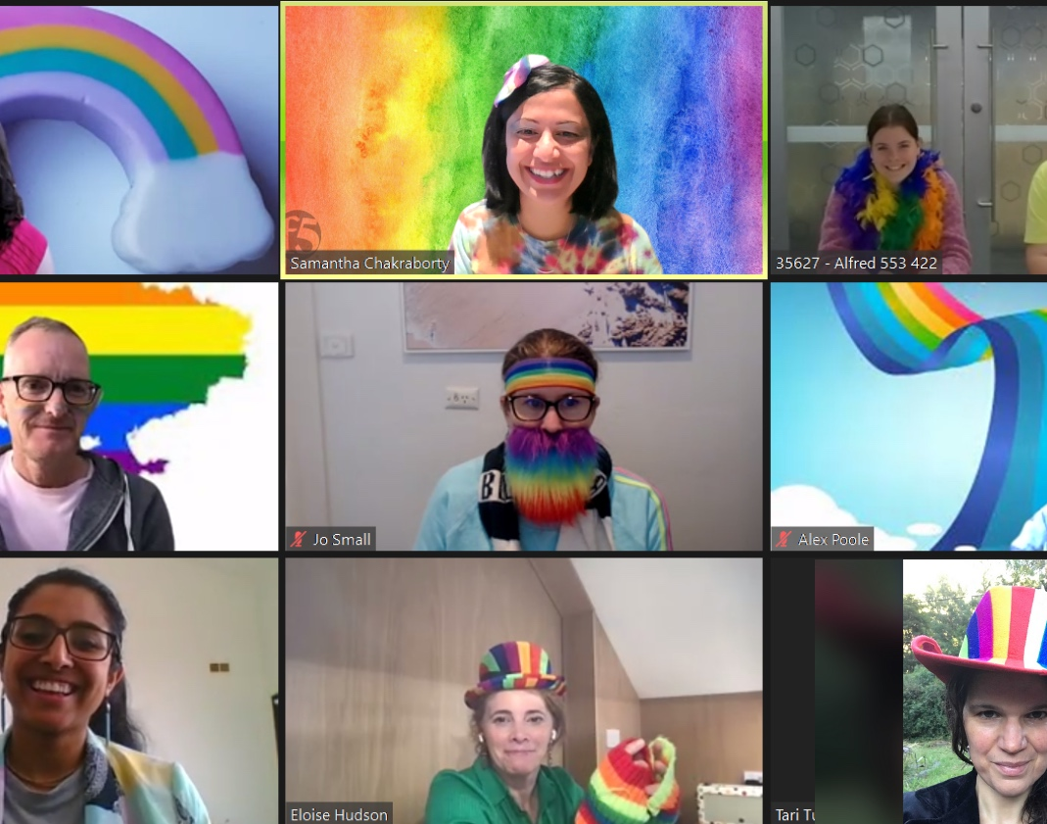
GeoGroup Directors meeting
Cochrane Austria
Cochrane Hong Kong
Cochrane Sweden
Cochrane Australia

Slide 10
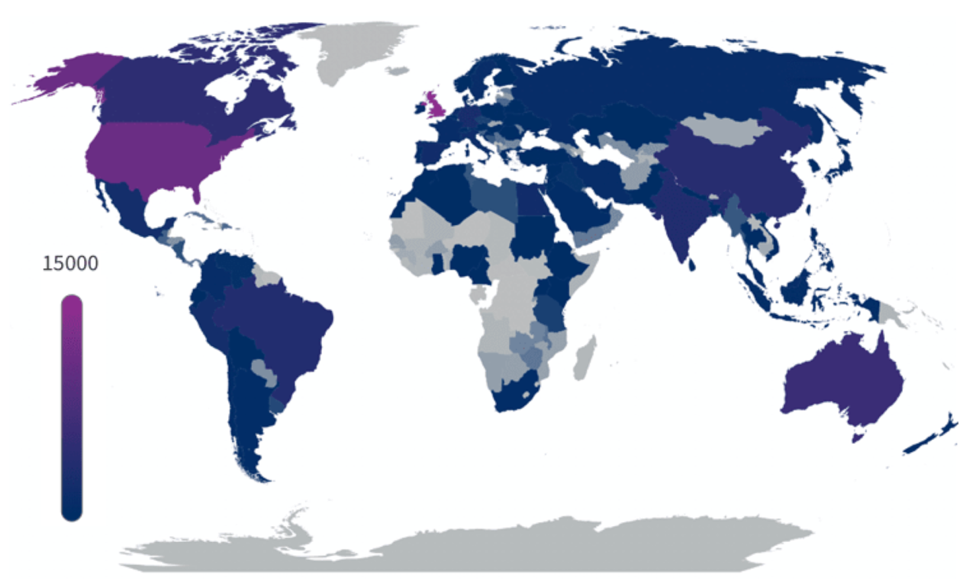
Cochrane Membership
13,445 Members
98,004
Supporters
Notes:
Membership scheme started in 2017 – we are 5 years’ in. As an initiative to recognize all volunteer contributors who make a substantive contribution to our work.
Community divided into Members and Supporters.
Latest figures are always available at: https://community.cochrane.org/organizational-info/resources/support-cet/membership/membership-dashboard

Slide 11
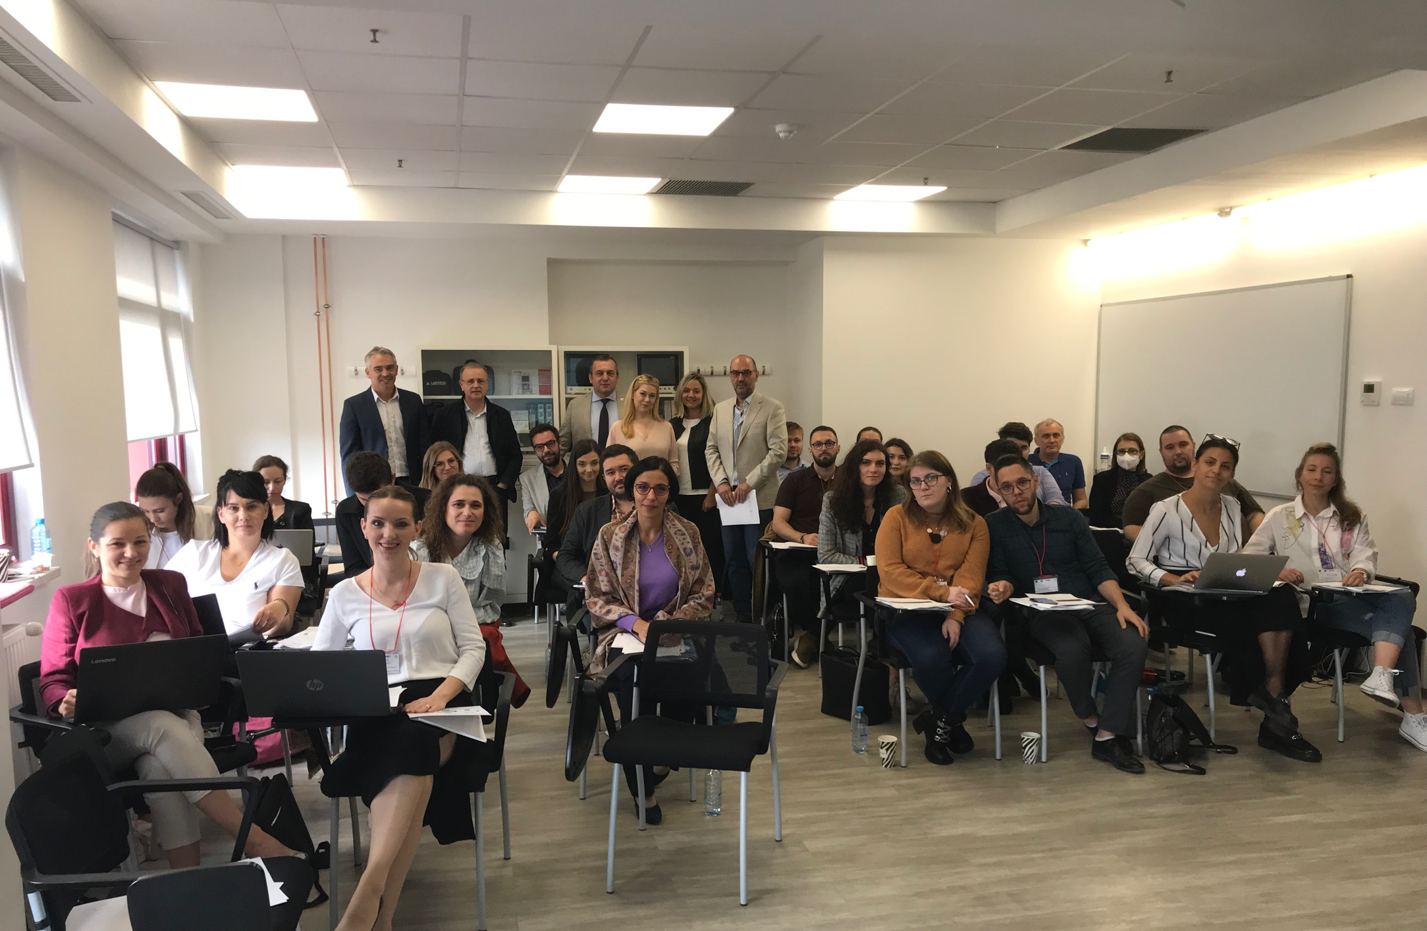

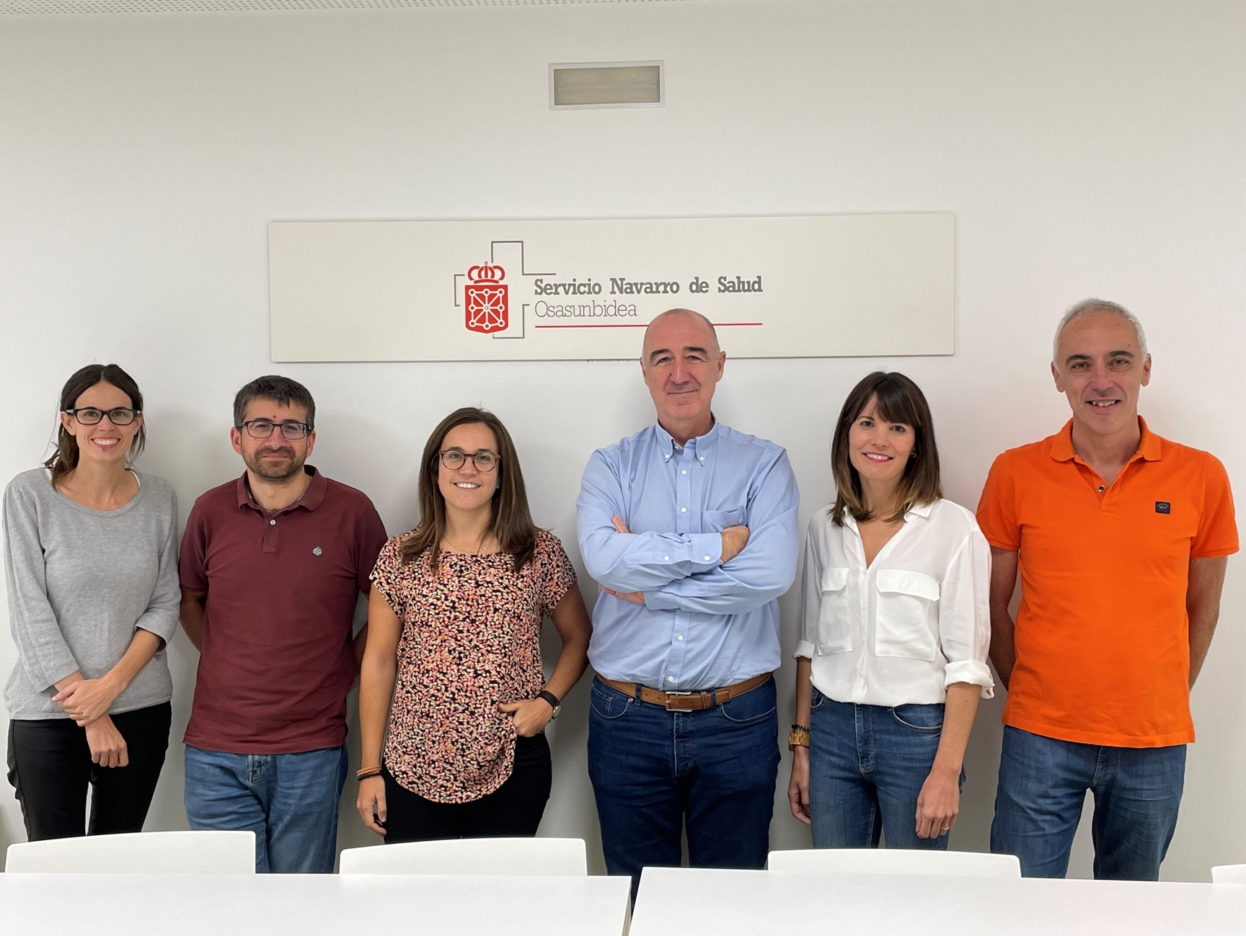
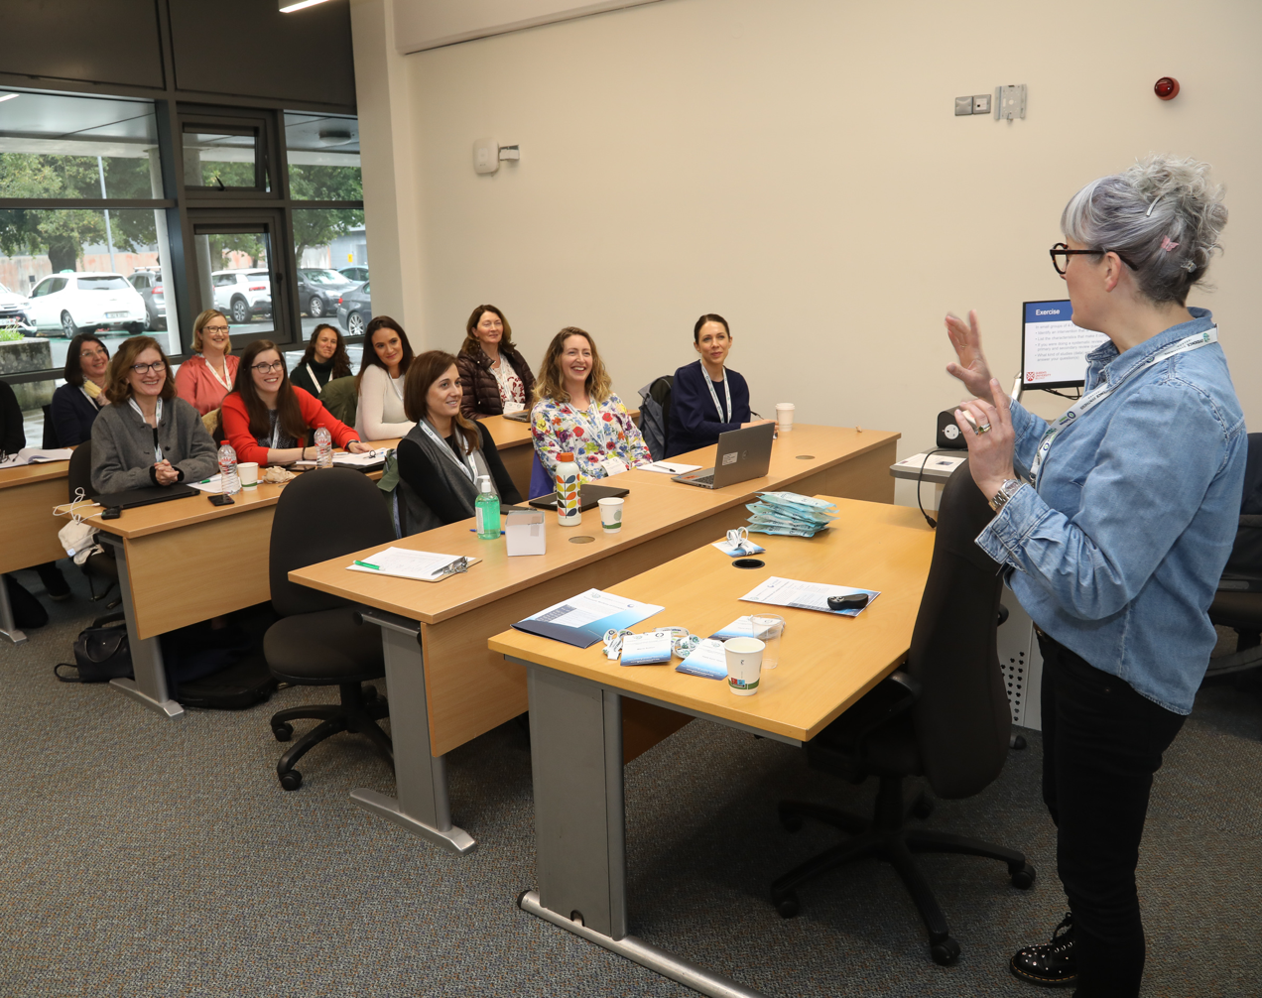
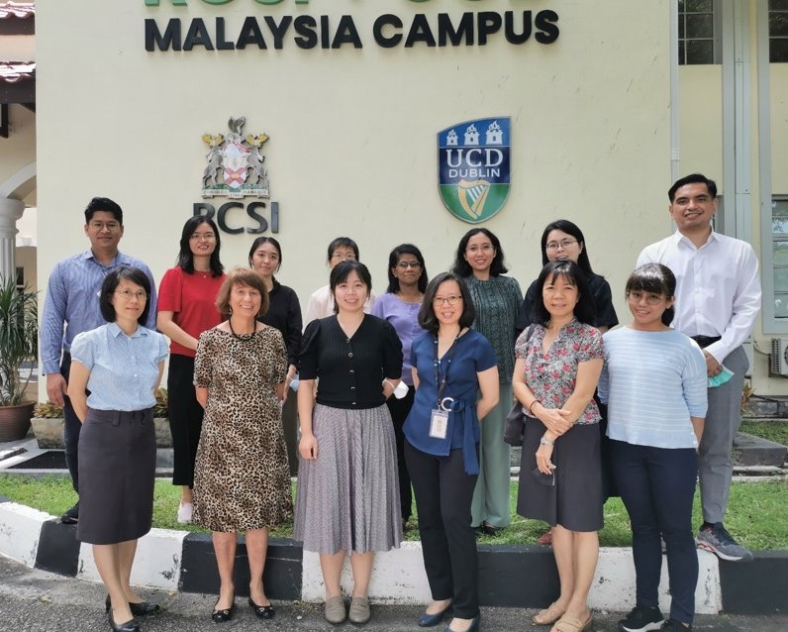
Cochrane Romania
Cochrane India
Cochrane Navarre
Cochrane Ireland
Cochrane Malaysia

Slide 12

Cochrane is welcoming and inclusive
We are a vibrant organization of over 100,000 members and supporters, growing daily
We celebrate diversity and welcome people with a wide range of life skills, cultural backgrounds, lived experience and abilities
To attract new people to Cochrane we need to be simpler – reduce barriers – find ways to be easier to use and work with

Slide 13
Diversity and inclusion is essential to Cochrane’s mission
6 out of 10 (from all different countries, ages, genders and language groups) said they did not feel as included in Cochrane as they wanted.
Those who were not currently involved described difficulties in getting started in Cochrane.
Many people described Cochrane as too centred around English speaking contributors.
Our leadership, governance and central teams should more closely represent the global and diverse organization we aspire to be.
Notes:
Diversity and inclusion is essential to Cochrane’s mission
People referred to ‘diversity’ in Cochrane as meaning an organisation run by, with contributions from and benefitting people with a variety of demographic, language and geographic characteristics as well as different levels of experience and professional expertise. They also used ‘diversity’ to mean synthesising evidence about a wide variety of topics, using various methods and dissemination routes, mindful of different local needs.

Slide 14
What people recommended
Recognising that diversity and inclusion is essential for Cochrane to achieve its mission
Acknowledging that Cochrane is not as diverse and inclusive as it could be and has work to do to address systemic institutional biases in Cochrane’s systems, processes and attitudes
Targeting and supporting people from low and middle income countries and people who speak a variety of languages to be decision-makers, authors and volunteers

Slide 15
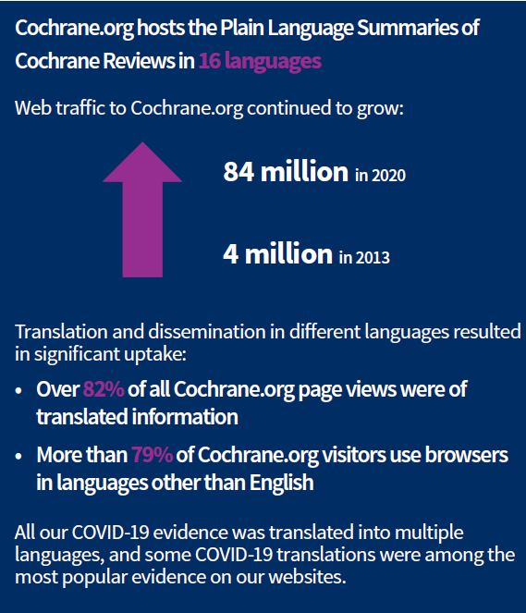
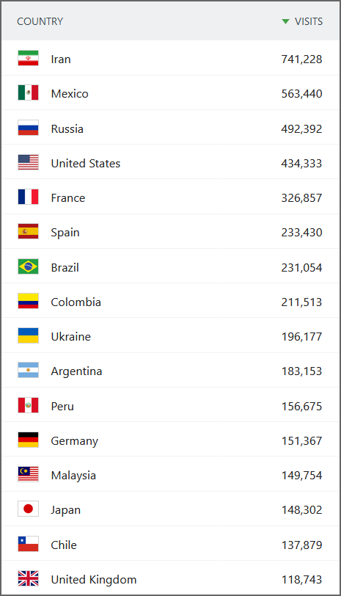
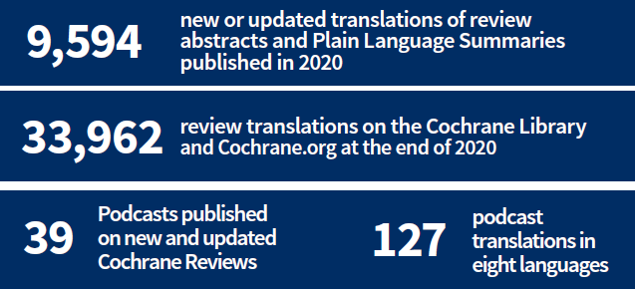

And huge access to our evidence globally and in different languages:
Location of visitors to Cochrane.org in Sept 2021:
Notes:
The international group including senior Cochrane members, joined a panel to share draft recommendations and learnings from COVID 19’s response after the previous week’s roundtable discussions. Our efforts now are focused on taking those lessons learned from the evidence synthesis response to the pandemic to form a written report and action plan which we will publish before the end of the year.
https://www.youtube.com/watch?v=KTMqc5t1ARw

Slide 16

Supporting the Community with events
Regular webinars under the Learning Live brand
Re-introducing the Cochrane Lecture (November 2022)
Early career professionals journal clubs and webinars
Regional events and symposia

Slide 17

Notes:
Refer to need to cancel Colloquium next year: plan to run these events to keep connected
Thanks to the work of Cochrane members and supporters, Groups, Council, other committees, Central Executive Team

Slide 18
Cochrane is transforming.
Our diverse global collaboration will:​
Innovate, and sustain our excellence in synthesizing evidence to improve health and care globally. ​
Focus on impactful priorities to make evidence available and accessible in a timely and equitable way for people making decisions.​
Streamline processes, embrace technological innovations and advances, and increase skills in evidence synthesis.​
Commit to Open Access publishing​
Work in partnerships with others to share our evidence.

Slide 19

New Emeritus and Lifetime Membership Awards
Two new forms of membership
Focused on acknowledging people who have made an enormous contribution to Cochrane over many years
Lifetime membership
Those who have made an extraordinary, longstanding contribution to the organization.
Emeritus members
Those who have made an extraordinary, longstanding contribution as a leader within the organization.

Slide 20
Nominations now open!
The deadline for first round nominations is: 6th January 2023.
We will announce new members in March 2023.
We will continue to request nominations annually
Cochrane's strength is in its collaborative, global community. Let’s celebrate these individuals who have made longstanding contributions to Cochrane’s success.
Contact support@cochrane.org for further information
Nomination form available on the website:
Cochrane.org > Join Cochrane > Membership

Slide 21

Thank you to all our members and supporters, and the staff of Cochrane Groups and Central Executive Team, the Council and other committees
governingboardsecretary@cochrane.org
This Photo by Unknown Author is licensed under CC BY-NC-ND

Slide 22

Chief Executive Officer’s Report Annual General Meeting 2022

Slide 23

ADD PICTURE
Notes:
AS a new CEO I was attracted to Cochrane to be part of building the future
I was captured by Public Health when I worked at icddr,b in Bangladesh – and I am thrilled to be using what I learned there at Cochrane to ensure evidence is more accessible and more equitable.

Slide 24
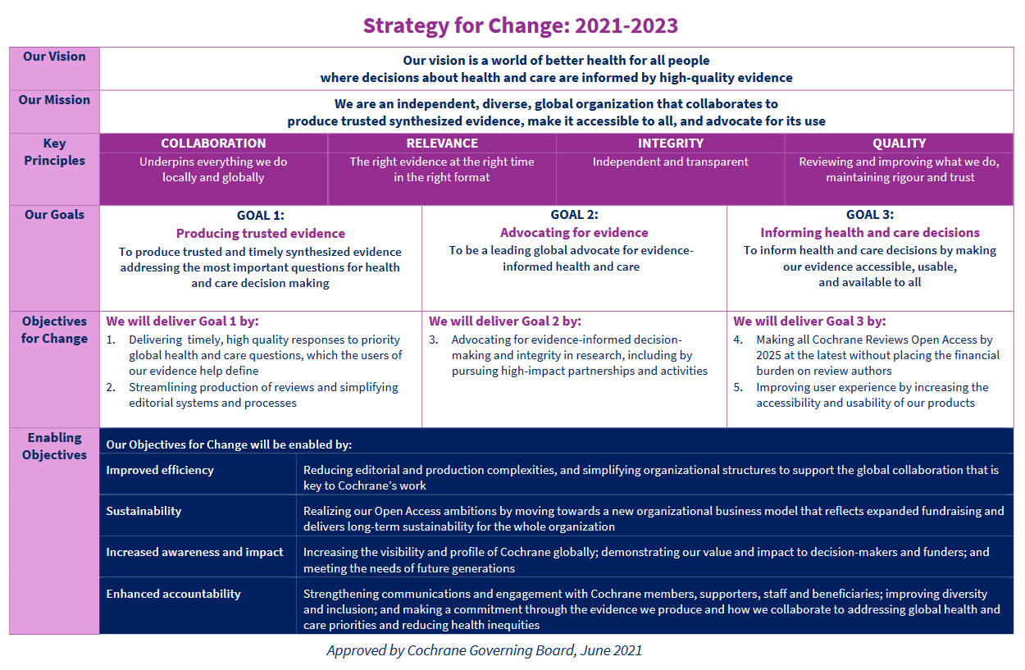
Notes:
This year has been focused on setting the foundations for transformation. We’ve done this through the Strategy for Change. This has been an extremely challenging process, and I am grateful to my colleagues in the Central Executive Team and Cochrane Community for their perseverance to create the right environment for success.
The review and reorganisation will make Cochrane more efficient and streamlined organisation and will position us for a more equitable the open access future
Along side the commitment to Open Access comes our investment in fundraising to diversify our income and increase sustainability

Slide 25
Highlights delivering our goals 2021-22 GOAL 1: Producing trusted evidence
Delivering the success of our COVID-19 work and learning that we can produce reviews quicker
Developing new approaches to increase relevance and timeliness
Focusing on editorial integrity and independence
23,000 Citizen Scientists identifying relevant studies in weekly Cochrane Crowd challenges. This enabled 6 million classifications of primary research
Notes:
My job as your CEO at this AGM is to report on the progress against our targets. Next year I will look forward to reporting on the progress I have delivered with you the community
We built on the success of what we learned responding to COVID 19.
We rolled out a new web-based version of our bespoke writing tool for Cochrane Reviews, RevMan Web, with many new features, including study-centric data, and support for methodology; and implemented the new editorial management system. Cochrane Crowd, our citizen science platform, passed 23,000 contributors and.

Slide 26


Highlights in delivering our goals 2021-22 GOAL 2: Advocating for evidence
Building on Cochrane Convenes
Relationship with WHO , PAHO and other partners
World Evidence Based Healthcare Day 2022
Notes:
Among our advocacy activities, we held a World Health Assembly side event together with the Evidence Commission, featuring national health ministers and the WHO Chief Scientist Dr Swam-in- a-than in May 2022.
In 2021, 76% of new WHO guidelines were informed by evidence from Cochrane reviews.
World Evidence Based Healthcare Day 2021 was a success, and preparations for 2022’s (20 October) are underway
Cochrane Groups continue to advocate for Cochrane activities and goals and I look forward to learning more.

Slide 27

Highlights in delivering our goals 2021-22 GOAL 3: Informing health and care decisions
75% of all Cochrane Reviews were – and still are – cost free to access globally
Teams in different countries continued to translate and disseminate Cochrane evidence into 15 languages
8,774 new or updated translations of review abstracts and Plain Language Summaries over the year
39,546 translations of Cochrane Reviews on the Cochrane Library and Cochrane.org websites at the end of 2021
Notes:
75% of all Cochrane Reviews were – and still are – cost free to access globally.
All COVID-19 related reviews continued to be made free to access and translated.
Teams in different countries continued to translate and disseminate Cochrane evidence into 15 languages.

Slide 28

Cochrane is building on an incredible past
Notes:
‘
We can congratulate all elements of our community for an astonishing 30 years. Our contribution to improving health care has been exceptional. We are here in Spain, celebrating the 25th anniversary of the Spanish Cochrane Centre, and next year we celebrate the 30th Anniversary at our Colloquium
Cochrane is transforming so that as a community we can achieve even more.

Slide 29

The next frontier: Aligning the future of Cochrane with Open Access
Our new approach will allow Cochrane to better respond to important global health and social care needs, streamline our model of evidence synthesis, invigorate funding sources and achieve long-term sustainability.
Notes:
Our move to full open access is essential, we are working hard on a new business model to ensure we can meet our commitment and secure the future of Cochrane.
Cochrane remains vital and that’s why we’re undergoing massive change – a transformation - to face the future, where we will be more agile. In the coming months we will clearly articulating the direction of travel as we develop our next strategy
We see an inclusive future improving on equity and recognizing that we can play a vital part to achieve more in world health, this includes contributing to achieve the Sustainable Development Goals, and really understanding what our users need.

Slide 30
Evidence that people want
Moving forwards, we want to ensure that we are truly contributing to improved global health
More reviews that address the greatest challenges
Increasing the collaboration of consumers, members and funders
Notes:
Cochrane has evolved as a very special network of experts contributing enormously to a very wide range of topics.
We will harness the expertise of our community to ensure that together we can achieve more and provide even greater value to world health
We will identify areas of most need and ensure that we have the evidence to support the most crucial questions that can help improve world health.
And we’ll collaborate more closely with partners to ensure that we achieve outcomes that matter

Slide 31
Excellence simplified
Maintain quality and independence
Simplify processes
Notes:
We know that we can encourage more people to be involved in Cochrane if we simplify our processes, which is why our focus is on ensuring that Cochrane including Cochrane Reviews are more straightforward, while continuing to be the best quality is vital. We know that we can deliver better if we simpli

Slide 32

Harness our potential
Our work moving forward with our much-valued Community will enable us to:
Increase the usefulness and impact of our reviews
Collaborate to enhance diversity and equity
Strengthen our collaboration and reunite our community
Notes:
We will release our potential to mirror the success we have already had in ensuring that the reliable and credible evidence is produced and used in local settings.

Slide 33

Develop new income streams
Notes:
All of these goals – Open Access and Global economic challenges will require greater income diversification
To achieve this we have appointed our new Development Director, Gavin Adams who will focus on better communication, fundraising and our membership.
Happily we have a long list of potential prospects to attract funding and an internal and external community who recognise that to enable Open Access the need to develop new income streams is vital.

Slide 34
Thank you! Muchas gracias! Catherine Spencer cspencer@cochrane.org
Notes:
Thank you to our hosts here in Spain and the community online. I very much look forward to the future, working with you.

Slide 35
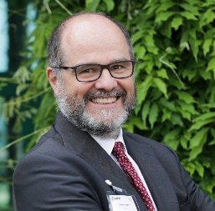

Council Report
Stefano Negrini & Robert Dellavalle
Council Co-Chairs
17 October 2022

Slide 36
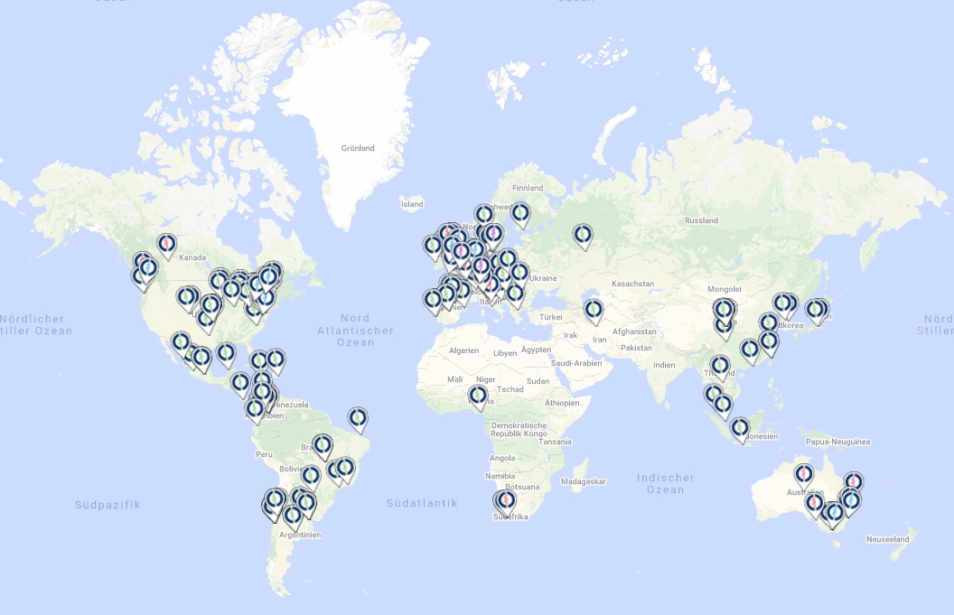
Purpose
Provide Cochrane Groups an effective voice in leadership
Consider high-level matters
Provide input to the Governing Board

Slide 37















Council Members
Authors
Consumers Network
Co-ordinating Editors
Early Career Professionals Network
Fields
Geographic Groups
Information Specialists
Managing Editors
Methods Groups

Slide 38




Outgoing members
Geographic Information specialists Methods group Author

Slide 39

Connections
Council meetings included Board Co-chairs
Board meetings, including the recent Board strategy meeting, included Council Co-chairs

Slide 40
Increasing connection
In 2023 Council will work with the Governing Board and CET to provide more effective communication channels for the Cochrane Community
London meeting Sept 2023

Slide 41
Contributions in 2022
Provided operational feedback: Co-Chairs met regularly with the Governing Board Co-Chairs between Council and Board meetings
Feedback provided to Board on
1) rollout of the new Editorial Management System
2) the future of evidence synthesis plan
3) the morale of the Cochrane Community
Face of the community: Co-Chairs hosted Cochrane Connects

Slide 42
Contributions in 2022
Cochrane Board Strategy Meeting: Stefano Negrini, Bob Dellavalle
CEO Selection Interview Committee: Bob Dellavalle, Stefano Negrini
Editorial Integrity & Efficiency Project: Vanessa Jordan
Future of Evidence Synthesis Oversight Committee: Vanessa Jordan, Stefano Negrini
Membership and Awards Committee: Liz Dooley

Slide 43

Priorities for 2023
Improved Communications:
Work with the new Head of Communications
Council Roadmap:
Partner with the Board and CET to redefine the Council’s mission and how it operates
30th Anniversary and Colloquium

Slide 44

Editor in Chief’s Report
Karla Soares-Weiser
Cochrane AGM, Barcelona
17 October 2022

Slide 45




The difference we make
La diferencia que hacemos
Producir y publicar evidencia en la Biblioteca Cochrane
Producing & publishing evidence in the Cochrane Library
Establecer estándares de métodos y apoyar los autores
Setting methods standards and supporting authors
Transformar la manera en la que producimos evidencia
Transforming the way we produce evidence synthesis
Notes:
Today I will looking back over the year and highlight the difference we have made and the impact we have delivered.
The results represent extraordinary collective and individual efforts, especially against the backdrop of a global pandemic and a time of profound change for our organization.
I will focus on three areas, which are: (can use the animations for this if you want to – I can take them off, just see if you want to use them) 1. Producing and publishing evidence in the Cochrane Library 2. Setting methods standards and enhancing capacity 3. Transforming the way we produce evidence synthesis

Slide 46

1. Producing and publishing evidence in the Cochrane Library
Cochrane Library in numbers
291 new or updated Cochrane Reviews & 186 protocols published
501 new or updated Cochrane Reviews & 255 protocols published
547 new or updated Cochrane Reviews & 271 protocols published
Impact factor increased from
7.89 to 12.00
in the same period
Notes:
Numbers needed from John – can update slide when these are available
In 2022 (so far), we have published XX new or updated Cochrane Reviews, and ZZ protocols
In 2021, we published 501 new or updated reviews and 255 protocols
In 2020, we published 547 new or updated reviews and 271 protocols
Impact factor increased from XX to ZZ in the same period

Slide 47

Cochrane is about collaboration!
Ibero-America contribution:
502 | New and updated reviews
126 | Protocols
848 | Authors
448 | Crowd volunteers
12 | Translators
116 | Early career professionals
33 | in Consumer Network
93 | in Methods Network

Slide 48
Impact facor
1. Producing and publishing evidence in the Cochrane Library
Cochrane Reviews cited in guidelines
121 of 176 (69%) of diagnostic test accuracy Cochrane Reviews
49 of 81 (60%) of Network meta-analyses
4 of 13 (31%) of prognosis Cochrane Reviews
9 of 20 (45%) of qualitative & mixed methods reviews
21 of 32 (66%) of Living Systematic Reviews
Of the 8915 reviews currently published in the Cochrane Library, 6362 reviews are cited in guidelines (71%)
Data from Anne Eisinga, Cochrane UK
Notes:
Key reviews citation/usage. This is all available at the Impact factor report
Other impact reviews
Treatment of periodontitis for glycaemic control in people with diabetes mellitus - https://www.cochranelibrary.com/cdsr/doi/10.1002/14651858.CD004714.pub4/full Produced in conjunction with NICE guidelines: https://www.nice.org.uk/guidance/ng28/update/ng28-update-5/documents/evidence-review
Others include… the one in mental health and the one just published in malaria

Slide 49





Creating evidence to inform guidelines
Notes:
Example of the WHO guidelines usage of reviews from the Pregnancy and Childbirth
HI Karla,
The updated recommendations on interventions to improve preterm birth outcomes
The WHO story and landing page can be found here https://www.who.int/news/item/30-09-2022-new-recommendations-from-WHO-to-help-improve-the-health-of-preterm-birth and here are the links to the updated guidelines just published:
WHO recommendations on antenatal corticosteroids for improving preterm birth outcomes, 2022
WHO recommendation on tocolytic therapy for improving preterm birth outcomes, 2022
Updated recommendations for induction of labour The primary goal of the guidelines is to improve the quality of care and outcomes for pregnant women undergoing induction of labour in under-resourced settings. The target audience of these guidelines includes obstetricians, midwives, general medical practitioners, health-care managers and public health policy-makers.The guidance provided is evidence-based and covers selected topics related to induction of labour that were regarded as critical priority questions by an international, multidisciplinary group of health-care workers, consumers and other stakeholders.
The main landing page for the 2011 WHO recommendations for induction of labour can be found here but here are the links to the specific recommendations that were updated and published this week.
WHO recommendations on outpatient settings for induction of labour, 2022
WHO recommendations on induction of labour, at or beyond term , 2022
WHO recommendations on mechanical methods for induction of labour, 2022
Preterm birth is the leading cause of death in newborns less than 28 days old with more than a million preterm infants dying each year. Those that do survive risk a range of disabilities throughout their lives. Alarmingly, in almost all countries with reliable data, preterm birth rates are increasing.
In order to improve the health outcomes for these newborn babies, the World Health Organization has issued updates for two interventions. One set of recommendations focuses on the use of antenatal corticosteroids. These drugs cross the placenta and enhance the structural maturity of the fetus’ developing lungs, helping to prevent respiratory-related morbidity and mortality in preterm newborns.
Safe and effective for use in low-income countries
This recommendation (and its nine sub-recommendations) resolves previous confusion about evidence on their use in low-resource settings. Clinical trials in high-resource settings suggested that antenatal corticosteroids were safe and beneficial to newborn outcomes. The Antenatal Corticosteroids Trial in lower-income countries however found a significant increase in the number of perinatal deaths (5 excess deaths per 1000 women exposed to the treatment) and maternal infections. A subsequent trial (WHO ACTION-1) also in lower-income countries found that under the right conditions, antenatal corticosteroids were safe and effective.
New recommendation on tocolytic drugs
Another new WHO recommendation out today, is for the use of tocolytic treatments. Tocolytic drugs inhibit contractions of the uterus and can be used to delay preterm labour and prolong pregnancy. This has multiple benefits; giving more time for fetal development, and for administering antenatal corticosteroids. It also creates a window of time for women to be transferred to a higher level of care, if necessary.
“These recommendations provide clear guidance to health professionals on the management of preterm birth and have the potential to improve the health of newborn babies, even in low-resource settings.” Dr Doris Chou, Medical Officer, Department of Sexual and Reproductive Health and Research.
In the 2015 WHO recommendations on interventions to improve preterm birth outcomes, tocolytic treatments (acute and maintenance treatments) were not recommended for women at risk of imminent preterm as there was insufficient evidence demonstrating substantive benefits. A review of the evidence in 2022, however, has recommended in favour of nifedipine for acute and maintenance tocolytic therapy for women with a high likelihood of preterm birth, when certain conditions are met.
In formulating these recommendations, WHO, in addition to considering the clinical evidence also considered aspects of cost-effectiveness, feasibility and resources, equity and whether the intervention was valued by and acceptable to stakeholders including clinicians as well as women and their families.

Slide 50
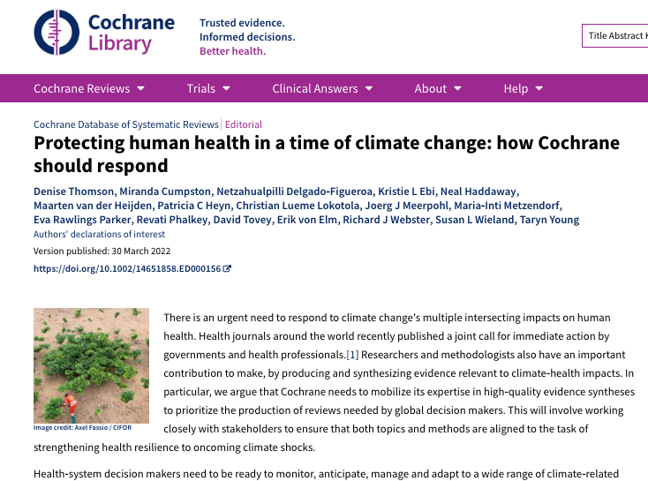
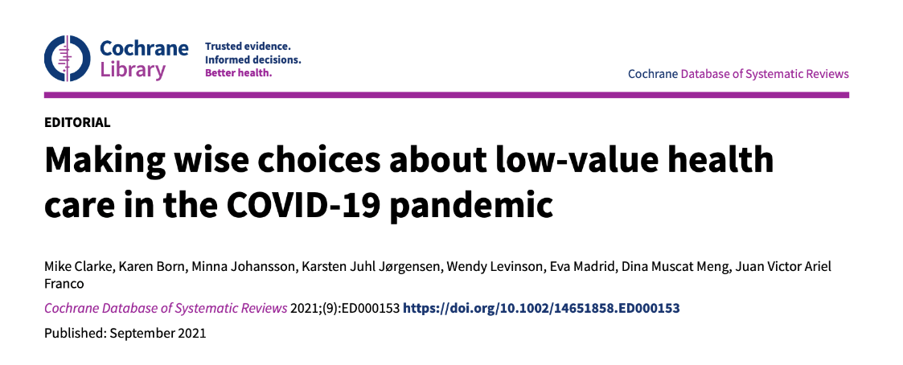
Looking forward: Focus on global challenges
Notes:
COVID was not the only global threat we have had to respond to - in future we will need to produce evidence that underpins policy making to arrest the impact of planet's climate emergency on health.
As this editorial reflects…
Additionally, the evidence we need to draw on to address user needs is more diverse than it was 30 years ago:
https://www.cochranelibrary.com/cdsr/doi/10.1002/14651858.CD014936.pub2/full; https://www.cochranelibrary.com/cdsr/doi/10.1002/14651858.CD015196.pub2/full;

Slide 51


2. Setting methods standards and supporting authors
Research integrity
Notes:
We initially worked on the COI policy and in the past two years we have been focusing on areas of research integrity
Research Integrity:
The Cochrane Research Integrity team is continuing its 3-pronged agenda of advocacy, policy and research related to research integrity (https://community.cochrane.org/organizational-info/resources/research-integrity).
This includes our research on the quality of preprints (https://bmjopen.bmj.com/content/11/7/e051821), bias in selection of outcomes for systematic reviews (https://www.jclinepi.com/article/S0895-4356(21)00368-1/fulltext ), and collaboration on:
Reducing the Inadvertent Spread of Retracted Science: Shaping a Research and Implementation Agenda
SOPs4RI (Standard Operating Procedures for Research Integrity)
Ongoing development, implementation and evaluation of our conflict of interest policy is also a key area of work.
I would like to highlight our recent work on developing methods to identify problematic and / or fraudulent studies, and policy to manage these in systematic reviews.
Some Cochrane review groups have been using a variety of methods for identifying problematic research, but these have not always been consistent with methods used more broadly across the research integrity community. Therefore, the research integrity team, with substantial input across Cochrane, developed a policy for identifying and managing problematic studies in Cochrane reviews.
The policy at this link:
https://www.cochranelibrary.com/cdsr/editorial-policies#problematic-studies
The accompanying editorial at:
https://www.cochranelibrary.com/cdsr/doi/10.1002/14651858.ED000152/full
Notably, we were not able to recommend a specific tool or method for identifying problematic studies and this is an active area of research for the research integrity team. We have reviewed the literature and interviewed international experts to identify tools that are currently in use across disciplines, as well as “red flags” for identifying problematic research (https://authors.elsevier.com/c/1fdNT3BcJQAoo0).
We are presenting this work at the Peer Review Congress in September and participating in a side meeting on identifying publications from “paper mills.” In addition, we are collaborating with PubPeer to develop a “Cochrane channel” where Cochrane investigations of research integrity (that meet our standards) will be published and linked to Cochrane reviews. This will prevent duplication of effort among researchers who may be investigating the same studies.
To carry forward this work, we have a small grant from NIHR (Jack Wilkinson PI) to develop and test a tool that can be used by systematic reviewers to identify problematic studies. Using Cochrane reviews, we will test the feasibility and accuracy of the tool.
As I noted in this recent Conversation article, systematic reviewers are in an ideal position to identify problematic studies because they look at the study level across a body of evidence:
https://theconversation.com/fake-research-can-be-harmful-to-your-health-a-new-study-offers-a-tool-for-rooting-it-out-187503
Cochrane has been a leader in developing tools for assessing various risks of bias, but these assume that the data being evaluated are real. I see the identification of untrustworthy data as the next frontier for ensuring the quality and trustworthiness of systematic reviews. Cochrane will be in a position to lead the way in providing tools that are applicable for systematic reviewers.

Slide 52

Cochrane Handbooks for diverse methods
Early 2023!
New contracts with Wiley:
Cochrane and Campbell Handbook for Qualitative Evidence Synthesis led by Jane Noyes and Angela Harden (Senior Editors)
Cochrane Handbook for Systematic Reviews of Prognosis Studies led by Carl Moons and Richard Riley (Senior Editors)
Notes:
Cochrane Handbooks (still waiting for picture from Ella)
Cochrane Handbook for Systematic Reviews of Diagnostic Test Accuracy: accepted by the editors and in production with Wiley; due to publish in 2023; led by Jon Deeks and Patrick Bossuyt (Senior Editors) with Yemisi Takwoingi and Mariska Leeflang (Associate Editors); all from the Screening and Diagnostic Tests Methods Group; webpage https://training.cochrane.org/handbook-diagnostic-test-accuracy/
Cochrane and Campbell Handbook for Qualitative Evidence Synthesis: in development and due to publish with Wiley in 2024; led by Jane Noyes and Angela Harden (Senior Editors); and supported by Tomas Pantoja, Kate Flemming, James Thomas, Ruth Garside, Andrew Booth, Katy Sutcliffe (Associate Editors); all from the Cochrane Qualitative and Implementation Methods Group
(if the contract is signed in time) Cochrane Handbook for Systematic Reviews of Prognosis Studies: in development and due to publish with Wiley in 2024/2025; led by Carl Moons and Richard Riley (Senior Editors); and supported by Alfonso Iorio, Nicole Skoetz, Lotty Hooft, Katrina Williams, Anneke Damen (Associate Editors); all from the Cochrane Prognosis Methods Group

Slide 53

A new Open Access Journal
Open for submission from November 2022
Notes:
Cochrane Evidence Synthesis and Methods will consider
1 SLIDE Open Access journal
Ella has shared these slides and a picture, but I think we should give a very simpler message (maybe using only the figure): name of the journal + picture of Michael Brown (appointed the Journal’s Editor) + “open for submissions from November 2022).

Slide 54
3. Transforming the way we produce evidence syntheses
10 projects, 3 critical for 2022-2023
Our vision for the new model is to allow Cochrane to better respond to important global health and social care needs, streamline and simplify our evidence synthesis development, and achieve long-term sustainability.
Streamline | Improve author experience | Diversity
Notes:
discussions with the Governing board to prioritise critical projects that we consider the ‘foundation pillars” (central editorial service (Frans Kellie and Helen Wakeford), support on review development (Toby Lasserson), new review format (Ella Flemying and Gert van Valkenhoef)
key successes so far – maybe from Ruth
We are creating KPIs – oversight committee

Slide 55
3. Transforming the way we produce evidence syntheses
Announcing the new Thematic Groups
Eight applications were assessed by an independent and diverse panel of 10 members (internal and external stakeholders)
The panel approved the first 3 Thematic Groups and is seeking clarification on other applications before a final decision by November 2022
Nutrition and Physical Activity
Public Health and Health Systems
Health Equity
Notes:
CRG work and acknowledgement that the contribution, in particular the ones leaving us
announcing thematic groups first round of thematic groups (IN CONFIDENCE) – we had hoped to announce all 5 Thematic Groups, but the panel thought that other submissions will need clarifications before they can be launched. Four proposals will be asked to address the concerns and resubmit, and we aim to complete the process until the end of the year. They will be informed.
In green are the ones will be announcing, but I am putting the topics in context to make sure people understand that they are all important

Slide 56


The difference you make!
In 1995, the first issue of the Cochrane Database of Systematic Reviews had 36 Cochrane Reviews and 16 protocols.
Since then, Cochrane Review Groups have published 16,000+ Cochrane Reviews (9,000 new & 7,000 updated) and almost 11,400 protocols.
Muchas gracias!
Thank you!
Photo by Taylor Brandon on Unsplash
Notes:
This collage represents faces from all around the world who contribute to living Covid-19 guidelines for the Australian National Covid-19 Evidence Taskforce. Not sure whether it will work using it here? Could reference it saying imagine the scale of collage we would need to represent the last 30 years and all who contributed… Otherwise I can find another image…
What about the photo of Iain Chalmers putting all those photos on the ceiling? I don’t have it but I think you have used it in other presentations…
1 SLIDE (FINAL) CRG work and acknowledgement that the contribution, in particular the ones leaving us
Ruth put together these photos from the community: https://www.dropbox.com/sh/8q1tbx8w29fee9z/AADGnU1Nv9cuwLxOQmMvxAiCa?dl=0
Some historical numbers in case they are of interest: The first issue of CDSR (April 1995) had 36 Cochrane Reviews and 16 protocols. Since then Cochrane Review Groups have published over 16,000 Cochrane Reviews (9000 new, 7000 updated) and about 11,400 protocols. In addition there have been about 22,200 published amendments (of reviews or protocols, for diverse reasons), reflecting the constant ongoing effort to correct and improve.
Toby suggestions:
What you leave behind is testament not just to talent, commitment and efforts, but to relationships maintained over last 30 years. When Archie Cochrane called on medical profession to organize periodic updates to critical summaries of randomised trials, he could not have known what sort of workforce would be needed to fulfil that call to action all these years later, nor how they would come together in response to his call, not just in collaboration but friendship. It is more than a job for so many of you and you will feel the loss of funding deeply and personally.
Cochrane is a better place for energy and commitment of its workforce - we salute our colleagues who have made X thousand reviews happen (check numbers with John) - helped to curate x00,000 records in CENTRAL. You have helped to make Cochrane what it is. You are more than a chapter in our history, you are the part of the story we will tell for our 30th year and beyond. Thank you.

Slide 57
2021 financial results
2022 financial update
External funding (Cochrane Groups)
2023 & beyond
Notes:
1. Note that we are talking – for the most part - about Cochrane the Charity

Slide 58
2021 financial results
The full statutory accounts can be found at www.cochrane.org
Notes:
Summary of Cochrane’s 2021 income & expenditure (expressed in millions) compared with 2020 and, for information, the 2021 budget
The reduced publishing income, particularly in respect of a one-off signing bonus, was the main reason for the operating deficit of £1.4m compared with the substantial net operating surplus, in 2020, of £3.8m
The 2021 £1.4m deficit was considerably reduced from the planned/budgeted deficit of £2.1m and comparable to the underlying 2020 deficit (without the signing bonus) of £1.2m.
Actual expenditure was at the same level as that seen in the COVID-affected 2020.
Free reserves reduced to £4.2m but note that these are in addition to £4.5m strategic funds - the £4.2m constitutes ‘freely available’ funds – not tied up for a specific purpose.
Details of this policy and more extensive notes can be found in the full statutory accounts on Cochranes website

Slide 59
2022 financial update
F = what is forecast to be spent, B = what is budgeted to be spent, A = actual spend,
Notes:
This is a very simple income and expenditure table setting out the 2022 projections
So along the top, F for forecast, B for budget, A for actual
Income, expenditure, net spend and free reserves
Free reserves - funds we have not ringfenced at all.
In 2022, we planned a reduced (transitional) budget deficit of £0.8m (second column)
Expenditure is both projected to come in on budget but we have a large favourable income variance resulting a small overall surplus.
Income from the Cochrane Library £0.4m over budget (probably more of an exchange rate gain than a real one)
And income from Cochrane Response team was £0.5m over income budget – congratulations - although unlike the Library income this does create a marginal cost.
There are some other overspends for recruitment costs and travel – as we took opportunities to connect as a Board as well as the CET.
(Adding to Reserves is a welcome financial result but the Board also need to be happy that the plans are on target.)
Questions?

Slide 60
External funding (Cochrane Groups)
Geographic Groups | Review Groups
Methods Groups | Fields
Notes:
Our groups face significant global funding challenges (remember these are not generally on the books of the Charity)
These figures are from our the 2020 financial monitoring exercise
Total funding of nearly £18m equivalent British Pounds. We converted for ease of reporting but there is a very valid purchasing power parities aspect that we will consider in future analysis.
Over two-thirds of funding comes from the top ten biggest funders (one of which is Cochrane, the charity)
NIHR, the largest funder by some distance (a quarter overall), will be ending most its funding in March 2023 (we have split between the Review Groups and Cochrane UK here).
We have some concerns over other UK, Northern Ireland and Australian funding
Questions?

Slide 61
2023 & beyond: financial challenges
External funding | Our groups face significant global funding challenges (e.g. NIHR (25%))
New production model | We will create a sustainable, affordable editorial service that is fit for purpose
Open access | We expect future Cochrane Library income, under an Open Access model, to fall (£6.5m -> ?)
Product development | What can we afford to invest on new and existing products? What can we not afford?
Cost of living/ inflation | Inflation will impact our staffing cost base (not the demand for our services?)
Notes:
New production model – I think reword makes this the plan rather than the (financial) challenge? So maybe this should move to the FES plan? And we say ‘Review production’ (which follows from falling funding) and say that ‘Our current review production model is risky and financially unsustainable’ hence FES etc…

Slide 62
2023 & beyond: our plans
Fundraising | We are investing in and implementing a new fundraising team and strategy
Income diversification | We are developing a new strategy and plan for commercial products beyond core publishing revenue
Future of evidence synthesis | This major change programme will open up new fundraising opportunities as well as promoting production efficiencies (e.g. new review format)
Reserves (ten months expenditure) | We have nearly £7.0m in ring-fenced or designated funds to support specific strategic investments and mitigate against strategic risks
Monitor risks/costs | We will continue to watch strategic risks (risk register) & our cost base (3Y office cost savings: nearly £1.0m)
Notes:
Positive things we will be doing.
Longer term narrative, outlook
Ongoing cost-base review???
Strategic risk management (working to embed across org)

Slide 63

Proposed Resolution
Vote at agm.cochrane.org
To receive and note the Trustees' Report and Financial Statements for the year ended 31st December 2021
Proposed by Karen Kelly
Seconded by Tracey Howe

Slide 64
Proposed Resolution
Vote at agm.cochrane.org
To note the reappointment of Sayer Vincent as auditors until the conclusion of the ongoing tender process and appointment of new auditors
Proposed by Karen Kelly
Seconded by Tracey Howe
In accordance with UK law the Governing Board of Cochrane will appoint new auditors following an open tender process

