Slide 1

Reading forest plots
Quiz questions

Slide 2
Reading forest plots - quiz
Look at the forest plot on the screen and select the statement that best fits the analysis.

Slide 3
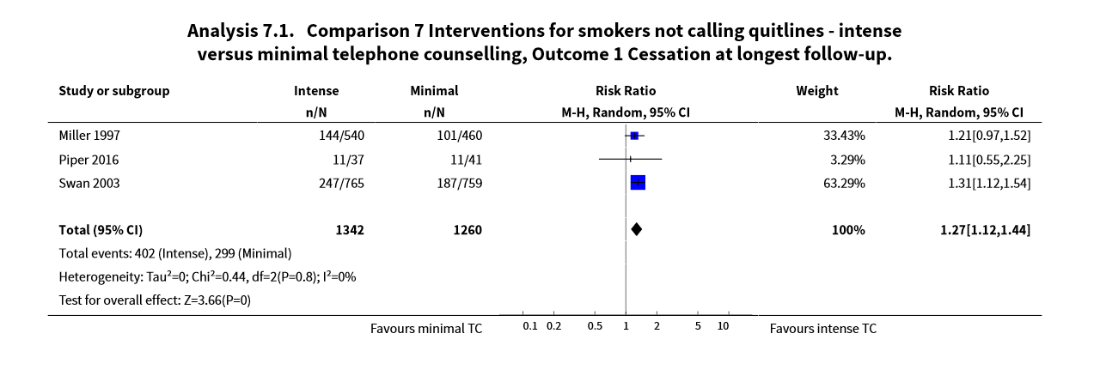
Swan 2003 added the most weight to the meta-analysis
The 95%CI in Piper 2016 crossed the line of no effect
The pooled effect shows that intense telecounselling increases the likelihood of smoking cessation
All of the above
Notes:
Correct answer: 4

Slide 4
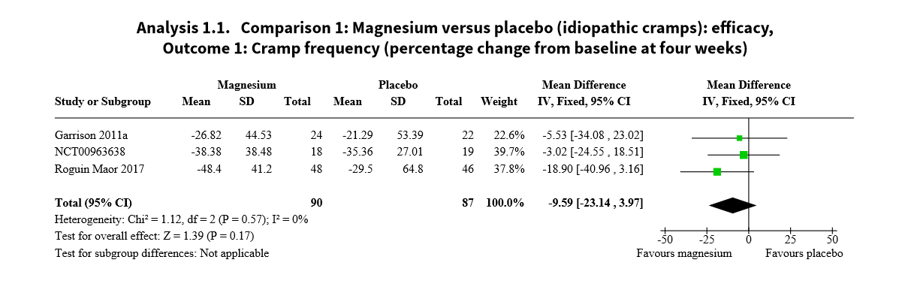
Garrison 2011a showed the biggest effect
The 95%CI of Roguin Maor 2017 did not cross the line of no effect
The pooled effect estimate favours magnesium
Authors used a SMD as outcomes were measured on different scales
Notes:
Correct answer: 3

Slide 5
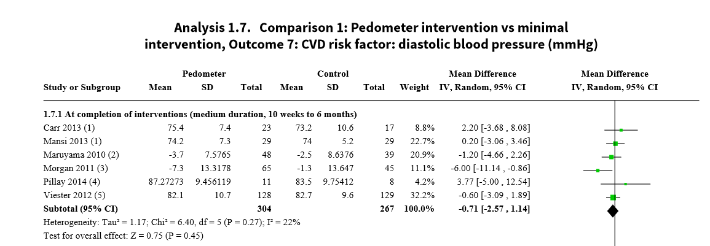
All studies added the same amount of weight to the analysis
The line of no effect is MD=0
All studies cross the line of no effect
All of the above
Notes:
Correct answer: 2

Slide 6
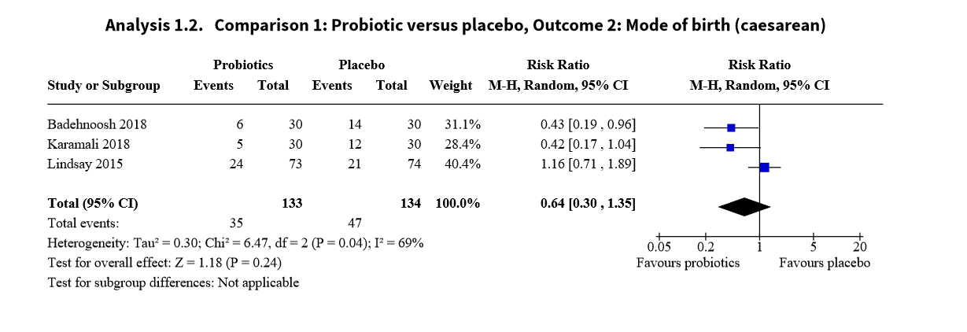
The 95% CI of Badehnoosh 2018 crosses the line of no effect
The 95%CI of Karamali 2018 does not cross the line of no effect
The effect estimate of Lindsay 2015 favours placebo
All studies have similar effect estimates
Notes:
Correct answer: 3

Slide 7
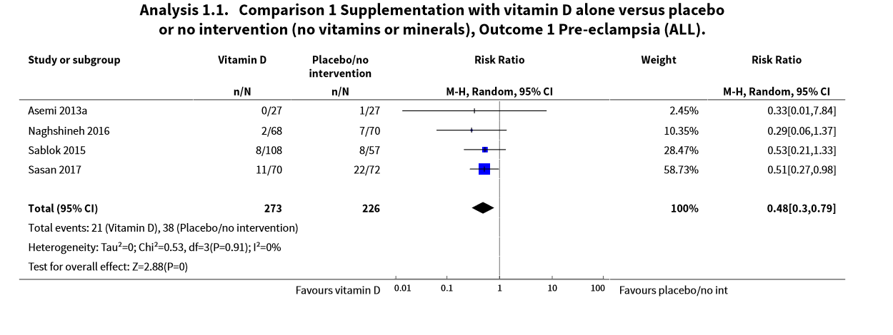
There was only 1 event in Asemi 2013a
The 95%CI of Sasan 2017 does not cross the line of no effect
The pooled effect favours Vitamin D
All of the above
Notes:
Correct answer: 4

Slide 8
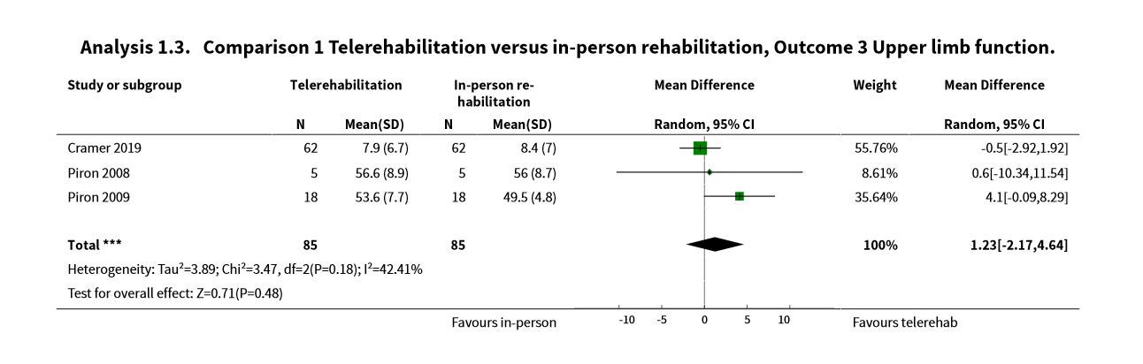
The 95%CI of Piron 2009 does not cross the line of no effect
The effect estimate of Cramer 2019 favours in-person rehabilitation
The pooled effect estimate favours in-person rehabilitation
The effect estimate of Prion 2008 is the smallest of all studies
Notes:
Correct answer: 2

Slide 9
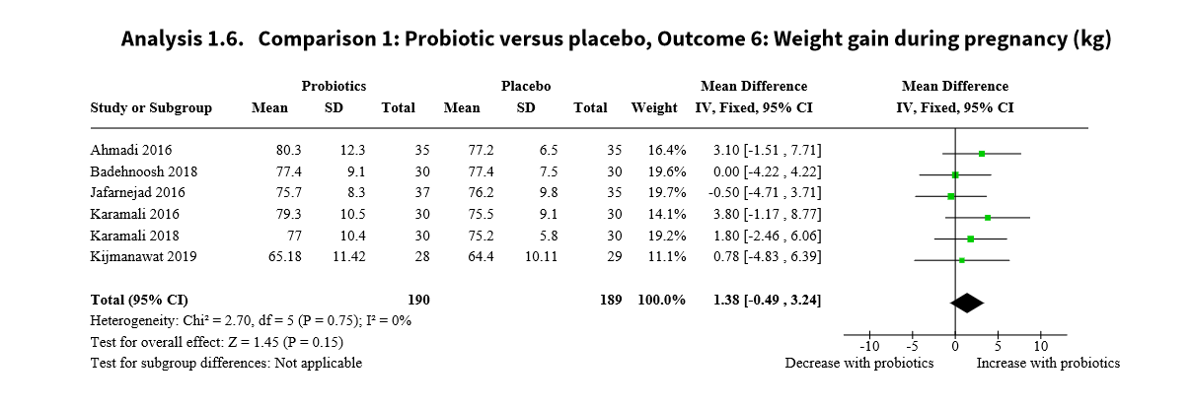
Badehnoosh 2018 added the most weight to the analysis
The effect estimate of Jafarnejad 2016 favours probiotics
The pooled effect favours probiotics
All of the above
Notes:
Correct answer: 3

Slide 10
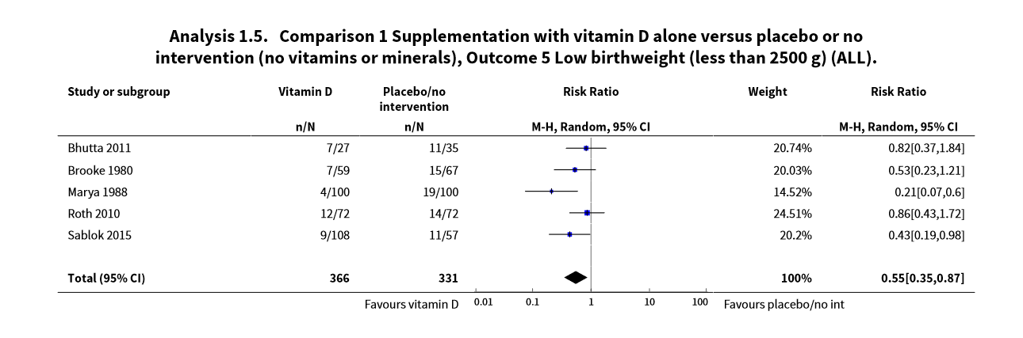
Roth 2010 added the most weight to the analysis
All studies cross the line of no effect
The effect estimate in Marya 1988 is the only one that favours Vit D
Roth 2010 showed the biggest effect
Notes:
Correct answer: 1

