Slide 1
Writing a protocol

Slide 2
Steps of a Cochrane Review
define the question
plan eligibility criteria
plan methods
search for studies
apply eligibility criteria
collect data
assess studies for risk of bias
analyse and present results
interpret results and draw conclusions
improve and update review
register title
publish protocol
Notes:
Once your title proposal has been accepted, the first part of the review process is to write a protocol. The protocol includes two important components: planning the eligibility criteria for the review (that is, which studies will be included and excluded), and planning out the methods you plan to use throughout the review process. The protocols for Cochrane Reviews are accepted and published in the Cochrane Library before you proceed with the review.

Slide 3
Session outline
rationale for writing a protocol
structure of a protocol for a Cochrane Review
See Chapter II and Chapter 1 of the Handbook
Notes:
In this presentation we’ll look at the rationale for writing a protocol, and the structure of a protocol for a Cochrane Review.
[NOTE TO TRAINERS: You can ask the participants to discuss this question with their neighbour: ‘Why do you think you should write a protocol?’]

Slide 4
Rationale for protocols
systematic reviews involve judgements
e.g. question definition, eligibility, outcome measures
retrospective research - decisions should not be based on known results
decide and document methods in advance
reduce impact of bias
allow peer review
reduce duplication
plan tasks and allocate resources
published in the Cochrane Library
published review will contain a link to your protocol
Notes:
Systematic reviews are a retrospective piece of research – the results of the studies we include in the review are in theory already available when we start to plan. As we make our decisions about the review methods – the focus of our question, the eligibility criteria for reviews, the outcomes we plan to report – it’s important that we’re not making decisions based on the known results of existing studies. It’s important that we don’t introduce bias to the review process, and risk presenting an inaccurate or biased picture of the evidence.
So, one of the ways we try to address this is to plan and document our methods for the review in advance, before we’ve looked at the included studies, and to make them publicly available, published in the Cochrane Library, so that others can see what we’re planning to do and hold us accountable if we make changes along the way that might have been influenced inappropriately. This increases the transparency of the methods we’re using, and as an added benefit, protocols for Cochrane Reviews are peer reviewed at this stage, so that authors receive feedback on their planned methods at an early stage, when it’s easy to implement changes, rather than waiting until the whole review is complete.
Other benefits include reducing duplication – others can see the details of reviews in progress, and won’t start working on a similar review topic. As authors, the protocol has the very practical benefit of helping you plan out the tasks and resources required for the review process – it makes sure you’ve really thought through the protocol in detail, and can anticipate any difficulties in advance.
Finally, when your review is published it will contain a link to your published protocol so that, if interested, readers can compare the methods you pre-specified in your protocol to the methods you actually used in the review.

Slide 5
Session outline
rationale for writing a protocol
structure of a Cochrane protocol
See Chapter III of the Handbook
Notes:
So what does a Cochrane protocol look like?

Slide 6
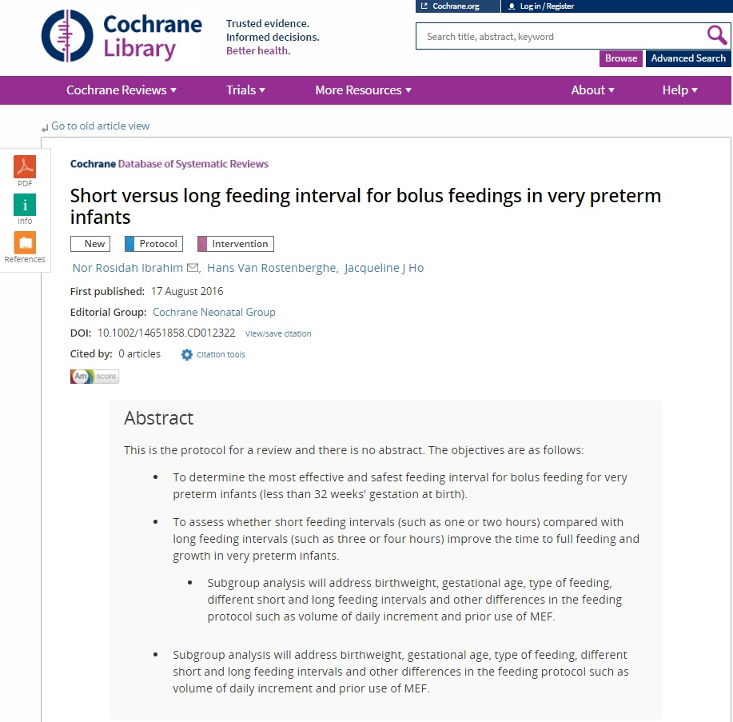
Notes:
Cochrane protocols have a standard format, helping readers find what they’re looking for quickly.
[NOTE TO TRAINERS: You can ask the participants: Has anyone read a protocol in the Cochrane Library?]
The best way to find out what a protocol should look like is to find some recently published protocols in the Cochrane Library, and get to know them.

Slide 7
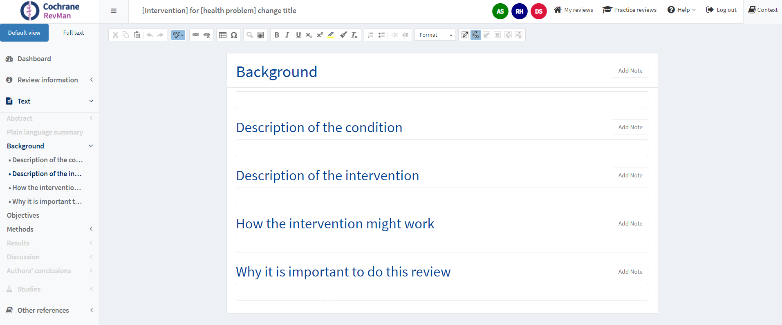
Notes:
The standard format is also designed to help authors with the review. This is a screen shot from RevMan, the software used to write Cochrane Reviews. You can see here the structure clearly outlined for authors to work through. The sections relevant to protocols are highlighted in blue, while those not needed until writing a full review are greyed out. All you need to do is work through and write the text required under each heading, like you would in a word processor.
When you’re finished, the protocol will form the basis of your review - you will in effect have written your review up to the end of the ‘Methods’ section.

Slide 8
Authors
must affirm that they:
made substantial contribution to:
the conception and design of review, or
the acquisition, analysis, or interpretation of data for the work
drafted the review or provided critical comments on intellectual content
approved the final version to be published
agree to be accountable for all aspects of the work
specific contributions listed in ‘Contribution of authors’ section
individuals, groups or both
order of authors relative to their contribution
institutional affiliations will be published
Notes:
Authors must meet these minimum criteria, and declare that they have made a substantial contribution to the review. The specific contributions of each author are recorded in the ‘Contribution of authors’ section of the protocol (and the final published review). Others who have contributed to the review, but who don’t meet the criteria for authors, should be noted in the Acknowledgements section.
Authors are usually individuals, but if you have a research group you’d like to list as an author, you can do that. The authors should be listed in order of their contribution – so the first author is the one who contributed the most to the review, and the last author contributed the least.
The authors’ institutional affiliations will be published in the protocol, so make sure these details are correct. These affiliation details are stored in your review in RevMan - if the details are not correct, open your review in RevMan Web to update them. You can also update your contact details through your Cochrane Account (https://account.cochrane.org).

Slide 9
Contact person
responsible for:
organising review team
communicating with Cochrane
monitoring progress with agreed timeline
submitting completed protocol/review
communicating feedback to co-authors
ensuring updates are prepared
usually the lead author
full contact details will be published
Notes:
As well as listing all the authors, you will be asked to nominate a contact person. This is the person who will take chief responsibility for communicating with Cochrane about the review and organising the review team throughout the process. This person is usually the lead author, but can be anyone from the author team.
Once the protocol is complete, the contact person’s details will be published with the protocol, becoming the contact author for any feedback on the protocol. An added benefit of taking on this role is that when the complete review is published, the contact person will receive a complimentary personal subscription to the Cochrane Library.

Slide 10
Writing your protocol
accessible language
easy to read and understand by someone who is not an expert
future tense, active voice
use the Cochrane Style Manual
http://community.cochrane.org/style-manual
terminology, statistics, spelling, references, formatting, etc.
Notes:
Now we come to the text of the protocol. Throughout the protocol, it’s important that you write in accessible language – remember that your audience may not be experts in this field, they may not be health professionals or researchers at all, so try to avoid using technical jargon.
A protocol is always written in the future tense, e.g. “we will do this...”, and use the active voice, e.g. “we will search” not “the literature will be searched”.
A crucial resource for your review is the Cochrane Style Manual. This manual is designed to make it easy to write and copy edit your review in line with our house style. We strongly recommend that you consult the Style Manual – it has helpful advice on terminology and spelling, references, formatting, etc. If you submit your draft and it’s not consistent with the Style Manual, the CRG may simply send it back to you until it has been corrected.

Slide 11
Background
put the review in context with the existing body of knowledge
description of the condition and its significance
description of the intervention
how the intervention might work
why it is important to do the review
Notes:
The ‘Background’ should be like the background section for any other research paper: it should put this study in the context of what we already know, and the questions we want to answer. The ‘Background’ should include:
a description of condition: biology, diagnosis, prognosis, prevalence or incidence, impact on affected people or communities
a description of intervention: in the context of standard or alternative interventions
for drugs – pharmacology, dosage, metabolism, selective effects, half-life, duration, interactions with other drugs
for complex interventions – description of components
how intervention might work: theoretical reasoning, empirical evidence to support reasoning
why it’s important to do the review: brief statement of the rationale – e.g. to bring together evidence to settle uncertainty.

Slide 12
Objectives
a precise statement of the primary objective
usually one sentence
may also include specific objectives relating to different
participant groups
comparisons of interventions
outcome measures
To assess the effects of [intervention or comparison]
for [health problem]
for/in [types of people, disease or problem and setting if specified].
Notes:
Once you have prepared the background, you will have a good idea about the important questions that need to be answered by this. The objectives really are the questions you want to have answered. Generally this is framed as a single sentence, derived from your question as stated in your review title. If you have key additional outcomes, for example to explore effects in specific participant groups or compare specific alternative interventions, you may state them here, but you should not try to outline all your planned analyses and explorations here – there will be plenty of space to do that in the ‘Methods’ section.

Slide 13
Methods
plan what you will do before you start
minimise bias
divide work among review authors and establish timeline
enough detail so that the decisions and methods could be replicated
select methods likely to deliver the best evidence on which to base decisions
consult your Cochrane Group - they may have a standard template
anticipate that a useful number of studies will be found
may be the case in future updates, if not now
Notes:
The ‘Methods’ section is where we set out in detail our plans for the review. As we mentioned, this is designed to minimise bias in our decision-making later on, once we have the results of the included studies. It’s also a very valuable way to plan out your tasks, and you can begin to allocate work within your team, and get a good idea of how long each part of the process will take. Make sure you describe your planned methods in enough detail so that someone else could follow the steps and replicate them if they wanted to. After all, you will need to follow these steps yourself when you begin working on the complete review.
At every stage, we want to make sure we’re selecting the best possible methods to give us reliable answers for decision-making. That’s why we consult the Cochrane Handbook, and it’s guidance based on the latest methodological research. You should also consult your Cochrane Group – they may have guidance on preferred methods, and they may even have a template for the text of your protocol for you to follow. If not, look at some other examples of recently published protocols from your Cochrane Group.
One final note: always write your protocol as if you will find enough studies to give you all the information you need to conduct all the measurements and analyses you’d like. Even if you suspect there are not many published studies in your field, don’t censor your protocol by assuming you won’t find any. You might find more studies than you think, but even if you don’t, future updates might find more studies, and the methods outlined in your protocol should be a useful plan of action in that case.

Slide 14
Methods
eligibility criteria
outcomes
searching
data collection
risk of bias assessment
analysis
summarising findings
To be covered in more detail...
Notes:
The ‘Methods’ are broken down into a number of sections:
the eligibility criteria, where you will define which studies will be included and excluded from the review.
the outcomes you plan to report on
how you will conduct your literature search to identify included studies
how you will collect data from your included studies
how you will critically appraise your included studies for possible biases
and finally, how you will conducted your analysis of the results.
Each of these sections will be covered in detail in other training materials/sessions.

Slide 15
Standards
MECIR: Methodological Expectations for Cochrane Intervention Reviews http://methods.cochrane.org/mecir
cover conduct and reporting
most mandatory, some highly desirable
consistent with PRISMA standards for reporting systematic reviews

Slide 16
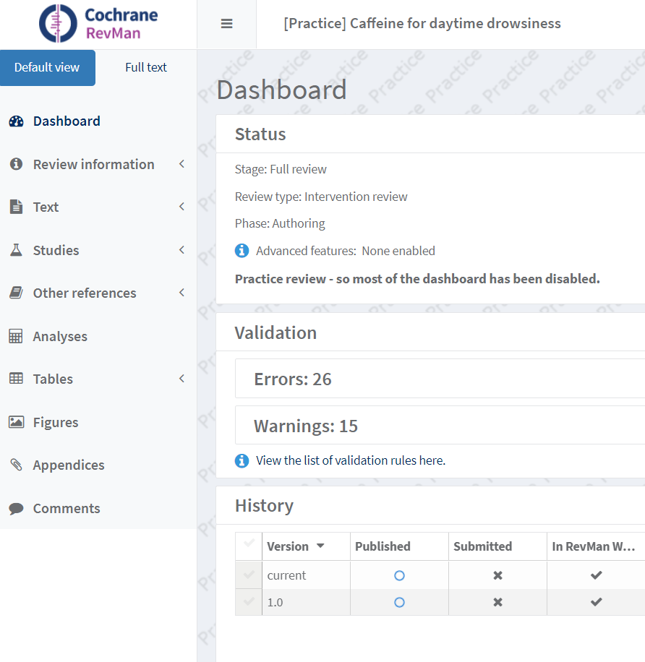
Studies and references
Studies
included or excluded from your review
not used for protocol
Other references
all protocol references e.g. Background, Methods
Notes:
When you have finished writing the methods, there are a few minor details to be completed before your protocol is ready for submission.
You will need to make sure that your references are completed. RevMan will keep a list of all your references, and allow you to link to them in the text of the protocol. RevMan keeps two kinds of references:
references to studies – these are the references to the included and excluded studies in your review. At the protocol you won’t have any of these, and these sections will be empty.
other references – this is where all the references for your protocol should be listed, e.g. those used in the ‘Background’ or ‘Methods’ section.

Slide 17
Additional information
acknowledgements
contributions of authors
declarations of interest
sources of support
any additional tables or appendices
Notes:
There is the ‘Acknowledgements’ section for you to recognise additional contributors to the protocol.
The ‘Contributions of authors’ section should include a specific description of how each author has contributed to the protocol – again, this is to ensure transparency, and demonstrate that all the named authors have contributed, and that all the contributors have been named.
The ‘Declarations of interest’ section must contain a statement that accurately reflects all interests declared by authors in their individual Declaration of Interest (DoI) forms (which are managed by CRG editorial teams). In their DoI forms, authors should report any current or recent (within the 36 months prior to registration of the review) financial relationships or activities with any commercial organization with an interest in the topic of the review that might lead to a real or perceived conflict of interest. Authors should also report any current or recent (again, within 36 months prior to registration) non-financial relationships and activities that have a direct and obvious connection to the topic of the review. Authors should always include the dates applicable to any declarations. Additionally, all authors should report involvement in any study that may be eligible for inclusion in the review. If an author has declared that they have no relevant financial or non-financial interests, this should be reported as ‘[AUTHOR INITIALS]: has declared that they have no conflict of interest’.
In addition, a complete list of all your sources of support should also be provided for each author in the review, whether or not they constitute a conflict, including specific funding for the project, support in the form of salary, and any in-kind support. ‘Sources of support’ section is divided into internal (from the institution(s) at which the review was produced), and external (provided by other organisations). Most authors should at least list the source of their salary (unless they are explicitly working on the review in their own time, outside the scope of their paid job).
Finally, you can add any additional tables or appendices, if you have any at the protocol stage. For example, if your review is on herbal medicines, you may wish to include a table to describe the different names and components of the herbs you plan to investigate in the review, if these are too complex to describe completely in the ‘Background’.

Slide 18
When your protocol is complete
check the details
spell check, validation check, Cochrane Group checklist
submit for editorial approval
expect internal and peer review
ME, Editor(s), Statistical Editor, peer referees, consumer
like any journal, may take several months
when it has been approved
complete License for Publication & Declaration of Interest forms
commence review
will be published immediately
Notes:
There are some final checks you should do before submitting your protocol. First, make sure you’ve run a spell check. Another important step is to use the Validation report – that will make sure you’ve filled in all the details you need to, and let you know of anything you need to fix. Your Cochrane Group may also have provided you with a checklist to complete before submission – if so, make sure you do so, to make sure your protocol is in good shape and ready for editorial review.
Then, you can go ahead and submit your draft. It’s likely that the first step will be internal review by one or more of Cochrane’s editors, and you may get comments back at this stage that you will be expected to address. When the Cochrane Group is happy, the draft will go out for external peer review, and your draft may also be seen by a consumer referee, a statistical editor and others at this stage.
Although the Cochrane Group will work to make sure this process goes smoothly, it can take some time. You will need to be patient and respond as quickly as you can when asked to address comments from the editors and referees. It’s worth being patient at this point – you don’t want to rush ahead and start working on the review. If your methods had to change in response to editorial feedback, you would need to go back and start over again.
As soon as they can, the Cochrane Group will let you know that the protocol has been approved for publication, and at that point you can go ahead and begin work. Once the draft has been approved, it will be published in the Cochrane Library immediately.

Slide 19

PROSPERO
international database of prospectively registered systematic reviews in health and social care
all Cochrane protocols automatically uploaded to PROSPERO
http://www.crd.york.ac.uk/PROSPERO/

Slide 20
PRISMA-P protocol reporting standards
Preferred reporting items for systematic review and meta-analysis protocols (PRISMA-P)
http://prisma-statement.org/Extensions/Protocols.aspx

Slide 21
Take home message
published protocols are a requirement for Cochrane Reviews, designed to minimise bias
write your protocol so that readers can understand in detail what you plan to do
follow the standard structure available in RevMan

Slide 22
References
Cumpston M, Chandler J. Chapter II: Planning a Cochrane Review. In: Higgins JPT, Thomas J, Chandler J, Cumpston M, Li T, Page MJ, Welch VA (editors). Cochrane Handbook for Systematic Reviews of Interventions, 2019. Available from https://training.cochrane.org/handbook/current/chapter-ii
Lasserson TJ, Thomas J, Higgins JP. Chapter 1: Starting a review. In: Higgins JP, Thomas J, Chandler J, Cumpston M, Li T, Page MJ, Welch VA (editors). Cochrane Handbook for Systematic Reviews of Interventions, 2019. Available from https://training.cochrane.org/handbook/current/chapter-01
Page MJ, Cumpston M, Chandler J, Lasserson T. Chapter III: Reporting the review. In: Higgins JPT, Thomas J, Chandler J, Cumpston M, Li T, Page MJ, Welch VA (editors). Cochrane Handbook for Systematic Reviews of Interventions, 2019. Available from https://training.cochrane.org/handbook/current/chapter-iii

Slide 23
Acknowledgements
Compiled by Miranda Cumpston
Based on materials by the Cochrane Australia
Approved by the Convenors of Cochrane Methods Groups

