Slide 1
Selecting studies

Slide 2
Steps of a Cochrane Review
define the question
plan eligibility criteria
plan methods
search for studies
apply eligibility criteria
collect data
assess studies for risk of bias
analyse and present results
interpret results and draw conclusions
improve and update review
See Chapter 4
of the Handbook
Notes:
After you’ve conducted a literature search and retrieved a number of records, you will apply the eligibility criteria to decide which articles to include in your review.

Slide 3
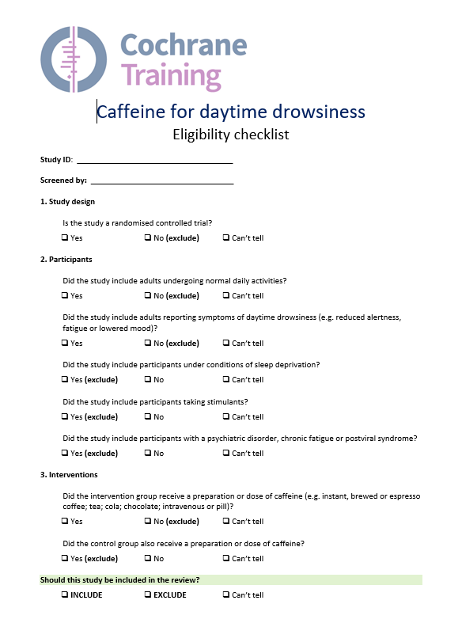
Minimising bias in selection
selecting studies involves judgement, and is highly influential on the outcomes of the review
compare each record with pre-specified eligibility criteria
written summary or checklist may be helpful
two authors should independently select studies
discussion may identify issues for clarification or gaps in your eligibility criteria
pilot selection on a few papers first
how will disagreements be resolved? e.g. discussion or referral to a third author
Notes:
Selecting which studies are included in and excluded from your review is perhaps the most important decision you will make, determining the results you will find to answer your review question. It’s essential to minimise any possible bias in making these judgements.
Each record identified through your search should be carefully compared against your inclusion criteria, and must meet all of them to be included in the review. This is why it is crucial to have clear, pre-specified criteria from your protocol to help you make these decisions as objectively as possible, and avoid ad hoc, biased decision making about inclusion. Having a written summary or checklist for authors to have on hand when screening the search results can be helpful – whether on paper or electronically as a form or spreadsheet. As soon as a study fails to meet one of the criteria, it can be excluded and there’s no need to consider it further.
[NOTE FOR TRAINERS: You can show and share a sample checklist for eligibility criteria]
If you are using Covidence, which is a tool available for Cochrane authors to help with selection of studies, you can add your inclusion and exclusion criteria at the top of the screening page, so that you can view it whilst screening.
To minimise the risk of bias, two authors should independently select studies. Having a second perspective is helpful especially where it isn’t clear whether a study meets the inclusion criteria or not. The process of discussion around the decision ensures that the criteria are applied fairly and consistently. It may be helpful to have one of the authors selecting studies not be a content expert, to avoid any preconceptions about particular studies or interventions.
Discussion about difficult decisions can identify gaps where your eligibility criteria are not clear, or where different authors interpret the criteria differently. It’s helpful to pilot the selection process on a few papers first, to identify any issues and perhaps clarify the checklist or explanation of eligibility criteria for authors. Although you should avoid making any changes to your criteria at this stage, it may be necessary to make an addition or change to address an issue not anticipated at the protocol stage. If that happens, you should be transparent in your review and declare any changes made. Any changes affecting the scope of your review should be agreed with your Cochrane Group.
When both authors have looked at all the included studies, they should come together to discuss their findings and identify any remaining disagreements, before making final decisions about the included studies. Make sure you’ve considered how disagreements will be resolved – for example, by discussion until you reach a consensus, or by referring the final decision to a third author.
[NOTE TO TRAINERS, if asked: It is possible to conduct selection process with blinding, e.g. by editing copies of the articles to removed information about authors, locations, journals and results. This is time-consuming and benefit has not been conclusively shown.]
[NOTE TO TRAINERS if asked: Agreement can be measured using the kappa statistic, but this is not required (see Handbook section 7.2.6 for method of calculation).]

Slide 4
Putting it into practice
examine titles and abstracts
could the record meet all eligibility criteria?
remove obviously irrelevant studies, but be inclusive
retrieve and examine full text reports
does the record meet all eligibility criteria?
link together multiple reports of the same study
may need all records to make a final decision
look for authors, study name, location, intervention, participants, baseline data, dates, registration no.
look for errata, comments and retractions
correspond with authors if further information is needed
Notes:
A typical selection process begins with the search results. The majority of your search results will be in the form of titles and abstracts retrieved from electronic databases, although sometimes you will only have the title and keywords, and other times you will immediately have the full text available.
The first stage is to go through the titles and abstracts, removing any records where it is clear that the study does not meet one or more of the eligibility criteria. It’s important to be inclusive at this stage, and to give records the benefit of any doubt, as only limited information is available in the abstract, and you might be surprised by what you find in the full text. It is best practice to have two authors complete the whole selection process.
Once you have removed any clearly excluded studies, then you can proceed to retrieve the full text of all the remaining reports. Studies must meet all your criteria to be included in the review, but make sure you have all the information you need.
Some studies are reported in more than one paper, but studies – not individual papers – are the primary units of your review. You will need to find and bring together all the reports of a study for your review before you have all the information about that study – not forgetting to include any errata, comments or retractions that may have been printed. Note that even reviews of trials may add additional data not included in the original papers – e.g. particularly check reports combining drug trials. In some cases, the information you have may not be enough to make a decision about the study, in which case you should contact the study’s authors if possible to obtain further details.

Slide 5
What about studies with no usable data?
studies must be included in the review if they meet your criteria
results reported in non-standard ways should still be reported in the review
studies that do not report outcomes of interest may have measured them – beware of selective reporting
studies that did not measure outcomes of interest may only be excluded if outcomes were pre-specified as part of your eligibility criteria
Notes:
Sometimes you will come across a study that meets your eligibility criteria in terms of the population, intervention, comparison and study design, but appears to report no useful data. It can be tempting to exclude such studies, but that isn’t the right way to go.
First of all, systematic reviews seek to provide a complete report on all the studies conducted that have attempted to answer a particular question. Reporting on studies – even with no useful data – is part of that complete picture of the available research.
Secondly, identifying whether a study can contribute usable data is not always straightforward. Sometimes studies report data, but in a format that does not appear useful or familiar. These studies and their results must be included to give a complete picture of the evidence – we’ll address how to deal with different types of data in separate presentations, and if you come across something you’re really not sure how to manage, get some advice from a statistician.
If the study doesn’t report your outcomes of interest, that doesn’t necessarily mean that the study didn’t measure these outcomes. They may simply have failed to report them in their publication. We know that reporting of outcomes can sometimes be done selectively, and that positive or statistically significant outcomes are more likely to appear in published papers. This is known as selective outcome reporting. To avoid introducing bias to your review, you shouldn’t exclude studies for failing to report outcomes. It’s possible that you might be able to get additional information on your outcomes of interest if you contact the study authors.
Even if you’re really sure that the study did not measure your outcomes of interest at all, you’ll need to refer back to your pre-specified eligibility criteria before excluding a study. If you included specific outcomes in the eligibility criteria, then you can legitimately exclude a study that did not measure those outcomes. If outcomes were not part of your eligibility criteria, then you should include the study and describe it in your review, giving a complete picture of the studies conducted in the field, even though it won’t contribute to your results.

Slide 6

Author support tools
Covidence
for intervention reviews
www.covidence.org
Notes:
As already mentioned, Covidence is available as an optional screening and data extraction tool for systematic review authors.
Specifically, Covidence allows your team to: upload search results, screen abstracts and full text;
collect descriptive and outcome data in a structured form;
conduct risk of bias assessment (NOTE: Covidence currently doesn’t support the use of RoB 2 tool – the tools and templates for using RoB 2 are available at https://www.riskofbias.info/welcome/rob-2-0-tool/current-version-of-rob-2);
compare duplicate decisions by two review authors and resolve disagreements;
export data into RevMan or Excel. (NOTE: Covidence doesn’t enable direct export of data to RevMan Web, which is now the recommended version of RevMan software for Cochrane authors)

Slide 7
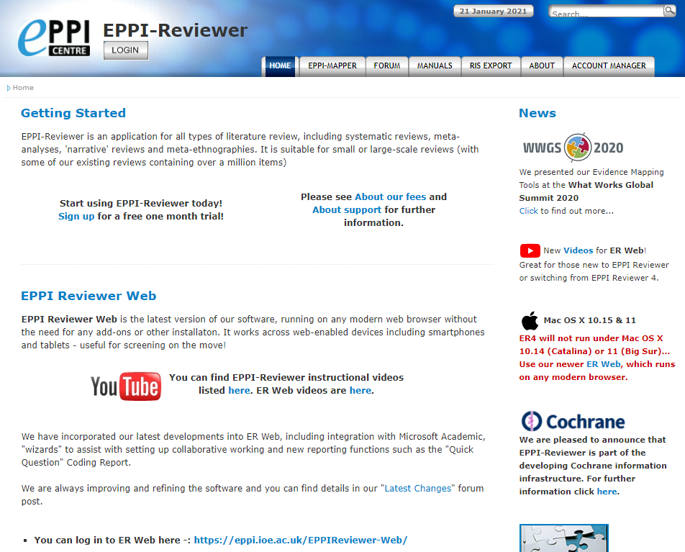
Author support tools
EPPI-Reviewer
for complex, non-randomised and qualitative reviews
eppi.ioe.ac.uk/cms/er4
Notes:
EPPI-Reviewer is an online tool that can conduct the complete systematic review process, including analysis. It allows your team to upload search results, select studies, and collect data in a structured data collection form, and is particularly recommended for reviews of complex questions and those collecting qualitative data.

Slide 8
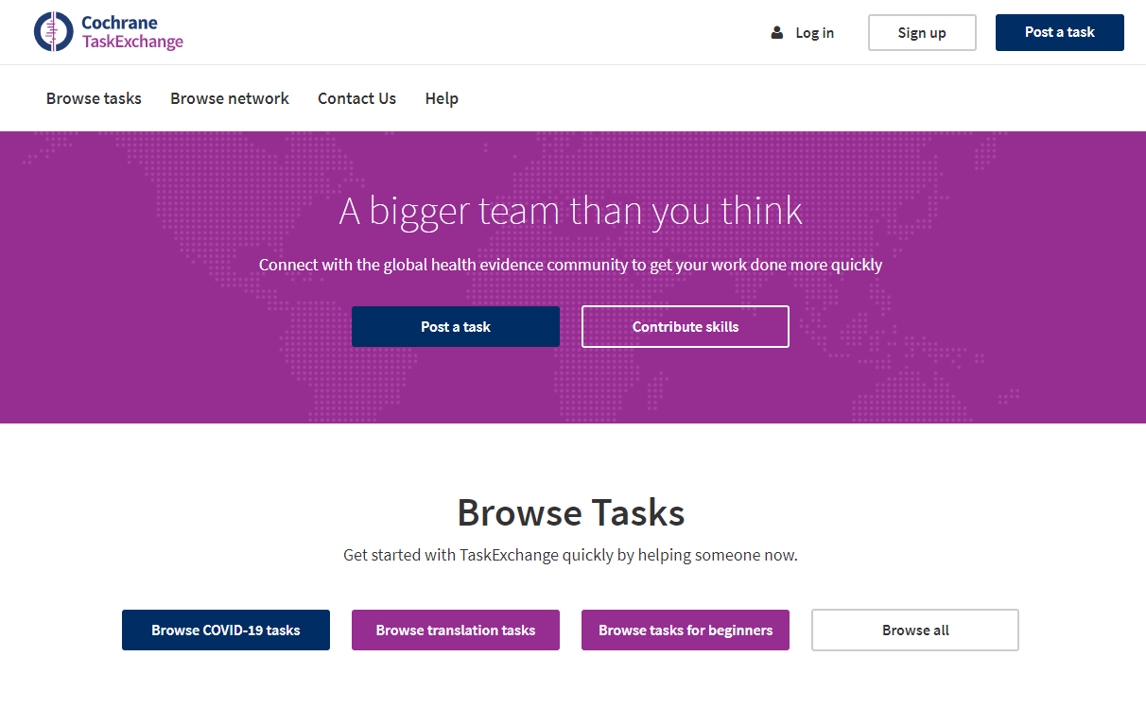
Author support tools
Task exchange
Connect to others who may be able to assist with your review
taskexchange.cochrane.org
Notes:
Task exchange is a platform through which you can find people willing to help you with specific tasks in your Cochrane Review, such as screening the records.

Slide 9
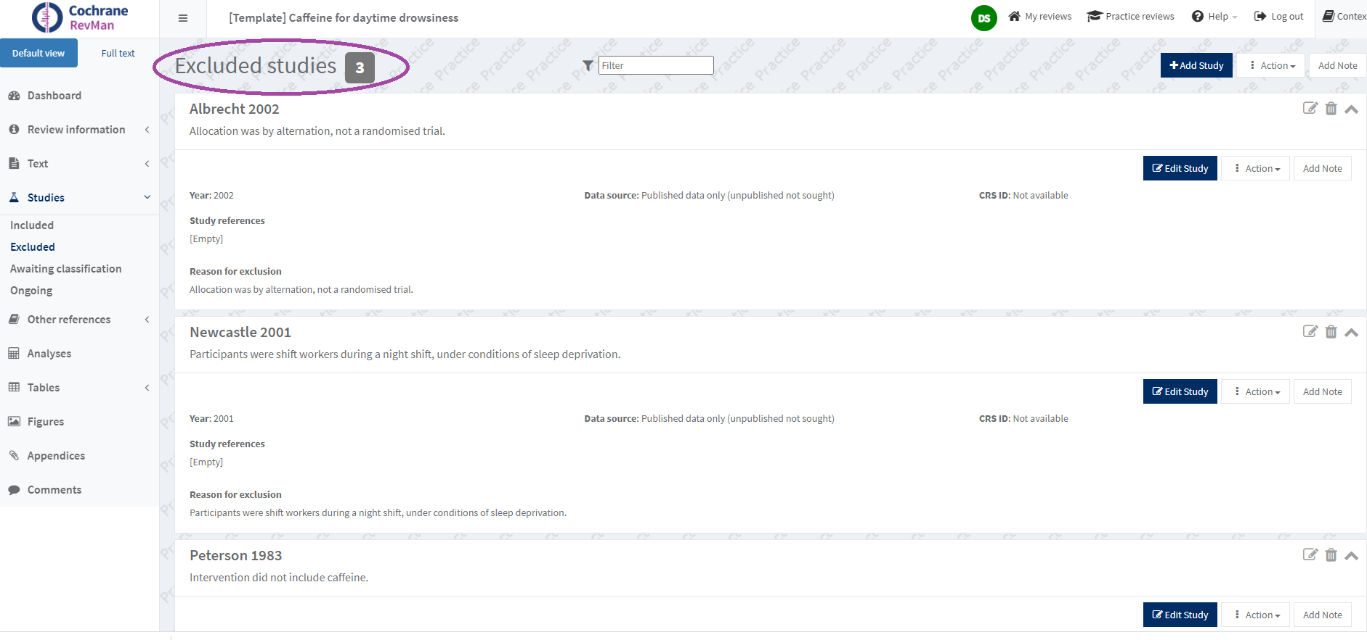
Reporting excluded studies
‘Results’ section
Search results, including no. identified and excluded at each stage
‘Characteristics of excluded studies’ table
list of key excluded studies, with primary reason for exclusion
list studies that may appear to readers to meet the eligibility criteria, but on closer inspection do not
no need to list studies that obviously do not meet criteria
Notes:
Throughout the selection process, you should keep careful records about the studies excluded from the review. In the ‘Results’ section of the review, you will be required to give a summary of the total number of records identified in your search, and the number excluded at each stage of the screening process (i.e. the number excluded at the title and abstract stage, the number retrieved in full text, and the final number included in the review). You may wish to give a brief summary here of the reasons for exclusion (e.g. so many excluded because they were not the right intervention, so many because they were not the right population, etc.).
You will also include in your review a table of ‘Characteristics of excluded studies’. Here you will have to list excluded studies that readers may think might meet your inclusion criteria, but which have been excluded. Each study should be listed along with the specific reason for it exclusion. Depending on the size of your search results, this list might include, for example all the studies you retrieved in full text, that could not be excluded on the basis of the abstract, or it may include a more limited list. This ensures the transparency of your decisions to exclude studies – any reader who wonders about a particular study or disagrees with your decision can see exactly why the study was excluded.

Slide 10
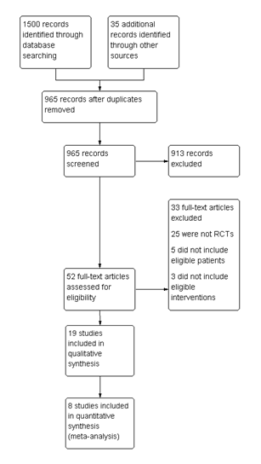

PRISMA flow chart
See www.prisma-statement.org
Notes:
This is a PRISMA flow chart, based on the PRISMA Statement, a set of guidelines for reporting systematic reviews (for further information please see the web link provided). The PRISMA Statements sets out good practice for reporting the results of your search in a systematic review, which can be summarised in this flowchart. The flowchart outlines the flow of records and studies through the different phases of the systematic review, that is, the number of records identified by database searching, the number of records excluded and the number of studies included in the systematic review and in a meta-analysis.
It is recommended that you include a PRISMA flowchart in your review so that your readers can clearly see how you accounted for all the records you found and the reasons each record was excluded. You can generate a flowchart easily in RevMan, Cochrane review production software.

Slide 11
What to include in your protocol
whether two authors will independently assess studies
process of assessment (e.g. abstracts, full text)
how disagreements will be managed
any other methods used
Notes:
Thinking back to the protocol stage, you should provide a brief description of this selection process. Describe whether two authors will independently assess each record identified from your search, the process you will use (e.g. starting with abstracts, then retrieving the full text of potentially relevant studies), how you will manage disagreements (e.g. by discussion, or using a third author), and any other details of your planned selection process.

Slide 12
Take home message
take a systematic approach to screening abstracts and full text reports against your eligibility criteria
this process should be done independently by two authors to minimise error and bias

Slide 13
References
Lefebvre C, Glanville J, Briscoe S, Littlewood A, Marshall C, Metzendorf M-I, Noel-Storr A, Rader T, Shokraneh F, Thomas J, Wieland LS. Chapter 4: Searching for and selecting studies. In: Higgins JPT, Thomas J, Chandler J, Cumpston M, Li T, Page MJ, Welch VA (editors). Cochrane Handbook for Systematic Reviews of Interventions version 6.1 (updated September 2020). Cochrane, 2020. Available from www.training.cochrane.org/handbook.
Acknowledgements
Compiled by Miranda Cumpston
Based on materials by Cochrane Australia
Approved by the Convenors of Cochrane Methods Groups

