Slide 1
Searching for studies

Slide 2
Steps of a Cochrane Review
define the question
plan eligibility criteria
plan methods
search for studies
apply eligibility criteria
collect data
assess studies for risk of bias
analyse and present results
interpret results and draw conclusions
improve and update review
Notes:
A well-planned and conducted search for studies is a key component of a Cochrane Review.

Slide 3
Session outline
planning the search process
constructing a search strategy
managing and reporting the search
see Chapter 4 of the Handbook

Slide 4
Cochrane Information Specialists (CIS)
contact your Cochrane Group’s CIS before you begin
services vary, but the CIS may:
      help plan your search
      design or comment on your search strategies
      run searches for you and send you the results
      give advice about searching other sources
      give advice about managing references
      draft or comment on the search methods in the Review
otherwise, consult a local health librarian
Notes:
Cochrane Groups employ or contract an Information Specialist to assist with searching. The level of support available will vary depending on the resources of each group.
Authors should still have an understanding of the overall search process, so they can:
consider and contribute to the search strategy
understand what the Information Specialist is doing
identify any additional searching that can or should be done
work with the Information Specialist to report the search strategy accurately in the review

Slide 5
A rigorous approach to searching
systematic reviews require an extensive search - MEDLINE is not enough!
a limited search may find an unrepresentative set of studies
      incomplete results
      selection bias
      reduced generalisability
balance sensitivity with efficiency
Notes:
A limited search will not only miss relevant studies, giving you incomplete and possibly inaccurate results.
You may be vulnerable to selection bias – finding only those studies that are easiest to find, e.g. indexed in MEDLINE, published in high impact factor, English-language journals, which may not be representative of all the studies conducted. Unfortunately, we know that ease of access to study reports is linked to the results of the study, that positive studies are more likely to be published and indexed where we can find them.
See also Cochrane Handbook Chapter 13 Assessing risk of bias due to missing results in a synthesis for further information on how the results of a study are linked to different aspects of publication and indexing.
Even if the results are accurate, including fewer studies reduces the range of populations and contexts in which your intervention is tested, and may lead people to conclude that your results are not applicable to them. More studies will increase the generalisability of the results.
Having said that, it’s important to be efficient and realistic in your search - start where you expect to find the most relevant studies.

Slide 6

Fishing for information
Fishing the River Nairn by Duncan Brown www.flickr.com/photos/cradlehall/3789625428/
Notes:
In a sense we are fishing for information. However, searching for a systematic review is not like this man with his fishing rod, fishing in one particular spot on one particular river, and targeting one fish at a time.

Slide 7


Fishing for information
Research Ship Sonne In Auckland I (crop) by Ingolfson http://commons.wikimedia.org/wiki/File:Research_Ship_Sonne_In_Auckland_I_(crop).jpg
Notes:
Rather, your search needs to be on a much larger scale. Like this fishing trawler, we’ll need to search in a number of different locations, thoroughly searching for all the information that meets our eligibility criteria. This might mean that we pull up more irrelevant material, which we have to throw back in, but it will also reduce our chance of missing something important.

Slide 8
Sources to search: overview
bibliographic databases
      likely to identify the majority of your included studies
      Cochrane Central Register of Controlled Trials (CENTRAL)
      MEDLINE
      Embase
      Cochrane Specialised Registers
      trials registers
      add others if appropriate
other sources
      journals and other databases
      unpublished and ongoing studies
start here
work down
Notes:
We aim to search multiple sources, to identify as many relevant studies as we can. It’s important to start with those sources likely to be the most productive – starting with CENTRAL, and then other electronic bibliographic databases such as MEDLINE and Embase are likely to provide most of your included studies, and are first main category to consider when building your search strategy.
Importantly, your CRG may keep a Specialised Register of studies relevant to the scope of the CRG, based on a range of their own searching activities. CRGs submit the information in their registers to be included in CENTRAL, but your Information Specialist may suggest searching the register itself, as it may contain some additional records. In some cases, the CRG may run regular searches of other bibliographic databases and incorporate these records in the register, in which case you may not have to search those individual databases yourself. Consult your Information Specialist for advice about searching specialised registers to avoid duplication. Some Cochrane Fields also have registers that you may wish to search, such as the Child Health Field.
Searching in trials registers is essential to identify relevant ongoing and unpublished studies.
Beyond these, there are other sources for published studies such as individual journal archives, other databases such as trials registers, and lastly there are sources to identify unpublished studies. The idea is to start with the major databases, and then add additional sources as appropriate to your question, until you have built up a comprehensive, thorough set of sources to search, that is still an achievable workload.

Slide 9
Cochrane Central Register of Controlled Trials
access via the Cochrane Library
RCTs and quasi-RCTs
includes MEDLINE and Embase
records (including Cochrane Crowd)
records from Cochrane Group searches,
handsearching journals
and conferences
CENTRAL
1.730,000 records
MEDLINE
585,000
Embase
450,000
Other
695,000
Notes:
Of all the bibliographic databases, the most important, first place to search is the Cochrane Central Register of Controlled Trials (CENTRAL), which is the most comprehensive source available for controlled trials.
As of January 2021, CENTRAL includes over 1,7 million records of randomized and quasi-randomised trials of interventions. It incorporates all the records of these trials that have been identified to date from both MEDLINE and Embase. It also includes the results of additional searching for eligible trials done by all the Cochrane Groups, including searching other databases, handsearching of individual journals, etc.

Slide 10
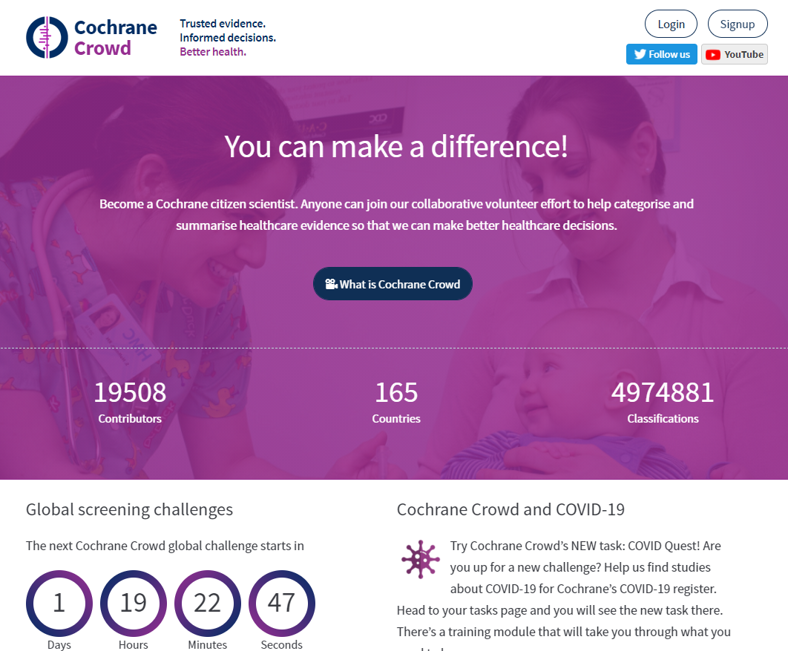
https://crowd.cochrane.org/
Notes:
Cochrane Crowd is a citizen science platform - a global community of volunteers who are helping to classify the research needed to support informed decision-making about healthcare. The job of the Cochrane Crowd community is to review descriptions of research studies to identify and classify randomized controlled trials (RCTs). Reports of RCTs are then fed into Cochrane’s Central Register of Controlled Trials.
Anyone can join Cochrane Crowd and no previous experience is necessary. Members find the experience helps build skills in evidence assessment, and by focusing their effort to a health topic of interest they can keep abreast of the latest research. Brief (and fun!) online training is provided, and any contribution is welcome.
More info at: http://community.cochrane.org/tools/data-management-tools/cochrane-crowd

Slide 11
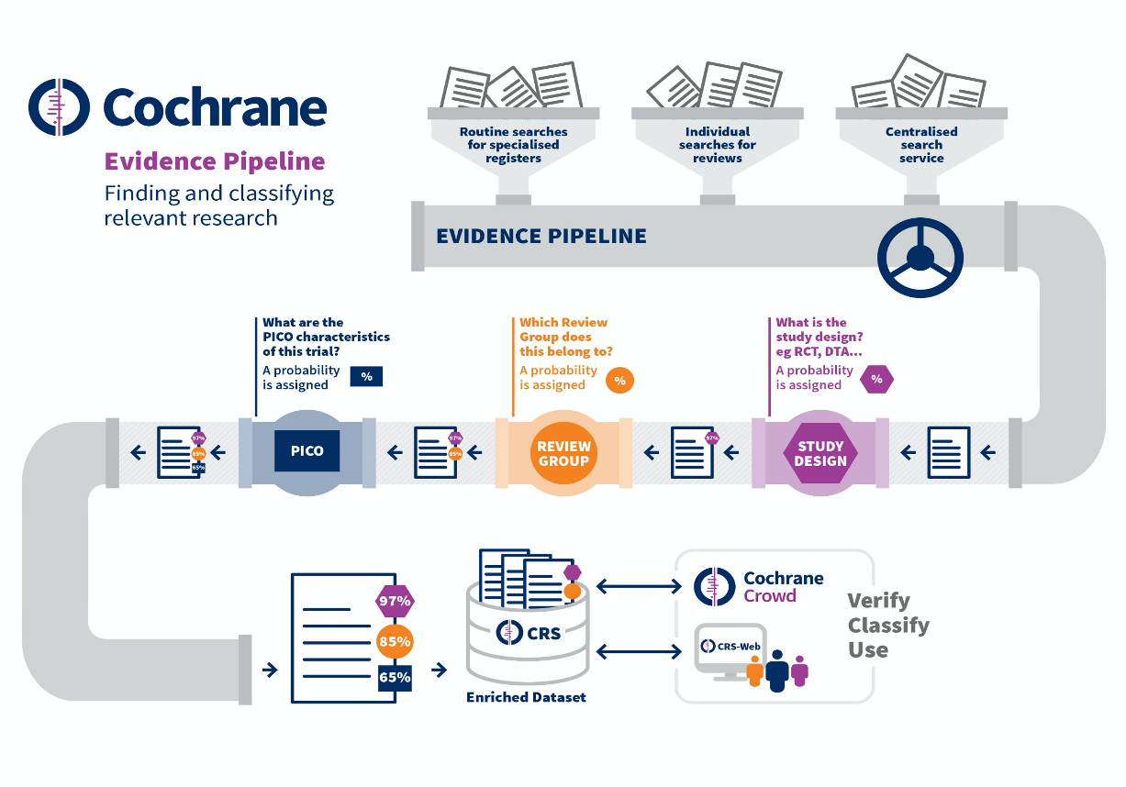
Notes:
This diagram shows what we call the ‘Evidence Pipeline’. It shows the ways in which studies are identified in Cochrane and tagged with meta-data regarding study type and PICO characteristics. It is useful for authors to be aware of this evidence pipeline as this is one of the core ways in which RCTs are identified for Cochrane’s Central Database of Controlled Trials (CENTRAL).

Slide 12
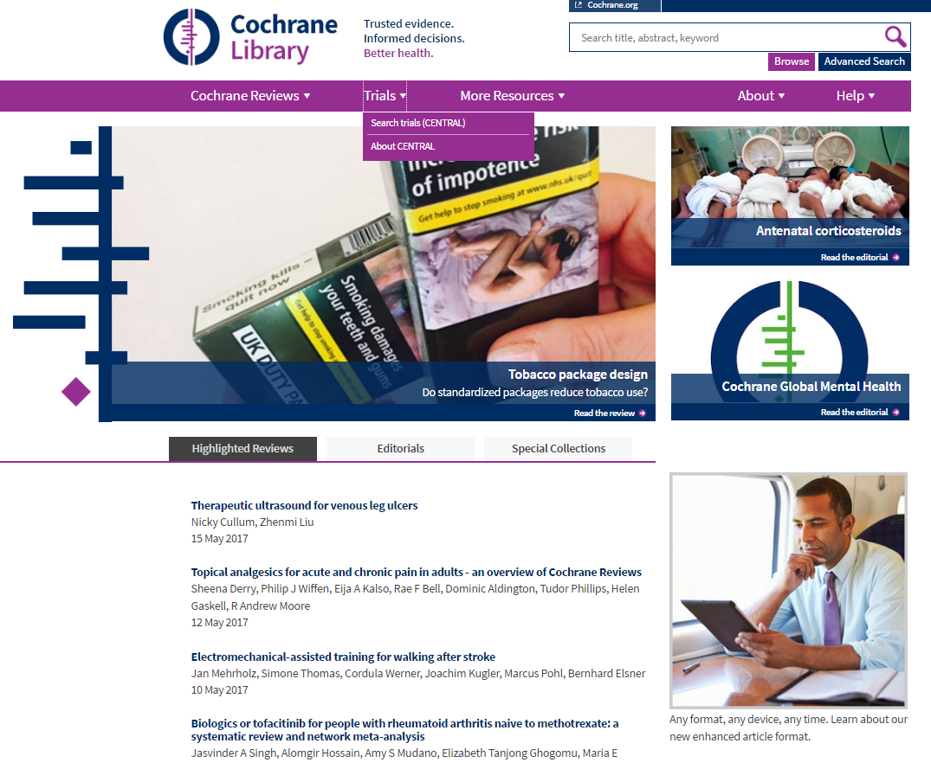
Searching CENTRAL for clinical trials
www.cochranelibrary.com
Notes:
CENTRAL is accessed via the Cochrane Library, just like Cochrane Reviews. The Cochrane Library includes six major databases: the first is the Cochrane Database of Systematic Reviews, which we’re all familiar with. There are also databases of other non-Cochrane reviews, health economics studies, etc. And it also incorporates CENTRAL.

Slide 13
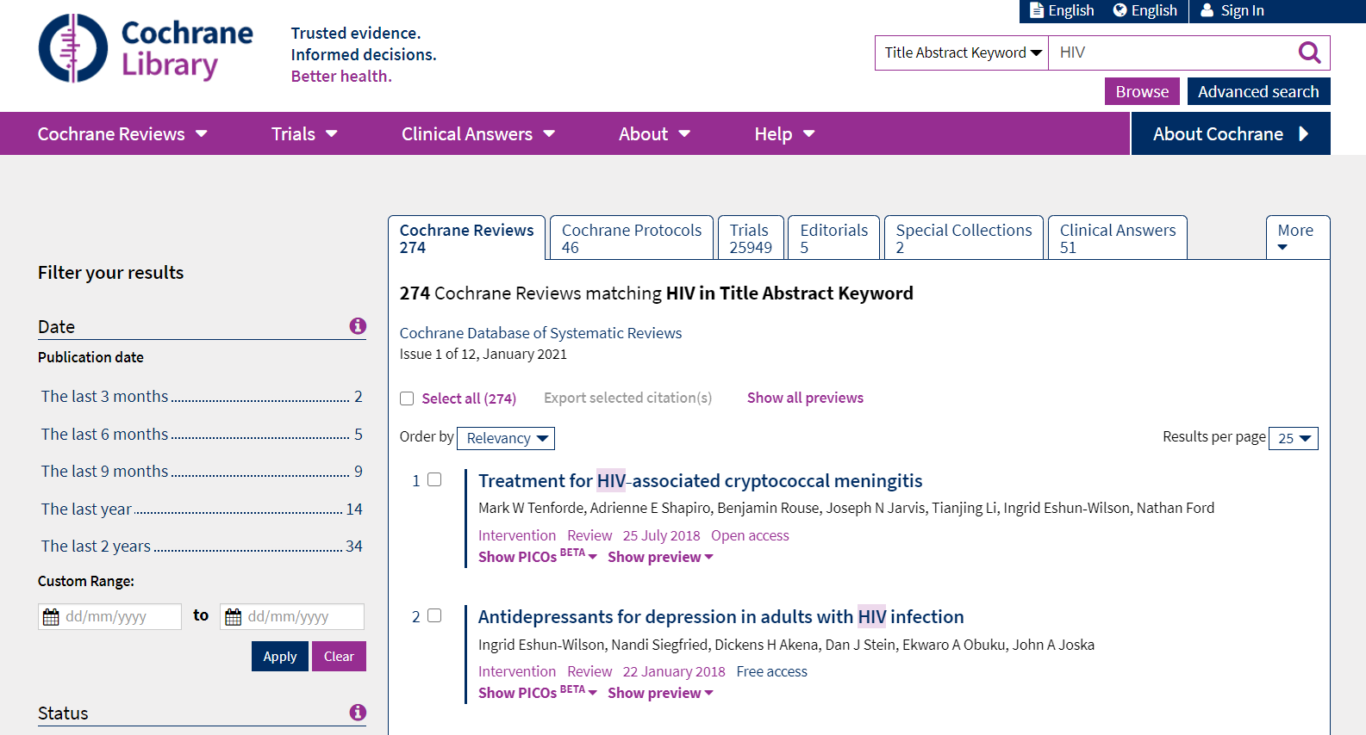
Searching for clinical trials
www.cochranelibrary.com
Notes:
When you run a search in the Cochrane Library, whether a simple or advanced search, the Cochrane Library will automatically search all its included databases. On the Search Results page, by default it will display the list of Cochrane Reviews relevant to your search terms. To see the list of trials from CENTRAL, click the Trials tab on the top menu bar. You can browse or mark and export these results as you would from any bibliographic database.
When you’re searching in the Cochrane Library, you can use the free text search, as shown on this slide...

Slide 14
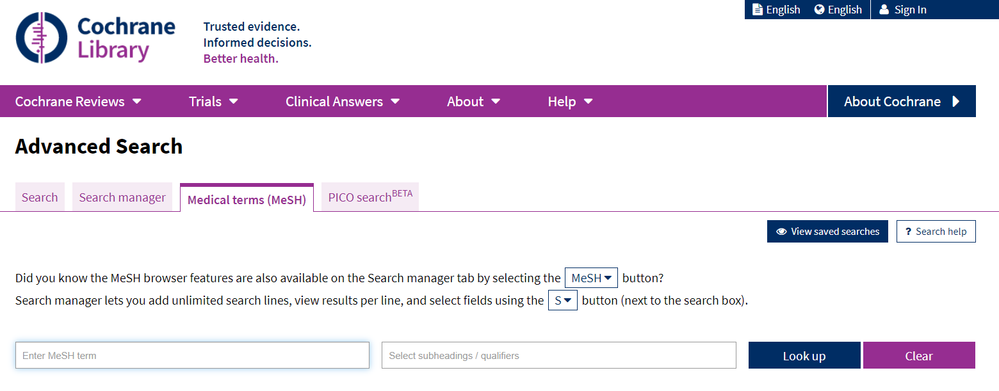
Searching for clinical trials - MeSH
www.cochranelibrary.com
Notes:
Or you can use the MeSH term for searching (under ‘Advanced Search).
[NOTE TO TRAINERS: You can choose to implement the exercise ‘Searching for studies in the Cochrane Library’ at this point. See package specific guidelines for more information]

Slide 15
Searching MEDLINE and Embase
avoid duplication!
what’s already included in CENTRAL?
      MEDLINE: records indexed as RCTs and CCTs back to 1966, updated daily
      Embase: RCTs and quasi-RCTs identified back to 1974, updated by Cochrane Crowd
ask your CIS or health librarian for advice on additional searching
      e.g. recent records not yet in CENTRAL, non-randomised studies, etc.
Notes:
Once you have searched CENTRAL, you can then move on to the other major databases. Studies from MEDLINE and Embase should always be included in your review, but it’s important not to duplicate the searching that has already been done. Many of the trials from MEDLINE and Embase have already been found and included in CENTRAL, thanks to comprehensive searches that are regularly run by the Cochrane Collaboration, and they may also be included in your CRG’s Specialised Register.
Be aware of what’s already included in CENTRAL: for MEDLINE, all records indexed as RCTs and controlled clinical trials (CCTs) back to 1966, updated quarterly. For Embase, it’s back to 1980 (with some records from1974 -1979), and updated annually. Consult with your Cochrane Information Specialist before you begin any additional searching of these databases, to discuss what’s also covered in their Specialised Register, and to discuss any supplementary searching of these databases that might be appropriate. For example, you might want to search for recent records that haven’t been uploaded to CENTRAL or the Specialised Register yet, or you may wish to search for study designs other than RCTs that aren’t included in the standard searches.

Slide 16
Other bibliographic databases
national and regional databases
      e.g. KoreaMed, LILACS
subject specific databases
      e.g. AMED, PsycINFO
dissertation databases
      e.g. Dissertations & Theses
grey literature databases
      e.g. OpenGrey, NTIS
Notes:
You may also wish to search some of the many other databases available, depending on the topic of your review, the access you have, and the available time and resources.
These are some examples of the many databases available - see the Handbook for links to these and many more. Each database has different search interfaces and different indexing terms or keywords, so if you are searching these yourself (and the TSC is not searching them for you), ask your TSC or local health librarian for advice.
[NOTE TO TRAINERS: ASK: Do any of the participants think they might wish to search additional electronic databases, and why? POSSIBLE ANSWERS: e.g. Chinese literature for herbal medicine, PEDro for physiotherapy.]
AIM: African Index Medicus
LILACS: (for Latin American & the Caribbean)
AMED: Allied & Complementary Medicine
PsycINFO: (for psychology)
OpenGrey: (grey literature)
NTIS: National Technical Information Service (US - govt sponsored research)

Slide 17
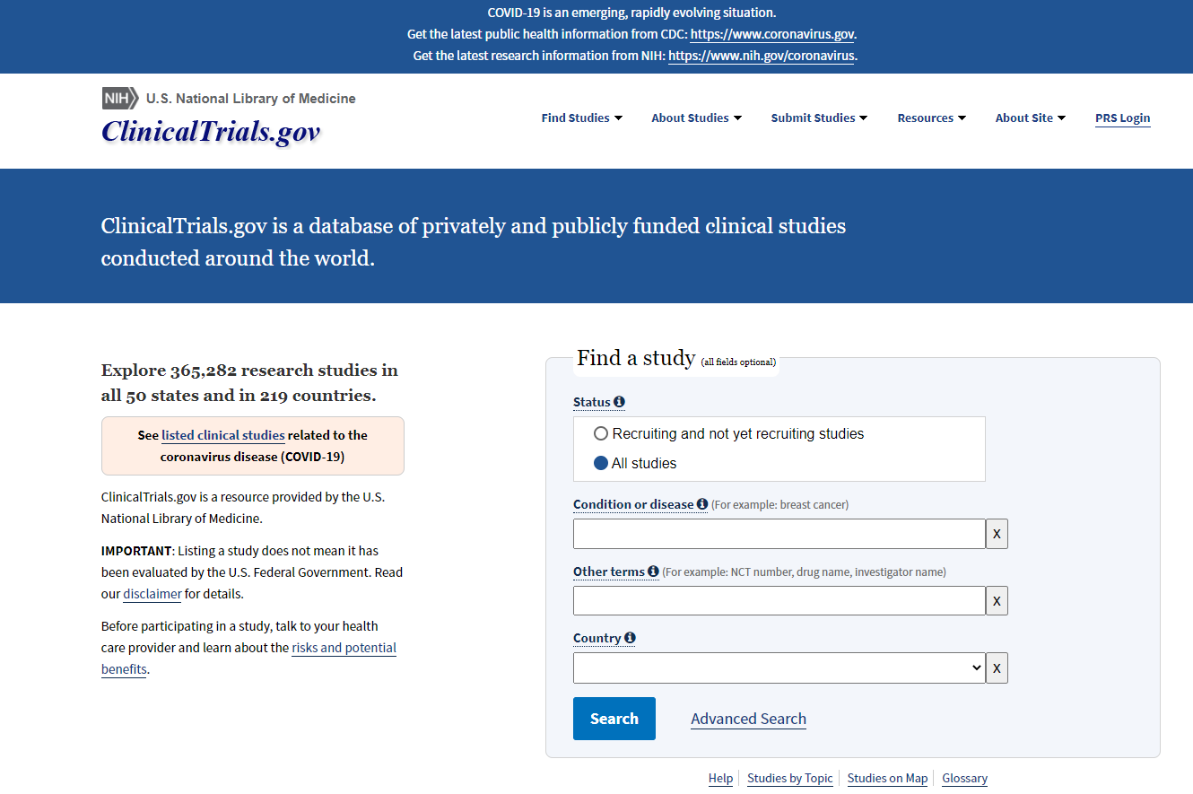
Unpublished and ongoing studies
very important to minimise bias
trials registers
      national and international
        start with ClinicalTrials.gov, WHO ICTRP
      subject-specific
      pharmaceutical industry
      regulatory agencies (e.g. FDA, EMA)
contact colleagues, organisations, other known researchers
>365,000 studies (Jan 2021)
Notes:
There is no easy way to identify unpublished studies, although things are now made easier by international initiatives to increase trial registration. The two key registers you should start with are the USA-based ClinicalTrials.gov, which researchers in many countries use, and the WHO International Clinical Trials Registry Platform, which helps you search across multiple national registers (including ClinicalTrials.gov, although you’ll get more information by searching ClinicalTrials.gov directly due to its additional features). See the Handbook for links to these and other registers. [NOTE TO TRAINERS: You can refer to or share the ‘Searching for studies – useful searching links’ handout]
You might also identify ongoing studies by contacting individuals or organisations that you know are working in the field.
Ongoing trials should be recorded in your review in the section provided, so readers are aware of them, and they can be fully assessed for future versions of the review once their results are available.

Slide 18
Identifying SRs
SRs as a source of primary studies
SRs provide context or rationale for your own review, and should be referred to in the Discussion
can inform your search strategy
Useful sources of SRs
  Cochrane Library
  PubMed
  Epistemonikos
  PROSPERO
Notes:
Published systematic reviews are a useful source of information about the primary studies they include. They can provide context or rationale for your own review and should also be referred to in the ‘Discussion’ section.
Previous systematic reviews are especially useful, as they provide information about the search strategy used, which may inform your own review.
There are sources available to help you look specifically for reviews and guidelines, such as the Cochrane Library, PubMed, Epistemonikos, and PROSPERO.

Slide 19
Other sources
consult your CIS or health librarian before proceeding
conference abstracts and proceedings
reviews and guidelines
      e.g. DARE, National Guideline Clearinghouse (AHRQ)
reference lists, citations and related articles
      e.g. Science Citation Index, Scopus
sources for specific study designs
      e.g. adverse event reports, economic databases
and possibly:
      individual journals (avoid duplication)
      search engines (e.g. Google Scholar, TRIP)
      web searching (low efficiency)
Notes:
Consult with your TSC about other possible sources for searching.
Some conference abstracts and proceedings are indexed in bibliographic databases such as Embase, although not in MEDLINE, and may also be found on websites and in print. They are important to consider as over half of trials reported at conferences never make it to full publication.
Other published reviews and guidelines are also a useful source of information about individual studies, especially systematic reviews – check with your TSC for useful sources.
Reference lists of reviews or individual included studies are useful places to look for other relevant studies. You can also use your included studies to track citations forward in time using databases like SCI and Scopus, finding later articles that cited those you’ve already found, or use the features available in some databases to find related articles.
Remember that if you’re including extra study designs in your review to look for particular kinds of evidence, such as studies looking at adverse effects, or health economics studies, you may need to consider additional sources that may be appropriate for those kinds of studies, such as data collected by governments on adverse effects of drugs, or specialised databases focusing on health economics.
Handsearching is the process of going through each issue of a journal or conference proceedings, page by page, to identify studies for inclusion in a review. Consult with your TSC if you feel there are key journals (whether indexed by MEDLINE or not) that you would like to handsearch for your review. Remember that over 3,000 journals have already been, or are being, handsearched by The Cochrane Collaboration, and these results included in CENTRAL, so be sure you are not duplicating this effort. If there is a journal that you would like to handsearch, talk to your TSC about how to do it thoroughly and contribute your findings to this project, so other authors don’t have to duplicate your search in future.
There are some web search engines that aim to identify research literature, such as Google Scholar and TRIP (Turning Research Into Practice), which may be useful. There’s little evidence to indicate that broader web searching using general search engines such as ordinary Google is useful, although it might be worthwhile looking at more targeted websites, depending on your topic, such as pharmaceutical manufacturers, government agencies, etc.

Slide 20
Session outline
planning the search process
constructing a search strategy
managing and reporting the search

Slide 21
Constructing a search strategy
don’t try this alone!
consult your CIS or health librarian
systematic reviews require complex, rigorous search strategies
this session is an introduction to basic principles only
Notes:
Most Cochrane Information Specialists will at least check your proposed search strategy for accuracy and completeness, if not actively assist you in its development. But if not, do ask for assistance from your local health librarian.

Slide 22
Structure of a search strategy
based on your eligibility criteria
start with the 2 or 3 most important concepts
focus on those most likely to be found in title & abstract
P participants
I intervention
C comparison
O outcomes
S study design
P participants
I intervention
C comparison
O outcomes
S study design
Notes:
Going back to the PICO format, which we used to map out the question for the review. We use some of the same components to design our search.
To run a good search, start by focusing on the 2 or 3 most important concepts for your topic. Most search strategies for Cochrane reviews will include three concepts: participants, intervention and study designs.
In most cases, the Comparison and Outcomes will not be used in a Cochrane search strategy. [CLICK] This is because they are often not well described in the title or abstract of a paper, and not well indexed in bibliographic databases. The more different concepts we include in the search, the fewer studies we will find, and the greater the risk that we will exclude something relevant to our review. Best to keep it simple.
There are exceptions to this general rule – e.g. where the population is not clearly defined (e.g. the general public), or where the intervention can be used for more than one different purpose, it can be useful to include a main outcome as a concept instead, or to add an additional concept.
e.g. Community wide interventions for increasing physical activity – the target audience is the general population, not a specific group with a health condition. In this case, the most appropriate concepts for search terms might be the intervention components (e.g. media), and terms around physical activity.
e.g. Hormone replacement therapy (HRT) for cognitive function in postmenopausal women – several reviews looking at HRT for various purposes (e.g. cardiovascular outcomes, menopausal symptoms, weight), so may be worth including terms around cognitive function.

Slide 23

Structure of a search strategy
Example:
Helmets for preventing head and facial injuries in cyclists
P cyclists
I helmets
S RCTs
Brits on Bikes 9 by John Wigham http://commons.wikimedia.org/wiki/File:Timeless_Books.jpg
Notes:
Here’s an example for our search today. Imagine that we are working on the review, ‘Helmets for preventing head and facial injuries in cyclists’.
ASK: What would our population be?
[CLICK] Answer: cyclists
ASK: What would our intervention be?
[CLICK] helmets
ASK: What kind of studies would we be looking for?
[CLICK] For todays exercise, lets assume that we are looking for RCTs, although it’s probably unlikely that we will find randomised trials of helmets in this area, for practical and ethical reasons.

Slide 24
Turning concepts into search terms
aim for high sensitivity
      express each concept in as many ways as possible
      minimise the risk of missing a relevant study
      will lead to lower precision – find a balance
use both text words and controlled vocabulary
preliminary searching may help test your strategy
strategies must be translated for every database or interface
Notes:
We want our search to be as sensitive as possible – finding all the relevant studies. So, when thinking of our search terms, we need to think of all the possible ways that our concept of interest might be described. That way, we minimise the risk of missing a study because it used different terminology or expressed the concept in a different way.
Using a broad range of terms that could describe our concept will reduce the precision of our search – we increase the risk of finding irrelevant studies. We have to balance the risk of missing something with the cost of having to screen through more search results.
To make sure we’re as thorough as possible in including all the ways our concepts can be expressed, we use two different types of search terms.
Text words are used by authors and appear in the titles and/or abstracts of a publication.
Controlled vocabulary or subject headings are pre-defined terms that are applied by the database indexers to describe the topics mentioned in the record.
You can work with your Cochrane Information Specialist or other librarian to identify appropriate search terms, and some preliminary test searching may help you with this. Remember that whatever search strategy you develop, you will need to carefully translate it for use in each different database or interface you search in, as each system works differently and may require different structure, punctuation or search terms.

Slide 25
Text words
words appearing in title and/or abstract of the record
include synonyms, related terms, opposites, international terms, alternative spellings, plurals
      e.g. brain injury, head injury, skull fracture
truncation and wildcards – * $ ?
      protect* = protects, protective, protection
      but beware: car* = cars (but also carcinoma)
proximity operators – NEAR, NEXT, ADJ
      e.g. liver ADJ3 cancer = liver cancer, liver and bowel cancer
syntax must be translated for each interface
Notes:
Be imaginative! The aim is to pick up all the different ways the concept might appear in the literature. The more variants you use, the more potentially relevant records you will find.
Use tools such as truncation and wildcards to identify variations on the words you’re looking for – but remember the way these tools are used can be different according to the interface, or service provider, you are using to access a database. See the Help files for each database and consult your Cochrane Information Specialist or librarian for details on how their searching syntax works.
QUESTION: what might the text words be that we would need to search for our review of bike helmets?

Slide 26
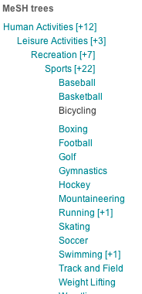
Controlled vocabulary
standardised subject terms assigned by indexers
      e.g. Medline = MeSH, Embase = EMTREE
      identifies relevant articles even if different terms are used for the same concept
      ‘explode’ to include all narrower terms
      caution – indexers may not be subject experts, and authors may not describe their study very well
check the terms applied to relevant papers for ideas
use database tools to map words to subject terms
controlled vocabulary must be translated for each database
MeSH Tree for ‘Bicycling’ www.thecochranelibrary.com
Notes:
In addition to searching for words and phrases in the text, you should also use the controlled vocabulary of the database. Each database has its own system of terms – usually organised in a tree structure from very broad terms down to increasingly specific terms.
A database will use the same set of vocabulary no matter which interface or service provider you use – for example, the controlled vocabulary system for MEDLINE is called MeSH, for Medical Subject Headings, and you will use the MeSH headings no matter whether you use PubMed, Ovid or another service provider.
ASK: Who has seen MeSH terms used in PubMed?
Controlled vocabulary terms are not perfect – which is why we use them in combination with text words, but they are useful for finding relevant papers even where the specific terms we thought of are not used.
Most databases will suggest controlled vocabulary terms that match text words if you enter them into a search, but make sure you know the definitions of the terms suggested, as they may not be what you expect. Also, think carefully about the suggested terms – is there a more specific term that would be better? Do you need to search a number of specific terms, or a whole branch of the tree? When using controlled vocabulary, the term ‘explode’ is used to mean using a heading and all its children. So, for example, if my review was about all kinds of protective equipment for sports, I could use the MeSH term ‘Sports’, and add the ‘explode’ option – then I would find all records tagged with ‘Sports’, as well as all records tagged with any of the individual terms listed under ‘Sports’ on the tree. Records are usually only tagged with either the higher or lower level term, not both. Depending on the interface, you might have to tick a box or type ‘exp’ into your search strategy to use the explode option.

Slide 27
Study design filters
a set of search terms to limit your results to specific study designs (e.g. RCTs)
research has been done to identify the most sensitive and efficient search terms
select according to:
      database and interface to be searched
      study designs needed for your review
do not use an RCT filter when searching CENTRAL
Notes:
While you’re thinking of all the possible ways to describe your main concepts, such as your population and intervention, you’ll be pleased to know that you don’t have to do the same thing for your study design. Information specialists and other researchers have already done this work for you, and have developed and published sets of search terms, called ‘study design filters’, that are the most effective way to find particular study designs such as RCTs.
All you need to do is select the right set of search terms for the database and interface you are using, and for the study designs you wish to find for your review. See the Handbook for RCT filters, and links to other sources if you need to find other study designs.
Don’t forget, you should not use a study design filter when searching CENTRAL, as CENTRAL has already been filtered to include only randomised and quasi-randomised trials. Another reason you might not use a filter is if your review is very broad, including a wide range of study designs, in which case it may not be helpful to try to include a filter to capture all your designs of interest. If this is the case, ask your Cochrane Information Specialist for advice on how best to proceed.

Slide 28
Cochrane Highly Sensitive Search Strategy
Sensitivity-maximising version, MEDLINE (PubMed)
randomized controlled trial [pt] controlled clinical trial [pt] randomized [tiab] placebo [tiab] drug therapy [sh] randomly [tiab] trial [tiab] groups [tiab] #1 OR #2 OR #3 OR #4 OR #5 OR #6 OR #7 OR #8 animals [mh] NOT humans [mh] #9 NOT #10
Notes:
Here’s an example. The Cochrane HSSS is a search filter, that you can then add to your search strategy. There are several versions available, including versions for Ovid MEDLINE. See the Cochrane Handbook, and get advice from your Cochrane Information Specialist about their preferred version.
This version is for use in PubMed, and is the sensitivity-maximising version.

Slide 29
Boolean operators
bicycle
helmet
bicycle
helmet
OR – to expand search
AND – to narrow search
Notes:
So, we have our major concepts: in this example, our population, our intervention and our study design. We have listed all the different ways we can think of to describe them. How do we bring these concepts together?
There are two main Boolean operators, or words we can use in a search strategy to bring terms together. The first is OR: if we say we want to search for records that contain the word bicycle OR the word helmet, this makes our search broader. It will find any record that has one or the other word. One way to remember this is: “OR is MORE.”
Alternatively, we can use AND. If we say we want to find records that contain bicycle AND helmet, each record found must have both of those words. This narrows down our search.
To bring all our search terms together, we need to use a combination of both AND and OR.

Slide 30
Bringing it all together
Population
bicycl* cycling cyclist* Bicycling/
Intervention
helmet* Head Protective Devices/
Study design
(see Cochrane HSSS)
OR
AND
OR
AND
OR
OR
Notes:
Within each concept, we have a list of alternative terms for the same thing. For our review of bike helmets, we have a group of terms around our population, cyclists, a group of terms around our intervention, helmets, and our filter terms to identify RCTs.
So within our population concept, we want each record to have at least one of the terms listed, e.g. bicycle or cyclist or the MeSH term Bicycling. [CLICK] We use the Boolean operator ‘OR’ to join together our set of synonyms and subject terms – because we only need the record to have at least one of the relevant terms for that concept. Using ‘OR’ to combine terms widens the search, to make sure we don’t miss any relevant records. We do the same for the intervention terms, and within the study design filter (for this we can use the exact terms from the Cochrane HSSS).
Once we grouped together our set of terms for each concept, [CLICK] we join them all together using the Boolean operator ‘AND’ – because we want each record to have every concept, at least one term from every set. Using ‘AND’ narrows the search, excluding the records that don’t have all three of our concepts.

Slide 31

Bringing it all together
Cyclists
Helmets
RCTs
Notes:
What we hope to find are the those records that have the right population, and the right intervention, and the right study design, without missing any – not just those that have one or two of the right concepts, like RCTs about bicycles, or editorials about bike helmets. Those records where all three concepts overlap are the ones that will be relevant to the review, and the ones we want to retrieve.

Slide 32
Sample CENTRAL strategy
bicycl*:ti,ab
cycling:ti,ab
cyclist*:ti,ab
MeSH descriptor Bicycling, this term only
#1 or #2 or #3 or #4
helmet*:ti,ab
MeSH descriptor Head Protective Devices, this term only
#6 or #7
#5 and #8
Cycling
Helmets
Notes:
The final search strategy will look something like this – although in fact, most searches for Cochrane Reviews will be longer than this. This version is designed to be used in CENTRAL. You can see a list of all our terms, grouped by concept, with rows combining the terms using ‘OR’ or ‘AND’. [CLICK] here we have the cycling terms, [CLICK] and here the helmet terms. Row 9 brings together all three concepts using AND.
It’s worth piloting your search strategy to see whether the results it identifies are what you expect. If you’re getting lots of irrelevant results (e.g. studies of radio frequency when looking for mass media interventions), you may be able to modify your terms to improve the precision of the search. BE CAREFUL AND GET ADVICE – it’s easy to accidentally exclude trials you do want.
On the other hand, you might find that you don’t identify very many results. If that’s the case, check that you haven’t made an error in your syntax. It may be that you have added too many concepts to your search, or that you have not thought of enough alternative terms for your concepts.
In this particular case, the real review of this topic found that there were in fact no randomised trials of helmets to prevent head injuries, perhaps due to ethical and practical reasons relating to the use of helmets, particularly by children. [The real review of this topic includes only non-randomised studies, and also includes in its search the additional concept of traffic accidents, which might exclude e.g. papers on the design and manufacture of helmets, or on trials of interventions to increase the use of helmets that don’t look at their impact on injuries]

Slide 33
Sample PubMed strategy
bicycl* [tiab]
cycling [tiab]
cyclist* [tiab]
bicycling [mesh: noexp]
#1 OR #2 OR #3 OR #4
helmet* [tiab]
head protective devices [mesh: noexp]
#6 OR #7
randomized controlled trial [pt]
controlled clinical trial [pt]
randomized [tiab]
placebo [tiab]
drug therapy [sh]
randomly [tiab]
trial [tiab]
groups [tiab]
#9 OR #10 OR #11 OR #12 OR #13 OR #14 OR #15 OR #16
animals [mh] NOT humans [mh]
#17 NOT #18
#5 AND #8 AND #19
Cycling
Helmets
RCTs
Notes:
This version is translated for PubMed. [CLICK] here we have the cycling terms, [CLICK] here the helmet terms, [CLICK] and here we have a study design filter. Row 20 brings together all three concepts using AND.

Slide 34
1. housing/
2. housing for the elderly/
3. public housing/
4. ((renovat$ or repair$) adj3 (home or homes or house or houses or housing)).ti,ab.
5. ((mite or mites or rat or rats or mouse or mice or cockroach$ or vermin or flea or fleas or infest$) adj3 (home or homes or house
or houses or housing)).ti,ab.
6. ((sanitation or sanitary) adj3 (home or homes or house or houses or housing)).ti,ab.
7. ((mold or mould or moldy or mouldy) adj3 (home or homes or house or houses or housing)).ti,ab.
8. ((damp$ or humid$) adj3 (home or homes or house or houses or housing)).ti,ab.
9. (heating adj3 (home or homes or house or houses or housing)).ti,ab.
10. ((retrofit$ or retro fit$) adj3 (home or homes or house or houses or housing)).ti,ab.
11. (ventilation adj3 (home or homes or house or houses or housing)).ti,ab.
12. (insulat$ adj3 (home or homes or house or houses or housing)).ti,ab.
13. (refurbish$ adj3 (home or homes or house or houses or housing)).ti,ab.
14. ((crowd$ or overcrowd$) adj3 (home or homes or house or houses or housing)).ti,ab.
15. (double glaz$ adj3 (home or homes or house or houses or housing)).ti,ab.
16. ((draft$ or draught$) adj3 (home or homes or house or houses or housing)).ti,ab.
17. (allergen$ adj3 (home or homes or house or houses or housing)).ti,ab.
18. Air Pollution, Indoor/
19. indoor air qualit$.ti,ab.
20. (towerblock$ or tower block$).ti,ab.
21. apartment$.ti,ab.
22. (bedsit$ or bed sit$).ti,ab.
23. (highrise$ or high rise$).ti,ab.
24. (multistor$ or multi stor$).ti,ab.
25. (bungalow$ or flats).ti,ab.
26. landlord$.ti,ab.
27. rehous$.ti,ab.
28. (homeowner$ or home owner$ or tenant$ or owner$ occup$).ti,ab.
29. dwellings.ti,ab.
30. squatter$.ti,ab.
31. or/1-30
32. (reduc$ or increas$ or decreas$ or evaluat$ or change$ or changing or intervention$ or grow$).ti,ab.
33. (improv$ or better or worse$ or effect$ or achieve$ or comfort or morale or harmful or impact$ or gain$).ti,ab.
34. 32 or 33
35. ((reduc$ or increas$ or decreas$ or evaluat$ or change$ or changing or intervention$ or grow$ or (improv$ or better or worse$
or effect$ or achieve$ or comfort or morale or harmful or impact$ or gain$)) adj3 housing).ti,ab.
36. 31 and 34
37. 35 or 36
38. homeless$.ti,ab.
39. exp homeless persons/
40. animal housing/
41. or/38-40
42. 37 not 41
43. exp research/
44. exp public policy/
45. exp evaluation studies/
46. exp epidemiologic study characteristics/
47. exp clinical trials/
48. (trial or trials or random$ or controlled or study or studies or intervention$).ti,ab.
49. (program or programs or programme or programmes or research or policy or policies).ti,ab.
50. quasi experimental.ti,ab.
51. longitudinal$.ti,ab.
52. prospective.ti,ab.
53. randomized controlled trial.pt.
54. clinical trial.pt.
55. or/43-54
56. 42 and 55
57. animal/
58. human/
59. 57 not (57 and 58)
60. 56 not 59
Medline search strategy from: Thomson H, Thomas S, Sellstrom E, Petticrew M. Housing improvements for health and associated socio-economic
outcomes. Cochrane Database of Systematic Reviews 2013, Issue 2. Art. No.: CD008657. DOI: 10.1002/14651858.CD008657.pub2.
Notes:
And here is an example of a small to medium length search strategy.
[NOTE TO TRAINERS: Participants are not meant to be able to read this – it is just to show that searches are not simple.]

Slide 35
Limits and restrictions
to avoid bias, do not limit by:
      language - ask your CRG about translation
      year - unless there is a clear point of change or availability
      format - may be additional information about a study in letters, etc.
See Chapter 13 of the Handbook
Notes:
As part of a systematic and sensitive search, we want to avoid excluding any possibly relevant study, regardless of where, when or how it was published. Limiting your search to studies published in English risks introducing bias, as trials with positive results are more likely to be published in the major international journals, which are often published in English. See Chapter 13 of the Handbook for more information on how this kind of reporting or publication bias can affect your review. Don’t forget that even if you don’t add any language limits to your search, if you only search databases that are primarily in English, you will miss much of the non-English literature. Think about including some of the national and regional databases in other languages.
Fortunately, Cochrane is well-placed to assist with translation of any publications you find that are published in a language you can’t read yourself – with tens of thousands of people contributing to the Cochrane work, we have contributors in most countries. A tip for translation – try first requesting assistance in checking the study against your inclusion criteria, before you request further translation of the document.
Restriction by year should be avoided unless there is a clear time period during which relevant studies might be found, for example if the intervention was invented in a particular year.
Remember that important information about studies may be published in letters and commentaries, including information about new studies not published elsewhere. Also, important concerns about previously published studies, such as errors or fraudulent data, may first be published as comments.
[NOTE TO TRAINERS: You can choose to implement the exercise: ‘Selecting Search terms’ at this point. See package specific guidance for more information.]

Slide 36
Session outline
planning the search process
constructing a search strategy
managing and reporting the search

Slide 37
Managing your search results
store results from each source
      download all available fields for each record
      use bibliographic or reference management software
        e.g. EndNote, Mendeley, ProCite, Reference Manager, RefWorks, Zotero
        ask your CIS for help with configuration files and import filters
        additional fields can be used for notes, e.g. source, assessment
collate and de-duplicate
Notes:
When your search is complete, you will have the exported results from each database, often in the form of a text file. Make sure you export as much information as is available. Although you can work directly with the text files if your search is small and manageable, reference management software is a good way to organise your search results. If your Cochrane Information Specialist is running your search, they may send you text files, or reference management software files, or they may even put the references directly into the RevMan file for your review. Ask them for assistance if you’re not sure how to import the file format they have sent into your software.
You can use whichever software package is available and supported at your institution. You can use this kind of software to store the results of your search of each database, including detailed bibliographic information and the abstract for each record if available – make sure you download as much information as you can from the source database.
You can also use the software to bring all your results together, and to identify and remove any duplicate records found in more than one database (e.g. a paper that is indexed in both MEDLINE and Embase – not two separate papers reporting the same study). Note that if your Cochrane Information Specialistis running your search, they may have done this for you already.
Reference management software can be used to store information about the methods and process of a search. For example, unused record fields can be used to store information such as:
- the name of the database or other source details from which a study report was identified;
- when and from where a full text copy of the publication was ordered and the date it is received;
- whether the study is included in or excluded from your review and, if excluded, the reasons for exclusion.
When you’re ready to write the review, you can import references from this software to RevMan, Cochrane’s review production software, without having to enter them all in by hand. At the protocol stage, this can also be helpful for references you’re using in the ‘Background’ and ‘Methods’ sections. See the RevMan Web Knowledge base for more information on importing the references: https://documentation.cochrane.org/revman-kb/studies-and-references

Slide 38
Documenting the search
important to document everything
      to report transparently what you’ve done in your review
      to reproduce or update in future
you need to document
      what (database and interface)
      when (date of search, date limits)
      how (copy and paste exact strategies, limits, set numbers, number of results)
keep copies of everything
      save locally or on paper
      don’t rely on internet bookmarks or saved searches
      save exported text files and reference management databases
  record non-database search activities
Notes:
It is important that your search is well documented at every stage. You will need to report the search in detail in the review, so that your readers can see what has been done to find all the relevant studies. Not only that, but you will yourself need to know what has been done so that you can keep track of all your results during the review process, and update the search in future.
You’ll need to keep records of what database was searched, using which interface (e.g. Medline (OvidSP) or MEDLINE (PubMed)), the dates on which the search was conducted (including a single date on which the whole search process can be said to be complete – usually the date on which the first source was searched), any date limits set on the search, the search strategies used (best to copy and paste this to avoid errors), and the numbers retrieved.
You can save your search strategies on many databases, but make sure you keep copies of everything locally as well – you never know when a database might be closed down, a website moved or your access rights changed. This applies to search results and individual documents found on the internet.
Finally, don’t forget to record non-database search activities such as contacting experts and reference list searching.

Slide 39
Reporting the search in your review
for your protocol
      Methods: describe your planned sources and limits
      you may also be asked to include at least one detailed (line by line) sample search strategy (e.g. CENTRAL)
for your review
      Dates – date of search
      Abstract – sources, dates, limits
      Methods – detailed description of sources, dates, limits
      Results – number of results found
      Figures – PRISMA flowchart
      Appendix – all detailed (line by line) search strategies
Notes:
To clarify the specifics of what should be reported where in your review:
At the protocol stage, you will need to list all the sources you plan to search, and any limits you plan to use (e.g. to exclude papers published before the invention of a drug). Don’t forget to include all sources, not just electronic databases - including reference and citation checking, web searches and people you plan to contact. You will get feedback from your Cochrane Information Specialist about these plans as part of the protocol publication process.
For some CRGs, you may be required to include one or more full search strategies for electronic databases in the protocol, which can then be translated for use across other databases later on. Don’t forget to consult your Cochrane Information Specialist or health librarian if you’re drafting a search strategy.
For your final review, expect to have to report your search in a high level of detail. You’ll need to report the sources searched (databases and interfaces), dates and limits, and the numbers found from each source, ideally in the form of a PRISMA flowchart, based on the PRISMA guidelines for good reporting of systematic reviews. We’ll look at the flowchart in more detail in the separate presentation on Selecting studies. In an Appendix you’ll need to include the full search strategies for every electronic database, including set numbers of each row. This will need to be summarised in the Abstract. There’s also a section in the review called Dates – you’ll need to record a single date for the search, which is usually the earliest date on which one of your sources was searched. This date isn’t published, but is used to help identify whether the review is up to date.

Slide 40
Updating your search
writing a review can take some time
you may need to update your search before completing the review
      rerun search if more than 12 months old
      screen for eligible studies and, if feasible, incorporate results
a well-documented search will make this easier
check for changes to databases and terms before searching (ask your Cochrane Information Specialist or health librarian)
Notes:
You may need to revisit your search before the review is complete. Although the search is usually the first thing you do after the protocol is published, it can take a long time to complete a review. If your search gets more than 12 months out of date before the review is published, you will need to update it before submitting the review for publication – and best practice is to do this if your search is more than 6 months old, if you can.
If you have updated your search, you should screen through the results and identify any potentially eligible studies. Ideally, the results of eligible studies should be fully incorporated into the review before publication. This aim should be balanced against the potential delay in publication – if it would result in an extended an unreasonable delay, then at the very minimum you should list the potentially eligible studies under ‘Studies awaiting classification’ or ‘Ongoing studies’ in the references of the review.
Whenever you update a search, you’ll need to make sure you begin exactly where you left the previous search, and that you revisit every source (not just the electronic databases). Having good documentation will help you with this. If you do not revisit every source you originally searched, you will need to report this with your justifications.
It’s important to note that sometimes there can be changes in the electronic databases over time – controlled vocabularies and definitions change, and sometimes the search syntax can also change. Check with your Cochrane Information Specialist or health librarian to make sure there haven’t been any changes that could affect your updated search.

Slide 41
Take home message
work closely with your Cochrane Information Specialist from the start
plan a systematic search, balancing sensitivity and efficiency
start with CENTRAL, your CRG’s Specialised Register, MEDLINE and Embase, trials registers, then consider other appropriate sources
think about the key concepts of your question, and how they might be described
search strategy must be translated for every database and interface
set up a system to manage your results and keep careful records

Slide 42
References
Lefebvre C, Glanville J, Briscoe S, Littlewood A, Marshall C, Metzendorf M-I, Noel-Storr A, Rader T, Shokraneh F, Thomas J, Wieland LS. Chapter 4: Searching for and selecting studies. In: Higgins JPT, Thomas J, Chandler J, Cumpston M, Li T, Page MJ, Welch VA (editors). Cochrane Handbook for Systematic Reviews of Interventions version 6.1 (updated September 2020). Cochrane, 2020. Available from www.training.cochrane.org/handbook.
Acknowledgements
Compiled by Miranda Cumpston and Carol Lefebvre
Based on materials by the UK Cochrane Centre, Cochrane Australia, Cochrane Information Retrieval Methods Group, Cochrane Canada and Cochrane Netherlands
Approved by the Convenors of Cochrane Methods Groups

