Slide 1
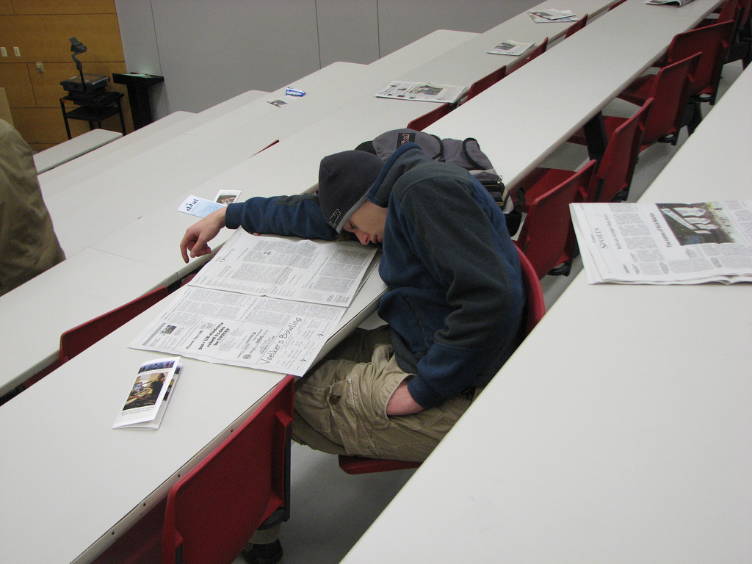
Feeling sleepy? Attention lagging?
Sleeping kid in NSC by rofltosh www.flickr.com/photos/21131327@N00/2100763009
Maybe you need…

Slide 2
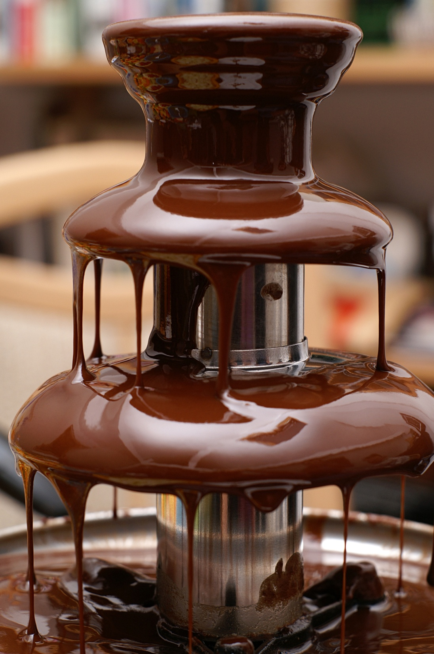
Small Chocolate Fountain by Alexander Klink http://commons.wikimedia.org/wiki/File:Small_Chocolate_Fountain.JPG

Slide 3
CHOC-ATT Trial
Does CHOColate improve ATTention during workshops and reduce sleepiness?

