Slide 1
Reporting the review

Slide 2

Session outline
Where we are starting from
‘Summary of findings’ table
Writing up your results
Discussing the evidence and drawing conclusions
Abstract and Plain language summary
See Chapter III and 14 of the Handbook
Notes:
Clear reporting of a systematic review allows readers to evaluate the rigour of the methods applied, and to interpret the findings appropriately.
In this session we will talk about writing a report of your systematic review. We will consider our starting point for the write up, then move on to explain ‘Summary of findings’ tables as the basis for writing up your review. The main sections that we’ll cover are ‘Results’, ‘Discussion’, ‘Authors conclusion’ and summary version of the review.

Slide 3
Where we are starting from
Write your review based on your protocol
Review questions & primary objectives – starting point
Background – only minor revisions needed
Methods:
Update information (e.g. dates of searches)
Adjust verb tense (future to past)
Describe and justify any changes to the planned methods
Results (incl. GRADE assessment) prepared
Write up: bringing all the elements together!
Notes:
Once you have completed the process of collecting, analysing, and interpreting the evidence in your review, your final task is to write the complete review.
At this point, it’s time to consider the structure of your write up.
At the protocol stage, you defined your review questions and the primary objectives in the PICO format. It’s important that you remember where you started from – those are the questions that you need to answer in the write up of your review.
The ‘Background’ section provides a context for your review question and objectives. You’ve already completed it at the protocol stage. You may now wish to revisit it to make any minor revisions or include updated references.
In the ‘Methods’ section of your protocol, you’ve already defined your eligibility criteria and described how you will conduct your review. You may wish to update some information (e.g. dates on which your sources were searched) and change the writing from from future tense (e.g., ‘we will search’) to past tense (e.g., ‘we searched’). If there were any changes to the methods planned in your protocol - including methods that were planned but not used, and new methods that were added – you should clearly describe them and provide reasons why the changes were necessary.
The ‘Results’ section will consist of your search results, included and excluded studies, the risk of bias assessment, forest plots and other data tables or figures. You will also have considered your results carefully to complete the GRADE assessment of the certainty of evidence, which is crucial for the interpretation of your review findings.
And now it’s time to bring all the elements together and write up the rest of the review.
[NOTE FOR TRAINERS: You may choose to show the ‘Review structure’ animation at this point: https://youtu.be/JcfTEDF0lvo]

Slide 4
‘Summary of findings’ table
Useful table to organise, summarise and present important findings from your review
Presents the results of the most important comparison(s) of your review and the evidence for important outcomes
Created in GRADEpro and imported in RevMan
Can be the basis for writing up the review
Notes:
‘Summary of findings’ tables, published with all Cochrane Reviews, are useful tables to organise, summarise and present the results for your important outcomes, along with their GRADE assessments.
‘Summary of findings’ tables can be created in GRADEpro, which is a free online software integrated with RevMan (Cochrane’s main review production tool).
[NOTE FOR TRAINERS: You may wish to point the learners to a webinar recording on how to create ‘Summary of findings’ tables in GRADEpro software: https://training.cochrane.org/resource/GRADE-CLL]
‘Summary of findings’ tables can be used as a basis for writing up the review.

Slide 5

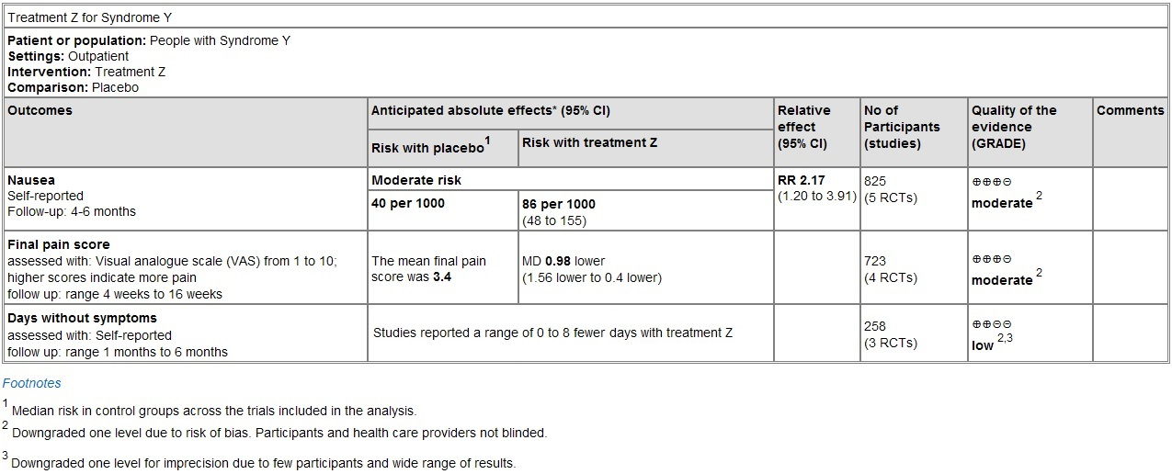
‘Summary of findings’ table
Outcomes (up to 7)
No. of participants and studies
Context
Certainty of evidence (GRADE)
What happened to people without treatment
What happened to people taking the treatment
Outcomes description
Relative effect
Comments
Footnotes – typically explanations of GRADE assessment
Notes:
What is a ‘Summary of findings’ table? Let’s review all the elements of a ‘Summary of findings’ table.
[CLICK] On top, there is the name of the comparsion, with a description of patient or population, settings, intervention and comparison. Most tablew will present the results for one comparison.
For example, your review could contain intervention X compared to placebo, X compared to intervention Y and X compared to intervention Z. You should include the comparison or comparisons that users will find most relevant. You can create more than one ‘Summary of findings’ table, but you should select one to be your main table. The decision about the most important comparison should be made a priori at the protocol stage, and not based on how much data is found in the review.
If your review contains a large number of comparisons, it would be worth focussing on a few important ones.
[CLICK] The first column lists up to seven important outcomes. These outcomes should include all the primary outcomes of the review, measured in the most important time point, as defined in the protocol. For a balanced summary of effects of interventions, you should present both benefits and harms. If you searched for an outcome but were not able to find data, you should report this in the table.
Outcomes can be dichotomous or continuous. [CLICK] You should always provide details about the outcome.
[CLICK] The table shows the number of studies and participants that contributed data to the analysis for each outcome,
[CLICK] the relative effect (if available),
and the absolute effects. [CLICK] This should include the baseline risk or control group risk, showing what happened to people without treatment. [CLICK] It should also include calculated risk based on the relative effect, showing what happened to people taking the treatment.
[CLICK] In this column, the table presents the certainty of the evidence (using GRADE assessment).
[CLICK] Footnotes or explanations are used to explain decisions made in the GRADE assessment. The source of the baseline or assumed risk is also provided in the footnotes.
[CLICK] Finally, a comments column can be used for additional explanations or information. For example, here you could summarize additional results from the studies not included in the meta-analysis for this outcome. You can use it to show the original pooled standardized mean difference (SMD) if you’ve converted it and presented as a mean difference. You can provide information about differences that are important to patients, which will help readers in interpreting the results. Or you can include a narrative statement about the effect, for example ‘treatment Z likely increases nausea’ – we will talk more about how to make those statements later.

Slide 6
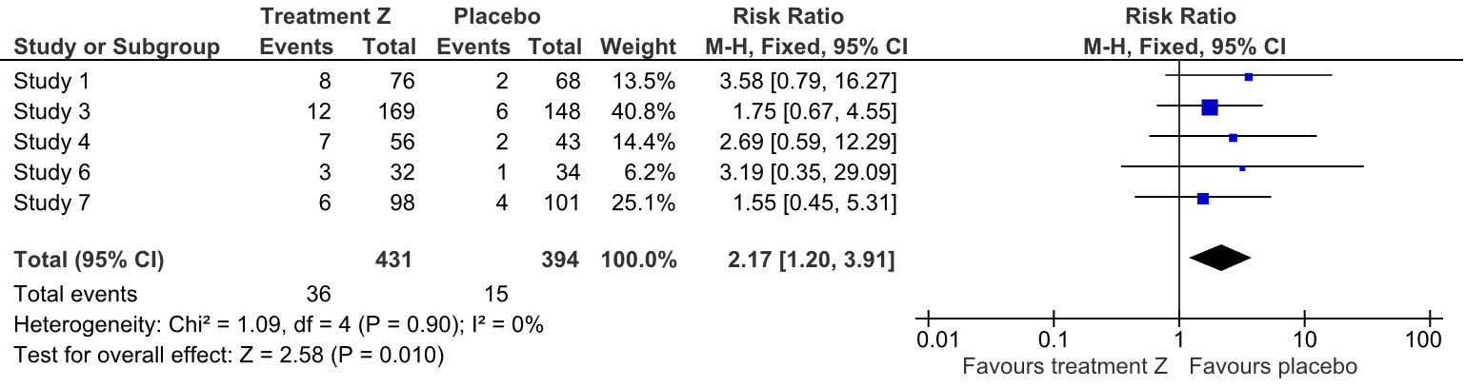
From meta-analysis to a ‘Summary of findings’ table: dichotomous outcomes
What does the RR of 2.17 (95%CI 1.20 to 3.91) mean?
Notes:
Now, let’s see where the information you put in the ‘Summary of findings’ table comes from. The process typically starts from a meta-analysis result.
This is an example of a fictitious review exploring the effect of Treatment Z compared to placebo for Syndrome Y on an outcome - nausea (adverse effect). Five studies have been included in the meta-analysis and the calculated risk ratio is 2.17 (95%CI 1.20 to 3.91).
[NOTE FOR TRAINERS: ASK: What does the RR of 2.17 (95%CI 1.20 to 3.91) mean? Let the participants suggest an answer. The correct answer is: ‘The risk of nausea with treatment Z is 2.17 times the risk when taking placebo and the effect could be as little as 1.2 times and as big as 3.91 times.
If your learners have access to Cochrane Interactive Learning, you can point them to Module 7: Interpreting the findings for more information about interpreting effects and assessing the certainty of evidence.]

Slide 7
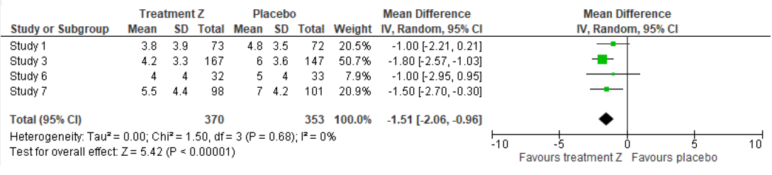
From meta-analysis to a ‘Summary of findings’ table: continuous outcomes
What does the Mean Difference of -1.51 (95%CI -2.06 to -0.96) mean?
Notes:
This is a continuous outcome – final pain score on a VAS scale from 1 to 10 - for the same fictitious review.
[NOTE FOR TRAINERS: ASK: What does a Mean Difference of -1.51 (95%CI -2.06 to -0.96) mean? Let the participants suggest an answer. The correct answer is: ‘The pain may be reduced by 1.51 points on a scale from 1 to 10 (worse) when taking treatment Z than when taking placebo. The reduction could be as big as 2.06 points or as little as 0.96 points.]

Slide 8
A side note: Caution when interpreting effects!
‘Not statistically significant’ does not equal ‘no effect’
Don’t describe results as ‘not statistically significant’ or ‘non-significant’
Notes:
Before we move on, let’s pause to review an important point.
This example is from the review ‘Heparin versus placebo in patient with cancer’, outcome minor bleeding. The risk is 1.34 (95% 0.84 to 2.14). The P-value is 0.19.
[NOTE FOR TRAINERS: ASK: Is there a statistically significant different between heparin and placebo? ANSWER: No. ASK: Can we say there is no effect of heparin on minor bleeding? ANSWER: No!]
Remember that ‘not statistically significant’ does not equal ‘no effect’. It is wrong to claim that inconclusive results (when there is a wide confidence interval that includes potentially important benefits or harms) shows that an intervention has had ‘no effect’. ‘Statistical significance’ should not be confused with whether there is an effect, or the size or importance of an effect.
Because P-values and statistical significance are so commonly misinterpreted, review authors are advised not to describe results as ‘not statistically significant’ or ‘non-significant’.
[NOTE FOR TRAINERS: You can choose to show the animation: ‘Interpreting the results of meta-analysis: Evidence of no effect?: https://youtu.be/Hug0yDJ8VOA]

Slide 9
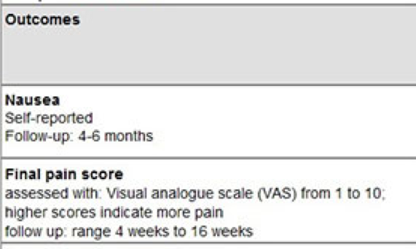
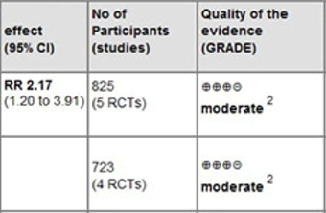

From meta-analysis to a ‘Summary of findings’ table
Notes:
Now, back to our fictitous review of Treatment Z vs placebo for Syndrome Y.
It might be helpful to put the results of meta-analyses in a table.
But we know that people have difficulties really understanding effect measures such as RR and MD.

Slide 10
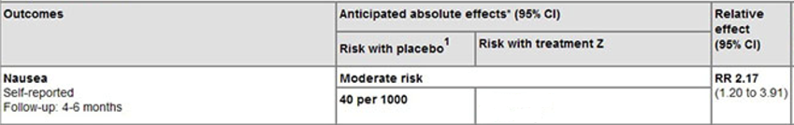

From meta-analysis to a ‘Summary of findings’ table
Notes:
So, it’s useful to present the results as absolute effects.
Let’s assume we know that 40 out of 1000 people will have nausea without treatment (or when receiving placebo) - we’ll talk about where this number comes from a bit later. How many people out of 1000 would have nausea if they took treatment? Remember we also know that the risk of nausea is 2.17 times higher if they take treatment than if they do not take it.
[NOTE FOR TRAINERS: Ask participants to discuss in pairs and calculate the risk with treatment Z. Let them volunteer their answers, then you confirm the correct answer and how to calculate it (RR values times 40).]

Slide 11
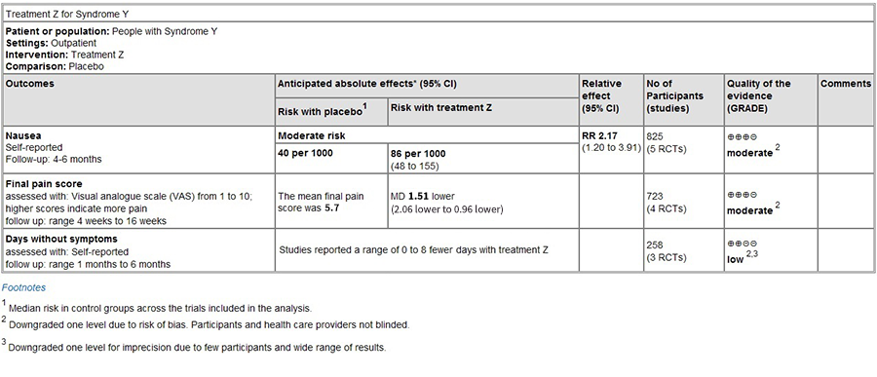
From meta-analysis to a ‘Summary of findings’ table
Notes:
We also try to explain more clearly what happens in the continuous outcome. Here, it’s important to state what was the mean final pain score in the group that didn’t received the treatment (or received placebo) – then the comparison with the score in the treatment group becomes meaningful.
And, importantly, the GRADE assessments indicate how certain we are that there are the true effects.

Slide 12
Assumed risk in the control group
Important for presenting absolute effects in your ‘Summary of findings’ table
This value can come from:
the mean of the risks in the control groups of the included studies,
the control group risk of a representative study, or
a well-conducted, non-randomized study
Notes:
Remember when we calculated how many more people have nausea with treatment Z? We decided that the risk of nausea without treatment was 40 out of 1000. But where did this number come from?
There are three options when you are choosing the risk in the control group:
1. The mean or median of the risks in the control groups of the studies included in your review. A mean is a straightforward option, but it does not include the weighting used in the overall meta-analysis.
2. The control group risk of a representative study. This could be a study you consider to be broadly representative of the population, or a study at low risk of bias. You can select more than one representative study if the population you are interested in may have high or low levels of underlying risk. For example, an older population, or a population with advanced disease, might be more likely to experience the event regardless of their treatment. For dichotomous outcomes, you can present more than one row in the ‘Summary of findings’ table for your outcome, showing different absolute effects for high and low control group risk levels.
3. A risk or prevalence of the outcome from a well-conducted, non-randomized study that establishes a typical population risk level, even if the study is not included in your review.
For continuous outcomes, you could also show the range of control group values. Whatever you decide to choose as the risk in the control group, you should explain your choice in a footnote to the ‘Summary of findings’ table.

Slide 13
Outcomes with no meta-analysiss
Meta analysis may not be possible (e.g. due to limited evidence, incomplete reporting, different effect measures used, or bias in the evidence)
Follow the guidance for how to synthesise and summarise this evidence
Cochrane Handbook Chapter 12)
reporting synthesis without meta-analysis (online learning module)
Plan in advance (protocol)
Use specific format for narrative outcomes in GRADEPro
Notes:
For some outcomes, meta-analysis will not be possible, for example due to limited evidence, incompletely reported outcome/effect estimates, different effect measures used across studies, and bias in the evidence. In such instances you may need to rely on a narrative synthesis, to explain your findings through words.
Even if you have not conducted meta-analysis, you should apply a transparent and systematic way of expressing and synthesizing the results of studies included in your review. Cochrane Handbook Chapter 12 provides guidance on synthesizing and presenting findings using other methods. A self-directed learning module ‘Synthesis without meta-analysis reporting guideline’ is freely available at: https://training.cochrane.org/online-learning/cochrane-methodology/swim-reporting-guideline. You should plan your approach in advance – at the protocol stage.
When making the table in GRADPro software, you can choose a specific format for narrative outcomes. Note that GRADEing of the certainty of evidence should be done even for the narrative outcomes.
[NOTE FOR TRAINERS: For a detailed guidance on how to report the synthesis without meta-analyisis in a systematic review, you can refer the participants to the ‘Synthesis Without Meta-analysis (SwiM) reporting guideline’ online learning module (training.cochrane.org/online-learning/cochrane-methodology/swim-reporting-guideline).]

Slide 14
‘Summary of findings’ table
Notes:
Once you’re completed the ‘Summary of findings’ table, it may be easier to report the results of your synthesis in the text of your review.
It will provide clear information by the outcome, the number of studies and participants, the effect, the absolute effect (in the case of dichotomous outcomes), and the certainty of evidence.
[NOTE FOR TRAINERS: At this point you can share the handout ‘How to avoid common problems in ‘Summary of findings’ tables’ for a future reference.]

Slide 15
Writing up the results
Summary of your search: PRISMA flow diagram
Risk of bias assessment (summarized by outcome)
Findings:
Present the effects of interventions
Avoid any inferences or interpretation
Report all the planned outcomes
Organize the outcomes in a consistent order
Check the consistency of data
Notes:
Here are the sections and the details you will need to cover when writing up your results.
Start by providing a summary of your search process and the 'Risk of bias' assessment, followed by a presentation of your findings.
Your summary of the search process should include the numbers of records found and excluded at each stage, through to the number of studies included in the review. This should all be supported by a PRISMA flow diagram (which we covered in a previous presentation on ‘Selecting studies). Make sure the numbers in your diagram match your text. For some reviews you won't find any studies that meet your eligibility criteria. In that case, you won't need to report further results. You just need to provide a summary of the search process.
After summarizing your ‘Risk of bias’ assessment by outcome, you can move on to presenting the findings of your review.
Your forest plots, and other data tables or figures – including any funnel plots investigating the risk of reporting bias for important outcomes – should be presented and described. You should check them to ensure the meta-analysis settings, scales, and headings are all complete and correct.
‘Results’ section of your review is not the place to make any inferences or interpretations, but to clearly and systematically present all the evidence found to address the objectives of your review. This presentation should include the certainty of evidence for each outcome, as assessed by GRADE.
Make sure you report all the outcomes you planned to include at the protocol stage – including those outcomes for which you were unable to find any evidence.
For ease of use by your readers, it is helpful to present the outcomes in the same order throughout the review, including the methods, results, figures, and summary formats. First, group the outcomes by comparison – for example, results from studies comparing exercise interventions with no intervention, followed by results from studies comparing two different exercise interventions. Within each comparison you should present the primary outcomes, followed by the secondary outcomes.
Make sure to double-check that the statistical results you present in the text of the review are consistent with the results in the forest plots and results tables, and the ‘Summary of findings’ tables.
[NOTE FOR TRAINERS: If you have enough time for the session, you can share the handout ‘Tips for writing up the results of the review’ and do the exercise ‘Presenting Effects of intervention’ (see additional materials)]

Slide 16
Writing up a discussion
Summary of main results
Overall completeness and applicability of evidence
Certainty of the evidence
Potential biases in the review process
your thresholds for inclusion of studies
your search (e.g. non-English studies)
contacting authors
Agreements and disagreements with other studies or reviews
Notes:
In a Cochrane Review, the ‘Discussion’ section consists of five subheadings, which provide a helpful structure to think through the key areas to be considered.
First, you should summarize the main findings, taking into account both important benefits and harms, and focus on the most important outcomes as presented in the ‘Summary of findings’ tables. You do not need to repeat detailed numerical data here, but can draw overall conclusions about the effects, including harms of the intervention, in the context of your overall review question. When summarising the results, think about the certainty of the evidence. For example, you shouldn't say that an intervention is effective if the evidence is low or very low certainty.
In ‘Overall completeness and applicability of evidence’ you should describe how well the evidence you have found answers your original review question. These are the same issues that you should already have given some consideration to when assessing the indirectness of evidence using the GRADE approach. In this section, you may also discuss and provide an overall judgement of the external validity of the review, that is, if the results are applicable to other settings.
In ‘Certainty of the evidence’ you should address whether the body of evidence identified in your review allows a robust conclusion regarding the objectives of the review. This is the place to discuss all the domains of your GRADE assessment and the certainty of the evidence supporting your conclusions, including the main reasons why the evidence may have been downgraded or upgraded, consistent with your 'Summary of findings' tables.

Slide 17
Writing up a discussion
Summary of main results
Overall completeness and applicability of evidence
Certainty of the evidence
Potential biases in the review process
your thresholds for inclusion of studies
your search (e.g. non-English studies)
contacting authors
Agreements and disagreements with other studies or reviews
Notes:
‘Potential biases in the review process’ are sometimes a source of confusion. This is not the place to discuss the biases in the included studies, but to reflect on the strengths and limitations of your review process, and the assumptions and decisions you have made as the author. These may be related to your thresholds for inclusion of studies, comprehensiveness of your search, or whether you’ve contacted authors for additional information. You may find it helpful to consult a tool designed for the assessment of reviews, such as ROBIS (http://www.bristol.ac.uk/population-health-sciences/projects/robis/), to identify any risks of bias in your review process.
Finally, you should discuss the agreements and disagreements of your review with other studies or reviews. If there are other relevant reviews, you should compare their findings with yours, point out the agreements, and try to explain disagreements. If there are no relevant reviews, you may note key individual studies, but be careful not to put too much emphasis on the results of single studies instead, for example non-randomized studies excluded from your review.

Slide 18

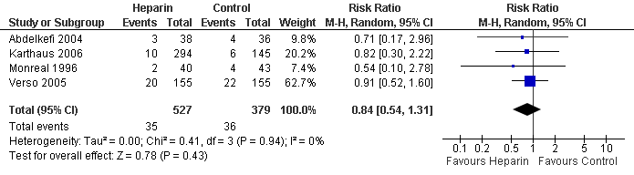

Summary of main results: Avoid positive spin and framing of conclusions
The effect of heparin on the risk of cancer is promising!
There is no difference in side effects.
Notes:
A thing to avoid in writing conclusions is positive spin and framing of conclusions.
[CLICK] Imagine you give someone the exact same meta-analysis but told them it was a result for the effect of heparin on the risk of cancer. That person might say [CLICK]: ‘The effect of the heparin on the risk of cancer is promising’.
[CLICK] But show a person the same meta-analysis but say it’s for side effects. [CLICK] They might interpret it as ‘no difference’.
It is important to avoid this type of framing when presenting results and drawing conclusions. Instead use standard narrative statements [see next slide]

Slide 19
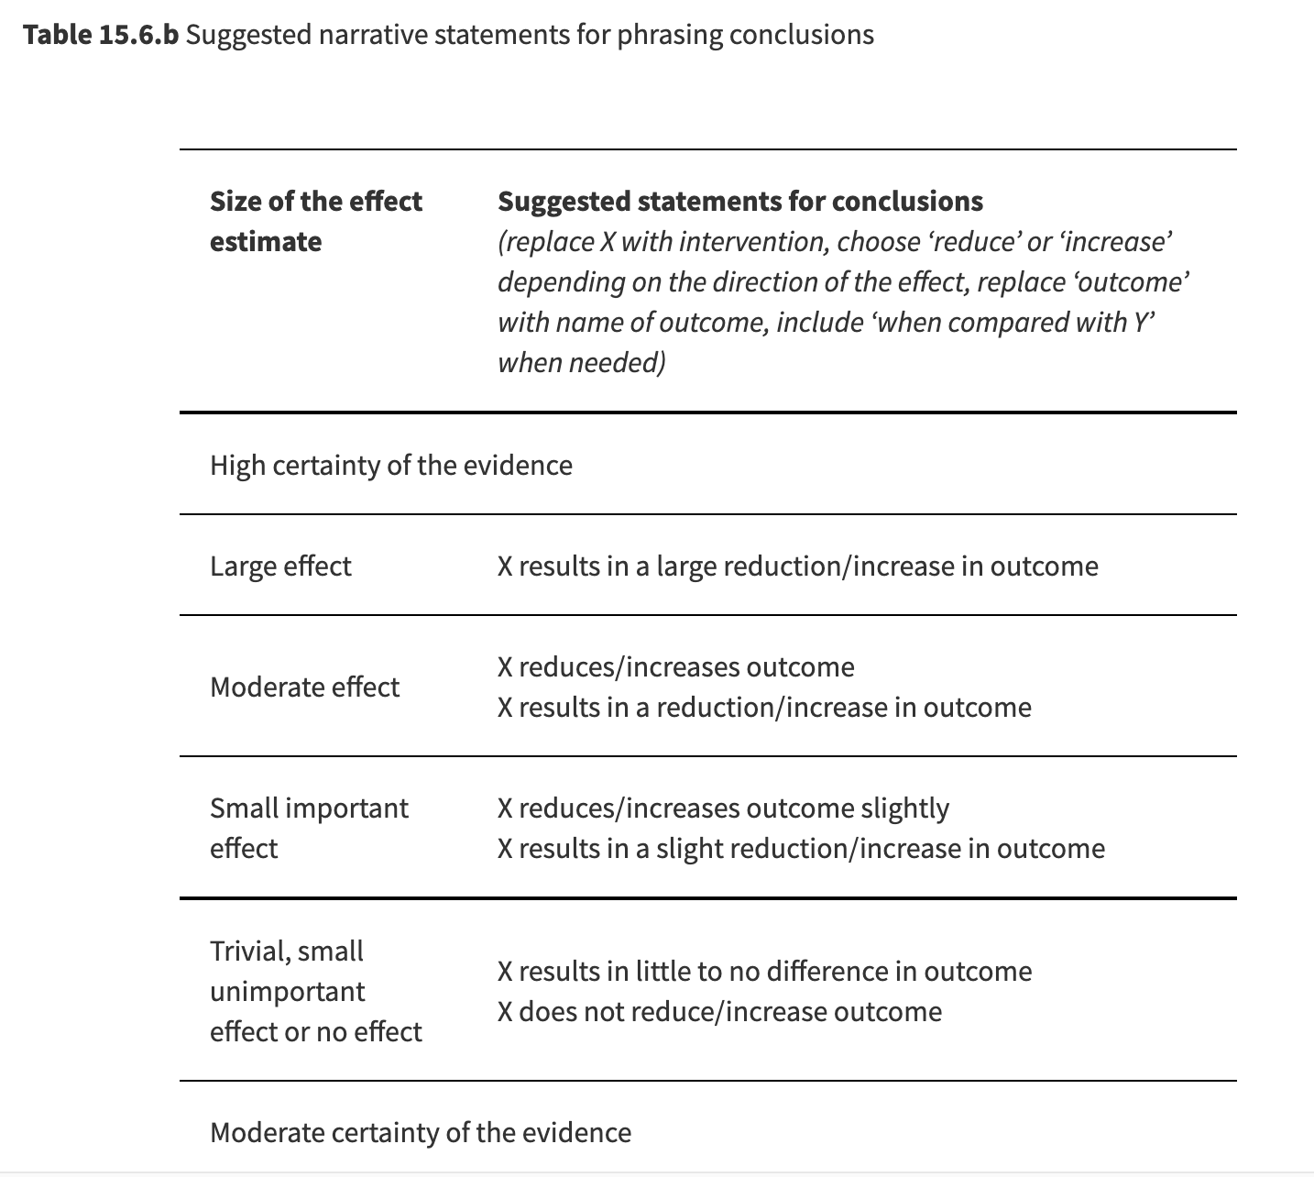
Summary of main results: Use narrative statements to write conclusions
Statements are based on size of the effect and e certainty of the evidence
For example, if the effect is a small but important increase, based on high certainty evidence, you could write: ”the intervention increases the outcome slightly”
Notes:
When writing conclusions, we recommend you use standard statements based on the effect size and the certainty of the evidence.
These statements should be consistently used when reporting the findings of the review, including in the summary versions (which we’ll talk about a bit later).

Slide 20
Narrative statements: example
 | Important benefit or harm | Less important benefit or harm | No important benefit or harm or null effect
High certainty | increases/ decreases | increases/ decreases slightly | little to no difference
Moderate certainty | probably increases/ decreases | probably increases/ decreases slightly | probably little to no difference
Low certainty | may increase/ decrease | may increase/ decrease slightly | may make little to no difference
Very low certainty | We are uncertain whether intervention increases/ decreases outcome
Notes:
Here’s an example from the previously cited Cochrane Review on hip protectors for preventing hip fractures in older people.
[NOTE FOR TRAINERS: Ask the learners to read the excerpt from the Results section of the review, then to discuss in pairs and suggest a statement to use when writing conclusions, based on this table. Then reveal the answer.]

Slide 21
“no evidence of effect”
Beware: ‘No evidence of effect’ vs ‘evidence of no effect’
Results
Combining the results of six randomised clinical trials including 710 patients with chronic alcoholic liver disease demonstrated no significant effects of propylthiouracil versus placebo on all-cause mortality (relative risks (RR) 0.93, 95% confidence interval (CI) 0.66 to 1.30), liver-related mortality (RR 0.80, 95% CI 0.50 to 1.29), complications of the liver disease, or liver histology.
Authors' conclusions
..... there is no evidence for an effect on mortality....
DO NOT USE
versus “evidence of no effect”
Notes:
Another thing to avoid is the confusion between ‘no evidence of effect’ and ‘evidence of no effect’.
Here’s an example where there is a lot of evidence but authors conclude there is ‘no evidence’.
[NOTE FOR TRAINERS: You can share the handout ‘Interpreting statistical significance’ at this point.]

Slide 22
Instead, use GRADE levels of evidence
‘There is low certainty evidence for little to no difference in mortality when people with chronic alcoholic liver disease take propylthiouracil.’
Notes:
This is how you could use GRADE assessment to draw a conclusion based on the previous results.

Slide 23

Implications for practice
Avoid recommendations!
Instead, describe the pros and cons that patients and clinicians may need to consider when making a decision
“Based on the results from this review and our clinical experience, patients at our hospital are recommended a diet high in fruit and vegetables, increased intake of fiber, low in saturated fat, and calorie restriction for patient over their ideal body weight.”
“Patients with a high preference for a potential survival prolongation, limited aversion to potential bleeding, and who do not consider heparin (both UFH or LMWH) therapy a burden may opt to use heparin, while those with aversion to bleeding may not.”
✗
Notes:
Remember: stand-alone systematic reviews may be read and used by people all over the world. It is not possible to give recommendations that would be appropriate in every context and take into consideration other important factors such as cost, accessibility or feasibility.
Specific recommendations for action should be avoided (and, in fact, are not permitted in Cochrane Reviews).
See the two examples:

Slide 24
Implications for research
Be explicit and specific about the need for future research – you know the state of the literature now
Use your GRADE assessments to inform what research should be done
High risk of bias | Identify how studies could be improved
Indirectness or inconsistency concerns | Indicate what populations, interventions, comparisons, or outcomes should be included or changed
Serious imprecision | More studies or studies with larger sample sizes
Publication bias detected | Call for transparent and greater publication of results
Notes:
After considering the evidence you have found, you should give explicit and specific recommendations on what research is needed to fill the gaps in knowledge. Be explicit here – don’t’ just say “More research is needed”, but give specific recommendations for what questions need to be answered.
Your GRADE assessment for each outcome can be helpful.
For example, it may be that more evidence is needed on the effects in particular populations, or with different variations of the intervention. Perhaps the comparisons in the existing studies are not optimal, for example head to head comparisons of drugs are often missing. Or the outcomes of interest were measured in many different ways, so more standardised outcomes would assist analysis across studies.
[NOTE FOR TRAINERS: ASK: Do these considerations remind you of something? Which framework they actually reflect?
ANSWER: PICO – patient/population, intervention, comparison, outcomes. This may be a useful framework to use when thinking about the implications of your review findings for future research.]
If studies were at high risk of bias for specific domains then methods of conducting future research may be improved. For example, if blinding was not done in most studies, indicate that blinding should be done or provide other ways that bias due to lack of blinding could be overcome (e.g., objective outcome assessment).
Finally, better reporting may be required in future research to facilitate the data extraction and analysis in the updates of your review. If this is the case, be specific about what could be better in study reports.

Slide 25
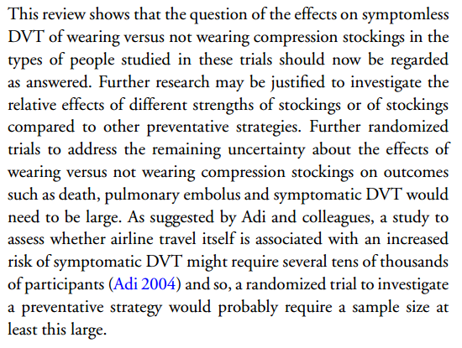
Implications for future research: example
Clarke MJ, Hopewell S, Juszczak E, Eisinga A, Kjeldstrøm M. Compression stockings for preventing deep vein thrombosis in airline passengers. Cochrane Database of Systematic Reviews 2006, Issue 2. Art. No.: CD004002.
Notes:
Here’s an example of the implications for research, from a review of compression stockings to prevent blood clots in long-distance airline passengers. Note that the authors have been very specific about the types of studies that would be useful in future. They have stated that no further studies of the kind found in the review are needed, as the answer to whether compression stockings are effective or not to prevent symptomless deep vein thromboses (DVTs) has been found. They note that although further studies might be useful to gain information on more serious, but rarer, outcomes such as death and pulmonary embolus, these studies might need to be extremely large, running to several tens of thousands of participants in order to gain enough information.

Slide 26
Summary versions of your review
‘Summary of findings’ tables
Abstract
Plain language summary (PLS)
Consistency is essential!
Avoid any information or conclusions not supported by the review
Avoid focusing on only some of the findings (e.g. significant results)
Comment on certainty of evidence
Notes:
A number of summary versions are commonly presented alongside reviews, or may be developed by others to accompany published reviews.
Standard summary versions in Cochrane Reviews are 'Summary of findings' tables, the abstract, and the Plain language summary (PLS). 'Summary of findings' tables should actually be the starting point – all outcomes listed in the abstract and the PLS should be consistent with the findings and the strength of evidence presented in the main 'Summary of findings' table.
Consistency is essential, even where the language used to summarise this information might vary. Your summaries should never include information or conclusions that are not supported by the review, or give a misleading message by focusing on only some of your findings such as those that found significant results, or those that could be synthesised in a meta-analysis.
Don’t forget to comment on the certainty of the evidence – your readers should not be left to make sense of the results without knowing how strong the evidence base is.

Slide 27
Writing an abstract
Format similar to abstracts of scientific papers
Organised under subheadings:
Background
Objectives
Search methods
Selection criteria
Data collection
Main results
Authors’ conclusions
Make sure it’s brief, accurate, complete and stands on its own
Avoid jargon and abbreviations
Notes:
You may already be familiar with writing abstracts for scientific papers. The format of a Cochrane Review abstract is very similar.
The content of an abstract is organised under subheadings. This helps to ensure that the abstract contains complete but brief information that mirrors the main review.
Where readers don't have access to the full text, they will only be able to read your summary, so make sure it's accurate, complete, and stands on its own to communicate your message in a way that's consistent with the full review. That's why, for example, abstracts shouldn't contain hyperlinks to any other part of the review.
Although you’re trying to be brief (preferably less than 700 and no more than 1,000 words), you can improve communication by avoiding jargon and abbreviations, and by using language that will make sense to a general audience. The abstracts are read not only by researchers, but also by decision makers of various kinds: health professionals, policy makers, and consumers, so keep this in mind when writing.
[NOTE FOR TRAINERS: You can share the handout ‘Cochrane Review Abstract sections with explanations’ at this point.]

Slide 28
Plain language summary
For anyone who needs brief, accurate and easy-to-read information to help them make a healthcare decision (e.g. consumers)
Uses simpler, conversational-style language
Does not report statistical data such as summary statistics and confidence intervals
Does not follow the set structure of Cochrane abstracts
Shorter (850 words maximum, compared to 1000 words for abstracts)
Does not feature on PubMed
Notes:
The second summary format used in Cochrane Reviews is the Plain language summary (PLS), aimed at anyone who needs brief, accurate, easy-to-read information to help them make a healthcare decision. These are often consumers of healthcare. The readers of PLSs might not have any knowledge of systematic reviews, or of the subject matter of the review. They may also not have English as their first language or they may be reading the summary in a language other than English.
Cochrane PLSs differ from Cochrane abstract in that they:
use simpler, conversational-style language;
do not report statistical data such as summary statistics and confidence intervals;
do not follow the set structure of Cochrane abstracts;
are shorter (850 words maximum, compared to 1000 words for abstracts);
do not feature on PubMed.

Slide 29
Writing a Plain language summary
PLS includes:
Title
Section that summarizes the key messages of the review
Brief explanation of the review topic and aims
Brief description of the review methods
Summary of the review results (whatever the strength of the evidence for them)
Summary of the limitations of the evidence
Statement about how current the evidence is
Guidance and a template for writing PLSs available at:
https://training.cochrane.org/pls-template-and-guide-user-testing
Notes:
Plain language summaries are structured to help the readers understand the key messages of the review.
Guidance and a template for writing PLSs has been developed and is currently in the testing phase, available at https://training.cochrane.org/pls-template-and-guide-user-testing.

Slide 30
Take home message
‘Summary of findings’ table – basis for writing up your review
Consider your results alongside the certainty of evidence
Follow the predefined structure for Results and Discussion sections
Avoid recommendations when discussing implications for practice
Be specific when discussing implications for research
Ensure consistency of all the summary versions with the review findings

Slide 31
References
Page MJ, Cumpston M, Chandler J, Lasserson T. Chapter III: Reporting the review.
Schünemann HJ, Higgins JPT, Vist GE, Glasziou P, Akl EA, Skoetz N, Guyatt GH. Chapter 14: Completing ‘Summary of findings’ tables and grading the certainty of the evidence.
In: Higgins JPT, Thomas J, Chandler J, Cumpston M, Li T, Page MJ, Welch VA (editors). Cochrane Handbook for Systematic Reviews of Interventions version 6.2 (updated February 2021). Cochrane, 2021. Available from www.training.cochrane.org/handbook.
Acknowledgements
Compiled by Dario Sambunjak and Nancy Santesso. Content in part based on:
Sambunjak D, Cumpston M, Watts C, Lasserson T, Livingstone N, Santesso N. Module 8: Reporting the review. In: Cochrane Interactive Learning: Conducting an intervention review. Cochrane, 2017. Available from https://training.cochrane.org/interactivelearning/module-8-reporting-review.

