Slide 1
Synthesising and presenting results using other methods
Notes:
This presentation is about methods for presenting results and synthesizing results when it may not be possible to use meta-analysis methods.

Slide 2
Steps in a Cochrane Review
define the question
plan eligibility criteria
plan methods
search for studies
apply eligibility criteria
collect data
assess studies for risk of bias
analyse and present results
interpret results and draw conclusions
improve and update review
Notes:
In terms of the steps in a Cochrane review, the methods presented here fall within step 8 ‘analyse and present results’

Slide 3
Session outline
Introduction
Reasons for not undertaking a meta-analysis of effect estimates
Structured summaries
Acceptable synthesis methods and accompanying visual displays
What to include in the protocol
Take home messages

Slide 4

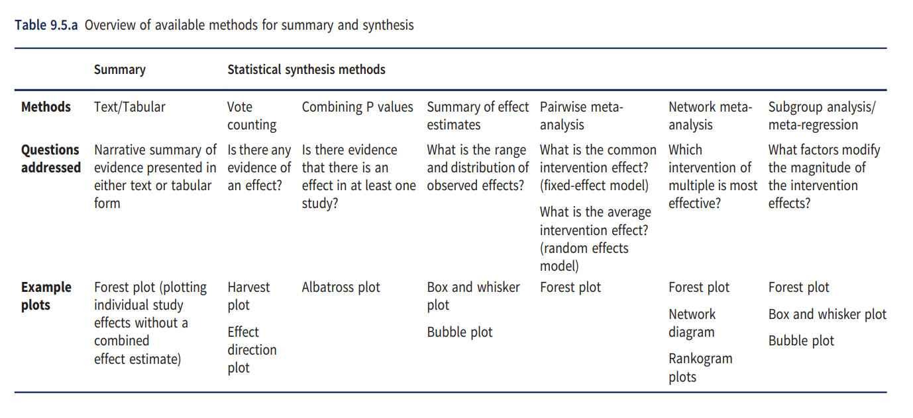
An overview of available methods for summary and synthesis*
Acceptable statistical synthesis methods
Preferred statistical synthesis methods
Structured summary of evidence presented in either text of tabular form
* Table 9.5.a (modified) from Chapter 9, 2019 Cochrane Handbook
Notes:
This table is from Chapter 9 of the Cochrane Handbook for Systematic Reviews of Interventions and provides an overview of presentation, statistical synthesis and display methods. We will refer to this table throughout the presentation.
[CLICK] The preferred statistical synthesis methods, being meta-analysis of effect estimates and its extensions, are covered in other training modules.
[CLICK] In this module, we focus on other acceptable statistical synthesis methods that might be considered when a meta-analysis of effect estimates is not possible.
[CLICK] We also cover approaches to structuring summaries of the evidence that should always be presented alongside any synthesis, and is particularly important in reviews without meta-analysis.
[CLICK] Finally, we will cover visual displays that can be used alongside the different summary and synthesis methods.

Slide 5
Session outline
Introduction
Reasons for not undertaking a meta-analysis of effect estimates
Structured summaries
Acceptable synthesis methods and accompanying visual displays
What to include in the protocol
Take home message

Slide 6
Reasons why meta-analysis of effect estimates may not be possible
Legitimate reasons
1. Limited evidence for a pre-specified comparison (one or no studies)
2. Incompletely reported outcome or effect estimate
3. Different effect measures across studies (e.g. some dichotomize time-to-event, others do not, leading to hazard ratios and risk ratios)
4. Bias in the evidence (missing studies, missing outcomes, or bias in studies)
Commonly cited reasons where meta-analysis should be considered
5. Clinical or methodological diversity (consider modifying comparisons with rationale)
6. Statistical heterogeneity (attempt to reduce or explain; present prediction intervals)
Arguments against using meta-analysis because of too much diversity equally apply to other synthesis approaches.
Notes:
On the left, legitimate reasons are listed for why meta-analysis of effect estimates may not be possible.
Point 1. Meta-analysis is not possible with no studies or only one study. This circumstance may reflect the infancy of research in a particular area.
Points 2-3. It may not be possible to undertake a meta-analysis because of incompletely reported outcomes or effect estimates, or because different effect measures are reported across studies; these are points which we return to in the next slide.
Point 4. There may be concerns about missing studies, or missing outcomes within studies, or bias in the studies. These are legitimate reasons for not undertaking a meta-analysis, and these concerns similarly apply to other synthesis methods.
[CLICK] On the right, are reasons that are commonly cited in the literature for not doing meta-analysis, but where meta-analysis should be considered.
Point 5. In scenarios where there are concerns about clinical or methodological diversity, it may be possible to rectify this by, for example, modifying the comparisons and providing rationale for the change.
Point 6. Where there is concern about the degree of statistical heterogeneity (which might be indicated by a large estimate of between-study heterogeneity), meta-analysis may provide important insights. For example, by using subgroup analysis or meta–regression to identify factors that may explain the heterogeneity.
[CLICK] It is important to note that arguments against using meta-analysis because of too much diversity equally apply to other synthesis approaches. So if you think there's too much diversity in the populations, or too much diversity in the interventions, such that you wouldn't undertake a meta-analysis, then equally you should not use other synthesis methods.
[CLICK] In the slides that follow, we will focus on Points 2 and 3, where the available data is not amendable to meta-analysis of effect estimates.

Slide 7
Scenarios reviewers may encounter
Consider a single study and outcome
Estimate of intervention effect | Variance of the estimate | Direction of effect (benefit or harm) | Statistical significance or P-value | Example of reporting | Can be included in a meta-analysis of effect estimates?
✓ | ✓ | (✓) | (✓) | “The intervention had a small effect on anxiety levels compared with the control (−0.52 (95%CI −1.34 to 0.30); scale 0-21, higher scores indicate greater anxiety).” | Yes
Notes:
Let’s begin by considering the scenarios review authors may encounter when they come to extract data from a single study and outcome.
In the optimal circumstance, an estimate of the intervention effect and its standard error will be reported, or can be calculated from the reported statistics. Recall that an estimate of the intervention effect and its standard error are all that we need to be able to undertake a meta-analysis.
The example provided here is one of complete reporting, where both the effect estimate and its confidence interval are reported. From the confidence interval, we could calculate the standard error, and use this in the meta-analysis. This can be easily done using the calculator in RevMan.
Note also, that when there is complete reporting, we also know the direction of effect – that is, whether it indicates that intervention is beneficial or harmful – and we could calculate a P value. In the table, we indicate with brackets that these statistics can be determined, even if they are not directly reported.

Slide 8
Scenarios reviewers may encounter
Consider a single study and outcome
Estimate of intervention effect | Variance of the estimate | Direction of effect (benefit or harm) | Statistical significance or P-value | Example of reporting | Can be included in a meta-analysis of effect estimates?
✓ | ✓ | (✓) | (✓) | “The intervention had a small effect on anxiety levels compared with the control (−0.52 (95%CI −1.34 to 0.30); scale 0-21, higher scores indicate greater anxiety).” | Yes
✓ |  | (✓) |  | “The intervention reduced anxiety levels by -0.52 compared with the control (scale 0-21, higher scores indicate greater anxiety).” | No
Notes:
Now, let’s consider a second scenario where there is less complete reporting. In this scenario, only the effect estimate may be reported, but without a standard error or the statistics required to calculate the standard error.
In this scenario, because we have an estimate of the intervention effect and information about how the scale operates, we also know the direction of effect.

Slide 9
Scenarios reviewers may encounter
Consider a single study and outcome
Estimate of intervention effect | Variance of the estimate | Direction of effect (benefit or harm) | Statistical significance or P-value | Example of reporting | Can be included in a meta-analysis of effect estimates?
✓ | ✓ | (✓) | (✓) | “The intervention had a small effect on anxiety levels compared with the control (−0.52 (95%CI −1.34 to 0.30); scale 0-21, higher scores indicate greater anxiety).” | Yes
✓ |  | (✓) |  | “The intervention reduced anxiety levels by -0.52 compared with the control (scale 0-21, higher scores indicate greater anxiety).” | No
 |  | ✓ | ✓ | “The intervention reduced anxiety levels, but was not statistically significant.” | No
Notes:
It may be the case that the direction of effect is reported along with the results from a statistical test. The results from the statistical test could be reported as an exact P value or as a statement about statistical significance.
In the example given, no information is reported about the size of the intervention effect; only the direction, and that the estimate of intervention effect was not statistically significant.

Slide 10
Scenarios reviewers may encounter
Consider a single study and outcome
Estimate of intervention effect | Variance of the estimate | Direction of effect (benefit or harm) | Statistical significance or P-value | Example of reporting | Can be included in a meta-analysis of effect estimates?
✓ | ✓ | (✓) | (✓) | “The intervention had a small effect on anxiety levels compared with the control (−0.52 (95%CI −1.34 to 0.30); scale 0-21, higher scores indicate greater anxiety).” | Yes
✓ |  | (✓) |  | “The intervention reduced anxiety levels by -0.52 compared with the control (scale 0-21, higher scores indicate greater anxiety).” | No
 |  | ✓ | ✓ | “The intervention reduced anxiety levels, but was not statistically significant.” | No
 |  | ✓ |  | “The intervention reduced anxiety levels.” | No
Notes:
Finally, it might be the case that the only information reported is about the direction of effect, such as the intervention increased or decreased anxiety levels.

Slide 11
Scenarios reviewers may encounter
Across studies the:
completeness of the reported statistics may vary
effect measures could vary (e.g. mix of SMDs, MDs)
Consider a multiple studies and a single outcome
Study | Estimate of intervention effect | Variance of the estimate | Direction of effect (benefit or harm) | Statistical significance or P-value
Study 1 |  |  | ✓
Study 2 |  |  | ✓ | ✓
Study 3 | ✓ |  | (✓)
Study 4 | ✓ | ✓ | (✓) | (✓)
Study 5 | ✓ | ✓ | (✓) | (✓)
In these circumstances, consideration might be given to using other synthesis methods beyond meta-analysis
Notes:
The completeness of the reported statistics may vary across the studies, as shown in the table.
It may also be the case that even for the same outcome, the effect measures could vary across the studies. For example, in some studies, the same continuous outcome might be dichotomised, and odds ratios might be calculated, while in other studies, the outcome might be treated as continuous, and mean differences might be calculated.
[CLICK] These circumstances can make it difficult to undertake a meta-analysis of effect estimates, and consideration can be given to using the other synthesis, along with methods to display and present the available effects visually. These other methods are the focus of the remainder of this presentation.

Slide 12
Session outline
Introduction
Reasons for not undertaking a meta-analysis of effect estimates
Structured summaries
Acceptable synthesis methods and accompanying visual displays
What to include in the protocol
Take home messages

Slide 13
An overview of available methods for summary and synthesis*
Acceptable statistical synthesis methods
Preferred statistical synthesis methods
Structured summary of evidence presented in either text of tabular form
* Table 9.5.a (modified) from Chapter 9, 2019 Cochrane Handbook
Notes:
Now that we have established the circumstance when we might consider using other statistical synthesis methods, let’s orient ourselves by returning to the overview of available methods for summary and synthesis.
Before we introduce acceptable statistical synthesis methods, we will cover structured summaries.
[CLICK] Structured summaries are important in all systematic reviews, but are particularly so when there is no meta-analysis for a particular synthesis question. Structured summaries typically include text and tabular methods, as well as plots.

Slide 14
Structured summary of effects
Consider ordering studies in text, tables and figures to increase the prominence of the most relevant and trustworthy evidence.
Options include ordering by:
certainty of the evidence (individual studies if no synthesis)
risk of bias, study size or study design characteristics
characteristics that determine how directly a study addresses the review question (e.g. relevance and validity of the outcome measures, time of publication)
Notes:
To create a structured summary, you can order studies in text, tables and figures in such a way to increase the prominence of the most relevant and trustworthy evidence. It’s important to plan in your protocol how you will decide on relevance and trustworthiness of the evidence. Here are some options.

Slide 15
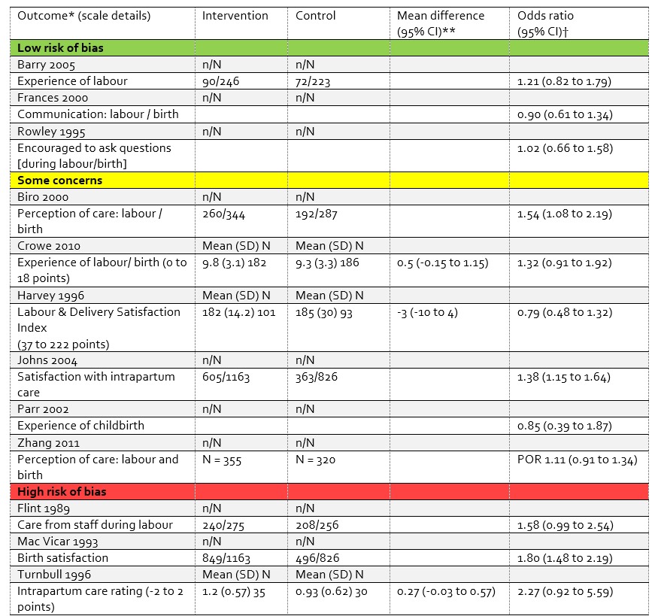
Results ordered by risk of bias to increase prominence of the most ‘trustworthy’ evidence
Calculate a standardized effect metric (measure)
Aids interpretation
Notes:
Let’s see how that would look in practice using the worked example presented in Chapter 12 of the Cochrane Handbook for Systematic Reviews of Interventions. In this example, we are interested in examining the effects of ‘midwife-led continuity models’ [intervention] versus ‘other models of care’ [comparator] on ‘maternal satisfaction with care during the labour and birth period’ [outcome].
Within the table, the studies have been ordered by the overall risk of bias assessment of the results in order to increase the prominence of the most ‘trustworthy’ evidence.
[CLICK] In addition, a standardized effect metric has been calculated. An odds ratio is presented for all of these studies, so that readers can compare and interpret the results more easily than if no effect estimates were calculated – for example, if only summary statistics were presented – or if a mix of effect metrices were reported – for example, mean differences and odds ratios.

Slide 16
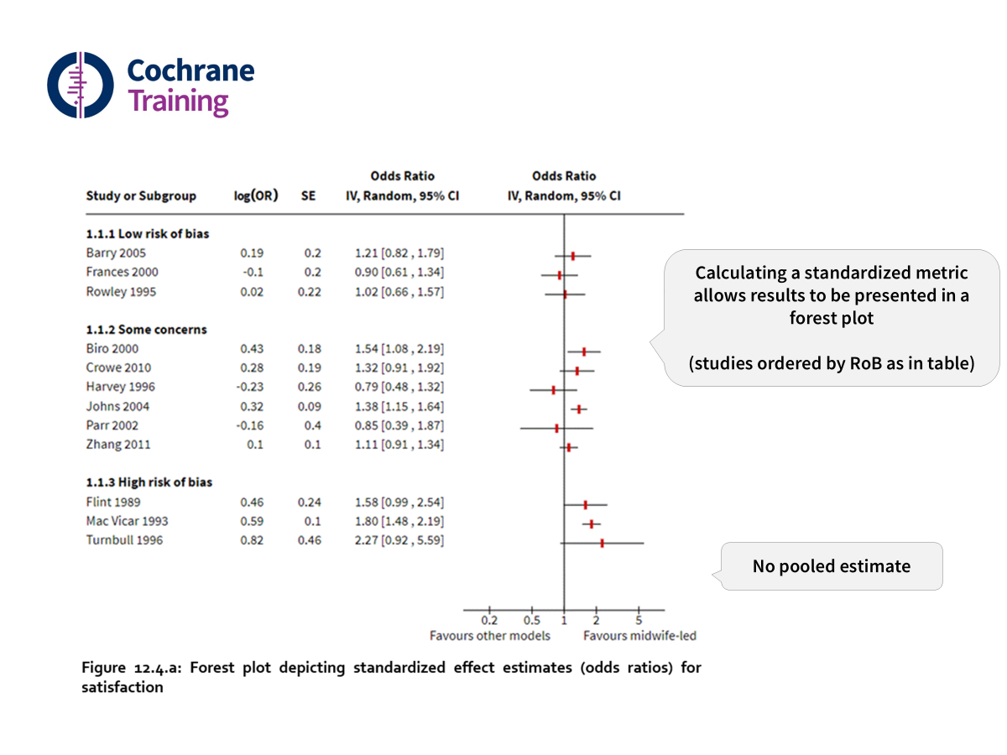
Notes:
Calculating a standard metric also allows results to be presented in a forest plot. Again, the studies are ordered (or grouped) by risk of bias. Note that there’s no pooled estimate on this forest plot, because the decision was made at the outset that the studies will not be pooled together. So, the point of this forest plot is to provide a structured overview of the results from the included studies, rather than a pooled estimate.

Slide 17

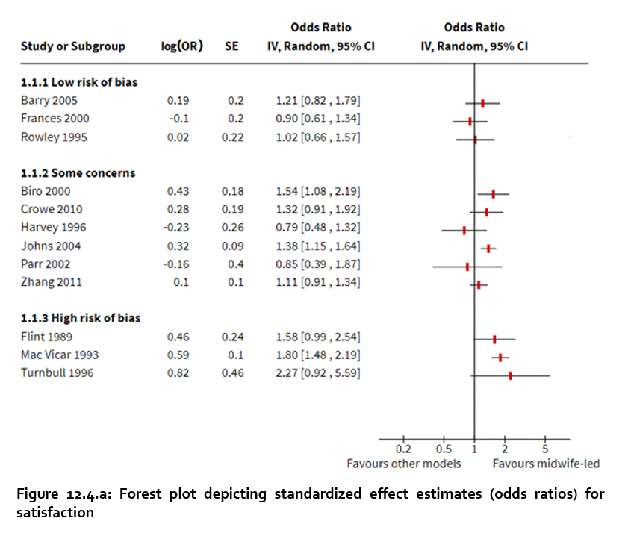
Calculating a standardized metric allows results to be presented in a forest plot
(studies ordered by RoB as in table)
No pooled estimate
Notes:
Now, how should this be described in text? It may be very challenging to write text about the results of individual studies when you need to describe each study in turn. Here is an example how this may be done.

Slide 18
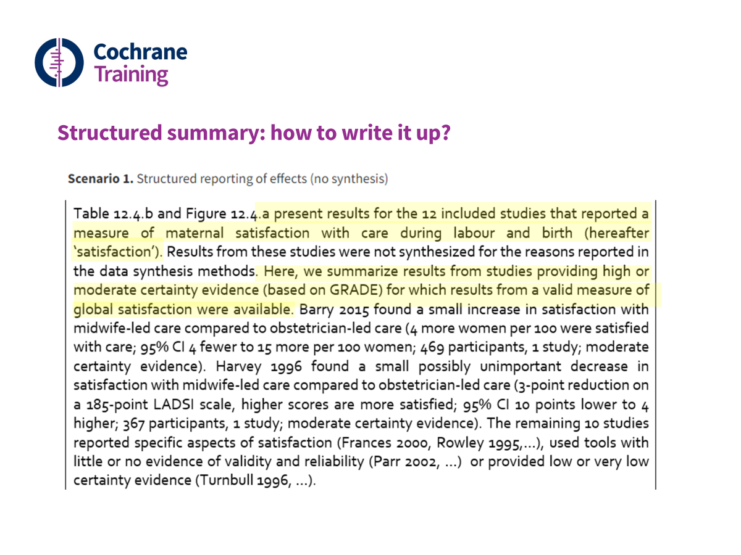
Structured summary: how to write it up?
Notes:
First, the authors state that they are describing the results of only those studies that meet a certain criteria – in this case, the studies providing high or moderate certainty evidence for which results from a valid measure of global satisfaction were available.
[CLICK] First, the authors state that they are describing the results of only those studies that meet a certain criteria – in this case, the studies providing high or moderate certainty evidence for which results from a valid measure of global satisfaction were available.
[CLICK] Then, the authors present the results of each of those studies that meet the criteria. In a way, they are focusing on the most relevant or valid evidence for this purpose. But they haven’t forgotten the rest of the studies.
[CLICK] They only briefly mention the remaining studies by highlighting the resons why they haven’t met the initial criteria of relevance or validity. Some of studies have reported specific aspects of satisfaction, rather than a global satisfaction. Others have used tools with little or no evidence of validity and still others have provided only low or very low certainty evidence. But note that all of them have been presented in the table and the forest plot that we’ve seen in the previous slides. It’s just the text that focuses on the results that we’re most confident in and that are the most relevant to the decision makers.

Slide 19
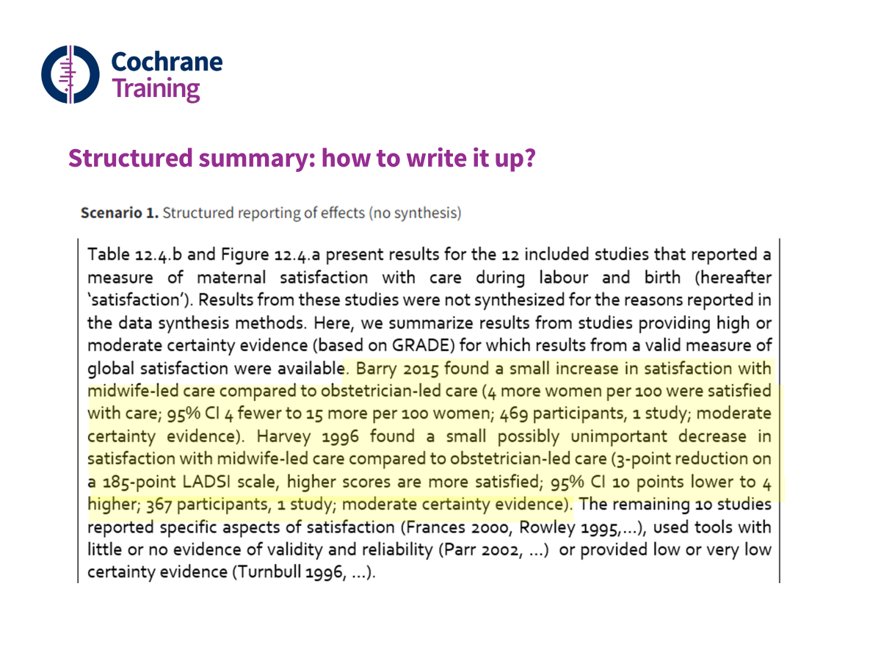
Structured summary: how to write it up?
Notes:
Then, the authors present the results of each of those studies that meet the criteria. In a way, they are focusing on the most relevant or valid evidence for this purpose. But they haven’t forgotten the rest of the studies.

Slide 20
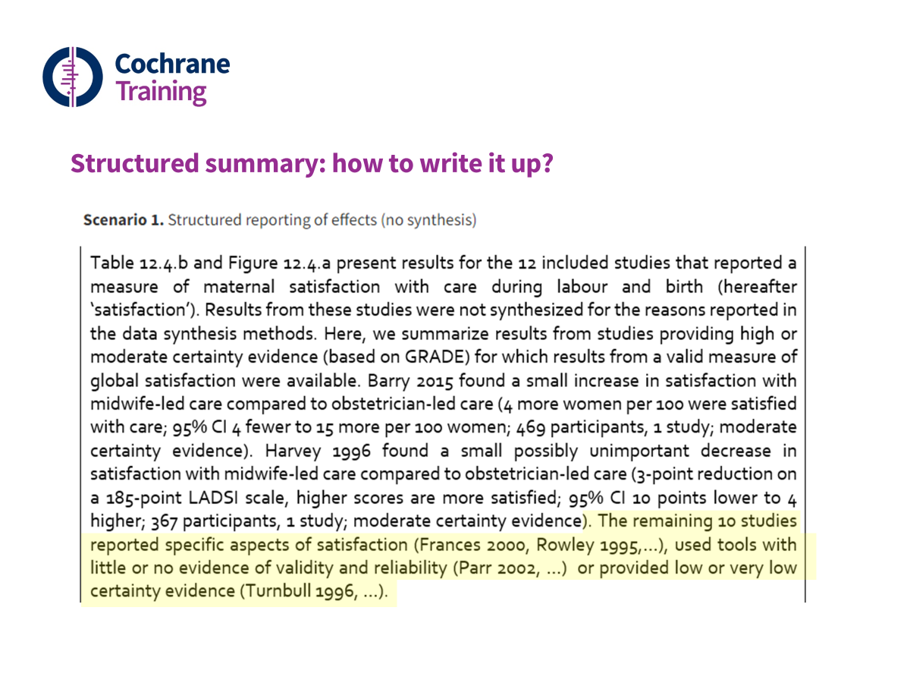
Structured summary: how to write it up?
Notes:
They only briefly mention the remaining studies by highlighting the resons why they haven’t met the initial criteria of relevance or validity. Some of studies have reported specific aspects of satisfaction, rather than a global satisfaction. Others have used tools with little or no evidence of validity and still others have provided only low or very low certainty evidence. But note that all of them have been presented in the table and the forest plot that we’ve seen in the previous slides. It’s just the text that focuses on the results that we’re most confident in and that are the most relevant to the decision makers.

Slide 21
In any systematic review we are aiming to:
make best use of available research
fairly represent the results
be transparent about the methods used, interpreting results appropriately and acknowledging any limitations of the methods.
Structured summaries may help with this, but it is more challenging to achieve these aims without synthesis (especially without meta-analysis)
Notes:
There are certain aims that we want to achieve in any systematic review. But when meta-analysis is not possible, these aims are difficult to achieve just with structured summaries. We want to take a step further and do some kind of synthesis, even if it’s not a meta-analysis.

Slide 22
Session outline
Introduction
Reasons for not undertaking a meta-analysis of effect estimates
Structured summaries
Acceptable synthesis methods and accompanying visual displays
What to include in the protocol
Take home messages

Slide 23
An overview of available methods for summary and synthesis*
Acceptable statistical synthesis methods
Preferred statistical synthesis methods
Structured summary of evidence presented in either text of tabular form
* Table 9.5.a (modified) from Chapter 9, 2019 Cochrane Handbook
Notes:
Let’s us return to the overview of available methods for summary and synthesis.
[CLICK] The methods on the right are preferred methods of synthesis, which are possible to use when effect estimates and a measure of precision – for example, a standard error or a confidence interval are available.
[CLICK] When the data is not available to use these preferred methods, we can turn to other methods which we call ‘acceptable statistical synthesis methods’. They are not preferred methods because they provide more limited information for healthcare decision making.
In this section of the module, we will introduce these other methods and note their limitations. We will not cover all the details of how to implement the methods, which can be found in Chapter 12 of the Cochrane Handbook for Systematic Reviews of Interventions.

Slide 24
Introduction to the acceptable synthesis methods
Similar to meta-analysis of effect estimates, the acceptable synthesis methods involve two primary steps:
A standardised summary statistic is calculated for each study that quantifies the impact of the intervention
The summary statistics are combined across the studies using a mathematical formula
Unlike meta-analysis of effect estimates, the acceptable synthesis methods differ in the data they require, the questions they address and the conclusions and recommendations that can be drawn
Notes:
A meta-analysis is typically undertaken using a two-step process. In the first step, a summary statistic is calculated for each study to quantify the impact of the intervention. The same type of statistic is calculated for each study, for example a risk ratio, so that these standardised statistics can then be combined in the second step using meta-analysis.
The same two steps are used for other synthesis methods also. But, the methods for synthesizing the summary statistics differs (i.e., the formula used to combine the statistics), and the summary statistics themselves can differ.
[CLICK] The acceptable synthesis methods differ in the data they require and the questions they address. We now consider these two aspects.

Slide 25
Synthesis methods: Question addressed and minimum data
Method | Question addressed | Estimate of effect | Variance | Direction of effect | Precise P value
Meta-analysis of effect estimates and extensions | What is the common (or average) effect? What intervention is most effective? What factors modify the magnitude of intervention effects? | ✓ | ✓
Summarizing effect estimates | What is the range and distribution of observed effects? | ✓
Combining P values | Is there evidence that there is an effect in at least one study? |  |  | ✓ | ✓
Vote counting based on direction of effect | Is there any evidence of an effect? |  |  | ✓
Notes:
This table presents the questions addressed by the preferable meta-analysis methods (and extensions), and those addressed by each of the acceptable statistical synthesis methods.
[CLICK] The table also presents the data required to use a particular synthesis method. As we have discussed, to undertake a meta-analysis, we require both an estimate of the intervention effect and its standard error (or the statistics to calculate the standard error).
As we’ve also discussed, these statistics won’t always be available, and in that circumstance, we may have to use other synthesis methods.
The choice of which to use is primarily determined by the statistics that are reported. For example, in the scenario where primarily only the direction of effect is available, then we would use vote counting based on the direction of effect.
[CLICK] Let’s begin with the first acceptable statistical synthesis method – summarizing effect estimates.

Slide 26
Summarising effect estimates
Question addressed: What is the range and distribution of observed effects?
Purpose
Can be used to synthesize when difficult to undertake a meta-analysis (e.g. missing variances of effects, unit of analysis errors)
Provides information on the magnitude and range of observed effects
Effects are summarised using descriptive statistics such as the median, interquartile range, and the range
Notes:
Summarising effect estimates allows us to describe the range and distribution of the observed effect estimates.
We can use this method when estimates of the intervention effect are available (or can be calculated), but the variances of effects are not reported or are incorrect. Incorrect calculation of standard errors arises more commonly in non-standard study designs that involve clustering or matching.
The effect estimates can be summarised using simple descriptive statistics, such as the median, interquartile range and the range.

Slide 27
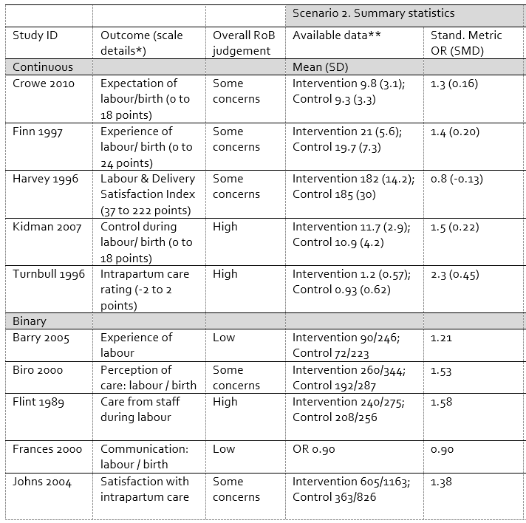
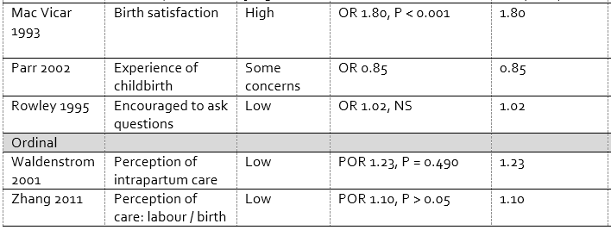
Summarising effect estimates
Required data: effect estimates without measures of precision
A measure of variance was not reported and couldn’t be calculated for 10 of 15 studies
Standardised estimates (OR)
Summary estimate: median OR and interquartile range
Notes:
To illustrate the acceptable synthesis methods, we are going to continue using the midwife-led continuity models of care example which we introduced when describing methods for structured summaries. For the purpose of illustrating the different synthesis methods, we have manipulated the data to create different scenarios.
Let’s take a closer look at the information presented in the table for this first scenario. There are five columns: the first column includes the study identifier; the second column, details of the outcome; the third column, the overall risk of bias judgement; the fourth column, the available data reported for each study; and, I'll come back to the fifth column. Also note that there are grey rows which indicate the outcome type; that is, whether the outcome is continuous, binary, or ordinal.
[CLICK] Looking more closely at the actual data reported in the fourth column, you might notice two issues. The first is that there are different effect measures across the studies (for example, odds ratio and means to calculate a mean difference). The second is that for some of the studies, an estimate of precision (e.g. variance of the effect estimate or its confidence interval) is not available. As an example, looking at 'Frances 2000', we can see that only an odds ratio of 0.9 is reported, with no estimate of precision.
[CLICK] In this table we've shown only a subset of the studies, but let's suppose that for 10 of the 15 studies, the variance of the effect estimates was not reported and could not be calculated. This would mean that if we were to meta-analyse the studies, we would only be able to include 5 of the 10 studies in the meta-analysis. Instead though, we could summarise the effect estimates, which would allow us to include 10 of the 15 studies in the synthesis.
[CLICK] Prior to summarising the effect estimates, we need to standardise them. In this example, we are going to use an odds ratio as our effect measure because most of the studies report the effect of the intervention using this measure. For the studies that report means and standard deviations, it is also possible to calculate a standardised mean difference, and then re-express this as an odds ratio. Details on how to do this are available in Chapter 10, Section 10.6, of the Cochrane Handbook.
[CLICK] Once we have calculated an odds ratio for each study, we can calculate the median of those odds ratios, which provides us the middle odds ratio of those observed. Calculating the interquartile range, provides us with information about the distribution of the observed odds ratios.

Slide 28
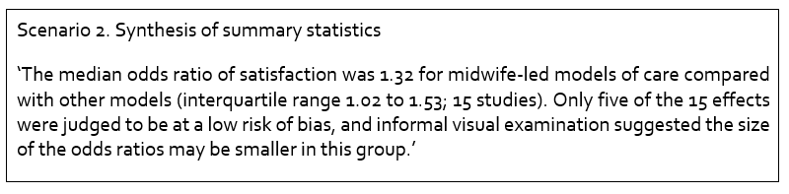
Summarising effect estimates: how to write it up?
Notes:
Here is an example of how the results could be written up.
[NOTE FOR TRAINER] Read out highlighted text.

Slide 29
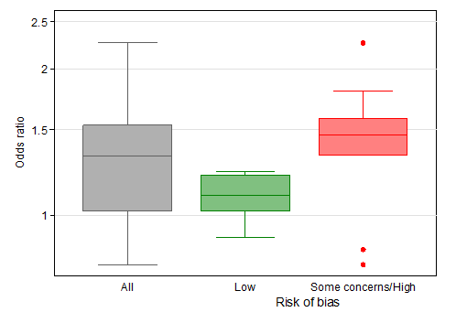
Summarising effect estimates: visual display of results
Box-and-whisker plots
(odds ratios for all outcomes & separately by overall RoB)
75th percentile
50th percentile (median)
25th percentile
Notes:
For each synthesis method, there are accompanying visual displays. The box-and-whisker plot is natural accompaniment to summarising effect estimates, because the plot displays the observed distribution of an outcome, with the outcome in this example, being the odds ratios.
Let’s take a closer look at the grey plot, which displays the odds ratios from all 15 studies.
[CLICK] The plot conventionally depicts five values. The upper and lower limits (or ‘hinges’) of the box, represent the 75th and 25th percentiles, respectively. The line within the box represents the 50th percentile (median), and the whiskers represent the extreme values.
[CLICK] Multiple box-plots can be juxtaposed, providing a visual comparison of the distributions of effect estimates. Here, studies are grouped based on their overall risk of bias, and as you can see, studies with a low risk of bias tend to have odds ratios closer to 1. The risk of bias may therefore be an explanatory of the magnitude of the observed odds ratios.

Slide 30
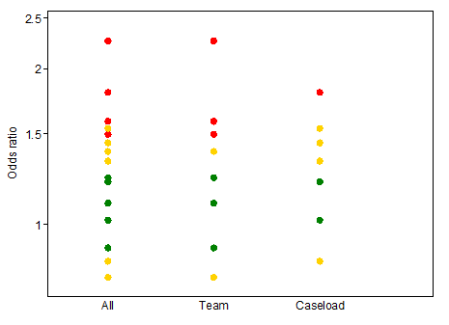
Summarising effect estimates: visual display of results
Bubble plot of odds ratios (odds ratios for all outcomes and separately by the model of care)
low risk of bias overall
some concerns
high risk of bias overall
Notes:
A bubble plot can also be used to provide a visual display of the distribution of observed effect estimates, and is more suited than the box-and-whisker plot when there are few studies. The plot is a scatter plot that can display multiple dimensions through the location, size and colour of the bubbles.
In this example, the odds ratio from each of the 15 studies is plotted. The colour of the bubble represents the overall risk of bias judgement for that result. Similar to the box-and-whisker plot, multiple bubble plots can be juxtaposed to provide a visual comparison of the distributions of effect estimates. Here, studies are grouped based on the model of care – team-based or a caseload model. These distributions are similar indicating that the model of care does not explain the magnitude of odds ratios.

Slide 31
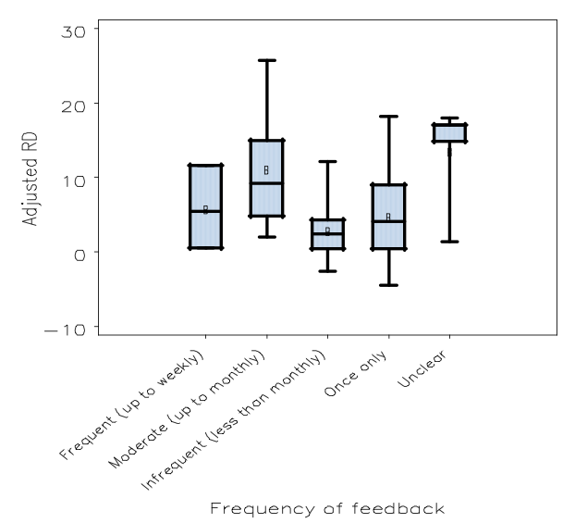
Summarising effect estimates: visual display of results
Audit and feedback: effects on professional practice and healthcare outcomes [Ivers 2012]
Figure 7. risk difference in adherence to recommended practice by frequency of feedback
Notes:
[NOTE FOR TRAINER] This example can be left out if running short on time.
This is an example from a Cochrane review examining the effects of an intervention called ‘audit and feedback’. Audit and feedback is a strategy to improve professional practice which involves giving feedback to practitioners when their practice is inconsistent with recommended practice.
The plot includes multiple box-and-whisker plots, with each displaying the observed distribution of differences in the risk of adherence to recommended practice between the intervention (‘audit and feedback’) and the control groups (i.e. risk differences). The studies have been grouped by the intensity of the intervention, which is defined as the frequency of feedback given to the practitioners. As you see, the distribution of risk differences are overlapping across different intensities of feedback, suggesting that the magnitude of the risk differences is not associated with intensity.

Slide 32
Summarising effect estimates
Question addressed: What is the range and distribution of observed effects?
Purpose
Can be used to synthesize when difficult to undertake a meta-analysis (e.g. missing variances of effects, unit of analysis errors)
Provides information on the magnitude and range of effects
Effects are summarised using descriptive statistics such as the median, interquartile range, and the range
Limitations
Does not account for differences in the relative size of studies
Notes:
Now that we’ve described the ‘summarising effect estimates’ method, let’s consider its key limitation. That is that the method does not account for differences in the relative sizes of the studies. So, a study with 10 participants contributes as much information to the analysis as a study with 1000 participants, even though we are much more certain about the effect estimate calculated in the latter study than the former. This is unlike standard meta-analysis methods where the sample size of the studies influences how much weight they will receive in the meta-analysis.

Slide 33
Synthesis methods: Question addressed and minimum data
Method | Question addressed | Estimate of effect | Variance | Direction of effect | Precise P value
Meta-analysis of effect estimates and extension | What is the common (or average) effect? What intervention is most effective? What factors modify the magnitude of intervention effects? | ✓ | ✓
Summarizing effect estimates | What is the range and distribution of observed effects? | ✓
Combining P values | Is there evidence that there is an effect in at least one study? |  |  | ✓ | ✓
Vote counting based on direction of effect | Is there any evidence of an effect? |  |  | ✓
Notes:
Let’s now introduce the second acceptable statistical synthesis method – combining P values.

Slide 34
Combining P values
Question addressed: Is there evidence that there is an effect in at least one study?
Purpose
Can be used to synthesize results when studies report:
no or minimal information beyond P values and direction of effect
results of non-parametric analyses
results of different types of outcomes and statistical tests
outcomes are different across studies (e.g. serious side effects)
Notes:
Combining P values allows us to answer the specific question: is there evidence that there is an effect in at least one study.
We can use this synthesis method when:
there is no, or minimal, information reported beyond the direction of the effect (that is, whether the intervention was favourable of harmful) and the precise (or exact) P values;
results of different types of outcomes are reported (for example continuous and binary), and the statistical tests differ (for example some studies may have used a t-test to calculate the P value and others a Z test); or,
the outcomes differ across studies. For example, a review author may be interested in examining ‘serious adverse events’, but the specific events measured across the trials might vary; in some trials ‘death’ might be measured, while in others ‘serious injury’.

Slide 35
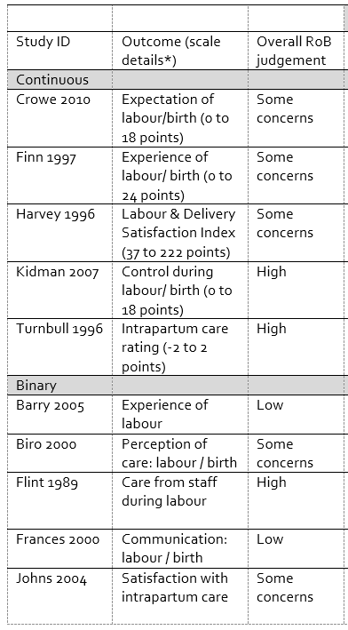
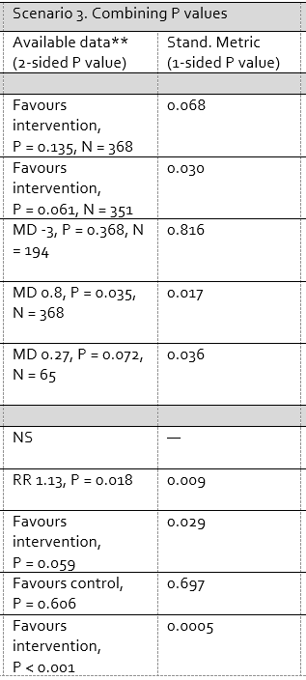
Combining P values
Required data: P value and direction of effect
Minimal reporting of data and statistical tests vary
11 of 15 studies provide a precise P value and direction of effect.
2 report a P value less than a threshold (< 0.001)
Convert to one-sided P values which incorporate direction of effect
Combine P values
Notes:
Let’s return to the midwife-led continuity models of care example. To demonstrate the combining P values synthesis method, we have again manipulated the data.
[CLICK] Let’s take a closer look at the data that is reported in the fourth column. You might notice a couple of issues. The first is that for some of the studies, minimal information has been reported. For example, in the case of Barry 2005, only a statement regarding the statistical significance of the intervention effect is reported; in the case of Crowe 2010, Finn 1997 and Johns 2004, only a P-value and the direction of effect is reported. The second issue is that the types of outcomes, and therefore, statistical tests vary across the studies.
[CLICK] In this table we’ve only shown a subset of the studies, but let’s suppose that there are 11 of 15 studies that provide a precise P value and the direction of effect. In a further two studies, a conventional level of significance is reported (e.g. in Johns 2004 with P < 0.001), along with the direction of effect.
[CLICK] As with all synthesis methods, prior to combining (or synthesizing) results, we need to standardise them. In this case our standardised metric is a one-sided P value. One-sided P values are used because they contain information about the direction of effect.
Let’s look at two examples to see how this is done. First, let’s look at Crowe 2010. In this study the midwife-led model of care has been favourable compared with the control group on the outcome satisfaction (although we don’t know by how much because this information is not reported). The 2-sided P value from a test of whether the midwife-led model of care is more effective than the control is 0.135. Because we are interested in testing whether midwife-led models of care are favourable compared with the control group, and in this particular study the effect is consistent with this direction, then to calculate the 1-sided P value, we simply divide the 2-sided P value by 2, which gives 0.068.
[CLICK] Looking at a second example, Harvey 1996, the midwife-led model of care intervention has been unfavourable compared with the control group on the outcome satisfaction in this study (i.e. it has reduced satisfaction). Because the effect is not consistent with our hypothesis (i.e. midwife-led models of care are favourable compared with the control group), the 1-sided P value is calculated as 1 minus the 2-sided P value divided by 2. So, here, that would be 1 – (0.368/2) = 0.816.
[CLICK] We convert all 2-sided P values to 1-sided P values, and then we can combine (or meta-analyse) the P values.

Slide 36
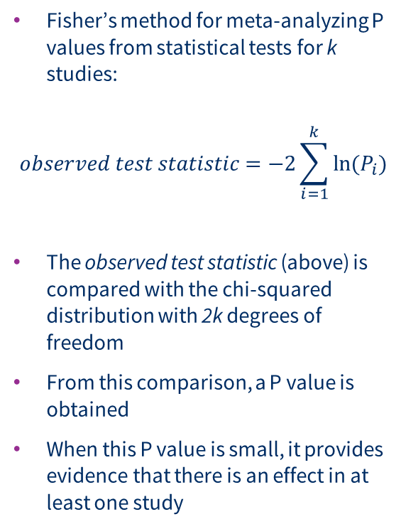
Combining P values
Fisher’s method for meta-analyzing P values from statistical tests for k studies:
$$observed test statistic=−2\sum_{i=1}^{k}{ln⁡(P_{i})}$$
The observed test statistic (above) is compared with the chi-squared distribution with 2k degrees of freedom
From this comparison, a P value is obtained
When this P value is small, it provides evidence that there is an effect in at least one study
Notes:
The formula for meta-analysing P values using Fisher’s method is presented here. This is one of many methods available to combine P values.
The worked example in Chapter 12 of the Cochrane Handbook demonstrates the formula using the midwife-led continuity models of care example.

Slide 37
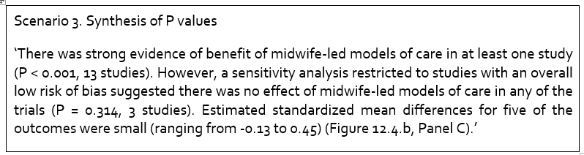
Combining P values: how to write it up?
Notes:
Here is an example of how the results could be written up.
[NOTE FOR TRAINER] Read out highlighted text.
While this synthesis method provides some indication of whether there is evidence that the intervention is beneficial in at least one study, it does not provide information on the size of the intervention effects. The size of the intervention effects is key for decision making, and we are able to estimate the size with minimal information provided in the studies by using an albatross plot.

Slide 38
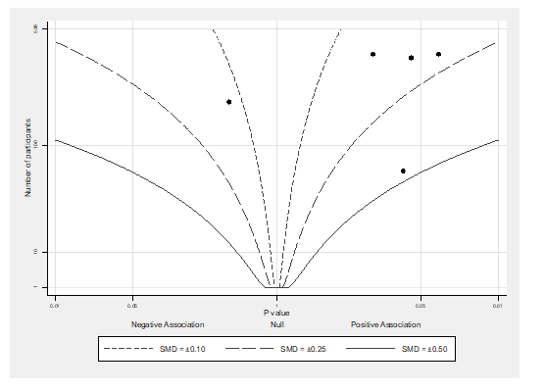
Combining P values: visual display of results
Albatross plot of the study sample size against P values (for the five continuous outcomes)
Allows approximate examination of the underlying intervention effects
The contours on the plot reflect standardized mean differences (SMD)
Each point reflects a study’s result
The location of the points relative to the SMD contours indicates their likely size
Notes:
This is an example of an albatross plot, which allows approximate examination of the underlying intervention effects. The albatross plot is a natural accompaniment to combining P values, because the only information required is the precise P value, direction of the effect, and the study sample size.
The plot is a scatter plot of each study’s sample size against the precise P value for the study result.
[CLICK] Superimposed on the plot are contours that represent, in this example, standardised mean differences. These contours can be calculated because we know the algebraic relationship between the standardised mean difference, sample size and P value. The highlighted contour is for a SMD of 0.5; indicating a moderate effect.
[CLICK] Each point reflects a study’s result.
[CLICK] The location of the points relative to the SMD contours indicate the their likely size.
[CLICK] For example, this point is sitting close to the contour representing SMDs of 0.5.
[CLICK] While these three points are sitting between two contours representing SMDs between 0.10 and 0.25, indicating that the effects of the SMDs in these studies are likely to be small.

Slide 39
Combining P values: how to write it up?
Notes:
So returning to our example, we might supplement reporting the results from the meta-analysis of P values with a statement about the likely size of the effects.
[NOTE FOR TRAINER] Read out highlighted text.

Slide 40
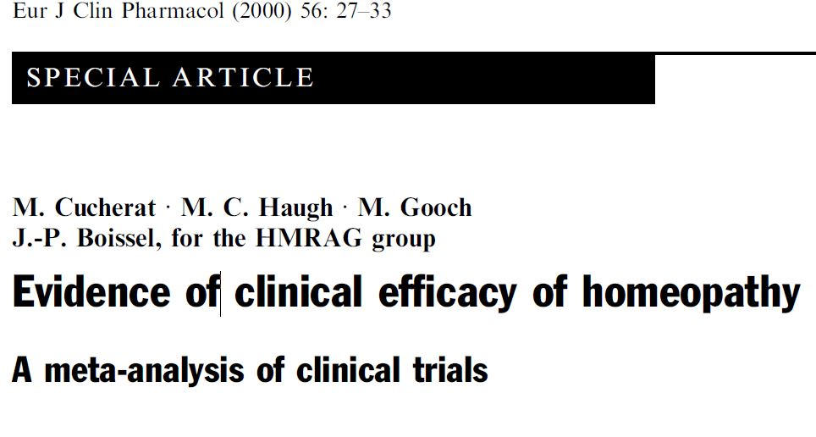
Notes:
[NOTE FOR TRAINER] This example can be left out if running short on time.
Now let’s look at another example. This is from a review aiming to examine whether homeopathy was effective.

Slide 41
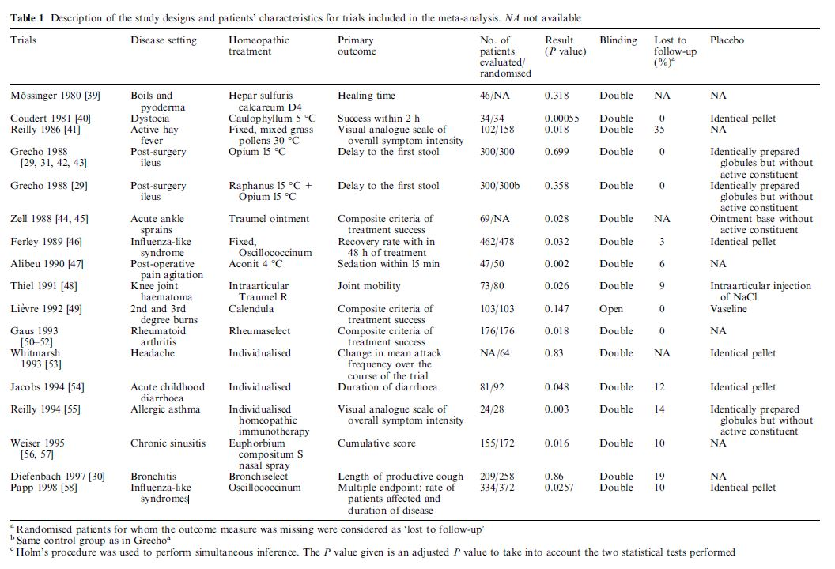
Notes:
This table from the review provides the characteristics of the studies in terms of disease, homeopathy treatment, outcome, sample size, P value from the statistical test comparing the treatment and control group, as well as methodological characteristics (blinding, missing data).
[CLICK] The first point to note is that homeopathy has been evaluated in many different diseases.
[CLICK] The second point to note is that, due to homeopathy having been evaluated across different diseases, the outcomes across studies differ.
[CLICK] Let’s take a closer look at two of the trials.
Ferley 1989 is examining the effects of homeopathy for influenza-like syndrome and measures the outcome ‘recovery rate within 48 h of treatment’ while Reilly 1994 examines the effects of homeopathy for allergic asthma and measures the outcome ‘overall symptom intensity’. These are very different outcomes.

Slide 42
Statistical analysis
“The statistical approach used, therefore, was the combination of the significance levels (P values) [6-8]. The rationale for this choice is that all the trials explored the same broad question, i.e. ``is homeopathic treatment efficacious?”, even if, for individual trials, the question asked expressed more specific terms and focused on a given treatment of a particular disease. Thus, unlike in the conventional meta-analytical methods, the method used does not involve pooling the numerical estimates of treatment effect sizes obtained, in our case, in very different situations. Using this approach, the null hypothesis tested is that the effect of interest (in this case, the efficacy of homeopathic treatment) is not present in any of the trials considered. If the null hypothesis is rejected, we can conclude that in at least one trial there is a non-null effect.”
Notes:
The authors of this review decided to combine P value to address the review question. The rationale they provided was: [NOTE FOR TRAINER] Read out highlighted text.
[CLICK] The authors go on to define their hypotheses: [NOTE FOR TRAINER] Read out highlighted text.

Slide 43
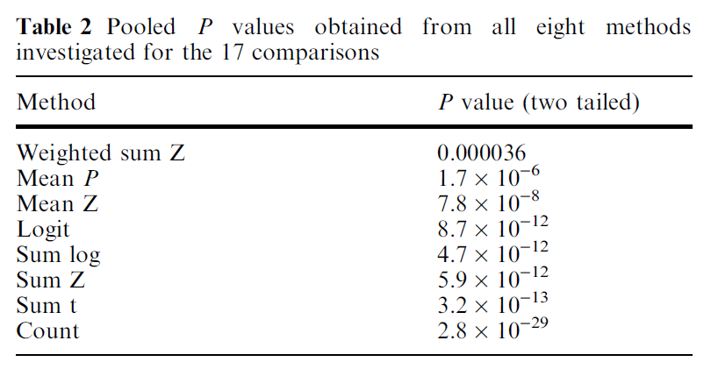
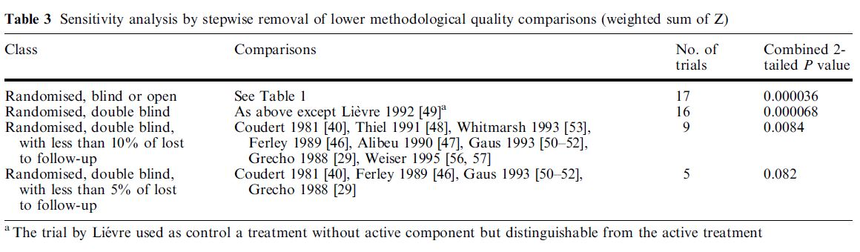
All results suggested that there was strong evidence that homeopathy was effective in at least one study
When the analysis was restricted to studies with fewer methodological limitations, there was no evidence to suggest in that homeopathy was effective in any trial
Notes:
The authors combined the P values across the studies using eight different methods. Irrespective of the particular method, all results suggested there was strong evidence that homeopathy was effective in at least one study.
[CLICK] But, these syntheses ignored potential methodological limitations that may bias the results. So, the review authors also undertook a sensitivity analysis that involved stepwise removal of studies that were determined to have more methodological limitations, and therefore be at a higher risk of bias. Including studies that had fewer methodological limitations, resulted in P values that supported the null hypothesis that there was no evidence to suggest that homeopathy was effective in any trial.

Slide 44
Combining P values
Question addressed: Is there evidence that there is an effect in at least one study?
Purpose
Can be used to synthesize results when studies report
no or minimal information beyond P values and direction of effect
results of non-parametric analyses
results of different types of outcomes and statistical tests
outcomes are different across studies (e.g. serious side effects)
Limitations
Provides no information on magnitude of effects
Does not distinguish between evidence from large studies with small effects and small studies with large effects
Difficult to interpret when statistically significant (null hypothesis can be rejected on the basis of an effect in only one study)
When combining few, small studies a non statistically significant test should not be interpreted as evidence of no effect in all studies
Notes:
Now that we have describe the combining P values method, let’s consider its key limitations.
The synthesis method provides no information on the size of the intervention effects. Accompanying the method with the albatross plot, or presenting any available effect estimates (in a table), or both, may help address this gap.
The method does not distinguish between evidence from large studies with small effects and small studies with large effects, which can yield the same P value.
The result can be difficult to interpret because the null hypothesis can be rejected on the basis of an intervention being effective in just one study.
Finally, when combining few small studies, a non statistically significant test should not be interpreted as evidence of no effect in all studies. The reason for this is that small studies will insufficiently powered to detect small to moderate intervention effects, which may be clinically important.

Slide 45
Synthesis methods: Question addressed and minimum data
Method | Question addressed | Estimate of effect | Variance | Direction of effect | Precise P value
Meta-analysis of effect estimates and extension | What is the common (or average) effect? What intervention is most effective? What factors modify the magnitude of intervention effects? | ✓ | ✓
Summarizing effect estimates | What is the range and distribution of observed effects? | ✓
Combining P values | Is there evidence that there is an effect in at least one study? |  |  | ✓ | ✓
Vote counting based on direction of effect | Is there any evidence of an effect? |  |  | ✓
Notes:
Let’s now introduce the last acceptable statistical synthesis method – vote counting based on the direction of effect.

Slide 46
Vote counting based on direction of effect
Question addressed: Is there any evidence of an effect?
Purpose
Can be used to synthesize results when only direction of effect is reported, or there is inconsistency in the effect measures or data reported across studies
For each study, the effect is categorised as beneficial or harmful based on the direction of effect.
Statistical significance is NOT considered.
Can apply a sign test to test if there is any evidence of an effect (equivalent to testing if the true proportion of effects favouring the intervention (or comparator) is equal to 0.5).
Notes:
Vote counting based on the direction of effect allows us to answer the question of: is there any evidence of an effect?
We can use this method when:
there is very incomplete reporting and only the direction of the effect (that is, whether the intervention was favourable or harmful) is reported; or,
there is inconsistency in the effect measures reported across the studies.
The method involves categorizing each study result as indicating whether the intervention was ‘favourable’ or ‘harmful’ based on the direction of effect. Importantly, statistical significance is not considered in this categorization; a point which we return to soon.
A statistical test – called the sign test – can be used to test if there is any evidence of effect. This test is equivalent to testing if there is evidence that the proportion of effects indicating the intervention is favourable is different from 0.5. If the intervention is not truly different from the control, then, by chance, we would expect approximately half the studies to show that the intervention is beneficial (based on the direction) and half to show it is harmful. But, if the intervention is truly different from the control, then we would expect the proportion to be smaller or greater than 0.5.

Slide 47
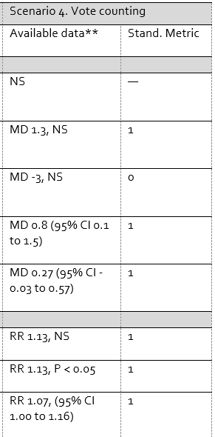
Vote counting based on direction of effect
Required data: direction of effect
Minimal reporting of data and type of effect measure varies across studies.
12 of 15 reported direction of effect (3 did not).
For each study, the effect is categorised as beneficial or harmful based on direction of effect
Statistical significance is NOT considered
Notes:
Let’s again return to the midwife-led continuity models of care example. To demonstrate vote counting based on the direction of effect, we have again manipulated the data.
[CLICK] Let’s take a closer look at the data that is reported in the fourth column. Similar to the scenario we showed with combining P values, the results from some of these studies are incompletely reported, but in this scenario, there is very limited reporting for in some of the studies. Take for example Finn 1997, Harvey 1996 and Barry 2005, where only the intervention effect estimate is reported along with a statement regarding statistical significance. In addition, the outcome types (continuous and binary) and associated effect measures (mean differences and risk ratios) differ across studies.
[CLICK] In this table, we have only shown a subset of the studies, but let’s suppose that in 12 of the 15 studies the direction of effect is reported; therefore allowing us to include these 12 studies our synthesis.
[CLICK] The first step is to calculate our standardised metric for each study, which in this case is simply assigning a 1 or 0 depending on whether the intervention was favourable or harmful. Let’s take a closer look at the results of two studies.
[CLICK] Harvey 1996 reports a mean difference of -3, meaning that satisfaction was 3 points lower for those receiving the intervention compared with the control. Because this point indicates the intervention reduces satisfaction, this study is given the value zero. Note that statistical significance, which for this study is ‘not significant’, is not considered when assigning a value of one or zero to the study result.
[CLICK] Biro 2000 reports a risk ratio of 1.13, meaning that the risk of being satisfied is 13% higher for those receiving the intervention compared with the control. Because this point indicates the intervention improves satisfaction, this result is given the value one. Note again, that statistical significance, which for this study is statistically significant at the 5% threshold, is not considered in the binary value assigned to the study result.

Slide 48
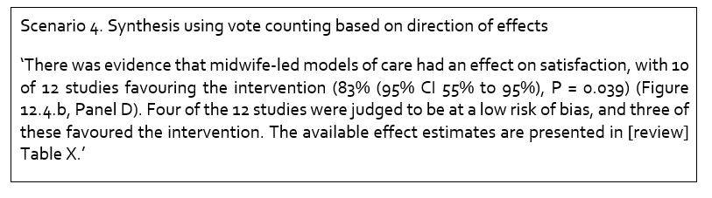
Vote counting based on direction of effect: how to write it up?
Notes:
Of the 12 studies that reported the direction of effect, in 10, satisfaction was higher in those who received the intervention.
[CLICK] Here is an example of how the results could be written up.
[NOTE FOR TRAINER] Read out highlighted text.
Details of how of the method used to calculate the confidence interval and how to calculate the P-value (using excel) are available in Chapter 12 of the Cochrane Handbook.
[CLICK] While this synthesis method addresses the question of whether there is any evidence of an effect, it does not provide information on the size of the intervention effects. The size of the intervention effects are key for decision making, and those that are available, or can be calculated, should be presented.

Slide 49
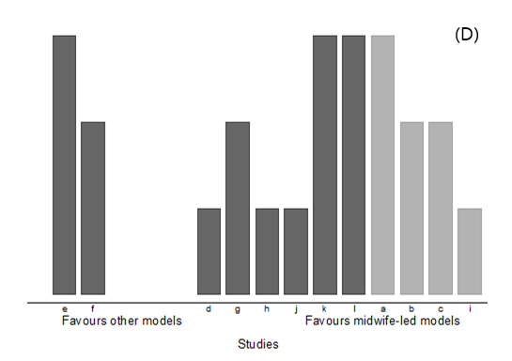
Vote counting based on direction of effect: Visual display
Each bar represents a result from one study, denoted by alphabet characters
The bars are categorized based on their effects, i.e. those where the intervention is favourable, and those where the alternative intervention is favourable
Height and shading can be used to depict characteristics of the studies. In this example:
height depicts overall risk of bias judgement (tall = low risk of bias, medium = some concerns, short = high risk of bias)
shading depicts model of care (light grey = caseload, dark grey = team)
Harvest plot
Notes:
The accompanying visual display for vote counting is called the harvest plot.
Each bar represents a result from one study, denoted by alphabet characters.
[CLICK] The bars are categorized based on their effects. In this example, those where the ‘other models of care’ are favourable, and those where ‘midwife-led models of care’ are favourable. It is immediately evident from this plot that most of the studies have found that satisfaction was higher in those who received midwife-led models of care.
[CLICK] Height and shading can be used to depict characteristics of the studies. In this example, height depicts the overall risk of bias. The tallest bars reflect studies that are judged to be at a low risk of bias, while the shortest bars reflect studies judged to be at a high risk of bias. The reason for using taller bars to depict studies at a low risk of bias is because this visually gives more prominence to these studies.
In this example, shading is used to depict the model of care.

Slide 50
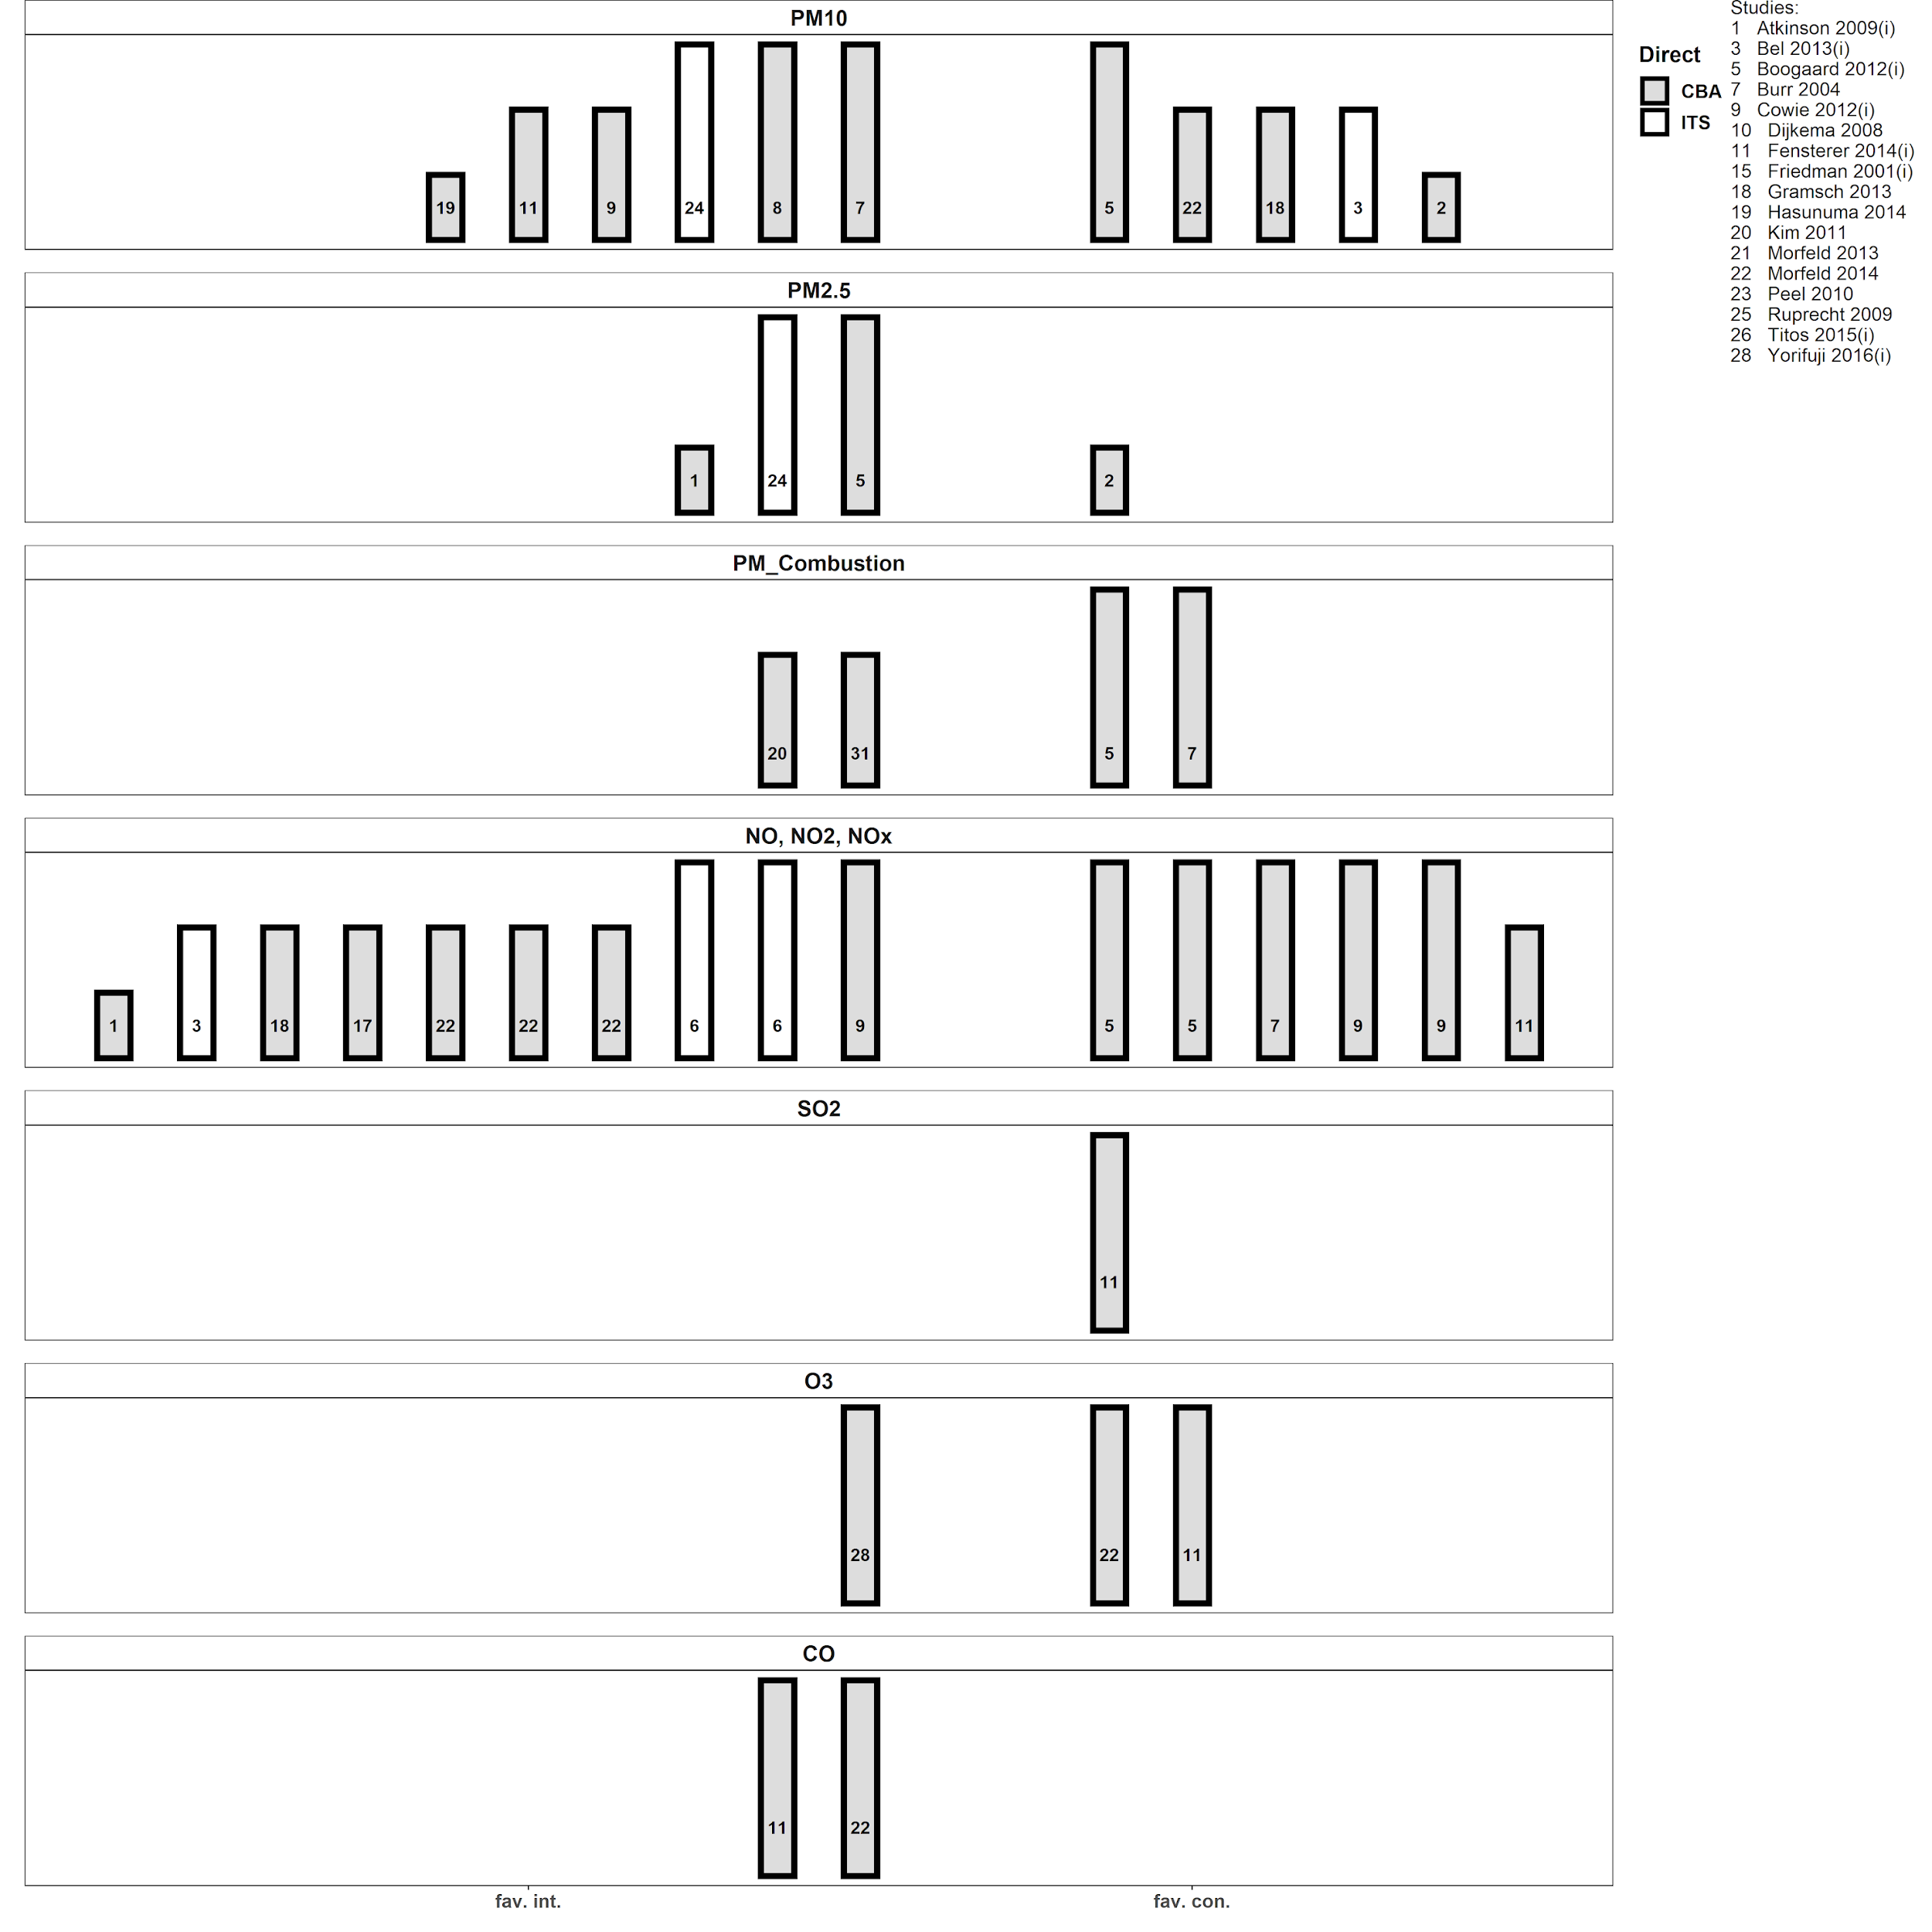
Vote counting based on direction of effect: Visual display
A series of harvest plots may be combined in a matrix that displays vote counting results from, for example, different comparisons or outcomes
In this example, each harvest plot depicts the vote count for one comparison, but different air pollution outcomes
Harvest plot

Slide 51
Vote counting based on direction of effect
Question addressed: Is there any evidence of an effect?
Purpose
Can be used to synthesize results when only direction of effect is reported, or there is inconsistency in the effect measures or data reported across studies
For each study, the effect is categorised as beneficial or harmful based on the direction of effect.
Statistical significance is NOT considered.
Can apply a sign test to test if there is any evidence of an effect (equivalent to testing if the true proportion of effects favouring the intervention (or comparator) is equal to 0.5).
Limitations
Provides no information on the magnitude of effects (e.g. equal importance given to risk difference of 5% and 50%).
Does not account for differences in the relative sizes of the studies.
Less powerful than methods used to combine P values.
May be confused with UNACCEPTABLE forms of vote counting:
when statistical significance used to define # positive and # negative studies
when subjective decisions are used to define ‘positive’ and ‘negative’ studies.
Notes:
Now we have described the vote counting based on the direction of effect method, let’s consider its key limitations.
The synthesis method gives equal importance to different magnitudes of intervention effect. In addition, the method provides no information on the magnitudes of intervention effect, so it’s important to accompany the synthesis method with estimates of intervention effect when they are available, or can be calculated.
The synthesis method does not account for differences in the relative sizes of the studies. So, very small studies contribute as much information as very large studies.
The method is less powerful than combining P values because P values encapsulate more information than just the direction of the effect.
Finally, vote counting based on the direction of effect may be confused with conventional forms of vote counting that use rules based on statistical significance and direction to categorize effects, or rules based on statistical significance, direction of effect, and magnitude of effect (when available). These forms of vote counting have serious limitations and should be avoided for the reason we now expand upon.

Slide 52

Unacceptable methods: Vote counting based on statistical significance
Create two stacks of papers
Stack 1: studies that show statistically significant benefit from the intervention
Stack 2: all other studies
If Stack 1 is highest, conclude the intervention is beneficial. Otherwise conclude that there is no effect.
Friedman 2001
Stack 1.
Statistically significant
Stack 2.
NOT statistically significant
Stack1
Stack2
Notes:
The conventional form of vote counting can be imagined as creating two stacks of papers. In stack 1, studies that show statistically significant benefit are placed, while in stack 2, all other studies are placed. If stack 1 is higher, it is concluded that the intervention is beneficial, while if stack 2 is higher, it is concluded that there is no effect.
[CLICK] This conventional form of vote counting should be avoided for the following reasons.

Slide 53
What are the problems with vote counting based on statistical significance?
Small studies with insufficient power to detect an underlying intervention effect are counted as not showing benefit.
As the number of studies (and participants) increases, the power of conventional vote counting tends to zero except with large studies and at least moderate intervention effects
Regardless of the specific formulation, when based on statistical significance, all vote counting methods have serious limitations and can lead to the wrong conclusion.

Slide 54
Session outline
Introduction
Reasons for not undertaking a meta-analysis of effect estimates
Structured summaries
Acceptable synthesis methods and accompanying visual displays
What to include in the protocol
Take home messages

Slide 55
What to include in the protocol
Provide details of the planned tabular structure to display results of individual studies
Provide details of other synthesis and visual display methods that may be used

Slide 56
Session outline
Introduction
Reasons for not undertaking a meta-analysis of effect estimates
Structured summaries
Acceptable synthesis methods and accompanying visual displays
What to include in the protocol
Take home messages

Slide 57
Take home messages
Other synthesis methods may be needed where there is incompletely reported data in the primary studies
These methods differ in the completeness of the data they require, the hypotheses they address, and the conclusions that can be drawn from their findings
Tabulation and visual display of the results should always be presented alongside any synthesis
Synthesis methods that involve vote counting based on statistical significance have serious limitations and are unacceptable

Slide 58
Slides prepared by: Joanne E. McKenzie and Sue E. Brennan School of Public Health and Preventive Medicine, Monash University, Australia
Based on:
McKenzie JE, Brennan SE. Chapter 12: Synthesizing and presenting findings using other methods. In: Higgins JPT, Thomas J, Chandler J, Cumpston M, Li T, Page MJ, Welch VA (editors). Cochrane Handbook for Systematic Reviews of Interventions. 2nd Edition. Chichester (UK): John Wiley & Sons, 2019: 321–348.

Slide 59
Other references
Cucherat, M., et al., Evidence of clinical efficacy of homeopathy. A meta-analysis of clinical trials. HMRAG. Homeopathic Medicines Research Advisory Group. Eur J Clin Pharmacol, 2000. 56(1): p. 27-33.
Friedman: Why vote-count reviews don’t count. Biological Psychiatry 2001, 49(2):161-162
Harrison S, Jones HE, Martin RM, Lewis SJ, Higgins JPT. The albatross plot: A novel graphical tool for presenting results of diversely reported studies in a systematic review. Res Synth Methods. 2017;8:281-9.
Ivers N, Jamtvedt G, Flottorp S, Young JM, Odgaard-Jensen J, French SD, et al. Audit and feedback: effects on professional practice and healthcare outcomes. Cochrane Database of Systematic Reviews. 2012;6:CD000259.
McKenzie JE, Brennan SE, Ryan RE, Thomson HJ, Johnson RV, Thomas J. Chapter 9: Summarizing study characteristics and preparing for synthesis. In: Higgins JPT, Thomas J, Chandler J, Cumpston M, Li T, Page MJ, et al., editors. Cochrane Handbook for Systematic Reviews of Interventions. 2nd ed. Chichester UK: John Wiley & Sons; 2019. p. 12.
McKenzie JE, Brennan SE. Chapter 12: Synthesizing and presenting findings using other methods. In: Higgins JPT, Thomas J, Chandler J, Cumpston M, Li T, Page MJ, et al., editors. Cochrane Handbook for Systematic Reviews of Interventions. 2nd ed. Chichester UK: John Wiley & Sons; 2019. p. 28.

