Slide 1
Analysing other outcomes and study designs

Slide 2
Steps of a Cochrane Review
define the question
plan eligibility criteria
plan methods
search for studies
apply eligibility criteria
collect data
assess studies for risk of bias
analyse and present results
interpret results and draw conclusions
improve and update review
Notes:
Sometimes in your reviews you will encounter other types of outcomes and study design. In this session we’ll explain how to deal with them.

Slide 3
Session outline
generic inverse variance meta-analysis
other outcome types
multi-arm studies
cluster-randomised trials
cross-over trials
non-randomised studies
See Chapters 10, 23 & 24 of the Handbook
Notes:
The purpose of this presentation is to introduce some of the non-standard types of data and study designs that you might come across in your review. These issues can be quite challenging, and we introduce them here not so that you will immediately know everything you need to know to analyse them, but so that you will be able to identify non-standard data in your review, and seek assistance as appropriate.
We’ve talked about meta-analysis of the most common data types – dichotomous and continuous data, but the next question is, what if your data doesn’t look like that? How can we meta-analyse other kinds of data?
The first thing we’re going to do is talk about the generic inverse-variance method of meta-analysis.

Slide 4
Analysing effect estimates
When you have an overall effect estimate, not separate group summaries
standard effect estimates (RR, OR, MD)
non-randomised studies, cluster or cross-over trials
time-to-event (HR), rate data (RR), ordinal data (POR)
adjusted data (e.g. from regression analysis)
Notes:
In many studies, we don’t have data summarising the results for the separate intervention groups, such as individual event numbers for dichotomous outcomes, or means and standard deviations (SD) for continuous outcomes. Many studies just report an overall effect estimate. This could be one of the effect estimates we’ve talked about before, such as an risk ratio (RR), odds ratio (OR) or mean difference (MD). It might be an adjusted odds ratio following a regression analysis (in which case don’t forget to record which factors have been adjusted for). It might be adjusted for study design issues, such as cluster or cross-over trials, which we will discuss shortly. It might be a non-randomised study, such as an interrupted time series design, measuring the change in level and slope of a particular characteristic over time, or a special outcome type such as hazard ratios for time-to-event data.
The good news is, we do have a method to meta-analyse any of these statistics.

Slide 5
The generic inverse-variance method
‘generic’ = can apply to any summary statistic
‘inverse-variance’ = uses the inverse of the variance to weight each study in meta-analysis
See Section 10.3 of the Handbook
Notes:
The generic inverse-variance method (GIV) can be used for any overall effect estimate. ‘Generic’ just means we can use it for any statistic, and ‘inverse-variance’ means that the inverse of the variance is used to weight the statistics in the meta-analysis, just as we can do for dichotomous and continuous outcomes. If other studies do have individual data, we’ll have to calculate effect estimate & standard error (SE) for them all (can do using RevMan, convert 95% CIs to SE, then combine all using GIV).

Slide 6
What do I do?
identify the statistic you wish to use
you will need the same statistic for each study
if using one of RevMan’s standard statistics, use the ordinary method to calculate results for other studies, and combine with your problem study using GIV
for each study, enter two numbers:
the summary statistic
the standard error of the summary statistic
Notes:
To use this method in RevMan, you’ll need to identify the statistic that you’d like to analyse this way, whether an OR, HR, etc. You’ll need to have two or more studies that report this effect estimate, or alternatively you may be able to calculate the same effect estimate for each study. For example, if you have several studies reporting quality of life as an ordinary continuous outcome, and one that reports the MD without the separate group summary data, you can use RevMan to calculate the MD for each of the ordinary studies, and then use the GIV method to combine all the studies together.
For each study, you’ll need to enter the summary statistic you wish to use, and its standard error, in this case, NOT the SD. You just need those two numbers – you don’t even need to include the sample size, as this information is incorporated into the SE. If you don’t have the standard error, but you have some other data such as the SD and sample size, confidence intervals or P values, then RevMan can help you calculate the SE. There’s also further information in the Handbook these calculations (see sections 6.5.2.3 and 6.3, and the formulae handout provided with the presentation on Continuous outcomes).

Slide 7
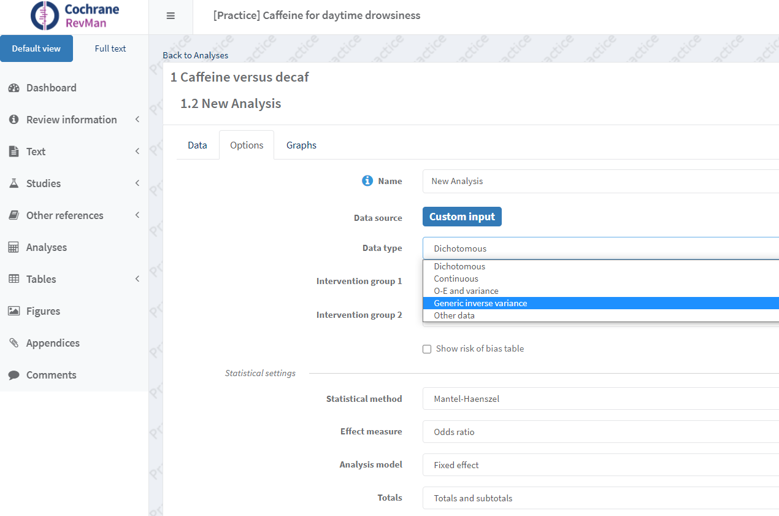
Generic inverse-variance meta-analysis
Notes:
In Revman, you’ll need to add a new outcome, and select the ‘Generic Inverse Variance’ outcome type, instead of the usual dichotomous or continuous data.

Slide 8
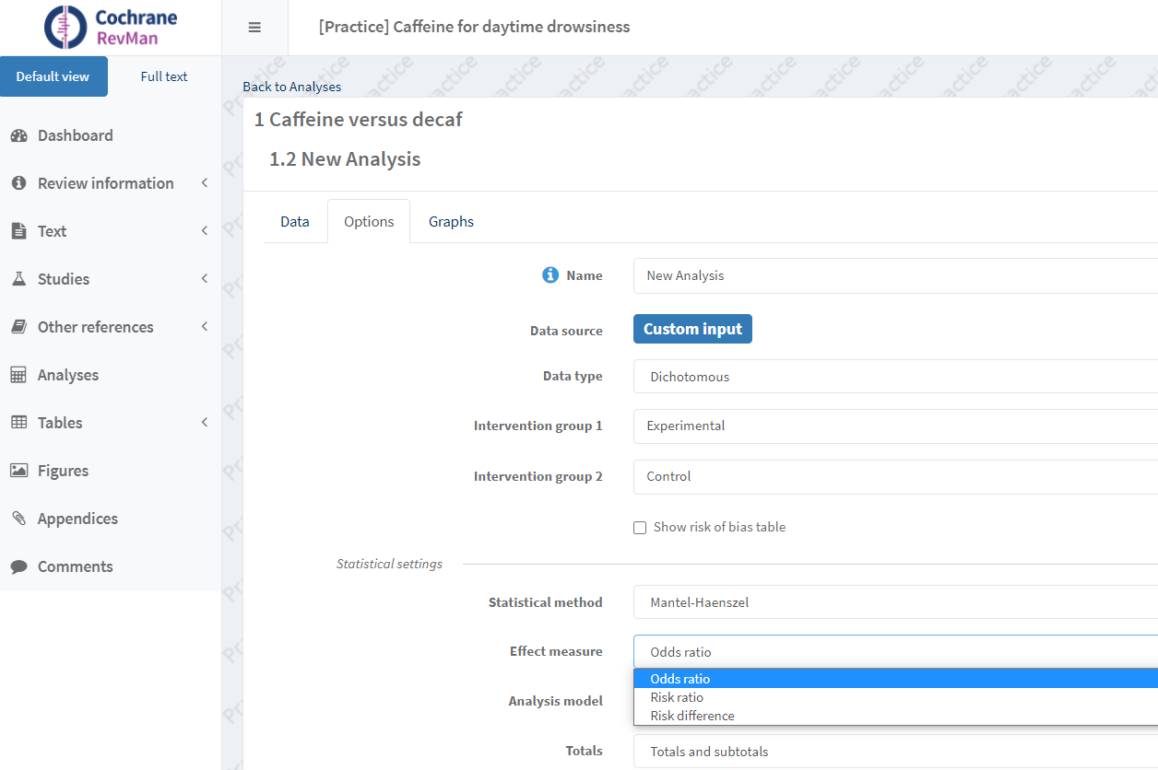
Generic inverse-variance outcomes
Notes:
You’ll then be able to choose which statistic you’re reporting – either one of the standard RevMan statistics, or you can select from a list of additional statistics, or you can enter your own label.

Slide 9
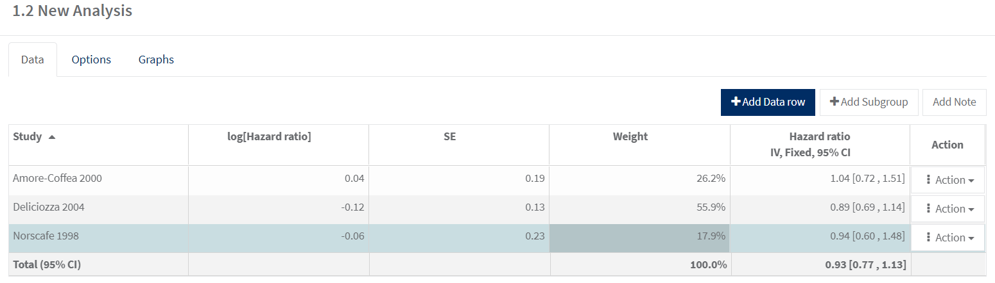
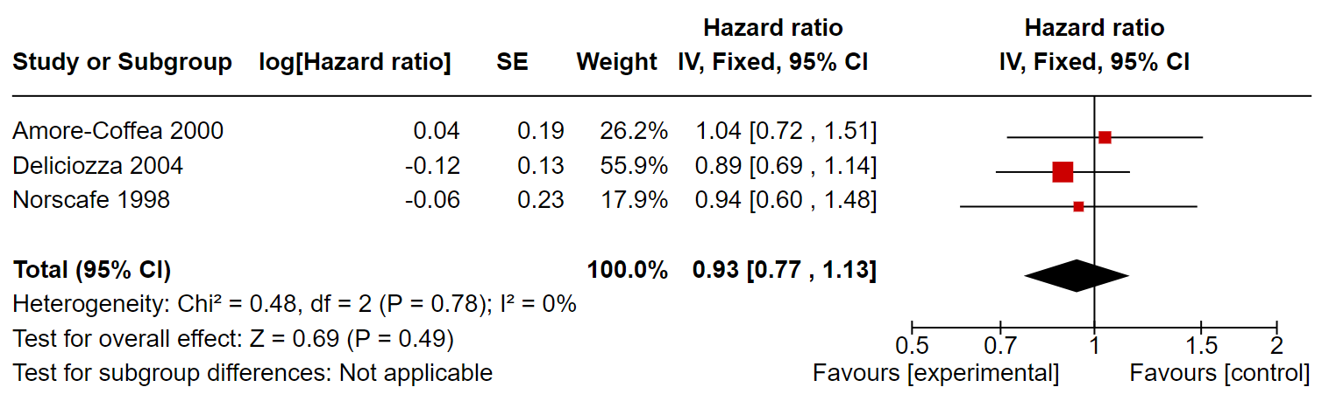
Generic inverse-variance outcomes
Notes:
RevMan will then create a data table for you. You can see that in this case we only have room to enter two numbers for each study – the statistic and its SE. In this case I’m using Hazard Ratios. On the forest plot, the squares representing the effect estimate for each study are red, to show that it’s a GIV outcome. Other than that, everything is much the same as other forest plots.

Slide 10
Important: if your statistic is a ratio
ratios are not normally distributed
must enter natural logarithms into RevMan
e.g. log OR and SE of log OR
check that the data reported in the study are not already in this form
RevMan will automatically convert the results back for display as normal
See Section 10.3.3 of the Handbook and seek statistical advice
Notes:
There is one important catch with this method, that you may have noticed on the previous slide. If your statistic is a ratio (whether an OR, RR, HR, etc.), then you need to know that ratios are not normally distributed – a negative effect can only range from 0 to 1, while a positive effect can range from 1 up to very large numbers. Because of this, ratios are usually log transformed before they are meta-analysed.
Because the GIV outcome type in RevMan can use either ratios or absolute measures, we need to tell RevMan which we are using, and ensure the analysis is correct by log transforming ratios before they are taken into the analysis. When the analysis is complete, RevMan will automatically convert the results back, e.g. to ordinary ORs, for display on the forest plot.

Slide 11
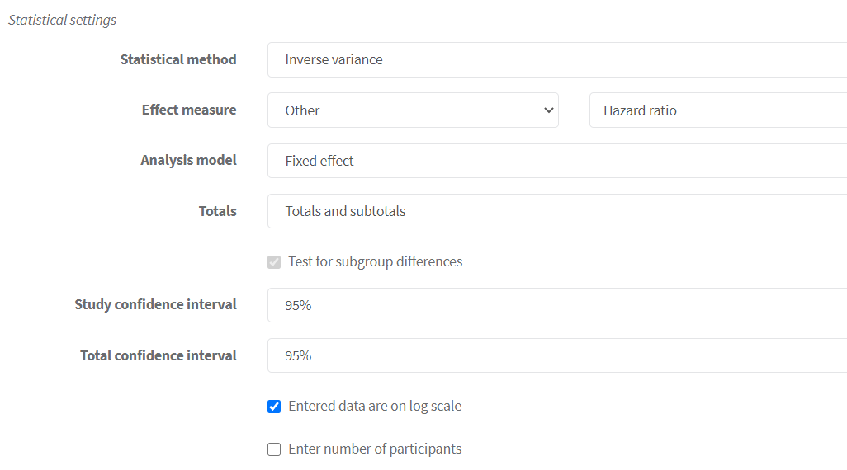
Statistical settings
Notes:
How to do this?
If you selected one of the default ratio measures when you created the outcome, such as RR, OR, Hazard Ratio or Rate Ratio, RevMan will automatically know you will be entering log transformed data. If you’ve added your own outcome statistic, you will need to check the option ‘Entered data are on log scale’ to tell RevMan that you are entering data on a log scale.
You can also use this window to ask RevMan to add columns for the number of participants in each group to the data table – this isn’t required for the analysis, but it is good practice to add these columns and report this information for your readers.

Slide 12
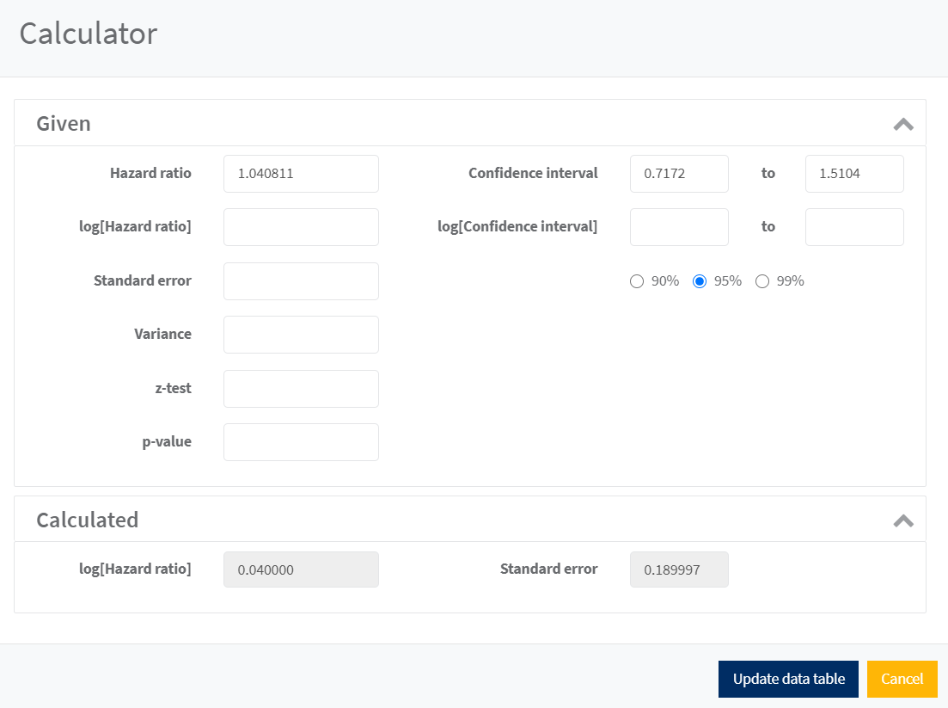
Notes:
Then, you need to transform the data and enter it into RevMan. Fortunately, the RevMan calculator for the GIV outcome type allows you to do this. For example, I could enter the ordinary Hazard Ratio and its 95% CI into the calculator, and RevMan will calculate the log transformed values. You can then click on the ‘Update data table’ button to enter the log transformed values into the table.
You could also do these calculations yourself using something like Excel. The process is outlined in Handbook section 6.1.2.1.

Slide 13
Session outline
generic inverse variance meta-analysis
other outcome types
multi-arm studies
cluster-randomised trials
cross-over trials
non-randomised studies
See Chapter 10 of the Handbook
Notes:
Now, let’s move on to the next topic in this presentation and talk about other outcome types that you might come across in your review

Slide 14
Types of data
dichotomous
continuous
ordinal
counts and rates
time-to-event
Notes:
As you already know, dichotomous and continuous data are the most common data types used in meta-analysis.
There are three other more common types of data that you might also find in your review: ordinal data, counts and rates, and time-to-event data.

Slide 15
Ordinal outcomes
ordered categories implying magnitude
short: e.g. pain scores, Likert scales
long measurement scales: e.g quality of life, function
analysing ordinal outcomes
dichotomous
short scales can be dichotomised
e.g. pain vs no pain, mild vs severe pain
continuous
longer scales – report mean scores
proportional odds ratio (POR)
analyse using GIV method
Notes:
Ordinal outcomes are scales with some sense of order or magnitude – they can be numerical scales, such as scores out of 5, or even long measurement scales such as quality of life or function tools. They can also include conceptual scales, such as those measuring strength of agreement or satisfaction.
There are several options available to analyse ordinal data. Which one you choose is likely to depend on the data that are reported in your included studies.
Short scales can effectively be turned into dichotomous data by dividing the scale into two groups. For example, on a 4 point pain scale, where 1 is no pain, and 4 is severe pain:
you can divide the data into those with no pain (or a score of 1), compared to those with any pain (a score of 2, 3 or 4).
you can divide the group into those with mild pain (a score of 1 or 2) compared to those with strong pain (a score of 3 or 4)
In your review, some of your included studies may treat short scales in this way. Or, if you have enough information, you can take measurements of short scales and ‘dichotomise’ them yourself. If you are doing this, it is important to choose the cut-off point without reference to the results, and you should be able to give a rationale for the cut-off point selected. Be careful that bias is not introduced by deliberately trying to maximise the difference between two arms.
The longer the scale, the more it behaves like a continuous numerical measure. As we have already seen, long ordinal scales are often treated as continuous data, reporting the mean score and SD for each group. Unlike true continuous data, it may not be possible for someone to have a value anywhere on the scale, including half scores and decimal places, and the points on the scale may be measuring qualitative rather than quantitative differences.
Specialist methods are sometimes used to analyse ordinal outcome data, especially short scales, in terms of proportional odds ratios, comparing each category on the scale to each other. If you do come across proportional odds ratios, they can be analysed in RevMan using the generic inverse variance method.
Although it’s preferable to pre-specify how you plan to analyse ordinal data in your protocol, this may be impossible. Your choice may be determined by the way the data are reported in the study, and also by the variation you find between studies, e.g. if one study reports the data separately for each individual category, and another study dichotomises the scale (perhaps at a different point than you would have selected yourself). At the data collection stage, it’s important to collect the data in as much detail as possible, in whatever form it is reported, so that all the options are available to you when you come to your analysis. If you’re dichotomising a scale, this will also help you to conduct a sensitivity analysis later, to test the impact of your choice of cut-off point on the analysis.

Slide 16
Counts and rates
counts of events that may happen more than once
e.g. hospitalisation, no. of decayed teeth
rates also consider the length of time in which events occurred
beware unit-of-analysis error
analysing counts and rates
dichotomous
number of participants with at least one event
continuous
mean no. of events per person
time to first event
rate ratio
analyse using GIV method
rate = number of events
length of time
Notes:
Counts refer to events that may happen to someone more than once – that is, we can count the number of times it happens to each participant in a study. A rate also incorporates the aspect of time – that is, how many events occurred during a particular period of time measured, e.g. per day, per year, or per person-year studied. Note that the word ‘rate’ is also commonly used to talk about ordinary dichotomous data, e.g. ‘control group event rate’, but we are using it in a more specific sense here.
There are a number of ways in which counts and rates may be analysed.
It is a common mistake to analyse counts and rates as simple dichotomous data, using the total number of events, and the total number of participants or person years of follow-up. Although you may have the number of events that occurred, for example the number of decayed teeth that were filled during a trial, this is not the same as the number of people who had a filling. It would be possible to have more decayed teeth than the total number of participants in the trial, which would make no sense to analyse. It is possible to analyse these data as dichotomous, by counting the number of people with at least one event, although this loses the element of time in the data.
It is possible to analyse counts of frequent events as continuous data, using the mean no. of events occurring for each person, along with its standard deviation. Be aware that data analysed in this way is likely to be skewed.
It ‘s also possible to analyse these kind of data as the time to first event. We will discuss time to event data in a moment.
The summary statistic usually used is the rate ratio. The rate for each group is the number of events divided by the amount of time over which they occurred (e.g. no. of decayed teeth per person-year of follow-up). Then the rate for the intervention group is divided by the rate for the control group, giving an overall effect estimate much like a risk ratio. To use rate ratios in RevMan, you will need to use the generic inverse variance method.
Again, although it’s preferable to pre-specify how you plan to analyse these data in your protocol, your choice may be determined by the way the data are reported in your included studies. At the data collection stage, it’s important to collect the data in as much detail as possible, in whatever form it is reported, so that all the options are available to you when you come to your analysis and it becomes clear what kind of reporting is most common or consistent.

Slide 17
Time-to-event (survival) outcomes
length of time until an event occurs
e.g. time until death, time free of epileptic fits
includes ‘censored’ data – people who did not experience the event during the study
analysing time-to-event data
dichotomous
data from a specific time point
continuous
mean days to event – not appropriate for censored data
hazard ratios
analyse using generic inverse variance method
O – E and V
Notes:
You will often come across time-to-event data in studies, for example, of cancer survival. Time-to-event data measures the time each person takes before a certain event of interest occurs, such as death, hospital admission, or the recurrence of a disease.
It is possible to analyse time-to-event data as a dichotomous outcome, if information is available on how many people did or did not have an event at a specific time point. For this to be accurate, you must have information on all the participants at that time point.
It’s not usually appropriate to analyse these data as continuous outcomes, as the mean length of time before an event occurs. This is because the data in these trials are censored – we only measure data until the end of the study. If some people don’t experience the event of interest before the end of the study, then you don’t know the actual length of time it took before the event occurred for them. They would have to be excluded from the analysis, which would introduce bias.
More appropriate analysis of time-to-event data can be done using either O – E and V statistics, or hazard ratios. Hazard is a similar idea to risk, but measures risk at specific moments in time, and will change over time (for example, your risk of an event such as death changes as you age, or as you engage in dangerous activities like crossing a road).
O – E and V statistics can be analysed in RevMan directly as a specific data type. Hazard ratios, on the other hand, can be analysed using the generic inverse variance method. Consult the Handbook Chapter 10 for more information.
Analysis of time-to-event data can be challenging given the different ways these results are reported in the literature – not always the way we need, and you may find different studies using different methods that cannot be directly compared. It may be preferable to obtain individual patient data from the study authors, and re-analyse them yourself, but as for the other data types, your choice of how to manage the data in practice may be limited by the way the data are reported in the published papers.

Slide 18
Session outline
generic inverse variance meta-analysis
other outcome types
multi-arm studies
cluster-randomised trials
cross-over trials
non-randomised studies
See Chapter 23.3 of the Handbook
Notes:
Next, we’ll talk about studies with more than one intervention group.

Slide 19
Studies with more than two groups
pair-wise comparisons are required for RevMan
consider your question of interest
ignore any groups not relevant to your question
compare arms two at a time in separate comparisons
pool two of the arms if appropriate
multiple treatments meta-analysis
be careful not to double-count any group in a meta-analysis
unit-of-analysis error
See Chapter 23.3 of the Handbook
Notes:
There are several options available to analyse the studies with more than one intervention group, such as a three-arm or four-arm study.
First, check to make sure that each of the intervention arms is relevant to your question. If you are interested in the effect of chemotherapy vs radiotherapy, and you find a study that also includes a third arm receiving surgery, then consider whether the effect of surgery is of interest in your review. If not, you do not have to analyse the results for this arm – you can just ignore it, and analyse the other two arms as for an ordinary trial.
If all the arms are of interest, then you will need to consider how best to include them in your analysis. In most cases, RevMan requires pairwise comparisons – you can only compare one group against one other group at a time. So, if you want to compare all three arms, you can consider them as separate comparisons, two at a time, e.g. chemotherapy vs radiotherapy, surgery vs radiotherapy, and chemotherapy vs radiotherapy.
Another option to consider is where two of the arms are clinically similar, from the perspective of your review, in which case it may be possible to combine the results of those two arms together, and treat them as one. For example, you might find a three-arm trial that compares a high dose of a drug, a lose dose of the drug, and a placebo, or perhaps between two drugs in a class, and a placebo. If you are interested in the broader comparison between drug treatment and no treatment, then it may make sense to combine the information from the two drug intervention arms, particularly if there is already variation in the dosages used, or the specific drugs in a class used across your other included studies.
The same principle might apply to different exercise interventions, or education interventions, or complex packages of treatment. Whenever we choose to combine studies, we have to make a judgement about what level of difference between studies is appropriate. You have to use your clinical judgment, and consider the question you are asking in your review, before deciding on the most appropriate course of action. The same thing applies to deciding to combine arms within a study. Remember that you can also explore the effect of the differences in the intervention used through subgroup analysis later on.
It is possible to conduct more advanced analysis comparing all groups in a trial using multiple-treatments meta-analysis, but this is not available in RevMan and requires statistical expertise.
An important point to make about analysing three-arm trials is the importance of not double-counting people in a meta-analysis. This can lead to what we call ‘unit-of-analysis error’ – a collection of problems that can occur when choices are made around the selection of the number to use as ‘n’ in a meta-analysis lead to a study getting too much or too little weight. In this case, if you put one arm of a trial on a forest plot twice, and double-count the people in that arm, they will get double the fair weight in the meta-analysis, which may affect the result.

Slide 20
Example: antibiotics to inhibit preterm labour
included a four-arm trial (ORACLE) - largest and best trial in the review
erythromycin
co-amoxiclav
erythromycin + co-amoxiclav
neither
author decided all three antibiotic arms were comparable
Source: Craig Ramsay
King JF, Flenady V, Murray L. Prophylactic antibiotics for inhibiting preterm labour with intact membranes. Cochrane Database of Systematic Reviews 2002, Issue 4. Art. No.: CD000246. DOI: 10.1002/14651858.CD000246.
Notes:
In this example, we have a four-arm trial, called the ORACLE trial, looking at antibiotics for inhibiting preterm labour. We have antibiotic A, vs antibiotic B, vs a combination of both drugs, vs no intervention.
In this review, the authors were asking a broad, over-arching question about the effects of any antibiotic versus no intervention – the other studies included in the review looked at a range of antibiotics - and so they decided that it made clinical sense to combine all three antibiotic arms in a meta-analysis, and compare them to no intervention.

Slide 21
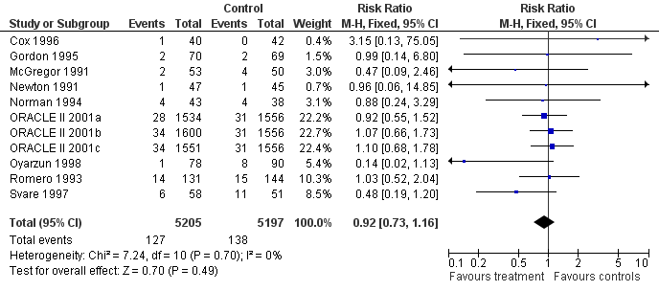
Example: Is this OK?
Source: Craig Ramsay
Adapted from: King JF, Flenady V, Murray L. Prophylactic antibiotics for inhibiting preterm labour with intact membranes. Cochrane Database of Systematic Reviews 2002, Issue 4. Art. No.: CD000246. DOI: 10.1002/14651858.CD000246.
Notes:
Here’s an example of one way to combine three arms on a forest plot. As you can see, we have three groups from the ORACLE trial, each compared to the placebo group, included in the forest plot.
[NOTE TO TRAINERS: ASK: Is there anything that could be wrong with this way of analysing the groups?]
By including the groups this way, the authors would be counting the control group three times in this forest plot, giving those individuals three times the fair weight in the meta-analysis. This one study is contributing nearly 70% of the total weight in this meta-analysis.

Slide 22
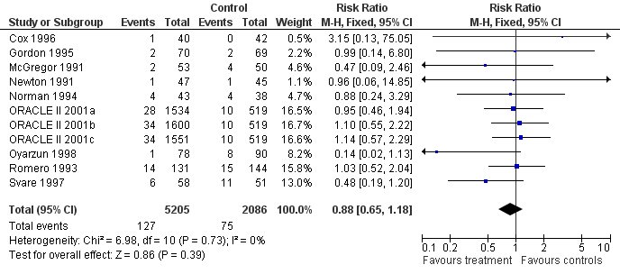
Example: shared control group
Source: Craig Ramsay
Adapted from: King JF, Flenady V, Murray L. Prophylactic antibiotics for inhibiting preterm labour with intact membranes. Cochrane Database of Systematic Reviews 2002, Issue 4. Art. No.: CD000246. DOI: 10.1002/14651858.CD000246.
Notes:
One approach would be to split the control group between the three intervention arms, making sure that each person in the control group is counted only once. By doing this, we can see that the weight given to each arm has dropped, and the total weight given to this study is now just over 50%. The risk ratio has also changed, from 0.92 to 0.88, although in this case the overall result and its interpretation would be similar.

Slide 23
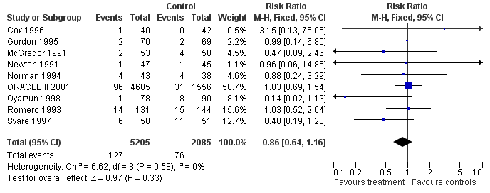
Example: combined arms
Source: Craig Ramsay
Adapted from: King JF, Flenady V, Murray L. Prophylactic antibiotics for inhibiting preterm labour with intact membranes. Cochrane Database of Systematic Reviews 2002, Issue 4. Art. No.: CD000246. DOI: 10.1002/14651858.CD000246.
Notes:
Another approach would the one the authors actually took. Because the authors were interested in the broader question of any antibiotic therapy versus no therapy, and because the studies in this meta-analysis looked at a range of different antibiotic types, here the three antibiotic groups have been added together, compared against the single, whole control group.

Slide 24
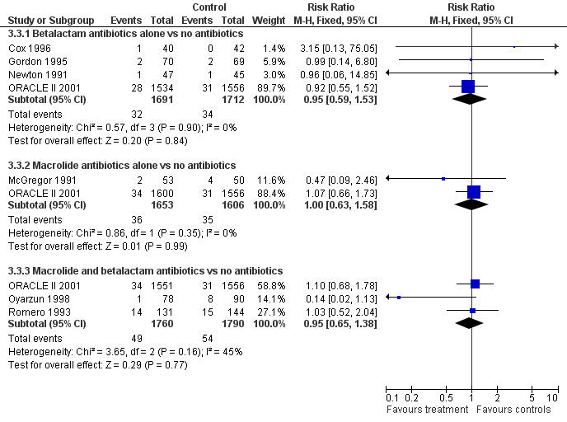
Example: separated arms
Source: Craig Ramsay
Adapted from: King JF, Flenady V, Murray L. Prophylactic antibiotics for inhibiting preterm labour with intact membranes. Cochrane Database of Systematic Reviews 2002, Issue 4. Art. No.: CD000246. DOI: 10.1002/14651858.CD000246.
Notes:
An alternative way to analyse the groups would be to include them on separate forest plots. In this case, we can see that there are two categories of antibiotic included in this review – betalactam antibiotics and macrolide antibiotics, and then some studies that look at both. One arm of the ORACLE trial falls into each of these categories, along with several of the other studies in the review. Because there is no overall meta-analysis combining these groups, it’s ok to include the whole control group in each case.
This kind of separate or subgroup analysis can be used in addition to a broader, overall analysis, to investigate the possible differences in effect between the two different drug types. We’ll discuss subgroup analysis further in a separate presentation on investigating heterogeneity.

Slide 25
Session outline
generic inverse variance meta-analysis
other outcome types
multi-arm studies
cluster-randomised trials
cross-over trials
non-randomised studies
See Chapter 23.1 of the Handbook
Notes:
Now, let’s look at cluster-randomised trials, which is another study design you might encounter.

Slide 26
Cluster-randomised trials
groups of individuals randomised together
e.g. clinics, schools, towns, families
may be used to test effects of interventions on groups
may be more practical to implement
avoids ‘contamination’ of randomised individuals
Notes:
In a cluster-randomised trial, instead of allocating individuals to the intervention or control group in a study, whole groups of people (clusters) are allocated together, such as clinics, schools, hospital wards or families, and everyone in the cluster receives the same intervention.
These trials can be used to examine interventions targeted at whole clusters, or where the intervention would be impractical to implement randomly for individuals, for example mass communication interventions that include whole towns, or organisational interventions where it would be difficult, for example, to have staff on the same ward using different treatment protocols for different patients.

Slide 27
Simple trial design
Unit of randomisation
Unit of
analysis
Individuals
Individuals
Intervention
Randomisation
Control
Source: Julian Higgins
Notes:
Cluster randomised trials require a method of analysis that takes account of the clustering and does not treat as if the participants were individually randomised. In an ordinary trial, individuals are randomised to the intervention or control groups – we say individuals are the ‘unit of randomisation’. In this case, the results are also analysed based on the number of individuals – individuals are also the ‘unit of analysis’.

Slide 28
Cluster-randomised design
Unit of randomisation
Unit of
analysis
Groups
Groups
Intervention
Randomisation
Control
Source: Julian Higgins
Notes:
In a cluster-randomised design, the unit of randomisation is not individuals, but clusters. When we come to the analysis, we have a choice. We could use clusters as our unit of analysis - meaning that the ‘n’ in our analysis would be the number of clusters – for example, we could measure the proportion of people with an event within each cluster, and combine those. This might be appropriate if our study was looking for effects at the cluster level. However, by doing this we do lose some level of detail about the outcomes we’re interested in at the individual participant level, especially if the clusters are large.

Slide 29
Cluster-randomised design
Unit of randomisation
Unit of
analysis
Groups
Individuals
Intervention
Randomisation
Control
Source: Julian Higgins
Notes:
Our other option is to use individuals as our unit of analysis, just as if this were an individually randomised trial, but this isn’t always appropriate either – the problem we run into is unit-of-analysis error.

Slide 30
Unit-of-analysis issues
individuals within a cluster are correlated
when we are interested in outcomes at the individual level:
analysing by individuals gives too much precision
false positive conclusions
more weight in meta-analysis
analysing by clusters gives too little precision
correct weight should be somewhere in between
may also occur in other studies
clustered delivery, e.g by practitioner
multiple treatments, e.g. cycles, body parts
Source: Julian Higgins
Notes:
The difficulty we get into with cluster-randomised trials is about precision. When we are interested in outcomes at the cluster level, we can analyse by clusters and there’s no problem. We need to be careful when we’re interested in the effect at the level of the individual.
Whether we analyse the results by the number of clusters, or by the number of individuals, our estimate of the intervention effect will be the same, but our confidence intervals might be very different. This can be important in our meta-analysis – because we use the variance to weight studies in a meta-analysis, if we get the precision wrong, a study can get too much or too little weight in the meta-analysis, which can change our overall result.
Say for example that our clusters were 10 schools, each containing 300 students. If we use clusters as our unit of analysis, then the ‘n’ in our analysis would 10. In a meta-analysis, a study with 10 participants will have very wide confidence intervals, and get hardly any weight. That doesn’t seem right when in fact we’re interested in the effect on the individuals, and in fact we have information on quite a lot of people. Our other option is to take the number of students as our ‘n’, which would be 3000. Then the study would get narrower confidence intervals and quite a lot of weight in the meta-analysis. The problem is, treating the study as if it were on 3,000 individuals doesn’t take into account correlation.
The students in a particular school, or the patients in a particular clinic, are likely to share a number of characteristics, such as where they live, socioeconomic status, patterns of health, etc. Individuals within a cluster are likely to be more similar to each other than they are to a random collection of individuals. So, because we have used a cluster analysis, we have a level of correlation between the individuals that we need to take into account. If the individuals within the clusters are very correlated, then we’re not getting as much new information by adding more people to the study – the result calculated at the cluster level will be closer to correct. If the clusters have very minimal correlation, then it’s much more similar to the case where we have 3,000 independent individuals, and we are getting more information by adding more individuals to the study.
This issue may also arise in individually randomised trials where clustering occurs, such as where the intervention is delivered by a number of practitioners, effectively creating clusters of patients receiving the intervention from each practitioner. You may also come across trials in which an individual is randomised, but they receive multiple treatments – for example, joint replacements on both knees, fillings in several teeth, or several cycles of treatment such as in a fertility trial.

Slide 31
Taking correlation into account
study may use appropriate analysis method
e.g. a mixed (multilevel) model, GEEs
meta-analyse using GIV method
if not, adjust the analysis for correlation
get statistical advice
clearly identify cluster-randomised trials and explain how you have dealt with the data
See Chapter 23.1 of the Handbook
Source: Julian Higgins
Notes:
So, how do we take this clustering into account in our analysis? As with some of the data types we discussed earlier, you may find a number of approaches in your included studies.
You may come across studies that have used advanced methods to appropriately adjust for clustering, for example using a mixed (multilevel) model or generalised estimating equations (GEE). In this case, if the study is reporting an overall effect estimate such as an OR adjusted for correlation, you can use the generic inverse variance model to meta-analyse that result with other studies using the same method.
Alternatively, you might find studies that do not correctly adjust for correlation. If you have enough information, you can use an estimate of the correlation – called the intracluster correlation coefficient – to adjust the analysis, calculating an ‘effective sample size’ somewhere between the number of clusters and the number of individuals, giving us a weight somewhere between those two options. This method can be used to adjust studies reporting ordinary dichotomous or continuous data types. See Chapter 23.1 of the Handbook for this, and get some statistical advice.
Whatever you do, you will need to clearly identify cluster-randomised designs and explain how you have managed the data in your review.

Slide 32
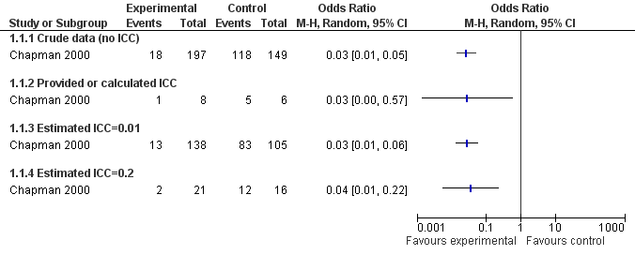
Example: Education to prevent dog bites
Source: Craig Ramsay
Duperrex O, Blackhall K, Burri M, Jeannot E. Education of children and adolescents for the prevention of dog bite injuries. Cochrane Database of Systematic Reviews 2009, Issue 2. Art. No.: CD004726. DOI: 10.1002/14651858.CD004726.pub2.
Notes:
In this example, from a Cochrane review of education of children and adolescents to prevent dog bites, the authors have shown the impact of a range of assumptions about correlation in a sensitivity analysis. The raw data from the study is in the first row, showing a very narrow confidence interval. They have then used different intra-cluster correlation coefficients to calculate effective sample sizes for the study – you can see that the numbers of events and numbers of participants have been adjusted in each row.
The second row uses a coefficient calculated from data in the paper of around 0.59. The third row shows the results using a very low coefficient of 0.01, indicating almost no correlation. The final row shows the results using a coefficient in the middle – 0.2. You can see that the point estimates do not vary (aside from some slight impact of rounding), but the confidence intervals vary a lot.
The more correlation is assumed – that is, the more similar people are within a cluster, the less precise we can be about the overall effect of the intervention.

Slide 33
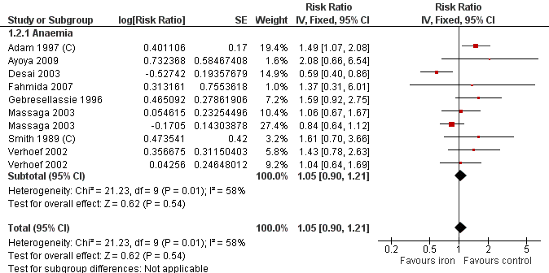
Example: Oral iron supplements to prevent malaria
Source: Matt Page
Adapted from Okebe JU, Yahav D, Shbita R, Paul M. Oral iron supplements for children in malaria-endemic areas. Cochrane Database of Systematic Reviews 2011, Issue 10. Art. No.: CD006589. DOI: 10.1002/14651858.CD006589.pub3.
Notes:
In this example, two studies have been appropriately adjusted by inflating the standard error in a GIV analysis. Compare the standard error of 0.17 in Adam 1997, which has been inflated to 0.19 on the next slide. Also compare the standard error of 0.42 in Smith 1989, which has been inflated to 0.48 on the next slide. For both these studies, the 95% confidence intervals become wider once the standard error is inflated. As a result of this inflation, the meta-analytic risk ratio has slightly changed, from 1.05 to 1.02.

Slide 34
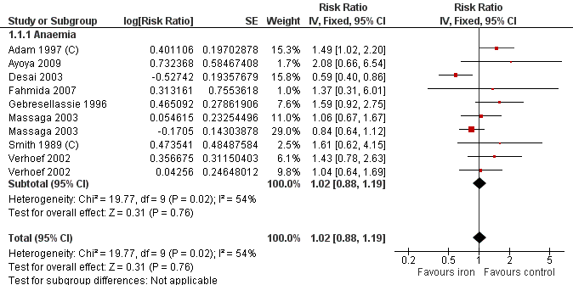
Example: Oral iron supplements to prevent malaria
Source: Matt Page
Adapted from Okebe JU, Yahav D, Shbita R, Paul M. Oral iron supplements for children in malaria-endemic areas. Cochrane Database of Systematic Reviews 2011, Issue 10. Art. No.: CD006589. DOI: 10.1002/14651858.CD006589.pub3.

Slide 35
Session outline
generic inverse variance meta-analysis
other outcome types
multi-arm studies
cluster-randomised trials
cross-over trials
non-randomised studies
See Chapter 23.2 of the Handbook
Notes:
Another study design that you may come across is cross-over trials.

Slide 36
Cross-over trials
all participants receive both intervention and control
ideally in random order
takes advantage of correlation
eliminates among-participant variation
fewer participants required to achieve desired power
Notes:
In a cross-over trial, there is only one group of participants, and everyone receives both the experimental and the control intervention – first one, and then the other. In a randomised cross-over trial, the order in which the interventions are received is random, so that some people will get one intervention in the first study period, and some will get the other first.
Cross-over designs are also affected by correlation – the outcome from one individual to the two different interventions will be correlated. These studies actually take advantage of the correlation within individuals to eliminate the effect of variation between individual participants in one group compared to the next, and get a more precise estimate of the intervention effect. Because of this, smaller sample sizes are needed to get adequate power.

Slide 37
Cross-over trials
Parallel group
Intervention
Outcome
Between-person comparison
Randomisation
Control
Outcome
Cross-over
Intervention
Outcome
Intervention
Outcome
Randomisation
Control
Outcome
Control
Outcome
Within-person comparison
Source: Julian Higgins
Notes:
So, rather than having two separate groups, and comparing results between the people in those groups, we are measuring and comparing the results within each individual – first after one intervention, then after the alternative.

Slide 38
Suitability of cross-over design
appropriate for:
chronic, stable conditions
short-term outcomes (e.g. relief of symptoms)
sufficient washout period between treatments
possible problems affecting the second intervention period
irreversible outcomes (e.g. death, cure)
period effect (e.g. degenerative conditions)
carryover effect (e.g. long-acting intervention)
consider using first period only as a parallel group trial
this information is rarely and selectively reported
Source: Julian Higgins
Notes:
Cross-over designs are not appropriate for every study. In order for the results in the first period and second period to be comparable, we need to assume that nothing else is affecting the participants’ responses over time. So, we need to assume that the condition the participants have is stable over time, and not deteriorating or fluctuating, which is true of many chronic conditions.
We also need to assume that the outcomes we’re trying to measure are short-term – for example, the short-term relief of symptoms such as pain. We don’t want the first intervention to still be having an effect when we try to measure the effect of the second intervention. You need a sufficient wash-out period after the first intervention to assume that the patient is back to their baseline condition before the second intervention period begins. If the first intervention causes a permanent change, such as death or a complete cure, or if it has a long-lasting effect on any outcome, then a cross-over design may not be appropriate.
If there are problems with a possible carryover effect, then it may still be appropriate to only report the first period of the trial, and exclude any data from the second or later periods. In this case, we analyse the data just as we would for an ordinary parallel trial. You may not always be able to do this – separate information for the first period is not always provided in the written reports, and where it is provided it may be done selectively – that is, it’s more likely to be provided if it shows a significant result.
Where we don’t have any of these problems, however, and we decide that a cross-over trial is fine, then it’s a shame not to use all the periods, all the information we learn from the trial, and take advantage of the within-person comparison. So how do we best do this?

Slide 39
Unit of analysis issues
measurements within individuals are correlated
within-person design should be taken into account
if not, study will receive too little weight in meta-analysis
may also occur in studies of multiple body parts
Source: Julian Higgins
Notes:
We could analyse cross-over trials in the same way as parallel studies, comparing the total results from the intervention to the total results from the control, and you will often see these results reported. This is ok, but it doesn’t take the within-person design into account. One of the benefits of using a cross-over design is that sequential measurements taken in individuals are more correlated than using separate groups of individuals to compare interventions. Removing the effect of between-person variation from our results gives us greater precision, requiring smaller sample sizes. If we don’t take this correlation into account, the smaller sample sizes will mean the studies get too little weight in the meta-analysis. Although this is a conservative error, under-weighting rather than over-weighting the study, it’s not ideal.
It’s also important to note that we can encounter this kind of effect in individually randomised trials. When we were thinking about clustering, we thought about the example of people who might have two knees, or several teeth receiving treatment, which forms a kind of cluster. If each body part within an individual is randomised separately, such as one knee receiving standard treatment and the other receiving the new experimental replacement joint, then the correlation between those joints within an individual can be considered as a kind of cross-over trial.

Slide 40
Taking correlation into account
study may use appropriate paired analysis
participant-specific differences between intervention & control
meta-analyse using GIV method
study may use simple comparison between intervention & control
if not, adjust the analysis for correlation
get statistical advice
clearly identify cross-over studies and explain how you have dealt with the data
See Chapter 23.2 of the Handbook
Notes:
As always, the approach you take is likely to be limited by the level of detail reported in the study. Some studies may appropriately take the correlation into account using a paired analysis, measuring the difference for each participant between the intervention and control conditions, and summarising these, e.g. as a mean difference. If so, you can go ahead and use the results as they are. If you have a group of studies reporting data this way, you can use the generic inverse variance method to meta-analyse them.
If the study does not take correlation into account, for example if they just give you the mean result for all participants in the intervention condition, and the mean result in the control condition, then as for cluster-randomised trials, you may be able to adjust the data yourself, and if comparable data are available, you can combine these studies with other studies in your meta-analysis. Consult Chapter 23.2 of the Handbook and get statistical advice before proceeding. However you proceed, be careful to always clearly identify cross-over studies in your analysis, and explain clearly how you have dealt with them.

Slide 41
Example: ignoring cross-over design
SMD with 95% CI
Woodcock 1981
Woodcock 1982
Johnson 83
Eiser A
Eiser B
Bruera 93
Light 96
Chua
Poole
Leung
Noseda
Jankelson
Pooled
-0.38 ( -0.61 , -0.15 )
-2
-1
0
1
2
Opioid better
Placebo better
Source: Julian Higgins.
Adapted from Jennings AL, Davies AN, Higgins JPT, Anzures-Cabrera J, Broadley KE. Opioids for the palliation of breathlessness in terminal illness. Cochrane Database of Systematic Reviews 2001, Issue 3. Art. No.: CD002066. DOI: 10.1002/14651858.CD002066.
Notes:
As before, here’s an example of a forest plot containing some cross-over trials - Johnson, Chua, Noseda and Jankelson - and some ordinary RCTs, for a review of opioids for breathlessness in palliative care. This forest plot just treats all the studies as parallel, not taking the correlation into account.

Slide 42
Example: accounting for cross-over design
SMD with 95% CI
Woodcock 1981
Woodcock 1982
Johnson 83
Eiser A
Eiser B
Bruera 93
Light 96
Chua
Poole
Leung
Noseda
Jankelson
Pooled
-0.32 ( -0.43 , -0.20 )
-2
-1
0
1
2
Opioid better
Placebo better
Source: Julian Higgins.
Adapted from Jennings AL, Davies AN, Higgins JPT, Anzures-Cabrera J, Broadley KE. Opioids for the palliation of breathlessness in terminal illness. Cochrane Database of Systematic Reviews 2001, Issue 3. Art. No.: CD002066. DOI: 10.1002/14651858.CD002066.
Notes:
If we adjust the cross-over trials, we can see that the confidence intervals get a lot narrower. This also means they get more weight in the meta-analysis. Although the overall effect estimate doesn’t change much, it also gets a lot more precise after the adjustment – the confidence interval has halved.
Again, as before, it’s ok to combine cross-over and parallel RCTs this way, although it’s also a good idea to explore whether the study designs are giving different results.

Slide 43
Session outline
generic inverse variance meta-analysis
other outcome types
multi-arm studies
cluster-randomised trials
cross-over trials
non-randomised studies
See Chapter 24 of the Handbook
Notes:
Finally, we should mention that some reviews will also incorporate non-randomised studies.

Slide 44
Non-randomised trials
may sometimes be included in reviews
controlled before and after studies
interrupted time series
for adverse events: other observational designs
economics
qualitative data
different methods and conditions apply
get advice before proceeding
Notes:
Non-randomised studies may include:
controlled before-and-after studies and interrupted time series where RCTs may not be practical
cohort or other observational designs for long-term and rare adverse effects
economic evaluations
qualitative research.
If you plan to include these designs in your review, be aware that different methods for analysis of their results apply, so consult the Handbook Chapter 24 and get advice before you proceed.

Slide 45
What to include in your protocol
no need to predict every possible issue
describe how to handle any expected:
statistical measures
outcome types
study designs

Slide 46
Take home message
special methods may be needed to address some outcome types and study designs
be aware of the issues - read the Handbook carefully and seek statistical advice if these apply to your review
the generic inverse-variance method can be used to meta-analyse overall summary statistics

Slide 47
References
Higgins JPT, Li T, Deeks JJ (editors). Chapter 6: Choosing effect measures and computing estimates of effect.
Deeks JJ, Higgins JPT, Altman DG. Chapter 10: Analysing data and undertaking meta-analyses.
Higgins JPT, Eldridge S, Li T. Chapter 23: Including variants on randomized trials.
Reeves BC, Deeks JJ, Higgins JPT, Shea B, Tugwell P, Wells GA. Chapter 24: Including non-randomized studies on intervention effects.
All the above in: Higgins JPT, Thomas J, Chandler J, Cumpston M, Li T, Page MJ, Welch VA (editors). Cochrane Handbook for Systematic Reviews of Interventions version 6.1 (updated September 2020). Cochrane, 2020. Available from www.training.cochrane.org/handbook.
Acknowledgements
Compiled by Miranda Cumpston
Based on materials by J Higgins, C Ramsay, Cochrane Statistical Methods Group and Cochrane Australia
Approved by the Convenors of Cochrane Methods Groups

