Slide 1
Introduction to meta-analysis

Slide 2
Steps of a Cochrane Review
define the question
plan eligibility criteria
plan methods
search for studies
apply eligibility criteria
collect data
assess studies for risk of bias
analyse and present results
interpret results and draw conclusions
improve and update review
Notes:
In this presentation we will explain how to do a meta-analysis and present its results.

Slide 3

Session outline
principles of meta-analysis
steps in a meta-analysis
presenting your results
See Chapter 10 of the Handbook

Slide 4
Study level
↓
Review level
↓
Study A
Effect measure
Outcome data
Study B
Effect measure
Outcome data
Effect measure
Study C
Effect measure
Outcome data
Study D
Effect measure
Outcome data
Source: Jo McKenzie & Miranda Cumpston
Notes:
As mentioned in the presentations on Dichotomous and Continuous data, we have until now been mainly focused on collecting appropriate data and effect estimates for each included study. With this presentation, we’re now looking at the review level – how to bring the results of our collection of included studies together, and one of the ways we can do that is meta-analysis.

Slide 5
What is a meta-analysis?
combines the results from two or more studies
estimates an ‘average’ or ‘common’ effect
optional part of a systematic review
Systematic reviews
Meta- analyses
Source: Julian Higgins
Notes:
The terms ‘systematic review’ and ‘meta-analysis’ are often used interchangeably, but they are not the same. Meta-analysis is the term used for the statistical method of combining the results of more than one study, to find the average or common effect across those studies.
A systematic review, bringing together all the relevant studies to answer a particular question, can synthesise the results with or without a meta-analysis – for example by presenting a narrative synthesis in the text, or it may not find enough of the right kind of data to perform a meta-analysis.
Equally, a meta-analysis can be presented with or without a systematic review. You can meta-analyse any old studies, that may not represent a systematic, critically appraised, comprehensive view of the literature.

Slide 6
Why perform a meta-analysis?
quantify treatment effects and their uncertainty
increase power
increase precision
explore differences between studies
settle controversies from conflicting studies
generate new hypotheses
Source: Julian Higgins
Notes:
There are a number of reasons why we might want to perform a meta-analysis in our review. First, it’s useful to have a quantitative answer as to how effective our intervention is, and how uncertain we are about the results.
Bringing together the results of multiple studies gives us advantages – by combining samples we increase our power to detect differences, and increase the precision of our answer. We can also do things that a single study can’t, no matter how well conducted – we can explore the differences between the individual studies, giving us more answers about the way the intervention works in different variations, or different populations and contexts.
If the individual studies are giving us conflicting answers, a meta-analysis may settle the controversy by giving us an overall answer, although sometimes controversies can be hard to settle. We can also identify new ideas and hypotheses to be tested by future studies.

Slide 7
When not to do a meta-analysis
mixing apples with oranges
each included study must address the same question
consider comparison and outcomes
requires your subjective judgement
combining a broad mix of studies answers broad questions
answer may be meaningless and genuine effects may be obscured if studies are too diverse
Source: Julian Higgins
Notes:
But it’s not always a good idea to perform a meta-analysis, and there are some situations where we should not. The first of these situations is where we are mixing apples with oranges – when the studies are too different from each other, and it would not make sense to combine their results. Before we combine the results of multiple studies, we need to be confident that they are comparing the same interventions and measuring the same outcomes.
You’ll need to use your judgement to decide whether this is the case and refer back to the objective of your review. In some cases, it might make sense to combine a broad range of studies. If your objective is to investigate the impact of exercise programs compared to no exercise, then you might be happy to combine studies using many different kinds of exercise programs, and you would get a broad answer about their effectiveness.
On the other hand, this would not answer questions about the difference between swimming and jogging, or between self-managed exercise versus exercise with a physiotherapist, or between short and long exercise programs, and the overall broad answer you get may be too broad to be useful in predicting the effect of any particular exercise program. If that’s what you want to do, you might decide to break up your review into several separate meta-analyses. It’s up to you to make those judgements.

Slide 8
When not to do a meta-analysis
garbage in – garbage out
a meta-analysis is only as good as the studies in it
if included studies are biased:
meta-analysis result will also be incorrect
will give more credibility and narrower confidence interval
if serious reporting biases present:
unrepresentative set of studies may give misleading result
Source: Julian Higgins
Notes:
The second reason why we may not want to do a meta-analysis is if the studies are too unreliable – if their risk of bias is too high for us to be confident that they are telling us the truth. A meta-analysis is only as good as the studies in it – as we say, ‘garbage in, garbage out’. If the studies are biased, then the result of the meta-analysis may also be wrong. Even worse, meta-analysing biased results will increase their precision, narrowing the confidence intervals and increasing people’s confidence in the result, and it will give the results more credibility by labelling them as a systematic review.
It’s also important to consider whether your studies are a true reflection of the research in a field. Reporting bias or publication bias might mean that we have an unrepresentative sample that exaggerates the true intervention effect. If you suspect that your review is suffering from this problem, it may be best not to present the meta-analysed result.

Slide 9
When can you do a meta-analysis?
more than one study has measured an effect
the studies are sufficiently similar to produce a meaningful and useful result
the outcome has been measured in similar ways
data are available in a format we can use
Notes:
However, if you are confident that you have a group of studies that are sufficiently comparable, and they are sufficiently reliable, then we can go ahead and do a meta-analysis. To do this, we need to have at least two studies measuring the same thing in a similar way, and we need the data in a format we can use, e.g. for dichotomous outcomes the number of events and the number of people in each group, and for continuous outcomes the mean, SD and number of people in each group.
NOTE to trainers: More information about the principles of meta-analysis is provided in the Cochrane Handbook, Section 10.2.1: Principles of meta-analysis.

Slide 10
Session outline
principles of meta-analysis
steps in a meta-analysis
presenting your results

Slide 11
Steps in a meta-analysis
identify comparisons to be made
identify outcomes to be reported and statistics to be used
collect data from each relevant study
combine the results to obtain the summary of effect
explore differences between the studies
interpret the results
Notes:
To generate a meta-analysis we follow these steps. We begin by identifying the comparison to be made, and then the outcome to be measured, and the appropriate statistics to measure the effect. When we’ve decided what we’re measuring, we collect the relevant data from each study, and combine the results together. We can then explore the differences between the studies, before reaching our final interpretation of the result and describing it in our review.
We’ll be looking at all these steps in more detail.

Slide 12
Selecting comparisons
Hypothetical review: Caffeine for daytime drowsiness
vs
caffeinated coffee
decaffeinated coffee
break your topic down into pair-wise comparisons
each review may have one or many
use your judgement to decide what to group together, and what should be a separate comparison
Notes:
The first step is to identify the comparisons in your review. In a Cochrane Review, we always have to break down our question into pairwise comparisons – one thing compared against another, e.g. intervention vs placebo, or intervention A vs intervention B. That way we can compare the two results against each other, and test which intervention is most effective.
Depending on your objective, your review may have a single comparison, or it may have many. You may be comparing one specific intervention to another specific intervention – which is one comparison. If you are looking at a number of different interventions for a condition, each different intervention might become a separate comparison.
In our hypothetical example, the review of caffeine for daytime drowsiness, we may have a collection of studies comparing ordinary coffee with decaffeinated coffee, but our review includes any studies of caffeine, so we may have other comparisons as well. We might have some studies comparing coffee vs tea, or tea vs placebo, or Red Bull versus coffee. We might also decide that the effect of caffeine in children should be treated as a separate comparison to the effect in adults. Although our review is interested in all those things, we need to break them down and look at them systematically, two at a time.
Your judgement will be needed here to decide what your comparisons are – you don’t need to take every tiny difference in your studies and make a separate comparison. We will still be exploring the important differences between the studies within each comparison. The purpose of selecting comparisons is to say “this group of studies is similar enough that it makes sense to analyse their results together”.

Slide 13
Selecting outcomes & effect measures
Hypothetical review: Caffeine for daytime drowsiness
vs
caffeinated coffee
decaffeinated coffee
asleep at end of trial (RR)
irritability (MD/SMD)
headaches (RR)
for each comparison, select outcomes
for each outcome, select an effect measure
may depend on the available data from included studies
Notes:
Once you have identified your comparisons, you can then select the outcomes you will be measuring to decide which of the interventions is the most effective. These outcomes should be those you identified at the protocol stage, although you may add additional outcomes that have been identified as important during the course of the review.
For each outcome, you’ll also need to identify the effect measure you will use to report the results. For example, in our review of caffeine vs decaf, our first outcome might be the number of people who fell asleep during the study – this is a dichotomous outcome, and based on our protocol, we have planned to report dichotomous outcomes using RR. Our next outcome, irritability, is a continuous outcome measured on a scale. We planned to report continuous outcomes using MD, unless we have studies measuring irritability on different scales, in which case we may need to use SMD.
Your decisions about how to analyse and report the results may depend on the data you have in your included studies. It may help you to map out which studies reported results for each outcome, and how they have reported it, as we discussed in the presentation on collecting data.

Slide 14
Calculating the summary result
collect a summary statistic from each contributing study
how do we bring them together?
treat as one big study – add intervention & control data?
breaks randomisation, will give the wrong answer
simple average?
weights all studies equally – some studies closer to the truth
weighted average
Notes:
So, starting with the first outcome in our first comparison, we need to combine the results from our set of studies together.
[NOTE FOR TRAINERS: ASK: How do we bring the results of several studies together?]
CLICK Particularly for dichotomous data, we could add the events and sample sizes from each study together, and then compare the groups as if they were part of one big study. CLICK This is not correct – in effect, we are comparing the intervention data from one study with the control data from other studies, which is not a randomised comparison, and this can change the answer we get.
CLICK We could simply take the average of all the study results. CLICK But this ignores the fact that some studies are contributing more information than others.
CLICK The way we combine results is using a weighted average.
[NOTE FOR TRAINERS: ASK: How do you think we might weight the studies?]
It would be nice to weight by their risk of bias, but unfortunately we don’t have the empirical information to calculate weights on that basis.

Slide 15
Weighting studies
more weight to the studies which give more information
more participants, more events, narrower confidence interval
calculated using the effect estimate and its variance
inverse-variance method:
Notes:
We want to give the most weight to the studies that give us the most information about the effect – the most precise estimate of the difference between the two groups. Usually that means the studies that have more participants, or more events of interest for dichotomous data, or more precise estimates of the mean for continuous data, should have the most weight.
To weight studies this way, we need two thing: an effect estimate for each study, and a measure of its precisions or uncertainty. A good way to summarise this precision is using the variance of the effect estimate. The variance is the same as the square of the standard error – a high variance means a very imprecise or uncertain study, and low variance means a more precise study that we want to give more weight to. For dichotomous data, RevMan can calculate the variance from the raw data about numbers of events and people. For continuous data, RevMan can use the number of people and the standard deviations we entered. Alternatively, we can enter the effect estimate and a measure of variance directly – such as when a study reports an effect estimate without the separate data for each group.
We use these numbers in what’s known as the inverse-variance method of meta-analysis. The weight of each study is the inverse of its variance - studies with a low variance get the most weight, and studies with a high variance get the least weight.
Note that this has some implications for the kind of studies that are likely to get greater weight. For example, if we’re measuring a continuous outcome, we enter the standard deviation into RevMan, which is used to calculate the variance. Pragmatic studies with broader inclusion criteria are likely to have more variation from participant to participant, and therefore a higher standard deviation. This will mean they get relatively lower weight in a meta-analysis than tightly-controlled studies. Similarly, studies with a longer follow-up period are likely to have higher standard deviations.
We multiply the result of each study by its weight, add them all together, and divide the result by the total of the weights to get the combined, meta-analysed result. You don’t need to calculate the weights or do these multiplications yourself – RevMan will calculate the weights and combine the results for you, but it’s important that you understand how the weights come about when you see them in your results.
NOTE: When doing inverse variance meta-analysis, data must be entered into RevMan as natural logarithms for odds ratios and risk ratios (i.e. log odds ratio and the SE of the log odds ratio). However, RevMan can also display results on the original scale (see Cochrane handbook Chapter 10.3.3 Performing inverse-variance meta-analysis).

Slide 16
For example
Headache | Caffeine | Decaf | Weight
Amore-Coffea 2000 | 2/31 | 10/34
Deliciozza 2004 | 10/40 | 9/40
Mama-Kaffa 1999 | 12/53 | 9/61
Morrocona 1998 | 3/15 | 1/17
Norscafe 1998 | 19/68 | 9/64
Oohlahlazza 1998 | 4/35 | 2/37
Piazza-Allerta 2003 | 8/35 | 6/37
Notes:
For example, we have a group of studies here measuring the effect of caffeine compared to decaf, measuring the outcome of headache.
[NOTES FOR TRAINERS:
ASK: Which study will have the most weight?
ASK: Which study will have the least weight?]

Slide 17
For example
Headache | Caffeine | Decaf | Weight
Amore-Coffea 2000 | 2/31 | 10/34 | 6.6%
Deliciozza 2004 | 10/40 | 9/40 | 21.9%
Mama-Kaffa 1999 | 12/53 | 9/61 | 22.2%
Morrocona 1998 | 3/15 | 1/17 | 2.9%
Norscafe 1998 | 19/68 | 9/64 | 26.4%
Oohlahlazza 1998 | 4/35 | 2/37 | 5.1%
Piazza-Allerta 2003 | 8/35 | 6/37 | 14.9%
Notes:
These are the results as calculated by RevMan. You can see that:
None of the studies is dominating the meta-analysis – no one study is taking most of the weight.
Norscafe, with the largest sample size, has the largest weight.
Not far behind is Mama-Kaffa, with only a slightly smaller sample.
Deliciozza has almost the same weight as Mama-Kaffa, even though it has a smaller sample – but with a very similar event rate, it’s giving us a very similar amount of information on the difference between the intervention and the control.
Morrocona, with it’s small sample and few events, has the least weight.

Slide 18
Meta-analysis options
for dichotomous or continuous data
inverse-variance
straightforward, general method
for dichotomous data only
Mantel-Haenszel (default)
good with few events – common in Cochrane reviews
weighting system depends on effect measure
Peto
for odds ratios only
good with few events and small effect sizes (OR close to 1)
Notes:
18
Although RevMan will do all these calculations for you, you do have some options about the meta-analysis method used.
The inverse variance method, as you’ve just seen, is a straightforward method that can be used generally in most situations, but there are some slight variations on this method available in RevMan.
One of these methods is called the Mantel-Haenszel method, and it’s actually the default method RevMan uses for dichotomous data. The Mantel-Haenszel method is particularly good for reviews with few events or small studies – which is often the case with Cochrane reviews. It can’t be used for continuous data.
For odds ratios, there’s also the additional Peto method. This is a good method if you have few events and small effects, such as an OR close to 1, but you shouldn’t use it if that’s not the case, as it can be biased.

Slide 19
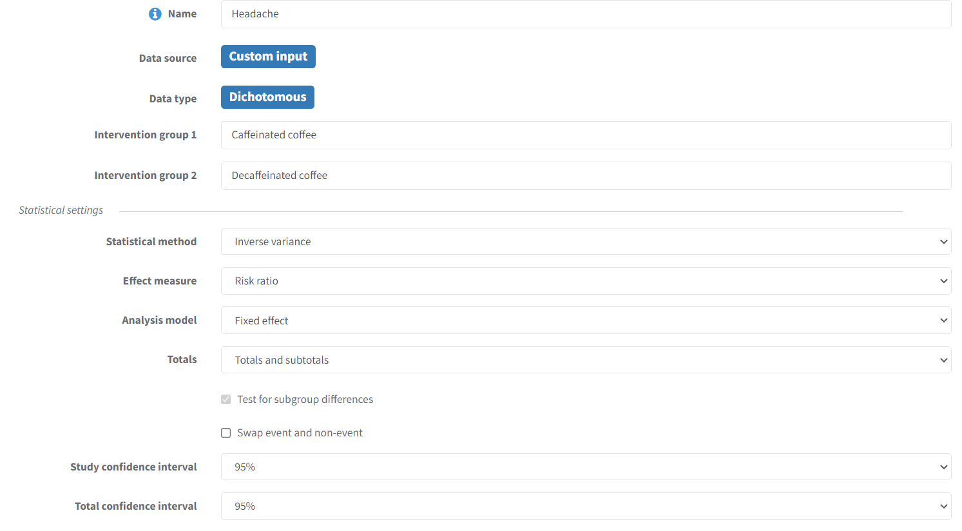
Meta-analysis options
Notes:
When you create an outcome in RevMan, these are the options you have available to choose from. You can see the choice between the meta-analysis method. Unless you have a strong preference, or you are working with a Cochrane group who has recommended one of these meta-analysis methods, you can leave the default settings in place.
For this dichotomous outcome, we can also choose between RR, OR and RD.
There’s one other important choice to make about your meta-analysis – between fixed-effect and random-effects meta-analysis. We’ll come back to that choice in a separate presentation, on Heterogeneity.

Slide 20
Session outline
principles of meta-analysis
steps in a meta-analysis
presenting your results

Slide 21

A forest of lines
Trees Joyce Kilmer Forest by charlescleonard http://www.flickr.com/photos/charlescleonard/3754931947/
Notes:
[NOTE TO TRAINERS: ASK: Does anyone know how we present the results of a meta-analysis?]
They are presented on a forest plot – so-called because it’s said to resemble a forest of lines on the page.

Slide 22
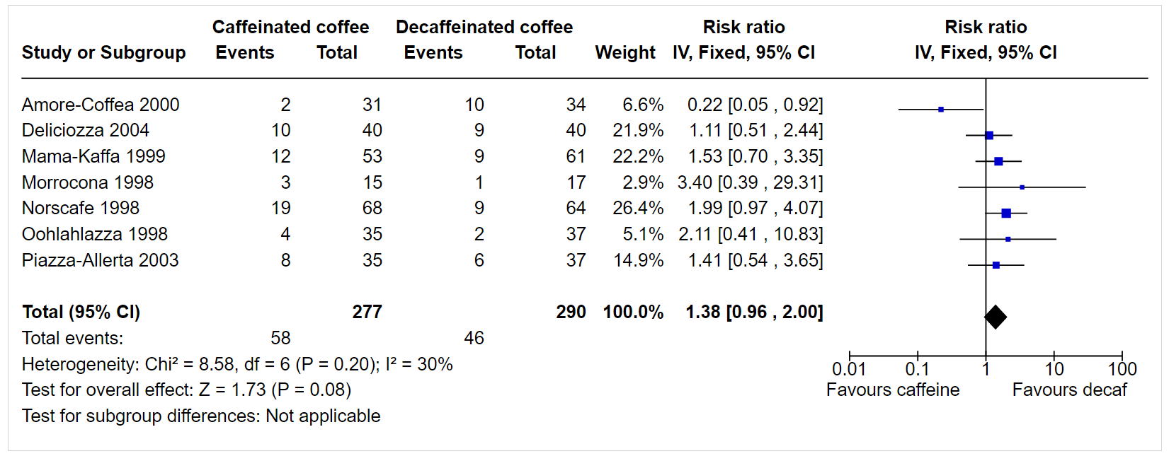
Forest plots
Headache at 24 hours
headings explain the comparison
Notes:
This is what a forest plot looks like. This example is from our caffeine review, reporting the headache outcome.
[NOTE TO TRAINERS: ASK: Who has seen one of these before? Are you comfortable interpreting a forest plot?]
CLICK: Headings at the top of the table tell you what the comparison is – first the intervention, and then the control. In this case, our intervention is caffeinated coffee, and our control is decaffeinated coffee.

Slide 23
Forest plots
Headache at 24 hours
list of included studies
Notes:
On the left is a list of included studies (by first author’s name and year of publication, by Cochrane convention).

Slide 24
Forest plots
Headache at 24 hours
raw data for each study
Notes:
Individual data are presented for each study – in this case, number of events and sample size. For a continuous outcome, the mean and SD would be shown with the sample size.

Slide 25
Forest plots
Headache at 24 hours
total data for all studies
Notes:
The total data for all the included studies is also given – in this case, the total number of events and participants in the intervention groups and control groups.

Slide 26
Forest plots
Headache at 24 hours
weight given to each study
Notes:
The weight assigned to each study in the meta-analysis is given.

Slide 27
Forest plots
Headache at 24 hours
effect estimate for each study, with CI
Notes:
The individual result for each study is given – in this case, the Risk Ratio with a 95% confidence interval. The statistical options chosen are noted at the top.

Slide 28
Forest plots
Headache at 24 hours
effect estimate for each study, with CI
Notes:
The individual study results are also presented graphically. The coloured square shows the effect estimate, and the size of the square corresponds to the weight given to the study in the meta-analysis.
The horizontal line shows the confidence interval. The vertical line down the middle indicates the line of no effect – in this case, for a ratio, at 1.
[NOTE TO TRAINERS: ASK: What does it mean if the 95% CI crosses the line of no effect?]
It means the results is not statistically significant, although there’s more to interpreting these results than statistical significance.

Slide 29
Forest plots
Headache at 24 hours
scale and direction of benefit
Notes:
At the bottom of the plot is the scale, which you can adjust in RevMan as needed. Note that for ratios the scale is a log scale. The lowest value a ratio can take is 0, 1 represents no effect, and highest value it can take is infinity. The data are presented on a log scale to make the scale and the confidence intervals appear symmetrical. For an absolute effect (e.g. RD, MD), the scale is symmetrical, showing positive and negative values around 0 as the point of no effect.
Below the scale is an indication of which side of the plot favours the intervention. This will depend on the outcome you are measuring. The right side of the scale always indicates more events, or a higher score, for the intervention. The left side always indicates fewer events, or a lower score for the intervention. If you’re measuring something good, such as recovery or quality of life, then a result on the right side will be a good outcome for the intervention, because you want an increase in your outcome. A result on the left side will favour your control, because it means a decrease in your desired outcome.
If you’re measuring something bad, such as headaches or irritability, then a result on the left side of the scale will indicate a favourable result for your intervention, because you wanted to reduce the outcome. A result on the right side will be bad for the intervention, because it indicates an increase in the negative outcome, and so results on the right side favour the control.
It’s important that you read these labels carefully, and make sure you have them the right way around, depending on whether you’re measuring a good or a bad outcome.

Slide 30
Forest plots
Headache at 24 hours
pooled effect estimate for all studies, with CI
Notes:
Finally, the pooled result for all the studies combined is presented, both in numbers and graphically. The result is shown graphically as a black diamond. The top and bottom points of the diamond correspond to the overall effect estimate, and the width of the diamond represents the confidence interval.

Slide 31
Confidence intervals
Always present estimate with a confidence interval (CI)
Effect estimate from study sample – best guess of effect
Estimating effect in greater population - uncertainty
95% CIs are calculated to describe uncertainty around the effect estimate
Describes a range of values we can be 95% certain includes the true effect
Precision
Narrow CI (e.g. 0.70 to 0.80) indicates that the effect size is known precisely
Wide CI (e.g. 0.60 to 0.93) indicates greater uncertainty
Very wide CI (e.g. 0.50 to 1.10) indicates that we have very little knowledge about the effect
Notes:
Whenever we present results in a Cochrane Review, we need to include a measure of uncertainty, such as a confidence interval. While the point estimate is our best guess of the effect of the intervention, based on the information we have, we need to take into account that next time we take a sample, we might not get the same result. The confidence interval represents the range of values we can be reasonably sure includes the true value of the effect – for a 95% CI, if we repeated the study indefinitely, the CI would include the true effect 95% of the time.
A narrow confidence interval means we have a precise estimate of the effect. A wide confidence interval means less precision, although sometimes we can still be certain enough to make a decision about the intervention – if the CI is wide, but both the top and bottom of the range indicate a beneficial effect, we can go ahead and use the intervention. If the CI is very wide, and it includes conflicting effects (e.g. benefit and harm), then perhaps we don’t have enough information to make a decision.

Slide 32
Confidence intervals
Largely affected by sample size
Larger sample = narrower 95%CIs in individual studies
In meta-analysis, more studies will lead to a narrower CI if results are similar
If results are conflicting, more studies may lead to a wider CI
Significance
if the CI includes the null value
rarely means evidence of no effect
effect cannot be confirmed or refuted by the available evidence
consider what level of change is clinically important
Notes:
The width of the confidence interval for an individual study depends to a large extent on the sample size. For an individual study, larger studies tend to have narrower confidence intervals (more precise effect). For a meta-analysis, more studies will usually mean a narrower CI, although if the study results are conflicting with each other, more studies may lead to a wider CI.
The CI can also tell us about the statistical significance of the estimate – if the CI includes the line of no effect, then the result is not statistically significant at that level (e.g. a 95% CI corresponds to a P value of 0.05, a 90% CI corresponds to a P value of 0.1). Authors are advised NOT to describe results as ‘not statistically significant’ or ‘non-significant’, but to interpret what the results tell us.
It’s important to be able to tell the difference between ‘evidence of no effect’ and ‘no evidence of effect’. A non-significant result may mean that we don’t have enough information to be certain that the intervention works, but if we had some more studies and more results, our precision might increase. Alternatively, if we have lots of studies, and a very precise result sitting right on the line of no effect, then perhaps we can be certain that the intervention has no effect.
It’s also important to consider clinical significance – for this outcome, in the context of your question, what level of change would be considered important? e.g. 10% decrease in risk? 2 point change on a 10 point pain scale? If the CI shows a range that includes values above and below your clinical important change, then you can’t be confident that the effect will be large enough to be important to your patients. If the range also includes the line of no effect, then you can’t be certain that the intervention will have any effect, and may even be harmful.
More on interpretation will be covered in a separate presentation.

Slide 33
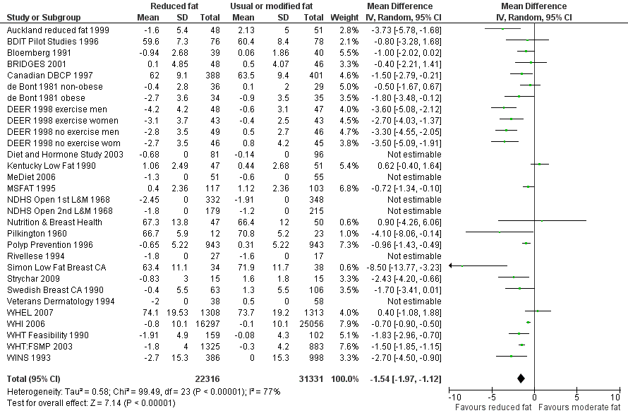
Considering clinical significance
Hooper L, Abdelhamid A, Bunn D, Brown T, Summerbell CD, Skeaff CM. Effects of total fat intake on body weight. Cochrane Database of Systematic Reviews 2015, Issue 8. Art. No.: CD011834. DOI: 10.1002/14651858.CD011834
Notes:
In this example, the review looks at the effects of total fat intake on body weight, comparing low dietary fat intake with usual fat intake in the general population. The mean difference in weight loss between groups with at least 6 months follow-up was 1.54kg (95%CI -1.97 to -1.12kg). This is a significant effect, as the 95% CI indicates, that we can be 95% certain that the weight loss in the population is somewhere between 1.12 and 1.97 kg (the CI does not cross ths line of no effect).
[NOTE TO TRAINERS: ASK: Is this effect clinically important?]
Is a difference in weight loss of 1.5kg between groups, over a period of 6 months clinically significant? Considering that our daily weight can fluctuate by up to 2kg due to fluid intake, perspiration, exercise, menstrual cycles etc. this statistically significant difference is probably not clinically significant. We would also want more information on the average baseline weight, as a 5-10% reduction from the baseline weight could be seen as clinically meaningful weight loss.

Slide 34
Presenting data in your review
present outcomes in consistent order throughout
Abstract, Methods, Results, data
forest plots
key forest plots linked as figures
usually primary outcomes
all forest plots will be published as supplementary data
avoid forest plots with only one study
may also add other data tables
results of single studies
summary data for each group, effect estimates, confidence intervals
non-standard data
Notes:
There’s more to your analysis than this, and we’ll come back to talk about some tricky types of data, and exploring and interpreting your results in separate presentations.
First, a few words on how your forest plots fit in with the results section of your review. First, your results section should present a systematic, narrative summary of the results. Don’t need to repeat all the data in the text, but make sure you summarise the key findings, and that the text makes sense without referring to the plots.
All your forest plots will be included in the online version of the review, and you should make sure that you’re not including unnecessary forest plots, such as repetitive variations on the same plot, or forest plots with only one included study, as these just make it more difficult for the reader to navigate through all the information. It may be preferable to include outcome data from single studies in a table rather than presenting multiple single-study forest plots.
The complete set of forest plots is treated as supplementary data alongside the online version of your published review. Some printed versions will not include all the forest plots, so you should select a small number of key forest plots, usually relating to your primary outcomes, and link them as figures in the results section – the same way you would for any published paper. These will then be included with any printed version of the review.
Don’t forget that you might also have other data you need to present, that wouldn’t fit in the forest plots, such as results in different formats that did not match the other studies, or results of single studies that were the only ones to report a particular comparison or outcome. These results should not be left out of your review - you need to give a complete and unbiased picture of the evidence.
Don’t forget, though, that some results may not be helpful to include. For example, trivial outcomes measured by your included studies but not considered important at the protocol stage do not have to be included (although you might note that they were measured in your ‘Characteristics of included studies’ table. You may also choose not to report results at high risk of bias. Always be clear and report when you have chosen not to include some results.

Slide 35
What to include in the protocol
how will you decide whether a meta-analysis is appropriate?
meta-analysis model to be used
Notes:
Thinking back to the protocol stage, you’ll need to give brief descriptions of your planned analysis. First, you’ll need to briefly state that you will consider whether your studies are similar enough to meta-analyse before proceeding. You’ll also need to specify the meta-analysis methods you plan to use.

Slide 36
Take home message
there are several advantages to performing a meta-analysis but it is not always possible (or appropriate)
plan your analysis carefully, including comparisons, outcomes and meta-analysis methods
forest plots display the results of meta-analyses graphically
interpret your results with caution

Slide 37
References
Deeks JJ, Higgins JPT, Altman DG (editors). Chapter 10: Analysing data and undertaking meta-analyses. In: Higgins JPT, Thomas J, Chandler J, Cumpston M, Li T, Page MJ, Welch VA (editors). Cochrane Handbook for Systematic Reviews of Interventions version 6.2 (updated February 2021). Cochrane, 2021. Available from www.training.cochrane.org/handbook.S
Schünemann HJ, Higgins JPT, Vist GE, Glasziou P, Akl EA, Skoetz N, Guyatt GH. Chapter 14: Completing ‘Summary of findings’ tables and grading the certainty of the evidence. In: Higgins JPT, Thomas J, Chandler J, Cumpston M, Li T, Page MJ, Welch VA (editors). Cochrane Handbook for Systematic Reviews of Interventions version 6.2 (updated February 2021). Cochrane, 2021. Available from www.training.cochrane.org/handbook.
Acknowledgements
Compiled by Miranda Cumpston
Based on materials by Sally Hopewell, Julian Higgins, the Cochrane Statistical Methods Group and Cochrane Netherlands
Approved by the Convenors of Cochrane Methods Groups

