Slide 1
Exploring heterogeneity

Slide 2
Steps of a Cochrane Review
define the question
plan eligibility criteria
plan methods
search for studies
apply eligibility criteria
collect data
assess studies for risk of bias
analyse and present results
interpret results and draw conclusions
improve and update review
Notes:
An important part of the analysis and interpretation of your results is assessment and exploration of heterogeneity.

Slide 3
Session outline
what is heterogeneity?
assumptions about heterogeneity
identifying heterogeneity
exploring your results
See Chapter 10 of the Handbook

Slide 4
What is heterogeneity?
Variation or differences
three broad types:
clinical
methodological
statistical
Notes:
Heterogeneity is a term to refer to variation or differences across studies. It's often used specifically for variation between the results of the studies in a review, but we'll start by taking a broader perspective. There are three general types of heterogeneity that we’re interested in: clinical, methodological and statistical.
We’re interested in these differences because they can indicate that our intervention may not be working in the same way every time it’s used. By investigating these differences we can reach a much greater understanding of what factors influence the intervention, and what result we can expect next time the intervention is implemented.

Slide 5
Clinical diversity
participants
e.g. condition, age, gender, location, study eligibility criteria
interventions
intensity/dose, duration, delivery, additional components, experience of practitioners, control (placebo, none, standard care)
outcomes
follow-up duration, ways of measuring, definition of an event, cut-off points
Notes:
Clinical heterogeneity, or clinical diversity, refers to the real world differences between the populations and interventions in the studies, and the concept applies even if your review is not looking at clinical question. These are likely to be the same variations you considered when you were considering the question for your review.
Each study will have its own eligibility criteria, and will be set in its own context. Populations may differ according to the type or severity of the health condition they have; their age, gender, ethnic background or socioeconomic status; and their geographic location.
Interventions will vary in how they are implemented between each study, including the dose or intensity of the intervention, the different components included, who delivered the intervention, and whether the intervention is being compared to exactly the same control.
Outcomes will also vary from study to study, in the way they are measured, how events and cut-off points are defined, and what time points are chosen for measurement.

Slide 6
Methodological diversity
design
e.g. randomised vs non-randomised, crossover vs parallel, individual vs cluster randomised
conduct
e.g. risk of bias, approach to analysis
Notes:
Studies can also differ in how they are designed and conducted – what we call methodological heterogeneity, or methodological diversity. Different study designs will produce different results, including randomised versus non-randomised designs, as well as variations on RCTs, such as crossover, parallel and cluster-randomised trials.
Within a study, we know that bias arising from the way the study is conducted can change the results. Including studies at high and low risk of bias may well lead to differences in the results. The choices made about how the results are analysed will also affect the results, such as the statistics used, any imputation of missing data, etc.
One further type of heterogeneity you might find is when the small studies in your review have systematically different findings to the large studies – what we call small study effects. This can have a number of different causes, including the possibility of publication bias among others. This possibility is discussed in further detail in a separate presentation on small study effects and reporting biases.

Slide 7
Statistical heterogeneity
there will always be random (sampling) variation between the results of different studies
heterogeneity is variation between the effects being evaluated in the different studies
caused by clinical and methodological diversity
alternative to homogeneity (identical true effects underlying every study)
study results will be more different from each other than if random variation is the only reason for the differences between the estimated intervention effects
Notes:
Both of these kinds of diversity – clinical and methodological – can be the cause of what we call statistical heterogeneity. Any time we take measurements from different samples – in this case, different study populations, there will be some random variation from study to study.
What we’re really interested in is what we call statistical heterogeneity - true differences in the underlying effect that studies are trying to measure, that can be caused by the kinds of clinical and methodological variation we’ve just discussed, such as differences in the population or intervention, or the presence of bias.
We can see statistical heterogeneity in the underlying effects when the results we observe from each study are more different from each other than we would expect to occur by chance, indicating that more substantive differences are present. Where heterogeneity is present, we are rejecting the assumption of homogeneity – that every study is trying to measure an identical effect.
Statistical heterogeneity is what we will refer to when we say ‘heterogeneity’ from here on in this presentation.

Slide 8
Session outline
what is heterogeneity?
assumptions about heterogeneity
identifying heterogeneity
exploring your results
Notes:
Before we look at the results of our meta-analysis, we need to consider our a priori view about heterogeneity, and some assumptions.

Slide 9
Fixed-effect vs random-effects
two models for meta-analysis available in RevMan
make different assumptions about heterogeneity
pre-specify your planned approach in your protocol
Notes:
Back at the planning stage of your meta-analysis, you will need to give some thought to heterogeneity in your review. Your assumptions about heterogeneity will affect the decisions you make about how to analyse your data.
There are two models of meta-analysis available in RevMan, fixed-effect and random-effects. Which one you choose will depend on your assumptions about heterogeneity, so it’s important to understand them and plan which one to use at the protocol stage.

Slide 10
Fixed-effect model
Random (sampling)
error
assumes all studies are measuring the same treatment effect
estimates that one effect
if not for random (sampling) error, all results would be identical
Study
result
Common
Source: Julian Higgins
true effect
Notes:
The fixed-effect model assumes that all the studies in your review are estimating the same underlying effect – that is, there is one true effect of your intervention, and each study is more or less accurate in trying to measure that one true effect.
[NOTE TO TRAINERS: ASK: If there is one true effect of the intervention, why don’t all the studies measure that effect? Why are they not lined up along the line?]
The answer is random error, or sampling variation. I can’t measure the universal true effect with perfect accuracy by measuring 20 people, or 200 people, or even 2000 – each time I will get an estimate that is more or less accurate at random. The smaller the study, the more likely it is to be mistaken about the true effect. So, say for example that the true effect of your intervention is 2. Not every study will report the exact answer of 2, but you will see answers scattered either side, e.g. 2.2, 2.5, 1.3 – and we can use these numbers to estimate the true effect.
Effectively, this model assumes that all the differences between studies are due to random error, and ignores the possibility of heterogeneity.

Slide 11
Random-effects model
Random
assumes the treatment effect varies between studies
estimates the mean of the distribution of effects
weighted for both within-study and between-study variation (tau², τ²)
error
Study-
specific
effect
Mean of true
Source: Julian Higgins
effects
Notes:
Using a random-effects model, we don’t accept that there is just one true effect for all the studies. Instead, we assume that each study has its own study-specific effect – that over and above the random error, there are genuine differences in the underlying effects being measured by each study. That is, this model assumes the presence of heterogeneity. Instead of having a single effect, your set of studies reports a distribution of related effects, depending on how and where the intervention is used each time.
The random-effects meta-analysis is one of the standard meta-analysis methods in RevMan that you can select. Instead of reporting an estimate of the overall effect, RevMan will estimate the mean of the distribution, the mean of those study-specific effects. It’s important that you get this right when reporting the results of your meta-analysis in your review.
In calculating this mean, the random-effects model weights the studies differently. The model uses the variance within each study as usual, and also adds a second measure known as tau². Tau² is an estimate of the variance of that distribution of effects between studies. You’ll see it reported at the bottom of each random-effects meta-analysis in RevMan.

Slide 12
What’s the difference?
random-effects (RE) meta-analyses are:
almost identical to fixed-effect when there is no heterogeneity
similar to fixed-effect but with wider confidence intervals when there is heterogeneity of the sort assumed by RE model
different from fixed-effect meta-analyses when results are related to study size
RE model gives relatively more weight to smaller studies
Notes:
So what difference does the choice of model make to our results? We saw in the Introduction to Meta-analysis presentation that the inverse-variance model of meta-analysis weights each study according to the inverse of its variance – that is, the variance within each study. This is the fixed-effect model.
In a random-effects meta-analysis the results are weighted differently. An extra value is incorporated – tau² represents the variance between the studies, giving us a picture of that distribution of effects, as well as the variance within each study. If there is no heterogeneity present, no observable difference between the effects measured by each study, then tau² is 0, and we are effectively using the fixed-effect formula. There will be no difference then in the weights given to each study or the results of the meta-analysis.
More commonly, there is some heterogeneity present, and tau² will have a value that changes the weighting. The effect of this is that the random-effects model will give more even weighting to all the studies in the meta-analysis – the big studies won’t get so much more weight than the others as they otherwise would. The effect estimate itself – remembering that this is now the mean effect across studies – will actually still be very similar to a fixed-effect analysis. However, the confidence intervals will be wider, indicating that we have greater uncertainty about our estimate of the mean effect than we would have if estimating a single effect using the fixed-effect model.
It’s important to note that the wider confidence intervals around a random-effects analysis don’t represent the width of the distribution of effects across studies, or show the degree of heterogeneity – they just represent our uncertainty around the estimate of the mean effect. If there are many studies in a meta-analysis, it’s possible to have a very narrow confidence interval around the estimate of the mean even when there is a large amount of heterogeneity. It’s possible to calculate statistics that reflect the width of the distribution, such as the predictive interval, but this isn’t yet available in RevMan. If we want to try to measure the heterogeneity, we need to use other tools, and we’ll discuss that further shortly.
There’s one important occasion when a fixed-effect and random-effects analysis will give you quite different results. The effect of giving more even weight to all studies, is that random-effects meta-analysis gives greater weight to the smaller studies. This is important where the results of the studies are correlated with their size – where the smaller studies are for some reason reporting systematically different results to the larger studies. In this case random-effects meta-analysis will give a different effect estimate, as well as a wider confidence interval. This is called ‘small study effects’, and deserves further investigation. Small study effects are discussed in more detail in a separate presentation that also looks at reporting biases (‘Bias due to missing results in a synthesis’).

Slide 13
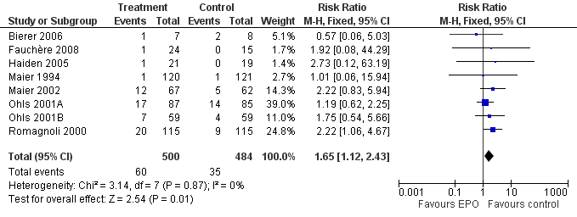
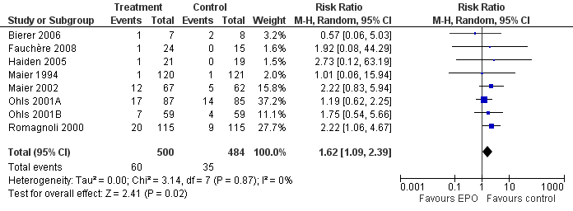
No heterogeneity
Fixed
Random
Adapted from Ohlsson A, Aher SM. Early erythropoietin for preventing red blood cell transfusion in preterm and/or low birth weight infants. Cochrane Database of Systematic Reviews 2006, Issue 3.
Notes:
Let’s see what that looks like in practice. In this case, we have a review of early erythropoietin to prevent red blood cell transfusions in preterm infants, and we are measuring the occurrence of retinopathy. This forest plot shows the results using the fixed-effect model, [CLICK] and this shows the same data analysed using the random-effects model.
In this case, the included studies are all giving very similar results – you can see from the forest plots that they are all quite well lined up. There is no heterogeneity to speak of, and you can see that the results are almost the same, although not exactly identical. We can also see the estimate of tau² – in this case it is 0, so there is no additional value to affect the weighting of studies.

Slide 14
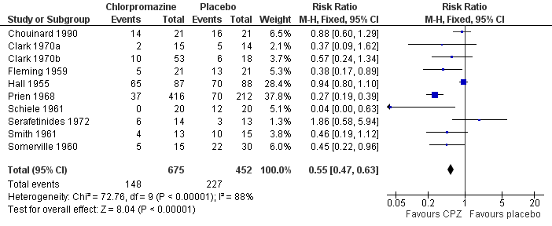
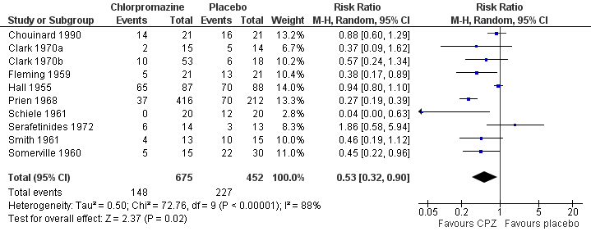
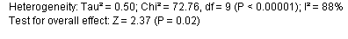
Some heterogeneity
Fixed
Random
Adapted from Adams CE, Awad G, Rathbone J, Thornley B. Chlorpromazine versus placebo for schizophrenia. Cochrane Database of Systematic Reviews 2007, Issue 2.
Notes:
In this case, we are looking at a review of chlorpromazine for schizophrenia, and we are looking at occurrence of deteriorated behaviour. In this case, there is more variation between the individual studies – they are not all reporting consistent results. Here is the fixed-effect analysis [CLICK] and here is the random-effects analysis. Looking at the results, the random-effects model is giving us a very similar effect estimate, but with a noticeably wider confidence interval.
We can see that, in this example, tau² is not zero – so we have an extra value affecting the calculation of the weights in this meta-analysis.
Remember that the diamond in the random-effects meta-analysis now represents the best estimate of the mean of effects across all the studies. The width of the diamond represents our uncertainty around that mean – it doesn’t truly represent the breadth of the distribution of effects, so we can expect to see individual studies reporting results outside this interval.

Slide 15
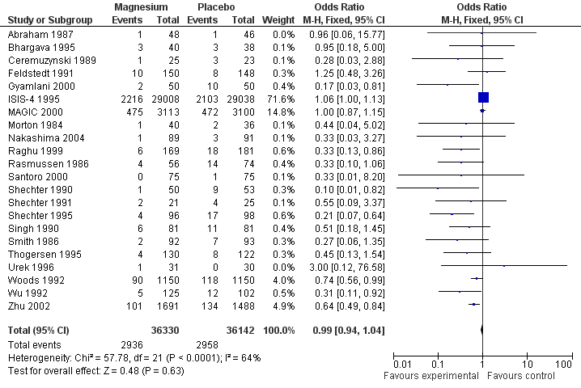
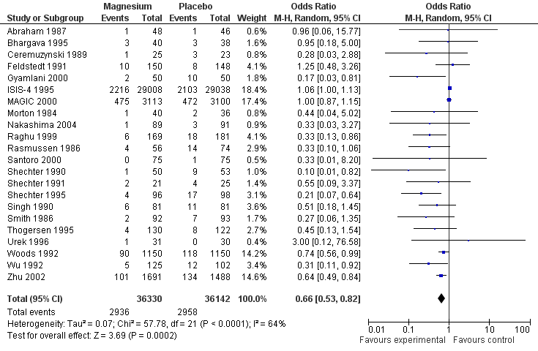
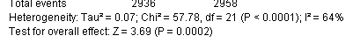
Small study effects
Fixed
Random
Adapted from Li J, Zhang Q, Zhang M, Egger M. Intravenous magnesium for acute myocardial infarction. Cochrane Database of Systematic Reviews 2007, Issue 2.
Notes:
Here we have an example where the size of the studies in the review is correlated with their results. This review is looking at intra-venous magnesium for acute myocardial infarction, and measuring mortality. As you can see, there are a few large studies, shown by the large squares, lined up closely to the line of no effect. There are then a lot of small studies, and they are all over to the left of the plot, showing a stronger reduction in mortality.
The fixed-effect model gives greater weight to the larger studies, and so the result is right on the line of no effect. [CLICK] In comparison, the random-effects model gives quite a different result – it has shifted to the left, and now shows a significant reduction in mortality. We can see that tau² is not zero, so that extra value is playing a role in the meta-analysis, but the really important place to look on this forest plot is the weights. The random-effects model gives much less weight to the large studies – you can see that the big squares are now very small, and the weight of the ISIS study has dropped from 71% to 18% of the total weight. Giving greater weight to all those small studies off to the left is what has affected the result of the meta-analysis.
Technically speaking, in these cases neither result is perfectly accurate – each has flaws in the assumptions they are making. If you come across this kind of example, you’ll need to do some further work to explore the reason for these small study effects. The important question is not, “which should I present?”, but “what does this mean?”, and we’ll talk further about how to explore that later.

Slide 16
Which to choose?
plan your approach at the protocol stage
do you expect your results to be very diverse?
consider the underlying assumptions of the model
fixed-effect
may be unrealistic – ignores heterogeneity
random-effects
allows for heterogeneity
estimate of distribution of studies may not be accurate if biases are present, few studies or few events
Notes:
There is no correct answer as to which model you should use for your review. If possible, it’s important to plan your analysis in advance, at the protocol stage, to avoid making biased decisions about the model once you see the results of your meta-analysis.
The most important thing to consider is the assumptions each model makes: essentially, do you believe in heterogeneity? Do you expect there will be differences between your studies that are not just caused by random chance, or do you expect your intervention to be consistent in most contexts?
In particular, don’t make this decision based on a particular measure of observed heterogeneity – heterogeneity may be at work or not regardless of whether we are able to detect it at a particular level with a particular test.
Each model has advantages and disadvantages. The fixed effect model is our best estimate of the overall effect of the intervention, based on the data we have, but it may be unrealistic to ignore heterogeneity in our model. It will give us a more precise effect estimate, with narrower confidence intervals, but that precise estimate may not really be applicable to all populations, contexts and variations on the intervention.
The random effects model takes that heterogeneity into account, although in doing so it does make some assumptions of its own about the distribution of the study effects, which may not be accurate if the study effects are not randomly distributed, for example if bias is present, or if we don’t have enough studies to get an accurate picture of the distribution.
If you are working with Cochrane group who have a preferred model, you should go ahead and use that, but otherwise, as review authors, you should select the model that you feel best represents your assumptions about heterogeneity.

Slide 17
Session outline
what is heterogeneity?
assumptions about heterogeneity
identifying heterogeneity
exploring your results
Notes:
So, when we are looking at the results of our meta-analysis, how do we know if we have heterogeneity?

Slide 18
Identifying heterogeneity
visual inspection of the forest plots
Chi-squared (χ²) test (Q test)
I² statistic to quantify heterogeneity
Notes:
There are three tools we can use to identify heterogeneity:
a visual inspection of the forest plot, also called the ‘eyeball test.’
the chi² test, otherwise known as the Q test
the I² statistic

Slide 19
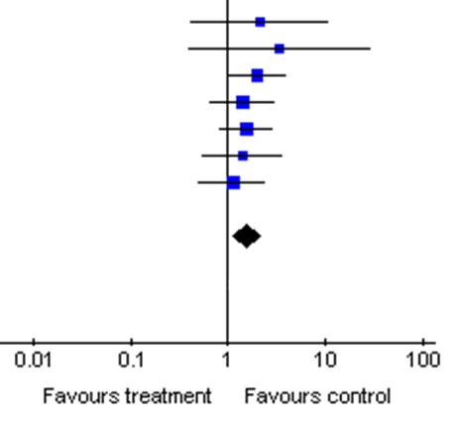
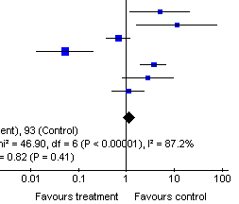
Visual inspection
Forest plot A
Forest plot B
Notes:
[NOTE TO TRAINERS: ASK: Which of these studies shows more heterogeneity?]
The first step you should always take is to visually examine your forest plots, and look to see whether all your studies are reporting consistent results. Look for overlap in the confidence intervals, not just differences in the effect estimate. For example, in Forest plot B, the studies on the left of the plot are not consistent with some of the studies on the right, not necessarily because their blue dots don’t’ line up, but because their confidence intervals don’t overlap – it’s not likely that each study is measuring the same true effect.
It’s also important to note that the presence of heterogeneity is not about which side of the line of no effect the results are on. It’s possible to have very consistent studies whose results are slightly one side of the line or the other, and it’s possible to have studies that are very inconsistent even thought they are all showing different degrees of a positive effect, all on one side of the line.
Having said that, whether the results are either side of the line of no effect may influence our assessment of whether the heterogeneity matters. For example, it affects our understanding more in a case like this, where the heterogeneity is around the null effect and we have studies going in each direction. If all the studies were showing different degrees of positive effect, we would be more confident of that the intervention is effective, and we would know how to act, even if we were uncertain about the exact strength of the effect.

Slide 20
The chi-squared (χ²) test
tests the null hypothesis of homogeneity
low power with few studies
may detect clinically unimportant differences with many studies
narrow question (yes/no) not useful if heterogeneity is inevitable
calculated automatically by RevMan
Notes:
One of the tools available to help us detect heterogeneity is the chi² test, which is added automatically to every forest plot created in RevMan. This test assumes the null hypothesis that all the studies are homogeneous, or that each study is measuring an identical effect, and gives us a P value to test this hypothesis. If the P value is very low, it means we can reject this assumption – the studies are too different for them all to be truly measuring the same effect, and we can conclude that heterogeneity is present.
However, the test is not very reliable – when there are few studies, which is the case with most Cochrane Reviews, then the test is not sensitive enough, and can wrongly conclude that there is no heterogeneity. For this reason, people often use a cut-off for the P value of P < 0.1, rather than P < 0.05, but insensitivity can still be a problem. On the other hand, when there are many studies, although this is less common, the study can be too sensitive, and can detect that there is heterogeneity – but it might detect heterogeneity that is not very important to us. A significant result may also arise from a single outlying study, rather than general dispersion of results – which would require two different approaches to interpreting the results.
In addition, a test like this is not very informative and quite rigid – it gives only a yes or no answer about heterogeneity, based on an arbitrary cut off point. Further, if it’s possible to assume that heterogeneity is always present (as we do for a random effects analysis), then using a test to tell us whether there is heterogeneity or not is not very useful.
[NOTE TO TRAINERS:: chi² test is calculated using the Q statistic, which is then compared to the chi² distribution to obtain a P value. Q = ∑w_{i}(y_{i}-Θ) ², where w is the weight of each study, y is the effect estimate of each study, and Θ (theta) is the effect estimate of the meta-analysis.]

Slide 21
The I² statistic
I² statistic describes the percentage of variability due to heterogeneity rather than chance (0% to 100%)
low values indicate no, or little, heterogeneity
high values indicate a lot of heterogeneity
calculated automatically by RevMan
be cautious in interpreting
Notes:
More useful than a simple yes/no test for heterogeneity is a way to measure the extent to which studies are agreeing with each other, and we can do that with the I² statistic. This measure tells us how much inconsistency we have – what percentage of the observed variability in effect estimates is above what we would expect to see from random chance or sampling error alone.
Low values of I², close to zero, indicate little or no heterogeneity – effectively, all the variation observed could be plausibly due to random error. 100% indicates very high heterogeneity. For the range of values in between, there are no universal cut-off points for interpretation, as the importance of a particular value of I² depends on factors such as the magnitude and direction of the meta-analysis result. Roughly speaking, below 30-40% may represent low or unimportant heterogeneity, 30-60% might represent moderate heterogeneity, 50-90% might represent substantial heterogeneity, and 75-100% might represent quite high heterogeneity.
It’s important that the I² is only taken as a guide, and not definitive proof that you do or don’t have heterogeneity at a particular level. Like any statistic, I² has a level of uncertainty. RevMan currently does not provide confidence intervals, but CIs for I² can be very wide, so be cautious. Because there is usually a lot of uncertainty in I², it should not be used alone. If confidence intervals are not available to you, look also at the result of the chi-squared test.

Slide 22
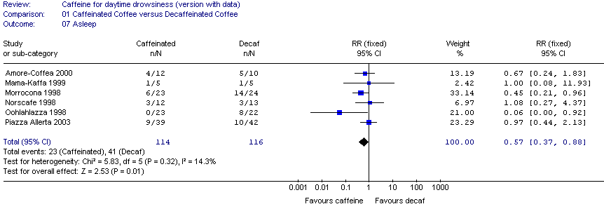
The I² statistic
Notes:
In this case, the I² has been calculated at 14.3%, which is low, and we can see that the studies are all fairly consistent with overlapping confidence intervals.

Slide 23
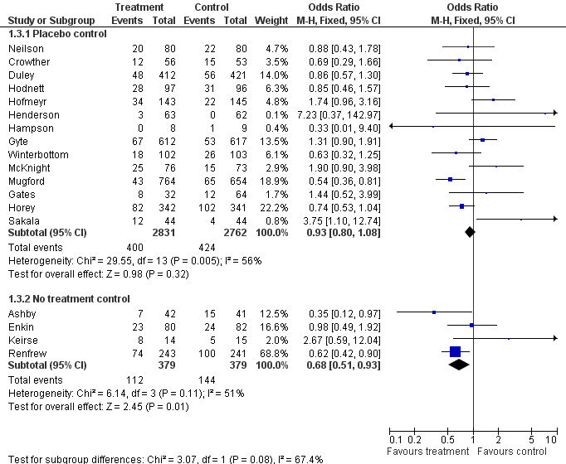
Source: Julian Higgins
Notes:
In these two examples, we have two groups of studies measuring bleeding as an outcome in a review on Vitamin K.
In the first group, using the chi² test, we have a P value of 0.005, indicating that there is heterogeneity present. In the second group, we have a P value of 0.11, which is not low enough to reject the null hypothesis of homogeneity.
[CLICK] However, if we look at the I² values, we can actually see that the amount of heterogeneity is very similar between these two meta-analyses, at a moderate level. Perhaps with fewer studies in the second group the test just did not have enough power to successfully identify heterogeneity.
Generally speaking, the I² statistic is more informative in most cases.

Slide 24
Plan approach in your protocol
Studies too dissimilar?
yes
Don’t proceed with MA
no
Proceed with MA
Check data.
Explore reasons as pre-planned
Heterogeneity?
yes
no
Report overall analysis. Cautiously present effect modifiers
Present overall analysis
Found effect modifiers?
no
Present overall analysis. Note unexplained heterogeneity
Notes:
What should you do about the heterogeneity in your meta-analysis? The following is a possible algorithm to follow.
Plan to use either a fixed-effect or random-effects meta-analysis model at the protocol stage, taking into consideration whether you expect heterogeneity to influence your analysis, and the features of each model. A fixed-effect analysis gives confidence intervals that ignore any heterogeneity across studies. Random-effects analysis allows for heterogeneity, but is an imperfect measure of the uncertainty across the distribution of effects. Never select a model based on a statistical test for heterogeneity, but follow your planned analysis. You may wish to conduct and comment on a sensitivity analysis, e.g. if you planned a fixed-effect analysis but observed high heterogeneity, or if a systematic difference in the results of small studies is affecting a random-effects analysis.
When you have all the studies included in your review, you need to decide if they are too dissimilar for a meaningful meta-analysis. This refers to the clinical and the methodological heterogeneity. If your studies are too dissimilar it may be best not to proceed with your meta-analysis. Any average result you calculate in these circumstances may be meaningless, and not useful for readers of the review hoping to predict how the intervention will work if they decide to use it. Instead, you could consider a narrative synthesis of the results.
When you combine your data in a meta-analysis, you will need to assess the level of heterogeneity in your results. If there is no heterogeneity, you can go on and present results of overall analysis.
If you find very high heterogeneity, you should first check the data – surprising results may be due to errors in the data collection or data entry, so make sure you check any outliers. Mistaking a standard error (SE) for a standard deviation (SD), or unit of analysis errors can also lead to overly narrow confidence intervals, which can increase your heterogeneity. If your data are all correct and the heterogeneity is still high, you should carefully think about exploring the results of your studies, to better understand why there is heterogeneity, and identify the important factors that are affecting your results. Some authors use specified I² values as thresholds for investigating heterogeneity, but particular values of I² may not be meaningful, especially if there are very few studies. As authors of the review, you still have a responsibility to interpret and contextualise the results for your readers. Your approach should avoid focusing on single outlying studies, changing the effect measure in your meta-analysis to reduce the heterogeneity, or investigating ad hoc theories on why studies are different. The possible factors likely to influence your results should be defined in the protocol, and investigated systematically as planned, e.g. by subgroup analyses or metaregression. If you do add any post-hoc factors to your analysis, these should be declared.
Be cautious when interpreting the results of subgroup analyses. Use the formal test for subgroup effects provided in your forest plot to identify whether subgroup effects are truly different from each other, and look for confidence intervals that don’t overlap, and noticeable reductions in heterogeneity within the subgroups, compared to the overall analysis.
If your exploratory analysis has not identified factors causing the heterogeneity, avoid speculating on other factors in your review. Note that unexplained heterogeneity is important to note when you present your results, e.g. as part of a GRADE assessment. Inconsistent results between the studies in your analysis indicate a level of uncertainty of the precise effect of your intervention, and what factors might influence that effect.
Remember to present the results of subgroup analysis, etc. with caution. The populations in subgroup analyses are rarely randomised, and so your results should be considered observational and hypothesis-generating, rather than definitive in most cases.

Slide 25
Session outline
what is heterogeneity?
assumptions about heterogeneity
identifying heterogeneity
exploring your results
Notes:
So, when we are looking at the results of our meta-analysis, how do we know if we have heterogeneity?

Slide 26
Exploring your results
what factors appear to modify the effect?
clinical diversity (population, interventions, outcomes)
methodological diversity (study design, risk of bias)
plan your strategy in your protocol
identify a limited number of important factors to investigate
have a scientific rationale for each factor chosen
declare any post-hoc investigations
Notes:
When you see heterogeneity in your results, the question we want to answer is, if not random chance, what differences in the studies cause these differences in effect? This variation caused by identifiable factors is sometimes called interaction or effect modification.
This is where we can start to explore the impact of what we described earlier as clinical or methodological heterogeneity. In defining the question for your review, it’s likely that you identified some important factors that could affect the study results, including variations in the population and the way the intervention was implemented. For example, perhaps in some studies in your review the drug was given at very low doses, and you want to know whether the low dose is as effective as the standard dose. Or perhaps you want to know if the intervention is effective in children versus adults, or when it’s delivered by in a health setting versus a community setting. We know that differences in the way the studies are conducted can also affect the results.
It’s very important, however, just like it was when we selected our statistical methods, to avoid post hoc decisions after we already have the data. planned subgroup analyses should be specified in the protocol – this will avoid selective decisions about which subgroups to investigate based on the studies’ results.
This can also avoid what we call data ‘dredging’. We want to avoid a situation where you see heterogeneity in the data and you think, perhaps it’s the age groups, so you investigate the age groups and don’t find anything, so then you try the geographic location, the components of the intervention, the severity of disease, the risk of bias of included studies, and finally you try testing for an effect based on whether the author’s last name comes before or after M in the alphabet, and suddenly you find a significant effect. This can happen – the more you investigate the data, the more likely you are to find a significant effect purely by chance.
The characteristics you investigate should be limited in number. Don’t try to investigate every possible variation on every possible factor – aside from anything else, presenting 10 different subgroup analyses on your 7 main outcomes might give you 70 forest plots before you even begin, which is too many to be useful to readers of your review. Think carefully about which key factors you expect to be most important. If there are more than one or two, you may want to consider changing your significance threshold to account for multiple comparisons – for example, requiring a P value of 0.01 rather than 0.05 to identify significance. Get some advice from a statistician about this.
Make sure you have a scientific rationale for each factor you select – how is it that you expect this factor to change the way the intervention works? Make sure you’re not confusing prognostic factors, like age or smoking, that will change the outcome of the health condition, with things that actually change the effect of the intervention. (Noting that age and smoking might also be effect modifiers in some circumstances).
If you do find something during the course of the review that appears to be having an important impact and was not pre-specified, you should go ahead and analyse it. Just be clear and transparent that this was a post-hoc analysis, and treat the results as hypothesis-generating at best, not a conclusive finding.
[NOTE TO TRAINERS: avoid simple analysis of control group risk as a modifying factor. This is inherently correlated with the effect estimate (e.g. odds ratio). If it is low or high by chance alone, then the odds ratio will also be low or high by chance alone, because it is calculated using the control group risk, but this is a complex issue and complex to interpret – statistical advice is required to do this well.]

Slide 27
Two methods available
subgroup analysis
group studies by pre-specified factors
look for differences in results and heterogeneity
meta-regression
examine interaction with categorical and continuous variables
not available in RevMan
Notes:
There are two main methods available to identify interaction, or factors that are modifying the effect of your intervention. Remember to proceed with caution. Each of these methods has potential pitfalls, and you want to avoid misinterpreting and misrepresenting your results.
The first, subgroup analysis, is the most commonly found in Cochrane Reviews. Just as you would in a primary study, we group studies by those pre-specified factors (specified at the protocol stage) that were likely to affect the results of the studies, such as age groups, location of studies, or variations on the intervention, and we compare the results.
The second is meta-regression. This method is not available in RevMan, but if you have statistical advice or you have the expertise yourself, you can run meta-regression in other statistical software. Meta-regression looks for associations between the results of studies and the variables of interest, and can be used for categorical variables (like subgroups) or continuous variables that change along a scale. You need at least 10 studies to run a meaningful meta-regression.
In a systematic review, we rarely have enough detailed data from the included studies to split individual patients into subgroups – it’s more common to group whole studies based on their different populations and interventions. Occasionally, individual patient data is available in the published studies, or obtained directly from the authors. When you have more detailed information within studies – either break-down by subgroup or individual participant data - both subgroup analyses and meta-regression can be extended to look at participant level factors.

Slide 28
Proceed with caution
results are observational, not randomised
be wary of multiple and post hoc comparisons
may not be useful with few studies
may not be able to investigate aggregate data
look for confounding factors
follow the plan specified in the protocol without over-emphasising particular findings
Results are rarely definitive
Notes:
Be cautious about the results. Subgroup analyses are not randomised comparisons – even if the participants are randomised within the study, they may not be randomised to the relevant subgroups. More commonly, we are comparing whole studies against each other, and participants are certainly not randomised to be in one particular study or another. Subgroup analyses are effectively observational studies, with all the associated limitations of possible bias.
Remember that the more subgroup analyses you add, the more likely we are to find false positive and false negative results, and we need to be particularly cautious around post-hoc analyses.
Even where subgroup analyses have been carefully planned, they may not successfully answer the questions we wanted to investigate. Once you have the results of your review, you might find that you have very few studies overall, or very few in one of your subgroups. Consider whether you have enough information to conduct a meaningful investigation of each group – this is quite a common problem in Cochrane Reviews.
Another problem you might come across is aggregate data – for example, if you want to assess the impact of age, you might find that studies only report results for their whole populations, and don’t provide separate data for different age groups. Unless the study populations are very different between studies – such as a group of studies whose whole population is under 30 years, and another group whose population is over 30 years, you won’t be able to effectively investigate these subgroups without individual patient data.
It’s also important to think about possible confounding factors operating at the study level, even though within your studies the individuals may be randomised. Are the studies that were conducted in low-income countries also the studies that used lower doses of the drug? Are the studies conducted in people with more severe disease also the studies that incorporated additional intervention components?
Your best approach is to carefully follow the planned subgroup analysis set out in your protocol. Conduct all the analyses you planned, if possible. When reporting the results, avoid focusing on those results that found significant differences, or that met your expectations, and report all your findings. Overall, you need to be very wary of presenting the results of subgroup analyses as definitive conclusions.

Slide 29
Interpreting subgroup analyses
look at results and heterogeneity within subgroups
are the subgroups genuinely different?
if only 2 subgroups – do the confidence intervals overlap?
statistical tests for subgroup difference
can be more confident about:
pre-specified analyses
within-study analyses
effect is clinically plausible and supported by indirect evidence
effect is clinically important and will alter recommendations
Notes:
When looking at the results of a subgroup analysis, we want to look at the effect estimate for each subgroup, to see whether they’re different from each other, and to see whether the heterogeneity within each subgroup is different from the overall level of heterogeneity, indicating that the studies are more consistent within than between subgroups, and the factor being grouped is explaining some of the observed heterogeneity.
We need to do this carefully, though - don’t just look at their results and see whether the effect estimate is different, or look to see whether the result is statistically significant for one group but not the other. We need to directly compare the subgroups with each other, to see whether the findings are consistent with the possibility that in fact the true underlying effects in each subgroup are the same.
If you have only two subgroups, the simplest way to do that is to compare the confidence intervals – do they overlap? If they don’t, you have a significant difference. It’s also possible for confidence intervals to overlap a tiny bit and the difference can still be significant.
RevMan can also test for a statistically significant difference between groups, and will report this on your forest plot below the heterogeneity statistics. As always, be cautious about these tests, as they may identify false positive results, particularly when using the fixed-effect model. Meta-regression is a more flexible tool for testing these differences, if you have access to it.
As we said, results are rarely definitive, but if the subgroups were planned in advance and there are a limited number, and we’ve considered all the reasons to be cautious, we can be more confident in their results. If the subgroups are based on within-study data (based on individual patient results), we can be more confident than between-study data (based on whole studies being grouped), especially if both within- and between-study analyses give us the same result.
Any observed effect should be clinically plausible – that is, we can understand how the characteristic can have the observed effect on the intervention. If there is any indirect supporting evidence from outside the review that supports our hypothesis, we can be that much more confident of our conclusions.
It’s also important to consider whether the observed effect is clinically meaningful – in a practical sense, does this difference between subgroups mean that we would make different recommendations for action for the different groups? e.g. the intervention is substantially more effective in some groups than others, or one variation on the intervention is more effective than other variations. If the results would not lead to different conclusions, then there may not be much benefit in presenting the subgroup analysis (although you might note that you explored the results and found no important difference).

Slide 30
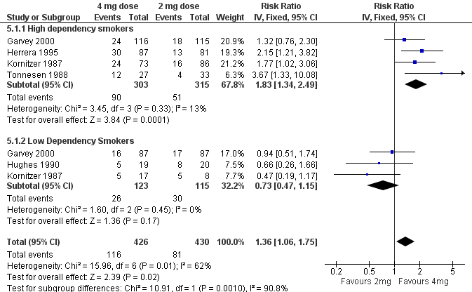
Participant subgroups
Based on Stead LF, Perera R, Bullen C, Mant D, Lancaster T. Nicotine replacement therapy for smoking cessation. Cochrane Database of Systematic Reviews 2008, Issue 1. Art. No.: CD000146. DOI: 10.1002/14651858.CD000146.pub3.
Notes:
Let’s look at an example. This is a review of nicotine replacement therapy, comparing a high dose 4mg gum with a lower dose 2 mg gum. The outcome being measured is the number of people who successfully quit smoking. You can generate forest plots like this in RevMan, that separate your study data into two or more groups. You can see there is a black diamond showing an overall effect for each group, and another one at the bottom – this one shows the overall effect estimate for all the data combined.
[NOTE TO TRAINERS: ASK: What is the overall effect of the 4mg gum, in comparison to the 2mg gum? The answer is that those using 4mg gums were 36% more likely to quit smoking than those using 2mg gums.]
Now let’s look at the subgroups, which are based on characteristics of the study participants. The top subgroup is high dependency smokers, and the lower subgroup is low dependency smokers.
NOTE TO TRAINERS: ASK: What is the effect of the 4mg gum in high dependency smokers, compared to 2mg gum? What is the effect of the 4mg gum in low dependency smokers? What does this indicate? ANSWER: the effect appears to be higher in high dependency smokers, while the use of stronger (4mg) gum appers not to make any difference in low dependency smokers?
ASK: What is the overall level of heterogeneity? What are the levels of heterogeneity in each subgroup? What does this indicate?
ANSWER: Overall level of heterogeneity is considerable (I²=62%), but much smaller in each subgroup (I²=13%, I²=0%). This indicates that the overall heterogeneity may be explained by differences among subgroups.
ASK: How can we tell if these subgroup results are significantly different from each other?
ANSWER: First we can look at whether their confidence intervals overlap – in this case, they don’t. We can also look at the chi² test for subgroup difference – in this case we find a very low P value of 0.001. So, it seems reasonable to conclude that while 4mg gum is more effective than 2mg in high dependency smokers, but it appears to be equally but no more effective for low dependency smokers.
Note that it’s much more common to find differences in the strength of an effect of an intervention between subgroups than to find qualitative differences – that is, it would be very unlikely to find that 4mg gum helped some people quit but prevented others from quitting.
ASK: is this difference clinically plausible?
Yes – it might well be that there is a threshold level of nicotine required to help you quit that varies depending on your regular nicotine intake.
ASK: Is the difference clinically important – would it affect your recommendations for the use of 4mg gum?
Yes – low dependency smokers might well prefer to use a lower dose, as it might be cheaper, or less likely to cause side-effects.
ASK: Are there any other factors we should consider?
It’s reassuring to note that in this case two of the included studies, Garvey and Kornitzer, are providing individual patient data to both subgroups, to go alongside between-study evidence from the other studies.

Slide 31
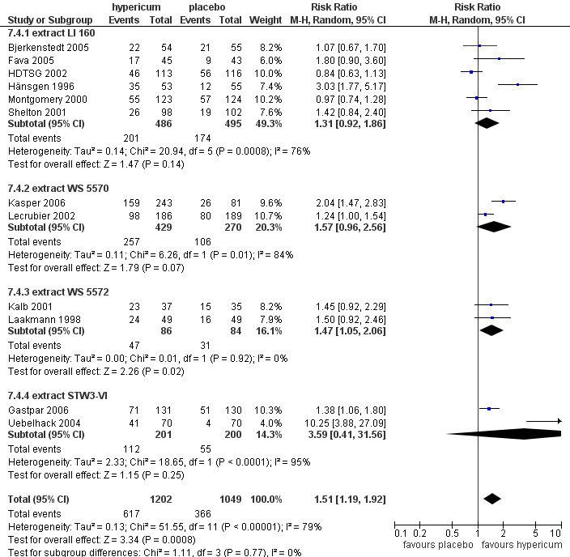
Intervention subgroups
Based on Linde K, Berner MM, Kriston L. St John's wort for major depression. Cochrane Database of Systematic Reviews 2008, Issue 4. Art. No.: CD000448. DOI: 10.1002/14651858.CD000448.pub3.
Notes:
Here’s another example. This review is of St John’s Wort for depression, and we’re measuring the number of people who successfully respond to the herbal extract. In this case, the authors have grouped the studies according to the different extracts of St John’s wort that have been used.
NOTE TO TRAINERS: ASK: Looking at the results for each subgroup, does it appear that there are important differences between the effects of the different extracts?
ANSWER: No. Although some results are significant and others are not, this does not mean the results are inconsistent – these are very small subgroups, and they vary in the amount of information they have, and their power to detect an effect. The diamonds all line up with each other relatively well, and the test for subgroup differences does not indicate a significance difference.
Although there is clear heterogeneity on this forest plot overall, it is not explained by the extract used, and the authors would need to move on to their other planned subgroup analyses. Note that there is one particular outlying study on this forest plot (Uebelhack 2004) – this study would cause heterogeneity to appear on any subgroup analysis, but it may be something else that’s different about this study, such as its risk of bias, or its population, that causes it to find different results.

Slide 32
Sensitivity analysis
not the same as subgroup analysis
testing the impact of decisions made during the review
inclusion of studies in the review
inclusion of results at high risk of bias
choice of effect measure
assumptions about missing data
cut-off points for dichotomised ordinal scales
correlation coefficients
repeat analysis using an alternative method or assumption
don’t present multiple forest plots – just report the results
if difference is minimal, can be more confident of conclusions
if difference is large, interpret results with caution
Notes:
Sensitivity analysis is often confused with subgroup analysis, but they’re not the same thing, although they are both important for your review.
The process of writing a systematic review involves a long series of decisions – in some cases objective decisions, and in some cases more subjective or arbitrary decisions. It can be helpful to test those decisions to see whether the findings of the review would have been different had we made a different decision.
Examples of decisions that might be useful to test include:
limits of your eligibility criteria (e.g. age limits, minimum dose or components for the intervention)
decision to include results at high risk of bias in your primary analysis
choice of statistic for dichotomous data (e.g. RR, OR)
decision to combine different scales using SMD
assumptions made about missing values (e.g. withdrawals or missing statistics)
method of analysis for non-standard data – cut-off points to dichotomise ordinal data, correlation coefficients for cluster or crossover data
fixed vs random-effects meta-analysis
Sensitivity analysis is done by repeating the meta-analysis using the alternative option, to see if the results change a little or a lot. If the results stay the same, then we can be even more confident about our conclusions. If they change a lot depending on the choices and assumptions we have made, then we should be more cautious about interpreting our results - if there’s anything we can do to further support our assumptions, such as obtaining any missing data from the study authors, then we should do so, and perhaps our uncertainty might identify areas where future research might fill in the gaps.
The results of sensitivity analyses should be briefly summarised and reported, e.g. in the text of the review or a table. Don’t present multiple versions of the meta-analysis – this is unnecessary and confusing for readers.

Slide 33
What to include in your protocol
assessment of heterogeneity
assessment of comparability of studies before meta-analysis
visual inspection and use of statistics such as I2
data synthesis
fixed-effect or random-effects model (or both)
subgroup analyses and investigation of heterogeneity
planned subgroup analyses
any other strategies for investigating heterogeneity
Notes:
Bringing all this back to your protocol – all of these methods around heterogeneity should be planned and outlined briefly in your protocol. In the ‘Methods’ section of the review, under the collective heading ‘Data and analysis’, there are subheadings to remind you to address all these things:
how you plan to assess heterogeneity, including your initial decisions about determining whether studies are similar enough to meta-analyse from a clinical perspective, and assessments of statistical heterogeneity such as visual assessment of forest plots and the I² statistic.
the statistical model your plan to use in your meta-analysis, including your choice of fixed-effect or random-effects meta-analysis.
the subgroups you plan to investigate, and any other methods relevant to heterogeneity that you may have planned.

Slide 34
Take home message
statistical heterogeneity is the presence of differences between estimated intervention effects greater than expected because of random (sampling) variation alone
it can be caused by clinical and methodological diversity
fixed and random-effects models make different assumptions about heterogeneity
explore any heterogeneity you find

Slide 35
References
Deeks JJ, Higgins JPT, Altman DG. Chapter 10: Analysing data and undertaking meta-analyses. In: Higgins JPT, Thomas J, Chandler J, Cumpston M, Li T, Page MJ, Welch VA (editors). Cochrane Handbook for Systematic Reviews of Interventions version 6.1 (updated September 2020). Cochrane, 2020. Available from www.training.cochrane.org/handbook.
Acknowledgements
Compiled by Miranda Cumpston
Based on materials by Georgia Salanti, Julian Higgins, Steff Lewis, Cochrane Statistical Methods Group, Cochrane Australia and Cochrane Netherlands

Slide 36
Examples: Assessing heterogeneity
Notes:
[NOTE TO TRAINERS: The following is a series of examples from real-life reviews – you can use it to reinforce the learning if you have enough time. If you’re giving handouts of the presentation before the session, make sure to delete this section from the handout.]

Slide 37
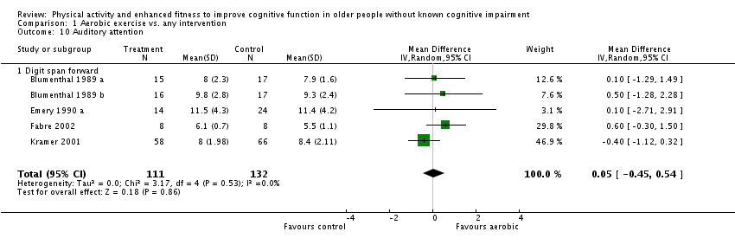
Does visual inspection show heterogeneity?
No.
The 95% CIs of each individual study overlap
Source: Angevaren M, Aufdemkampe G, Verhaar HJJ, Aleman A, Vanhees L. Physical activity and enhanced fitness to improve cognitive function in older people without known cognitive impairment. Cochrane Database of Systematic Reviews 2008, Issue 3.
Notes:
Look at the following forest plot taken from a review on Physical activity and enhanced fitness to improve cognitive function in older people without cognitive impairment. In this plot you see the results of a meta-analysis for the comparison of aerobic exercise versus any intervention for the outcome auditory attention. CLICK red line appears ASK: Does visual inspecton of this forest plot show statistical heterogeneity? Raise your hand if your answer is yes. ASK: why is your answer Yes? [CLICK] The answer is NO. You see a strong overlap of the CI’s of the included studies.

Slide 38
Do the statistics show heterogeneity?
No.
In this example, I² is zero, which suggests that the variation between the studies is no more than that expected to occur by chance.
Source: Angevaren M, Aufdemkampe G, Verhaar HJJ, Aleman A, Vanhees L. Physical activity and enhanced fitness to improve cognitive function in older people without known cognitive impairment. Cochrane Database of Systematic Reviews 2008, Issue 3.
Notes:
Looking at the statistics of the same forest plot [CLICK red oval appears] – P value is 0.53 and I² is 0%. ASK: Do the calculated statistics indicate statistical heterogeneity? [CLICK] The answer is NO there is no indication of statistical heterogeneity.

Slide 39
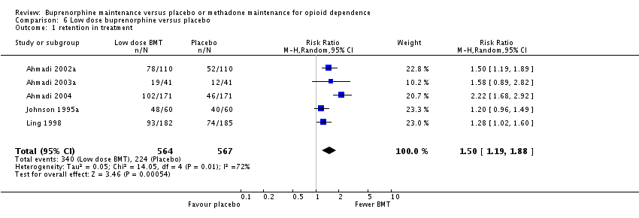
Does visual inspection show heterogeneity?
Yes.
In this forest plot, although the effect estimates are all on the right side of the plot, not all of the 95% CIs of individual studies overlap.
Source: Mattick RP, Kimber J, Breen C,Davoli M. Buprenorphine maintenance versus placebo or methadone maintenance for opioid dependence. Cochrane Database of Systematic Reviews 2008, Issue 2.
Notes:
Looking at this following forest plot taken from a review of Buprenorphine maintenance versus placebo or methadone maintenance for opioid dependence. The outcome is retention in treatment comparing a low does versus placebo. [CLICK - red line appears] [NOTE TO TRAINERS: ASK: does visual inspection of this plot show statistical heteogeneity? Ask the learners to raise their hand if they think the answer is yes. ASK: why is you answer yes/no? [CLICK] point estimates are all on right side however not all CI’s do overlap.

Slide 40
Do the statistics show heterogeneity?
Yes.
The I² statistic is high (72%)
Source: Mattick RP, Kimber J, Breen C,Davoli M. Buprenorphine maintenance versus placebo or methadone maintenance for opioid dependence. Cochrane Database of Systematic Reviews 2008, Issue 2.
Notes:
Looking at the statistics of the same forest plot [CLICK red oval appears] – P value is 0.01 and I² is 72%. ASK: based on the statistics would you say there is statistical heterogeneity? [CLICK] the answer is YES. P value is significant (less than 0.05) but more importantly the I² is quite high.

Slide 41
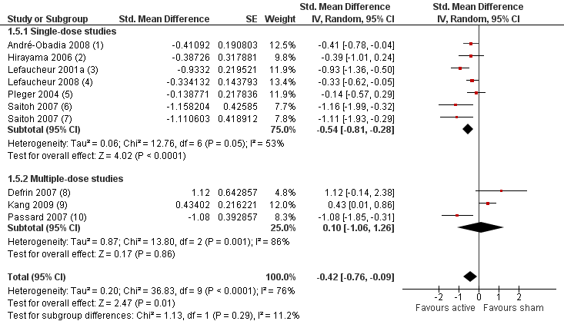
Do these subgroups explain the observed heterogeneity?
No.
The 95% CIs overlap and the test for subgroup differences was not statistically significant (p = 0.29). Heterogeneity is not explained by type of dose, so is likely caused by some other factor.
Based on: O’Connell NE, Wand BM, Marston L, Spencer S, DeSouza LH. Non-invasive brain stimulation techniques for chronic pain. Cochrane Database of Systematic Reviews 2010, Issue 9.
Notes:
Another example. Look at the following forest plot of a review of Non-invasive brain stimulation techniques for chronic pain, comparing non-invasive high intensity (>5 Hz) techniques for the motor cortex versus sham. The outcome being measured is a standardized measure of pain. The study data is separated into two subgroups – studies using single dose intervention vs. those using multiple dose. You can see there is a black diamond showing an overall effect for each group, and another one at the bottom – this one shows the overall effect estimate for all the data combined.
So looking at this plot do you think these subgroups explain heterogeneity? Raise your hand if you think the answer is yes. ASK why did you answer yes/no? [CLICK - Green box appears]. The answer is NO. Look at overlapping CI. [CLICK red line and oval appears]. The test for subgroup differences show a p-value of 0.29 indicating no subgroup differences. Heterogeneity drops a bit in group 1 to 53% but increases in group 2 to 86%. DISCUSS: there are other factors that explain heterogeneity that we don’t know of yet.
Effects multi-dose are inconsistent and two studies show non–significant effects in favour of control, characteristics of the studies?
Overall there is evidence of heterogeneity; should you do a meta-analysis at all? Heterogeneity is not that high and you need to explore further and move on to different subgroup analyses that was pre planned.

Slide 42
References
Deeks JJ, Higgins JPT, Altman DG. Chapter 10: Analysing data and undertaking meta-analyses. In: Higgins JPT, Thomas J, Chandler J, Cumpston M, Li T, Page MJ, Welch VA (editors). Cochrane Handbook for Systematic Reviews of Interventions version 6.1 (updated September 2020). Cochrane, 2020. Available from www.training.cochrane.org/handbook.
Acknowledgements
Compiled by Sharon Kramer
Based on Cochrane online training modules developed by the University of Portsmouth and the Cochrane UK.

