Slide 1
Health equity in systematic reviews

Slide 2

Session outline
Introduction to health equity
Equity in all reviews
Equity-focused reviews
What to include in your protocol
See Chapter 16 of the Handbook
Notes:
In this session, we will first describe health equity. Then, we will go through the equity considerations that are relevant for all Cochrane Reviews and then we will provide a description of equity-focused systematic reviews. In the final section, we’ll discuss how you can incorporate equity into your protocol and provide some resources for further guidance.

Slide 3
What is health equity?
Health equity is the absence of avoidable and unfair differences in health outcomes
- Whitehead, 1991
Notes:
Health equity is the absence of avoidable and unfair differences in health outcomes.

Slide 4
Health inequity
Differences in Health Outcomes
Unavoidable
Acceptable
Unacceptable AND Unfair
Potentially Avoidable
Notes:
This figure helps to describe health inequities.
What is an example of a difference in health outcomes? Some people die from COVID-19 and others don’t.
What are unavoidable differences? Older people are more likely to die from COVID-19 than younger people. If this occurs solely due to age then we would consider this to be unavoidable but if other factors contribute to this increased risk, such as ageism (prejudice or discrimination on the grounds of a person's age), then we may need to consider if this difference is inequitable.
There are health differences that are potentially avoidable. An example is an injury from a skiing accident. If a person has freely chosen to participate in skiing, then we would consider the injury to be avoidable but not unfair and therefore not an inequity.
If a person lives in a neighbourhood that lacks access to nutritious food choices, then we would consider this to be an unfair difference and therefore a health inequity.
[NOTE: You can ask the learners to think of other examples of acceptable and unacceptable differences in health outcomes that are potentially avoidable]

Slide 5
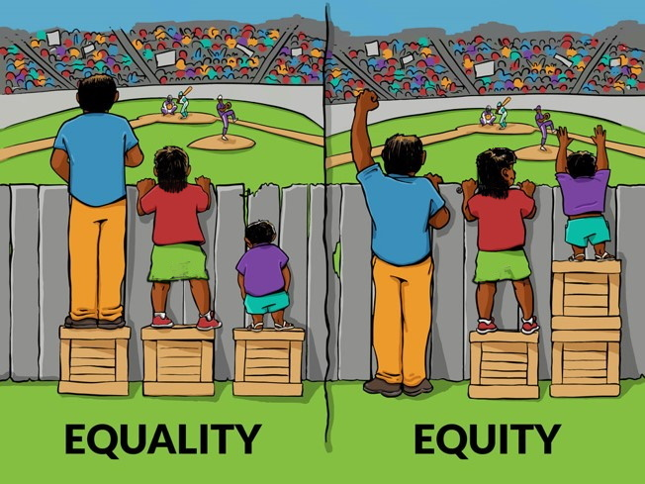
Image credit: Interaction Institute for Social Change | Artist: Angus Maguire
Notes:
Equality and equity are terms that are sometimes used interchangeable. This illustration is often used to portray the difference between them.
On the left, each individual has been given the same amount of assistance: 1 crate. This has increased their height by the same amount. But, the goal of seeing the game has not been achieved for each person.
On the right, the crates have distributed differently. The individual with the greatest need has been given 2 crates while the tallest person, who did not need any help, has been given none.

Slide 6








PROGRESS
 | Place of residence
 | Race/ethnicity/culture/language
 | Occupation
 | Gender/sex
 | Religion
 | Education
 | Socioeconomic status
 | Social Capital
Notes:
Who might experience health inequities?
The Cochrane Equity Methods Group recommends the acronym PROGRESS-Plus. This helps authors think about the population and whether there may be groups within it who experience differences in baseline risk of the condition or problem or for whom the intervention may work differently.
PROGRESS stands for:
Place of residence – This can refer to the country, such as high versus low-income, but if can also refer to the region or community, such as rural versus inner-city
Occupation – Which can refer to the type of job a person has or whether they are out-of-work
Gender/sex
Religion
Education
Socio-economic status
Social Capital – which refers to a person’s social networks and their connections to their community.
NOTE: You can ask the learners to suggest some examples of how some of the PROGRESS-elements can cause health inequities. For example:
Place of residence - in some rural areas, individuals are unable to receive treatment due to their distance to a health facility or their lack of access to trained professionals. And in big cities people are often more exposed to air pollution.
Race/ethnicity/culture/language – Some ethnic communities have been racialized through discrimination and racism affecting their health opportunities and outcomes, and these inequities may be perpetuated across generations.
Occupation – People working informally (without a contract) often don’t have adequate work protection equipment and are thus exposed to avoidable and unfair increase in risk of injury or death
Gender/sex – differences in receipt of hip replacement for women with equal need as men are considered inequitable because these are due to a complex system of unconscious bias, discrimination and gender roles that affect decisions of both men/women and their health care providers.
Religion - Religious affiliation, or lack thereof, may contribute to inequities, particularly if it limits access to services. Actual care may differ when religious affiliation is discordant with that of the provider or sponsor of the service.
Education - Higher educational attainment is associated with better health outcomes for a range of conditions. Education availability and choice may be dependent on larger contextual factors such as economic and political situations.
Socioeconomic status – Generally, people with lower SES have greater morbidity and shorter life expectancy compared to those of higher SES. This may be caused by many determinants of health including access to nutritious food, health services, and optimal living conditions.
Social capital - Individuals who experience social isolation have higher death rates compared to those with adequate support.

Slide 7

PROGRESS-Plus
Personal characteristics associated with discrimination and/or exclusion (e.g. age, disability);
Features of relationships (e.g. smoking parents, excluded from school);
Time-dependant relationships (e.g. leaving the hospital, respite care, other instances where a person may be temporarily at a disadvantage).
Notes:
PROGRESS doesn’t capture all of the possible characteristics that could be associated with disadvantage so the ‘plus’ includes these.
The plus includes 3 categories. The first is additional personal characteristics, such as age or disability, that may contribute to health inequities. For example, older adults often have reduced access to assistive technologies and devices because of barriers such as cost and accessibility. Inequities for older adults often result from the accumulation of exposures and experiences and relate to other factors such as place of residence, gender, and socioeconomic status as well as discrimination related to ageism.
The second ‘Plus’ factor is features of relationships such as a child who lives in a house with parents who smoke in the home or a woman in an abusive relationship because these may influence their health outcomes.
The third is time-dependant relationships in which a person may be temporarily at a disadvantage. For example, a person who has just been discharged from a hospital may require additional supports, for example in home care or assistive devices. Without these they may risk ongoing health issues or rehospitalization.

Slide 8
Who might be concerned about health equity
1. Patients and caregivers
2. Public
3. Providers
4. Purchasers
5. Payers (of health care and of research)
6. Policy makers
7. Product makers
8. Program managers
9. Principal investigators
10. Press, Publishers and other media
10 Ps
(Sources: Concannon et al. 2011, Tugwell et al. 2006)
Notes:
Health equity considerations are important for many stakeholders who may be interested in using your review. These include patients, health care and health service providers, and policy makers. But, this also includes other stakeholders, such as

Slide 9

Session outline
Introduction to health equity
Equity in all reviews
Equity-focused reviews
What to include in your protocol
See Chapter 16 of the Handbook
Notes:
We’ve defined the health equity and explained the PROGRESS-Plus factors for considering social determinants of health. Now, let’s see how the equity considerations are relevant for all Cochrane Reviews.

Slide 10
Considering equity in your systematic review of interventions
Is everyone receiving the same benefit from the intervention?
Does the intervention work in the disadvantaged?
Notes:
In systematic reviews, we are often focused on the average results. When we focus on the average we may not understand what is happening for under-represented, disadvantaged, or marginalized groups within the population. Is everyone receiving the same benefit from the intervention? Does the intervention work the same way for those who may be disadvantaged?

Slide 11
Why is equity important for your review?
Need to consider applicability of results to other settings
Identifying and analysing the differences between population groups help us understand who really benefits from an intervention
Important:
Plan and report that you have tried to assess health equity even if data is not available from the primary studies. No available data is a useful finding.
If you are able to assess health equity and differences are identified this is also an important finding
Notes:
Why is it important for Cochrane Review to consider health equity? First, Cochrane Reviews are used to improve decision-making and policy-making globally. Therefore, systematic review authors need to consider the applicability of their results to other contexts and settings.
As we’ve just discussed, average results can hide differences in effects between populations groups. Therefore, planning to extract and analyze data about these potential differences can help with our understanding of the intervention and it’s effectiveness.
It is important to mention two things here. Reporting that you have tried to assess health equity is important, even if data is not available from your primary studies. This helps with planning future studies or can indicate that primary studies need to be presenting disaggregated results. Second, if authors are able to make equity assessments and find no differences, this is also important for the users of the review to know.

Slide 12
All Cochrane authors can consider health equity in their reviews
Consider health equity when:
formulating the question (e.g. use a logic model);
planning the methods (how the evidence related to equity and specific populations will be identified and appraised);
creating ‘Summary of findings’ tables (e.g. separate tables for disadvantaged populations, separate rows for differences in risk of events); and
interpreting findings (in relation to health equity).
Notes:
There are 4 ways that Cochrane review authors can think about health equity in all of their reviews.
We’ll work through each of these in the next few slides.
Briefly, these are: - Thinking about health equity right at the beginning of the review, in the question formulation stage. One way to help think about health equity is by using a logic model.
Review authors should also think about the methods they will use and plan to identify and appraise evidence related to health equity.
Review authors can present ‘Summary of findings’ tables differently. For example, authors can use separate rows or additional tables.
Finally, authors can interpret their findings and their potential effects on health equity within the discussion section.

Slide 13
1. Logic model
Notes:
First, we’ll look at logic models. A logic model is also sometimes called an causal pathway or analytical framework.
[NOTE: you can show the learners one of the following videos:
https://www.youtube.com/watch?v=xQ25JYAv_84&t=5s (slide placeholder on next page)
https://www.youtube.com/watch?v=-ou2gBQoNSE&t=31s]

Slide 14
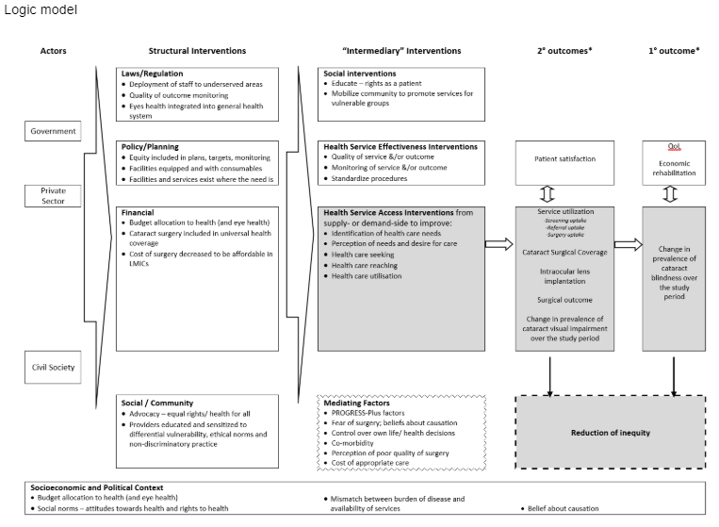
Notes:
Play video: https://www.youtube.com/watch?v=xQ25JYAv_84&t=5s

Slide 15
2. Methods
Notes:
The second thing is to think about the methods when planning to identify and appraise evidence related to health equity.

Slide 16
2. Methods
Consider
Are there populations experiencing health inequities from the condition or problem in which you are interested?
Are there populations who might experience disadvantage related to the intervention you are assessing?
Are there social gradients in the burden of disease? Are there likely to be different absolute or relative effects of the intervention for different populations?
Notes:
To decide on methods for assessing equity in your review, there are three things to consider. You’ll want to think about whether the population or groups within the population are experiencing health inequities from the condition in which you’re interested. There may also be populations who experience inequities related to the intervention. Finally, there may be social gradients in the burden of disease and therefore there may be differences in absolute or relative effects. Consider these and decide how you will plan your methods so that you can plan to extract relevant information and how you might assess and report on these.
At the very least, consider adding a section to the background to describe these differences and how then intervention may affect different populations.
Consider modifying your ‘Summary of findings’ table to present these differences.

Slide 17
3. ‘Summary of findings’ table
Notes:
Now we’ll look at an example of presenting equity considerations in ‘Summary of findings’ tables.

Slide 18
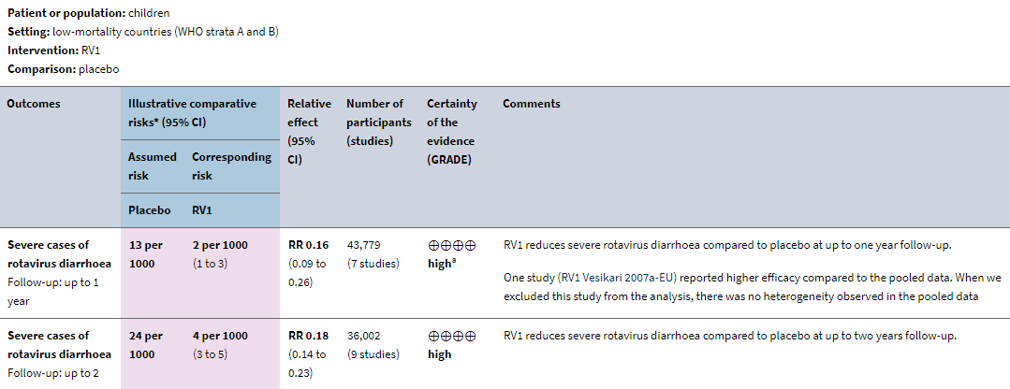
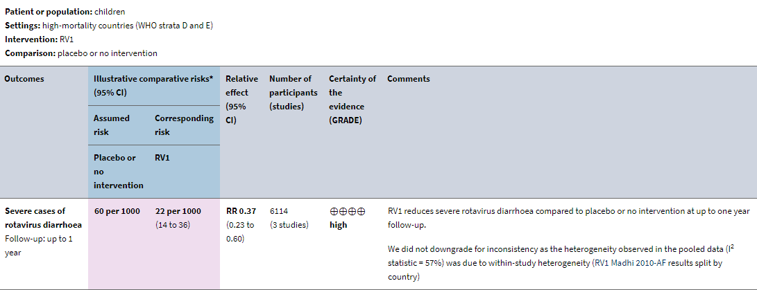
Vaccines for preventing rotavirus diarrhoea: vaccines in use
Soares-Weiser et al. 2019
Notes:
This are the ‘Summary of findings’ tables for the Cochrane review on rotavirus vaccines.
As you can see, this review has presented separate tables based on the baseline risk of rotavirus diarrhea. The first table focuses on evidence from studies in low-mortality countries while the second table includes studies from high-mortality countries.
Alternatively, the intervention may have differential effectiveness for population groups. You’ll want to consider assessing differences in magnitude of relative effects between populations. You may also want to consider assessing differences in baseline risk and absolute effects and presenting these in your summary of findings table.
Finally, in choosing your outcomes, consider the relative importance of outcomes for different population groups. Stakeholder input can help to ensure you have selected outcomes of interest to different population groups.

Slide 19
4. Interpret findings related to health equity in the discussion
Notes:
Finally, you should interpret your review findings and their potential effects on health equity within the discussion section.

Slide 20
Discuss implications for equity
Applicability to other settings and population groups
E.g. context in which the studies were conducted
The burden of the intervention for the patient and the provider
E.g. inconvenience, cost, time
Notes:
Discuss the implications of your results for improving health equity. Consider the overall completeness and applicability of your findings to other settings and population groups. You’ll want to determine that context in which your studies were conducted and how this may affect the generalizability of the results.

Slide 21
Example: Lay health workers in primary and community health care for maternal and child health and the management of infectious diseases
“A substantial proportion of the included studies (33%, n = 27) were conducted in LMICs or were directed at low income groups in high income countries… it may be concluded that these interventions could potentially be extrapolated to other settings, be effective in reaching low income groups, and contribute to reducing health inequalities. However, the degree to which the findings from studies in high income settings can be generalised to low income settings remains unclear and requires further empirical research. This is a particularly important consideration in the context of the two subgroups (LHWs providing support to mothers of sick children; and LHWs to prevent child abuse), where all of the studies were conducted in the United States”
Lewin et al. 2010
Notes:
This example, from the Cochrane Review about lay health workers, reports on the potential for extrapolation of the results to other settings.

Slide 22
Session outline
Introduction to health equity
Equity in all reviews
Equity-focused reviews
What to include in your protocol
See Chapter 16 of the Handbook
Notes:
After exploring how health equity can be considered in all Cochrane Reviews, we will not have a brief look at the equity-focused reviews.

Slide 23
What is an ‘equity-focused’ systematic review?
Those designed to:
Assess effects of interventions targeted at disadvantaged or at-risk populations (e.g., school feeding for disadvantaged children).
These may not include equity outcomes but by targeting disadvantaged populations will reduce inequities.
Assess effects of interventions aimed at reducing social gradients across populations or among subgroups of the population (e.g., interventions to reduce the social gradient in smoking, obesity prevention in children, interventions delivered by lay health workers)
Notes:
We consider and equity focused review to be one that aims to assess the effects of an intervention either targeted to a disadvantaged population or that will affect the social gradients across populations or among subgroups of the population.

Slide 24
Additional considerations for equity-focused reviews
Include relevant study designs to address health equity
Identify information sources for health equity questions
Assess the influence of context and process on health equity outcomes
Notes:
Equity questions may require you to think about different study designs. Some interventions designed to assess effects on health equity may require non-randomized study designs.
To identify eligible studies for your review, you may need to consider additional databases. For example, some journals with evidence from low- and middle-income countries are published in databases which may not be included in typical search strategies. The Cochrane EPOC group has a list of potential resources on their website.
Assessing context and process can often be done through standard systematic review methods, such as meta-analysis.

Slide 25
Session outline
Introduction to health equity
Equity in all reviews
Equity-focused reviews
What to include in your protocol
See Chapter 16 of the Handbook
Notes:
Finally, we’ll have a look at what to include in your protocol.

Slide 26
What to include in your protocol
Create a heading for a section in your background on health equity in which you can describe whether:
certain population groups experience a greater burden of disease from the condition under study
the intervention has differential effectiveness for specific population groups (e.g. literacy issues, adherence, etc.)
the outcomes have different importance for specific populations (e.g. inconvenience, stigma, return to work).
If you identify important considerations in the background section, describe in your methods section how you will assess these differences (e.g. through sensitivity or subgroup analyses).
Notes:
When writing your protocol, there are a couple things you can keep in mind to include equity in your review. First, you may want to add a heading for health equity in your background section. Within this section, you can describe potential population differences in the burden of disease for the condition of interest. Are there groups within the population that have a higher baseline risk? You should also consider whether the intervention may work different for different groups. Are there reasons that the intervention may be less effective because of issues related to, for example, literacy? Finally, are there differences in the outcomes that are important?
If you have identified any differences that could be important, then it would be useful to outline in your methods how you plan to assess these differences.
In addition, you may also want to consider developing or adapting an existing logic model to help describe your assumptions about health equity and its potential effect on the intervention and outcomes.
You can follow this through to the writing up your review by:
including separate rows for those at higher or lower risk of the outcome of interest in your ‘Summary of findings’ table or a separate ‘Summary of findings’ table if effects are different for socially disadvantaged populations;
assessing the applicability of the findings of the review and whether they are representative of the population of interest or other populations across PROGRESS-Plus characteristics, and
including a section to interpret your equity findings within your discussion.

Slide 27
Take home message
Think about equity early in the review process
Plan how you will address four considerations
1. question formulation (logic model)
2. methods for assessing equity
3. ‘Summary of findings’ tables
4. Implications for equity

Slide 28
Additional Resources
Visit https://methods.cochrane.org/equity/resources-review-authors for additional resources, including:
Equity Checklist for planning to incorporate equity in your review
PROGRESS-Plus
PRISMA-Equity
Chapter 16 of the Cochrane Handbook
Interactive Learning Module 11

Slide 29
References
Evans, T., Brown, H. Road traffic crashes: operationalizing equity in the context of health sector reform. Inj Control Saf Promot. 2003;10:11–12.
O'Neill J, Tabish H, Welch V, Petticrew M, Pottie K, Clarke M, Evans T, et al. Applying an equity lens to interventions: using PROGRESS ensures consideration of socially stratifying factors to illuminate inequities in health. Journal of Clinical Epidemiology. 2014, 67 (1), pg. 56-64. doi:10.1016/j.jclinepi.2013.08.005
Whitehead, M. The concepts and principles of equity and health. Int J Health Serv. 1992;22:429–445.
Acknowledgements
Compiled by Jennifer Petkovic, Vivian Welch, Peter Tugwell, Jordi Pardo Pardo, Stephanie Duench, Dario Sambunjak
Acknowledgements: Elie Akl, Pablo Alonso Coello, Javier Eslava-Schmalback, Regina Greer-Smith, Janet Elizabeth Jull, Elizabeth A. Kristjansson, Anne Lyddiatt, Richard Morley, Mark Petticrew, Kevin Pottie, Jacqueline Ramke, Maureen Smith

