Slide 1
Continuous outcomes

Slide 2
Steps of a Cochrane Review
define the question
plan eligibility criteria
plan methods
search for studies
apply eligibility criteria
collect data
assess studies for risk of bias
analyse and present results
interpret results and draw conclusions
improve and update review
Notes:
In this presentation, we will explain how to collect and analyse continuous data.

Slide 3
Study level
↓
Review level
↓
Study A
Effect measure
Outcome data
Study B
Effect measure
Outcome data
Effect measure
Study C
Effect measure
Outcome data
Study D
Effect measure
Outcome data
Source: Jo McKenzie & Miranda Cumpston
Notes:
[NOTE TO TRAINERS: This is the same slide used in the ‘Dichotomous outcomes’. If you’ve already presented it during your workshop, you can use it here just as a reminder.]
When we’ve collected the data from a study, we need to organise it and make sense of it. Each study measures outcomes among its individual participants, and reports those outcomes in various ways. For each study in your review, you will select an effect measure – a statistic to represent the effect of the intervention on the people in that study, such as an odds ratio. It might be the effect measure reported in the study itself, or you might choose a different effect measure that you think is more useful.
[Click] We have to do this for each included study in your review – if possible, so that we have a comparable set of effect measures for each study.
[Click] Ultimately, our aim will be to synthesise those results across all the studies, and report an overall effect for the intervention. We’ll come back to that stage of the process later. For now, we will look at some of the different types of outcome data you are likely to find at the study level, and how we can select and calculate appropriate effect measures. We’re going to start by talking about the analysis of dichotomous outcomes.

Slide 4

Session outline
effect measures for continuous outcomes
collecting data for continuous outcomes
See Chapters 5, 6 & 10 of the Handbook

Slide 5
What are continuous outcomes?
  can take any value in a specified range
  intervals between values are equally spaced
  e.g. height, weight
    a person can be 178.35627 cm tall
    distance from 1 to 2 cm is the same as 171 to 172 cm
  other numerical scales commonly assessed as continuous
    e.g. quality of life, pain, depression
Notes:
Continuous outcomes, generally, are any outcomes measured on a numerical scale.
Truly continuous outcomes, using a formal definition, have two characteristics:
firstly, the outcome can take any value in a specified range. That is, not just whole numbers – for any two values on the scale, there could be one in between. in theory, a person could be 178.35627cm tall if only we had an instrument sensitive enough to measure it.
secondly, each interval on the scale should be evenly spaced, and have the same quantitative value. So, the distance between 1 and 2 cm is the same as the distance between two and three, or 171 and 172.
Many of the numerical scales we use in research don’t formally meet these requirements – many scales can only measure in whole numbers, and in some qualitative scales, such as quality of life, we can’t really say that the distance between 1 and 2 points is quantitatively the same as the distance between 29 and 30 points. Formally speaking these are called ‘ordinal’ outcomes, rather than truly continuous, but these scales are commonly analysed in studies as if they were continuous. For now, we’ll treat them that way. More information about the specific measures available to analyse ordinal outcomes is covered in a separate presentation on Non-standard data.

Slide 6
Expressing continuous outcomes
  two components
    mean value
    measure of variation
Irritability score | Mean | SD | N
Caffeine | 20 | 9.1 | 65
Decaf | 33 | 8.6 | 67
Notes:
When reporting the results of a continuous outcome, we need to do more than report the number of people in a particular category. We need to take a measurement from each person in a group, and then summarise the results – commonly as a mean value (to give us an idea of the average of the group), and a measure of variability within the group, or how spread out they are, such as the standard deviation.

Slide 7
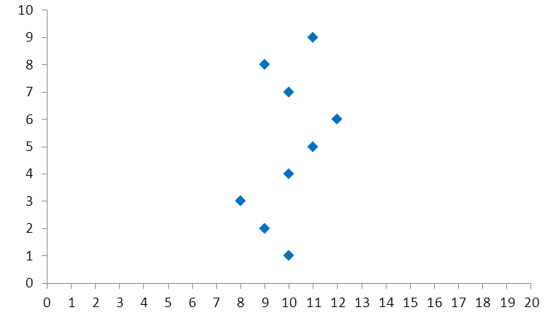
Standard deviations
m = 10
participants
sd = 1
scores
Notes:
It’s important to have both the mean and the standard deviation to give us a good idea of the values in each group. In this example, we have a group of participants each with a score on a continuous scale from 1 to 20. The mean score is 10, with some scatter of individual values that are higher or lower than 10. The standard deviation is 1 – if the data are normally distributed, then we would not expect many scores more than two standard deviations – in this case two points, either side of the mean.

Slide 8
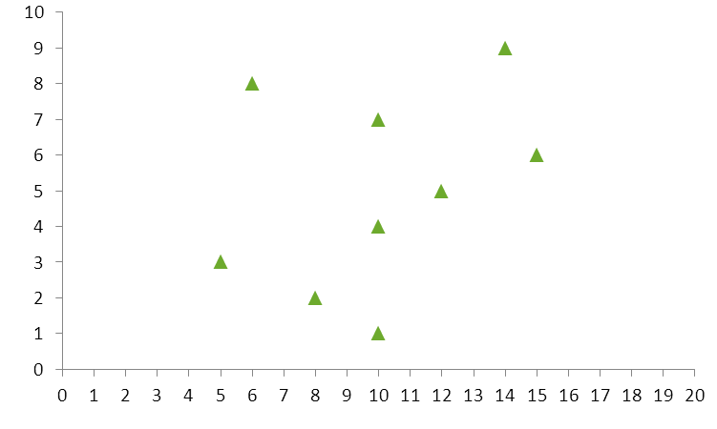
Standard deviations
m = 10
participants
sd = 3
scores
Notes:
In this example, the mean score for the group is still 10, but you can see the data are more scattered either side – the SD for this group is 3.

Slide 9
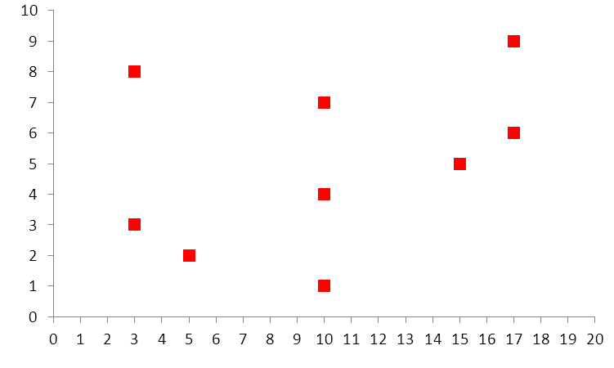
Standard deviations
m = 10
participants
sd = 5
scores
Notes:
Or we could find the data even more scattered – here the mean is still 10, but the SD is 5. You can see that although we have the same number of participants and the same mean, without the standard deviation we are missing some important information to represent the data in the study.

Slide 10
Comparing two groups
  effect measures
    mean difference (MD) (difference of means)
    standardised mean difference (SMD) (effect size)
  all estimates are uncertain, and should be presented with a confidence interval
Notes:
When comparing two groups together using continuous outcomes, the two most commonly used effect measures to summarise the difference between groups are the mean difference (MD) and the standardised mean difference (SMD). The intervention effect of the MD is the difference in means and not a mean of the underlying difference and is therefore also called the difference of means. Th SMD is sometimes called an effect size, however this term is not preferred and is commonly encountered in social sciences. There are clear circumstances in which you would use each option.
As always, any effect estimate is uncertain, and should always be reported with a measure of that uncertainty, such as a confidence interval.

Slide 11
Mean difference
  when all studies use the same measurement scale
mean difference = mean of intervention – mean of control
= 20 – 33
= -13 points
When mean difference = 0, there is no difference between the groups
Irritability score | Mean | SD | N
Caffeine | 20 | 9.1 | 65
Decaf | 33 | 8.6 | 67
Notes:
Our first effect estimate is the MD. The MD is quite simply the mean score in the intervention group, minus the mean score in the control group. The result is then expressed in units on the scale used to measure the outcome.
In this example, we are measuring irritability. We take the mean in the intervention group, 20 points on the irritability scale, and subtract the mean in the control group, which is 33 points. So, 20 – 33 is -13 points.
Like a risk difference, this is an absolute measure – if the result is 0, this implies there is no difference in the average score between the two groups. Zero is our point of no effect. If the result is a positive number, then the intervention group scored higher on the scale. If the result is negative, the intervention group scored lower on the scale.

Slide 12
Interpreting mean difference
  how should we interpret a score of -13?
  depends on:
    direction of the scale
    length of the scale
    minimally important difference
    good or bad outcome
higher = more irritable
0-50
5
bad
Notes:
[NOTE TO TRAINERS: ASK: So, how would you interpret our score of -13? Does our intervention have an effect on irritability? Is it a positive or a harmful effect?]
An MD of -13 indicates that the intervention group had, on average, a lower score on the irritability scale. But what does that mean? Interpreting a continuous outcome score depends on knowing the scale you’re using.
[CLICK] First, we need to know whether a higher score means more irritability or less irritability – this isn’t always clear, so be sure to check your study carefully to make sure you have the direction correct. [CLICK] Lets assume that on this scale, a higher score means more irritability. So a score that is 13 points lower means the intervention group, on average, was less irritable.
But, how much less irritable? [CLICK] To know whether 13 points is a big or small change, we need to know how long the scale is – 1-20, 1-200? [CLICK] In this case, lets say the scale is 0-50. ASK: Do you think 13 points is a big or small change relative to the size of the scale?
It’s still hard to know if this is a qualitatively important change. [CLICK] We can’t just tell the importance of a change from the numbers – we also need to know what’s called the minimally important difference on this scale, also called the clinically important difference. That is, how big does a change have to be on this scale before it is meaningful and noticeable to patients and health professionals? For example, on a 10 point pain scale, it’s usually agreed that about 1.5 to 2 points is the smallest change that is noticeable for patients. Any change smaller than that is too small to make a difference. [CLICK] Let’s assume that the MID for this scale is 5. ASK: Is our MD an important change?
[CLICK] Finally, before we and our readers can interpret the numbers, we need to make a judgement about whether we’re measuring a good or bad outcome. We’ve established that our intervention causes less irritability.
ASK: Is that a good thing? Is that the effect we hoped our intervention would have?
ANSWER: Yes, irritability is a bad thing, [CLICK] so less irritability favours our intervention.
It’s very important to make sure you have reported all this information about the scale, so that readers can clearly understand your conclusions.

Slide 13
Expressing it in words
  Mean difference -13
    on average, participants with the intervention scored 13 points lower on the irritability scale
    on average, the intervention reduced irritability by 13 points on the irritability scale
  or for an increase:
  Mean difference 13
    on average, participants with the intervention scored 13 points higher on the irritability scale
    on average, the intervention increased irritability by 13 points on the irritability scale
Notes:
To express in words our MD of -13, we might say that, on average, participants in the intervention group scored 13 points lower on the irritability scale. Because we know the direction of the scale, we could also say that the intervention reduced irritability, which would also help our readers interpret the score.
Hypothetically, if our score had been positive 13, we would say that, on average, participants in the intervention group scored 13 points higher on the irritability scale, or that it increased irritability by 13 points.

Slide 14
Study level
↓
Review level
↓
Effect measure
Scale 1
Study A
Outcome data
kg
Scale 2
Effect measure
Study B
Outcome data
g
Effect measure
Effect measure
Scale 1
Study C
Outcome data
lb
Scale 3
g
Study D
Effect measure
Outcome data
Notes:
Let’s go back to think about our study level data for a minute. If we can calculate a mean difference for each study, we can use that to compare the results across studies.
[CLICK] But what if each of our studies uses a different way of measuring an outcome? For example, in a study of premature babies, one of the outcomes might be weight. Most studies might measure weight in grams, but some might use kilograms or pounds. At the study level that’s no problem - we can calculate a mean difference for each study. Thinking ahead to the review stage, though, but thinking ahead to the review stage, when we want to compare the results, the mean differences would not be comparable with each other. A mean difference of 50 grams is not directly comparable to a mean difference of 50 pounds.
ASK: So what can we do to make the scores more comparable?
ANSWER: Since we know the relative size of grams, kg and pounds – what we call the ‘scale factor’ – we can simply choose the most useful scale (e.g. grams) and convert the other scores to grams by multiplying or dividing.
[CLICK] However, what if the different measures are not just different numerical scales, but qualitatively different, such as different depression scales, or different quality of life scales? One study might use the Hamilton Rating Scale for Depression, another might use the Beck Depression Inventory, and another might use the Major Depression Inventory. These scales are measuring the same underlying concept – depression – but it isn’t easy to tell what scale factor would appropriately convert one scale to another. It’s not just about the length of the scale – there are qualitative aspects of how the scale works that determine where a person with a given level of depression would fall on each scale. We can’t assume that someone who scored 3 out of 10 on one scale would score 30 out of 100 on another.
ASK: So what can we do to make these kinds of scores more comparable?

Slide 15
Standardised mean difference
  when different scales used to measure the same outcome
  SMD standardises the results
    units of standard deviation
    does not correct for direction – may need to multiply by -1
SMD = mean of intervention group – mean of control group
pooled standard deviation of both groups
When standardised mean difference = 0, there is no difference between the groups
Notes:
The second common effect measure we have for continuous data is the standardised mean difference. We use this effect measure when we have several studies measuring a concept, e.g. depression, but they are not all using the same measurement scale. When we don’t know the scale factor to mathematically convert one score into another, we can standardise the results of each study using its standard deviations, so that when we get to the review stage we can compare the scores.
It’s important to be careful when doing this, and to make sure the scales are measuring the same concept. It’s ok to have some variation, for example, different quality of life scales will have different questions, or you might be combining different measures of weight, such as BMI, weight in kg and skinfold measurements. Although these measures aren’t exactly the same, if you’re asking a question about the effect on weight, then combining them together will give you a useful answer. Sometimes the scales are too different, and combining them would not give meaningful results. For example, if one study is measuring pain, and another measures a combination of pain and function, these scales are not really measuring the same thing, and the results should not be combined. In some cases, even studies that appear to be measuring the same outcome – e.g. health care costs – may not be comparable, e.g. if the studies comparing costs were from different countries with very different health systems.
It’s up to you to use your judgement and decide when measures are similar enough to combine and give a meaningful answer to your review question. These decisions are always a trade-off – limiting your results to studies with exactly the same measures may give you a more specific answer, but you may end up with analyses including fewer studies that give you a less complete picture of the evidence.
If you have decided your different scales are measuring the same thing, then the SMD is calculated by taking the mean difference for each study and dividing it by the pooled standard deviation of outcomes for all the participants in that study, before being combined in a meta-analysis. This is based on the assumption that differences in the scales (e.g. the difference in a 10 point scale vs a 25 point scale) will be reflected in the SD of the scores measured, and can be adjusted accordingly.
The precise formula for this is not shown here, but you do not need to perform this calculation yourself – RevMan will do it for you. [Note: more detailed formulae are available in the Handbook]
There are some tricks you need to know, so read the Handbook chapters on this before you try it. For example, what should you do if your scales are running in different directions? e.g. if you have two depression scales – on one scale, more points means more depression, and on the other scale, more points means less depression. In that case, you have to alter the results so they all run in the same direction before you combine them, by multiplying the results of one scale by -1. This doesn’t change the values, just the direction of the scale.
The results of the analysis are then no longer in units on one scale or another – they will be reported in units of standard deviation. Like an ordinary mean difference, if the result is 0, this implies there is no difference in the average score between the two groups. A positive number will mean more points in the intervention group, and a negative number will mean fewer points in the intervention group.

Slide 16
Interpreting standardised mean difference
Irritability score | Mean | SD | N | MD | SMD
Caffeine | 20 | 9.1 | 65 | -13 | -1.5
Decaf | 33 | 8.6 | 67
how should we interpret a score of -1.5?
compare to available SDs
  was study likely to have high or low variation?
  difficult for readers to interpret – convert results to a specific scale for reporting
depends on same factors as mean difference
Notes:
Going back to our example, the SMD works out to be -1.5 (We have not shown the detailed calculations – but you don’t need to calculate this yourself. RevMan will run this calculation for you).
[NOTE TO TRAINERS: ASK: How would you interpret this SMD?]
In terms of the direction of effect, and whether this is a good or bad result for our intervention, the interpretation is the same as for a MD. It’s the same original data for our intervention groups, and a score less than zero still means that we have found a reduction in irritability in the intervention group.
Assessing the size of the effect is more difficult with a SMD. Our score means that, on average, irritability was 1.5 standard deviations lower in the intervention group. ASK: How can we tell how big 1.5 standard deviations is?
ANSWER: We have some standard deviations for this particular score already available to us. Looking at the original scores, as a rough guide, we can see that the SD was 8.6 in the control group, which is what we’re comparing things to. We can calculate that 1.5 standard deviations would be 12.9 points, which pretty close to our MD result. To interpret that, we would still need to consider the length of the scale, the minimally important difference and those other factors we discussed, just as we would for the MD.
The accuracy of this transformation back to points on the scale depends a lot on the range of SDs in your included studies. In a meta-analysis, you might have some studies with high variability, or high SDs, and some studies with low variability. You might then get very different results, depending on the value you choose to calculate with.
NOTE TO TRAINERS: If participants want more information on this, you can refer them to the handbook, section 6.5.1.2. You may want to point out that the SD is not always a good scaling factor, as firstly, the method assumes that variation in SDs reflects only differences in measurement scales and not differences in the i) reliability of outcome measures or ii) variability among study populations. Secondly, trials with restrictive eligibility criteria may have increased SMDs as an artefact resulting from less variability between participants (i.e. smaller SDs). Chapter 10.5.1 also provides useful explanations: “For the mean difference approach, the SDs are used together with the sample sizes to compute the weight given to each study. Studies with small SDs are given relatively higher weight whilst studies with larger SDs are given relatively smaller weights. This is appropriate if variation in SDs between studies reflects differences in the reliability of outcome measurements, but is probably not appropriate if the differences in SD reflect real differences in the variability of outcomes in the study populations”; “For the standardized mean difference approach, the SDs are used to standardize the mean differences to a single scale, as well as in the computation of study weights. Thus, studies with small SDs lead to relatively higher estimates of SMD, whilst studies with larger SDs lead to relatively smaller estimates of SMD. For this to be appropriate, it must be assumed that between-study variation in SDs reflects only differences in measurement scales and not differences in the reliability of outcome measures or variability among study populations”
Another option is to use a rough rule of thumb – for example: 0.2 represents a small effect, 0.5 represents a moderate effect, and anything larger than 0.8 represents a large effect. This rule doesn’t take into account what you consider to be a minimally important difference for a particular outcome.
Later, at the review stage, even when we’re looking across several studies using different scales, we’ll always have the original study group data to help us get a rough estimate of how to interpret the SMD. However, you do need to take into consideration factors that might affect whether a particular study was likely to have high or low levels of variation. For example, was this a study of a very diverse patient population, or a very narrowly defined population? Was the study a pragmatic trial, in which you might expect variation in the delivery of the intervention, or was it a very tightly controlled protocol? These factors might explain differences in SD among your included studies, and help you interpret and discuss your results.
Although it’s possible to do these rough comparisons, we know this is more difficult for readers understand than simple units on a scale. To help communicate the results of these outcomes, after all your analysis is completed, you may wish to convert the final results back into units on one of the scales used – methods for this are described in Chapter 15, section 15.5.3 of the Handbook.

Slide 17
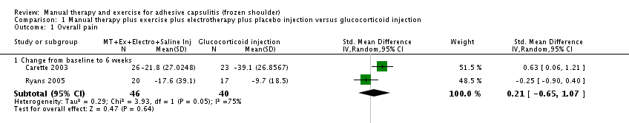
Example: converting SMD
pain measured using:
  SPADI pain scale in Carette 2003 and VAS rest pain in Ryans 2005
convert SMD to SPADI scale:
  multiply SMD and 95% CI by pooled baseline SD from Carette 2003 = 18
MD = (SMD x pooled baseline SD) = (0.21 x 18) = 3.78
  report result:
  “SMD 0.21, 95% CI -0.65 to 1.07; this is equivalent to a MD of 3.78 points (-11.7 to 19.26) on a 100-point scale (SPADI)”
Page MJ et al. Manual therapy and exercise for adhesive capsulitis (frozen shoulder). Cochrane Database of Systematic Reviews 2014;8:CD011275.
Notes:
Here is an example of how to back-transform a meta-analytic SMD.
This example is from a Cochrane Review of “Manual therapy and exercise for adhesive capsulitis (frozen shoulder)”.
There was a meta-analysis of two trials comparing “manual therapy plus exercise plus electrotherapy plus placebo injection” versus “glucocorticoid injection”, for the outcome “pain”.
Overall pain was measured using the Shoulder Pain and Disability Index (SPADI, 0-100 scale) in Carette 2003 and daytime rest pain was measured using a visual analogue scale (0-100 scale) in Ryans 2005.
To back-transform the SMD to the 100-point SPADI pain score, the meta-analytic SMD and 95% CI were multiplied by the pooled baseline SD in Carette 2003. By pooled baseline SD, we mean that the baseline SDs of the intervention and control groups were pooled. This pooled baseline SD was 18.
The authors reported both the SMD and back-transformed result as follows: “(SMD 0.21, 95% CI -0.65 to 1.07; this is equivalent to a MD of 3.78 (-11.7 to 19.26) on a 100-point scale (SPADI)”
Sometimes authors may present a range here.

Slide 18
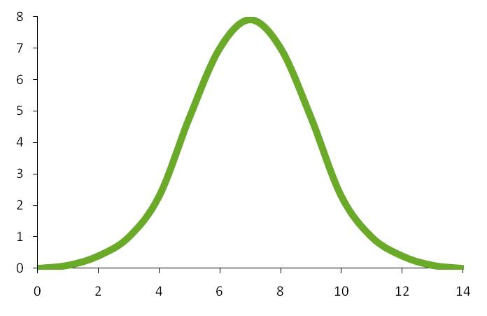
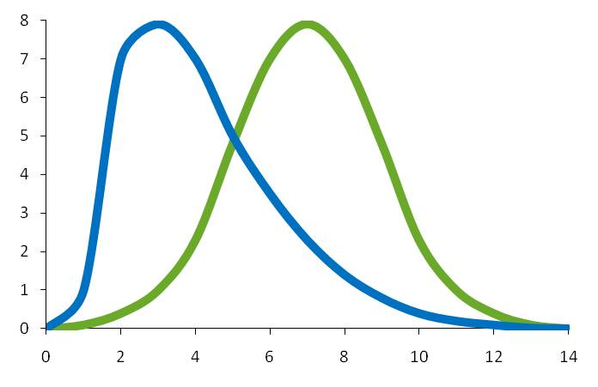
Normally distributed data
Notes:
Analysis of continuous data assumes that the outcome data are normally distributed – that is, the mean is in the centre, and the sample measurements are evenly spread either side, to a width of roughly 2 standard deviations.
In some cases, that assumption isn’t true, and we have what we call skewed data. [CLICK] For example here we have a lot of values towards the left side of the distribution, and a few values creating a relatively long tail out to the right – this is called positive skew. When data are skewed, the mean and SD aren’t as good a way to describe the distribution of the data.
Skew can be expected where most people in a sample will have similar measurements, but some will have either very low or very high scores. For example, length of stay in hospital. Most people might stay one or two days, but a few might stay for several weeks, giving the distribution its tail of high values to the right. On the other hand, no-one can stay in hospital for less than 0 days, so there’s no corresponding tail out to the left. A similar situation might occur with nutritional values – most people might have low baseline levels of a particular nutrient, unless they happen to have eaten something very rich in that nutrient that day, in which case they will have a very high score.

Slide 19
Skewed data
  indications of skew
    reported as geometric mean or median, interquartile range
    large SD in relation to the mean
      < 2 x SD between mean and highest/lowest possible score
  addressing skew
    get statistical advice before proceeding
    may be no action required
    possible actions may include sensitivity analysis without skewed studies, log transformation or other methods.
Notes:
Because our analysis depends on this assumption that the data are normally distributed, it’s important to be aware if you have skewed data in your review. One way to spot it is if the results are reported as a geometric mean based on log transformed data. Also, median and interquartile ranges are often reported when data are skewed, although it can be difficult to make assumptions about the data if the authors aren’t clear.
Alternatively, another way to spot skew is if you have a large SD in relation to the size of the mean, especially where your data has a maximum or minimum value. Normally distributed data are spread roughly two SDs either side of the mean. You can use the following formulae to check this:
(mean – lowest possible score)/SD < 2 indicates skewed data
(highest possible score – mean)/SD < 2 indicates skewed data
For a ratio<1, there is strong evidence for skewed data. As per section 10.5.3 of the Cochrane Handbook: “Thus, the check may be used for outcomes such as weight, volume and blood concentrations, which have lowest possible values of 0, or for scale outcomes with minimum or maximum scores, but it may not be appropriate for change-from-baseline measures.”
If you do have skewed data, it’s important to get some statistical advice before you proceed. It may be that you don’t need to do anything to address it, especially if your included studies are large. It may be that some action is appropriate – approaches may include a sensitivity analysis to test the impact of studies with skewed data on your overall result, reporting the results of studies with skewed data separately to the others in your review, log transformation of the data, or other methods. It’s very important to get statistical advice before modifying any data, or combining skewed data with non-skewed data, as it’s easy to get into trouble, and any inappropriate steps will make your conclusions less reliable.

Slide 20
Session outline
effect measures for continuous outcomes
collecting data for continuous outcomes

Slide 21
Collecting data
six numbers needed for meta-analysis
 | Mean | SD | N
Intervention | 20 | 9.1 | 65
Control | 33 | 8.6 | 67
Try to collect the actual number measured for each outcome, at each time point
Notes:
We need slightly more information to analyse continuous outcomes than we did for dichotomous outcomes, but it’s still very straightforward. We need three numbers for each group in the study: the mean value, the SD and the number of people in each group.
CLICK. As always, try to get the actual number of people in each group who were measured for this particular outcome at each time point if you can, although you may only be able to find the total number of people randomised to each group. The reason we try to use the number actually measured relates to the issue of intention-to-treat analysis. Wherever possible, we want complete data about the whole sample, but when people are missing, we need to make sure that we are aware of that. If we don’t have measurements on some people, and we use the total sample size as our N, then we are effectively imputing data – making an assumption that the mean value among the missing people is the same as the mean value among the people remaining in the study. This may or may not be a plausible assumption, so it’s important to be clear on the decisions you’re making, and get statistical advice if you want to know more about imputation.

Slide 22
Post-intervention vs change from baseline
Control group
Baseline
m(sd)
change m(sd)
Post
m(sd)
MD
MD
Intervention group
Baseline
m(sd)
Post
m(sd)
change m(sd)
Notes:
So we know we’re looking for a mean and standard deviation, but there’s more than one way to measure the mean for continuous data. The simplest way is to implement your intervention, and then measure the values for each group post-intervention.
Sometimes, one or more of your included studies may also measure the values at the start of the study, and report the difference between the baseline and post-intervention scores, otherwise called the change from baseline. If that’s the case, the mean and standard deviations of the change score can be collected, and a mean difference can be calculated.

Slide 23
Change from baseline data
  can increase or decrease precision
    reduce between-person variation
    increase error for unstable or imprecise measures
  regression (ANCOVA) better to adjusting for baseline values
  work with what is reported in your included studies:
    either post-intervention or change scores can be used
    can use a mixture (only for MD, not SMD)
    better to be consistent if possible
    avoid selective outcome reporting
    change scores require SD of the change
Notes:
Reporting the change from baseline is sometimes done to adjust for the baseline values, and reduce the variation between individuals in the study and increase the precision of the estimate. However, this isn’t always required. Factoring baseline measures in to the analysis can introduce additional error – particularly in unstable or imprecise measures. To calculate a change score we have to measure everyone in the sample twice – and every time we take a measurement we introduce error.
If you’re concerned about baseline imbalance in a study, it’s true that even with randomisation, a particular study may have, for example, a few more older participants, or a more participants who are less health at baseline. Even so, it’s not always necessary to take these baseline values in the analysis. At the review level, looking across a number of studies, on average any baseline imbalances will effectively be cancelled out, as your group of studies is likely to have a range of slight imbalances in both directions.
Actually, the best way to adjust for baseline differences in an analysis is to use a more advanced analysis method such as regression (or ANCOVA) analysis. It’s relatively rare to find these analyses in your included studies, but if you do, the study is likely to report an adjusted effect estimate and measure of variance. These can be meta-analysed using the generic inverse variance method, which we will cover in a separate presentation (on Non-standard data).
To some extent we are always dependent on whatever is reported in the data. If your included studies that all use post-intervention data, or all use change data, that’s no problem, you can use either.
[NOTE TO TRAINERS: ASK: What should you do if you find a mixture of some studies that report post-intervention data, and some that report change from baseline?]
[CLICK]
In some cases, you might have most of your studies reporting change scores, and just one reporting post-intervention scores. In that case, if you have the baseline measure for that one study, it can be tempting to try to calculate the change score yourself, to be consistent. Be careful – you might be able to calculate the mean change from baseline, but you can’t easily calculate the SD of the change.
In fact, it is possible to use a mixture of change and post-intervention scores in your analysis – this might seem strange, but it’s perfectly fine to include both, as they are estimating the same intervention effect: the MD between the groups. If you have a choice, it’s best to be consistent if possible and report the same measure for all studies, or at least make as many of your studies as possible consistent. It’s very important not to be selective about which you choose based which gives you the best results – pre-specifying your preference in your protocol can help avoid this.
An important note: change and post-intervention data should not be combined in an SMD meta-analysis. The SMD assumes that the differences in SDs are due to the differences in the measurement scale, but the SDs of change and post-intervention data will also be different from each other because of the reduction in between-person variation, not just the difference in the scale. To summarise: it’s possible to use a mixture of studies using different measurement scales, and it’s possible to use a mixture of change and post-intervention data, but you cannot do both at the same time.

Slide 24
Other data formats can also be used
  statistics other than mean and SD
    e.g. standard error, confidence interval, P value, t value, median, interquartile range
    clarify with the author if unclear
    can often calculate or estimate the mean and SD
  overall effect estimate
    e.g. MD, ANCOVA, ratio of means, ratio of geometric means
    can include in meta-analysis using generic inverse variance method
    need a measure of variance (e.g. SE, 95% CI)
See Section 6.5.2 of the Handbook
Notes:
Entering the means and SDs may be the most straightforward way to analyse continuous data, but it’s very important to remember that if your study does not report those numbers, it doesn’t mean you can’t use the data reported in the study. There are other ways the outcome can be reported that are just as useful.
In some cases, it might be unclear which statistic you have, for example, where a mean value is reported with a number in brackets after it, that could be an SD or SE. Check carefully and make sure you know exactly what you have. In these cases, you can clarify with the author, but if no further information is available you may need to use your judgement. For example, if the number is much smaller than the SDs given for other studies – especially if there is no clear reason why this sample may be less variable than the other studies, such as tighter inclusion criteria - this may be an indicator that it is an SE, and not an SD.
Sometimes, the data may be reported using something other than the mean and SD – e.g. SE, confidence interval, P value, t value, median, range, interquartile range – sometimes each of your included studies will report something different. There’s no need to worry - in many cases you can use these figures to calculate the statistics you need – or indeed to double-check that the number you have is an SD or not. That’s one of the reasons why it’s important to collect as much information as possible from the study reports at the data collection stage, allowing you to consider all the available options once you have a complete picture of all the data you have. Instructions on what you can use and how to convert it are included in Section 6.5.2 of the Handbook.
[NOTE TO TRAINERS: You can share the ‘Analysing continuous outcomes – formulae handout’]
It’s important to note that medians and interquartile ranges can be used on the assumption that the data are not skewed – although skewed data is often the reason why median & interquartile range are reported. As for all cases with skewed data – get statistical advice – if this is the only data available, it may be preferable to include the study rather than exclude from your analysis altogether. On the other hand, ranges are too unstable, and should never be used to estimate an SD.
Sometimes, it may not be possible to calculate an SD, or obtain clarification from the authors. In that case, it may be possible to ‘impute’ the data you need, e.g. by borrowing an SD from another study. This should be done very carefully. Any time you make assumptions about data in your analysis, be sure to note what you’ve done in the review, and conduct a sensitivity analysis to see what impact your assumption may have on the analysis. More about sensitivity analysis will be covered in a separate presentation (Heterogeneity). You also have the alternative not to meta-analyse the data, although you should always present the relevant results from all your included studies – for example in a table, and discuss them in your narrative description of the results in your review.
Alternatively, your study might not provide separate data for the intervention and control groups at all, but might report the overall effect estimate – such as the MD, adjusted results from an ANCOVA analysis, a ratio of means, or as we mentioned earlier they might be using geometric means for log transformed data. You can use these effect estimates in a meta-analysis, too, as long as they have been reported with a measure of variance, such as the standard error or a confidence interval that can be used for this.
When we enter the usual means and SDs, RevMan uses these to calculate the effect estimate along with the variance or uncertainty for each study. In effect, studies that report effect estimates have done these calculations for you. Because they’re in a different format, these studies need to be entered using a different outcome type in RevMan, not the usual Continuous outcome type, called the generic inverse variance method. An explanation of the generic inverse variance method, and what to do if you have an overall effect estimate instead of separate data for each group, will be given in a separate presentation on analysing non-standard data.

Slide 25
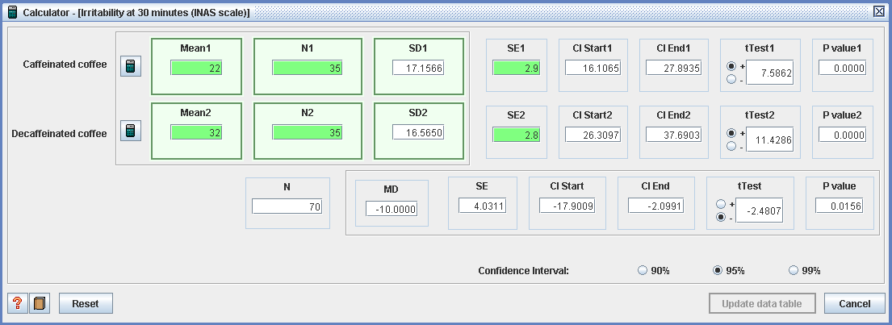
RevMan Calculator
Notes:
In RevMan there is a calculator that you can use to convert different measures of variability, such as a standard error or 95% confidence interval, or even a mean difference, to the standard deviation which you can then enter into a meta-analysis later. (Note that as of January 2021, RevMan Web does not have this calculator function.)
In this example, the study reported the means and standard errors in each group. So to calculate the standard deviations of each group, all you need to do is enter the mean, sample size and standard error values into the appropriate fields which are highlighted in bright green, and once you have entered these values, the rest of the fields in the calculator will be completed automatically.
However, just like any calculator, you have to be careful that you enter the correct values into the correct fields in the calculator so that you don’t end up calculating incorrect standard deviations and then entering them into the meta-analysis.

Slide 26
What to include in your protocol
effect measure(s) to be used for continuous data
Notes:
Going back to the protocol, you should include a brief statement of the effect measures you plan to use for continuous data, such as MD if studies all use the same scale, and SMD if it’s possible that you’ll want to combine studies using different scales. You can also mention additional elements such as plans to convert statistics into the required formats, and whether you have a preference to use post-intervention or change scores.
It is highly desirable that you define minimally important differences for key outcome measures.
If you know in advance you will be using more complex methods, such as imputation of SDs or methods to address skewed data, go ahead and describe them here. It’s likely that some methods cannot be decided until you know what data are reported in your included studies. Where you adopt additional methods later in the review process, these can be added to the ‘Methods’ section (although any post-hoc changes should be clearly identified, and noted in the ‘Differences between the protocol and the review’ section).

Slide 27
Take home message
mean difference and standardised mean difference compare continuous measures between two groups
for basic analysis of continuous data you need the mean and SD and the number of participants in each group
both change and post-intervention data can be combined in your analysis
the required statistics can often be calculated from the reported data

Slide 28
References
Higgins JPT, Li T, Deeks JJ (editors). Chapter 6: Choosing effect measures and computing estimates of effect. In: Higgins JPT, Thomas J, Chandler J, Cumpston M, Li T, Page MJ, Welch VA (editors). Cochrane Handbook for Systematic Reviews of Interventions version 6.1 (updated September 2020). Cochrane, 2020. Available from www.training.cochrane.org/handbook.
Deeks JJ, Higgins JPT, Altman DG (editors). Chapter 10: Analysing data and undertaking meta-analyses. In: Higgins JPT, Thomas J, Chandler J, Cumpston M, Li T, Page MJ, Welch VA (editors). Cochrane Handbook for Systematic Reviews of Interventions version 6.1 (updated September 2020). Cochrane, 2020. Available from www.training.cochrane.org/handbook.
Acknowledgements
Compiled by Miranda Cumpston
Based on materials by Cochrane Australia, Cochrane UK and the Cochrane Statistical Methods Group.
Approved by the Convenors of Cochrane Methods Groups

