Slide 1
Collecting data

Slide 2
Steps of a Cochrane Review
define the question
plan eligibility criteria
plan methods
search for studies
apply eligibility criteria
collect data
assess studies for risk of bias
analyse and present results
interpret results and draw conclusions
improve and update review
Notes:
After you’ve selected the studies to be included in you review, you need to collect the data from them.

Slide 3

Session outline
data to be collected
putting it into practice
See Chapter 5 of the Handbook

Slide 4
What data should you collect?
comprehensive information about each study
      population and setting (e.g. age, race, sex, socioeconomic details, disease status, duration, severity, comorbidities)
      interventions and integrity of delivery
      methods and potential sources of bias
      outcomes, authors’ conclusions
      citation, author contact details
      sources of funding, etc.
information required for:
      references
      description of included studies
      risk of bias assessment
      analyses
Notes:
[NOTE TO TRAINERS: ASK: What kind of data do you think we need to collect about each study?]
You will need to collect a wide range of information about each study: everything you will want to report and analyse in your review, and everything your readers will want to know about your included studies.
First, you will need to describe your included studies in detail – so, you’ll need to collect information on the population, setting, and the intervention, remembering those factors and variations in the population and intervention that you think might have an impact on the results of the study, and that you specified in your protocol that you would like to investigate.
The readers of your review will want information detailed enough to help them decide whether to apply the results in their context. For example, information such as socioeconomic or cultural information might have a big impact on whether an intervention is feasible in different settings. Interventions should be described in enough detail to allow them to be replicated in practice. Integrity of delivery, or compliance/fidelity, can help understand whether incomplete implementation may explain poor findings, and can also highlight difficulties in feasibility for future users.
You will need to collect detailed information how the studies were conducted for your risk of bias assessment.
Then, you will need to collect detailed information about the outcomes. We’ll come back to this in more detail later. You should focus on the outcomes you planned to report in your protocol, but you may wish to report a complete list of the outcomes measured by each study for your readers, or perhaps to identify important outcomes that you did not consider at the protocol stage. Although you will be conducting your own analysis, it’s also helpful to collect the study authors’ conclusions – these can be useful to double-check your own findings later.
Other items of interest include bibliographic information, contact details of the authors, sources of funding, the trial registration number, etc. You may have additional things you’d like to collect relevant to your question.
HANDOUT: Data collection: what items to consider?

Slide 5
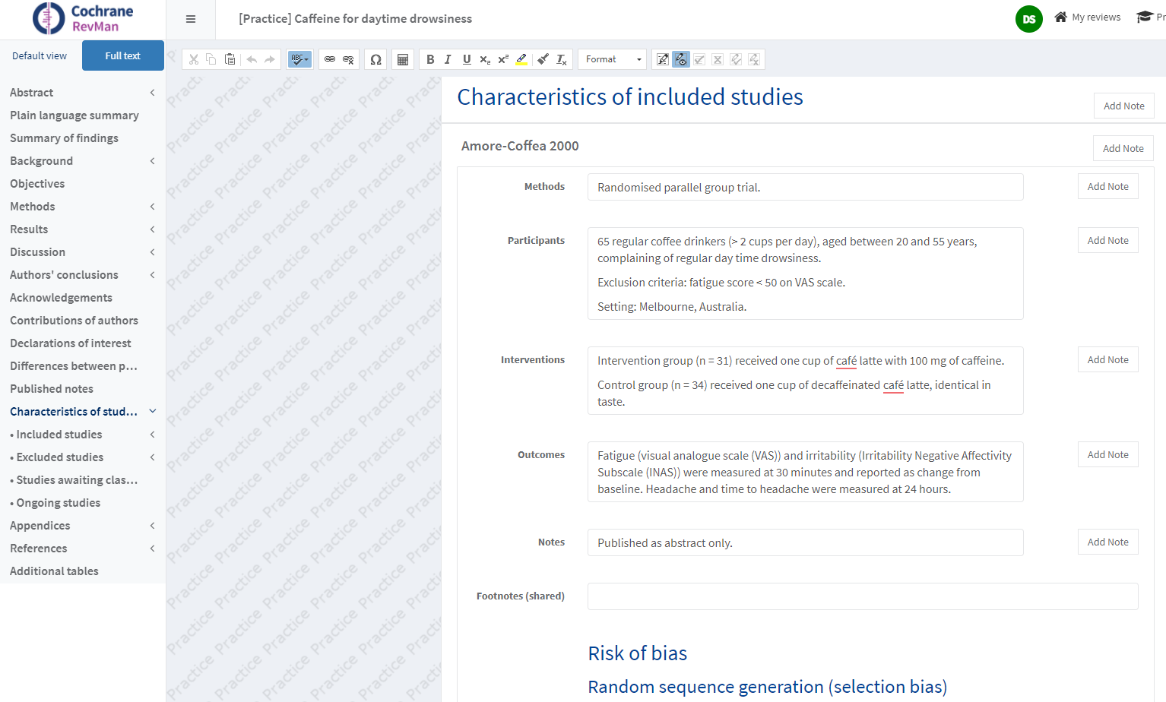
Notes:
The descriptive information you collect about each study will be entered into your review in the ‘Characteristics of included studies’ table – this is what the table looks like in RevMan.
The table has five fields for each study: Methods, Participants, Interventions, Outcomes and Notes. You can add additional fields if there is particular information you’d like to provide that isn’t conveniently covered by these headings, e.g. it may be appropriate to provide a row for information about the funding of each study. There is also a field for footnotes.
Note that the methods description in this table should be very brief – for example, noting that it’s a randomised trial, or a parallel versus a crossover trial. Detailed presentation and appraisal of the study methods is done in a separate table, called the ‘Risk of bias’ table. ‘Risk of bias’ assessment is covered in a separate presentation.
Check to see if your Cochrane Group has standard content for the ‘Characteristics of included studies’ table.

Slide 6
Collecting outcome data
focus on those outcomes specified in your protocol
    be open to unexpected findings, e.g. adverse effects
measures used
    definition (e.g. diagnostic criteria, threshold)
    timing
    unit of measurement
    for scales – upper and lower limits, direction of benefit, modifications, validation, minimally important difference
numerical results
    may be in many formats - conversion may be required
    collect whatever is available
    no. participants for each outcome & time point
Notes:
Results should only be reported and analysed for those outcomes specified in your protocol, although you should be aware of any important and unexpected outcomes, e.g. serious adverse effects. Remember to clearly identify any outcomes that weren’t pre-specified in your protocol. Also, if a study is included with more than two intervention arms, extract data only for intervention and control groups that meet the eligibility criteria (but make it clear in the ‘Characteristics of included studies’ table that these intervention groups were present in the study).
Quite a lot of detail is needed for good reporting of outcomes. Aside from the results themselves, you should collect information about the definitions used in each outcome, such as diagnostic criteria or thresholds for definitions such as ‘improved’ or ‘high vs low’ levels of any measure, as these might vary from study to study. Collect details on the timing of each measure – each study is likely to report measures at several time points. The unit of measurement is also very important.
When a study is reporting results measured on a scale, be as detailed as you can. Report the upper and lower limits of the scale – is it a 0-10 pain scale, or a 1-10 pain scale? For some complex scales such as quality of life or function, it may not be possible to score 0. Report the direction of benefit – does a higher score mean better quality of life, or worse? This may not be the same for every scale used in your included studies. Is the study using a complete scale, or a modified version or subscale? Has the scale has been validated? What is the minimally important difference on the scale – that is, what size difference on the scale is big enough to be detectable and important to study participants? e.g. in a 10 point pain scale, changes of less than 1.5 points may not be considered large enough to be important to patients. This level of details is important not just for your own benefit – your readers may not be experts in this field, and may not be familiar with the scales used.
There are many ways to report statistics and numerical outcomes. and you should expect to find some variation among your included studies. RevMan requires results in specific formats for analysis – you may need to do some simple calculations to get the results from your included studies into the right format, or to make results from one study comparable to the others. We’ll be looking in detail at how to present and analyse your results in a separate presentation. For now, the best strategy when collecting data is to collect whatever outcome measures are reported in the study – that way you have the most comprehensive picture possible, and you can compare the results reported across all your included studies before selecting the best approach to take.
Participant numbers will change throughout the study – keep track of how many people were still in each group and were measured for each outcome at each time point? These changes affect your analysis, and will also help you assess the risk of bias for each study.

Slide 7
Data types
Data can be presented in various types and formats:
Dichotomous data: Only two categories (binary data)
    e.g. pregnant or not pregnant
Continuous data: Data measured on a scale
    e.g. weight
Ordinal data: Categories with a meaningful order (e.g. mild, moderate, severe)
    e.g. degree of burns (I-IV)
Counts and rates: Number of times an event happens to an individual (counts) over a certain period of time (rates)
    e.g. number of falls per person in a year
Time to event: time taken before each participant experiences the event
    e.g. time to discharge from hospital

Slide 8
Data to collect for different types
Dichotomous data
    Number of participants with events in the experimental group
    Number of participants with events in the control group
    Total number of participants in the experimental group
    Total number of participants in the control group
Continuous data
    Mean value of the outcome measurements in each group
    Standard deviation of the outcome measurements in each group
    Number of participants on whom the outcome was measured in each group
Notes:
Dichotomous data: It’s not always clear whether the total number of people for whom the outcome was measured is the same as the total sample size at any given time point. Where possible, collect the actual number of people who were measured for each outcome, at each time point. If that information is not available, you should contact the authors to request more information. If that is not possible, you can use the total sample size for the group, but bear in mind that this is not ideal and should be made clear in the interpretation. For further information on collecting dichotomous data, see Cochrane Handbook Chapter 6.4.2.
Continuous data: Try to get the actual number of people in each group who were measured for this particular outcome at each time point if you can, although you may only be able to find the total number of people randomized to each group. For further information see Cochrane Handbook Chapter 6.5.2. If medians and interquartile ranges are reported instead of means, that may indicate that the data is skewed.

Slide 9
Data to collect for different types
Ordinal data
    Data in any form they are given in the study report
Counts and rates
    Data in any form they are given in the study report
Time to event
    Data in any form they are given in the study report
Notes:
Ordinal data: Analysis depends on whether the data will be converted to dichotomous categories, treated as continuous, or analysed directly as ordinal data. See also Cochrane Handbook Chapter 6.6.2.
Counts and rates: See also Cochrane Handbook Chapter 6.7.2.
Time to event: See also Cochrane Handbook Chapter 6.8.2.

Slide 10
Data in many formats
Outcome | Reported as | Trials
Volume transfused (ml) | Mean and Standard Error of the Mean (SEM) Mean and Standard Deviation (SD) Mean and something in brackets Median and something in brackets Two unlabelled numbers e.g. x(y) Bar chart showing mean per person per day | 4 2 1 1 1 1
Units transfused | Mean and SEM Mean only Total in each group | 1 1 1
Volume adjusted for patient mass (ml/kg) | Mean and SD | 1
Patients who had a transfusion | Number of patients | 3
Not reported | Not reported | 1
Source: Phil Wiffen
Notes:
This is an example of data collected for a real review, measuring blood transfusion as an outcome. As you can see, almost every study reported the data in a different way. Some reported the outcome as the volume of blood transfused, some as the number of standard units transfused, some as the volume of blood adjusted for the weight of the patient, and some simply the number of patients who had any blood transfused. Some studies may have reported the result in more than one way, appearing more than once on this table.
Within each of those outcome definitions, the numbers reported also differed. Most reported means, but one reported medians. Some reported standard errors, some standard deviations. Quite a few did not label the numbers they reported, making it very difficult to interpret. One study only reported the results in a graph, so that the systematic review author would have to measure the graph to work out the numerical results.
The data aren’t always presented in a way that is useful for meta-analysis.
[NOTE TO TRAINERS: ASK: How would you manage a set of data like this?]
Unless we can get more data from the authors, it’s difficult to summarise all these studies together, as they’re not all quite measuring the same thing. There are some choices we can make as authors: where studies report results in more than one way, we can choose the most common measure. We can do some conversion of results into more useful formats – we’ll address that in more detail in a separate presentation (Continuous outcomes). We should certainly contact the authors to clarify what they’re reporting, and see if we can get more detailed information that may help us report consistent data from each study.
We won’t have a clear picture of all the data we have, how compatible they are, and the best way to manage them, until after we have completed our data collection from all our included studies, and collected all this detail.

Slide 11
Session outline
data to be collected
putting it into practice

Slide 12
Data collection forms
organise all the information you need
      reminds you what to collect
      records what was not reported in the study
      records the decisions you make about each study
      source document for data entry into your review
must be tailored to your review
      adapt from a good example
electronic or paper – your choice
Notes:
A data collection form is a crucial tool to help you organise the collection of all this information. Once you have decided what you need to collect, creating a form will help you systematically look for and collect the data. The form will keep a record of what you found, in an organised way, and also what was not reported in the study. The form will then act as the main source document for your review, saving you repeatedly going back to the study reports to sift through the various sections wondering where the piece of information you are looking for might be found.
Every review is unique, and so you will need to create your own form for your review. Some examples are available that you may wish to adapt – ask your Cochrane Group if they have a model to work from. You can set up the form however you prefer – on paper, in a Word document, an Excel spreadsheet, a PDF form, a database – depending on how and where you like to work. Data collection forms are also built in author support software such as Covidence and EPPI-Reviewer, so you can also use them.
Paper forms can be taken anywhere, such as in the back garden or on the train, and are easy to create, and easy to compare forms completed by different authors.
Electronic forms can be more advanced, perhaps including simple data calculations or guided steps. They allow you to copy and paste data into RevMan when you are finished, they save paper, and you don’t have to rely on reading messy handwriting.
Note that your Cochrane Group may ask you to submit data extraction forms for checking. You might also need them to check your own data entry at later stages of the review, or even after publication, so make sure you keep them.

Slide 13
Hints and tips
plan what you need to collect – not too much or too little
consider including:
      review title
      name of author completing the form
      Study ID (and Record ID if multiple reports of a study)
      plenty of space for notes (at beginning and throughout)
      eligibility criteria at the beginning
      source of each piece of information (e.g. page no.)
      tick boxes or coded options to save time
      ‘not reported’ and ‘unclear’ options
      format to match RevMan data entry
provide instructions for all authors
Notes:
Some suggestions about what to include in your data collection form. Make sure you have planned the data you need to collect – include everything you will need later on, but make sure you are not collecting too much information that you don’t need.
Begin your form with the review title and the name of the author completing the form, and then a clear identification of the study to which this data relates. If there is more than one publication for a study, clearly identify which report the data is coming from, although you may also choose to record information from all publications on a single form.
Include plenty of space for notes, including on the front page for notes to yourself that you need to remember, such as missing data you need to follow up.
If you wish, you can incorporate your eligibility criteria on at the beginning of the form, combining the selection and data collection processes.
For each item you are collecting, note where in the report it was found (e.g. page numbers), consider whether you can use tick-boxes or lists of pre-specified categories to save time, and make sure you include ‘not reported’ and ‘unclear’ as well as ‘yes and ‘no’ or other available options. Weeks and months after you complete the form, it will be difficult to remember the details of what was found, and keeping track of where information was not available, or some information was reported but not enough to classify the study, will save you time re-reading the papers again later.
If possible, format your data tables to match the required data entry in RevMan (which we will address in a separate presentation). This will save time if you are able to cut and paste from an electronic form, but even if you are using a paper form it will help prevent data entry errors, such as entering the intervention group data into the control group column.

Slide 14
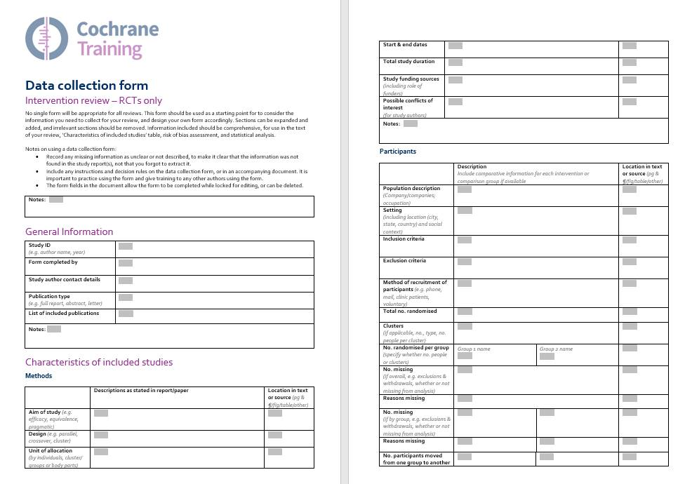
Source: Miranda Cumpston
Notes:
This is an example of a data collection form completed on paper – this one is four pages long, and includes the eligibility criteria on the first page, and a combination of checkboxes (yes/no/unclear, or other coded options as appropriate) and space for notes about each aspect of the study. At the end is a table for data entry. You can see there’s plenty of notes, and corrections, which gives a history of decisions made.

Slide 15
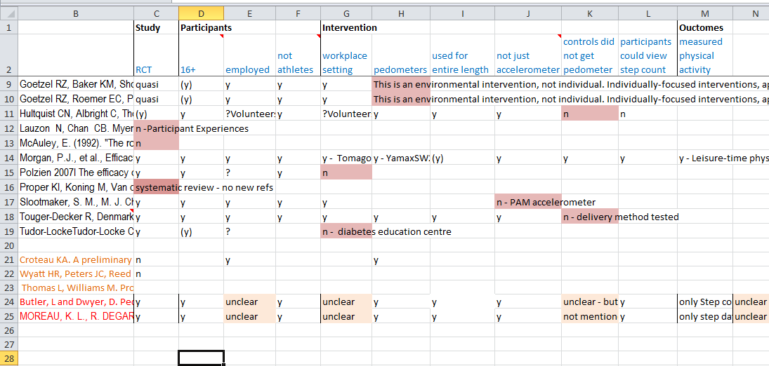
Notes:
Here is another example of a filled out data extraction sheet, this one in a Excel document.

Slide 16

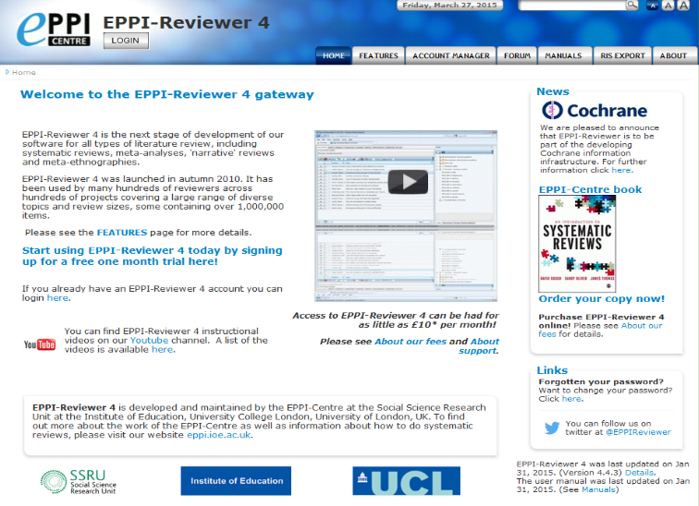
Author support tools
Covidence
  Intervention reviews
  www.covidence.org
EPPI Reviewer
  for complex reviews (non randomised, qualitative studies)
  eppi.ioe.ac.uk/cms/er4
Notes:
As mentioned earlier, author support software such as Covidence and EPPI-Reviewer allow data collection, so you may try using them for this purpose.
Specifically, Covidence allows your team to:
upload search results, screen abstracts and full text;
collect descriptive and outcome data in a structured form;
conduct risk of bias assessment (NOTE: Covidence currently doesn’t support the use of RoB 2 tool – the tools and templates for using RoB 2 are available at https://www.riskofbias.info/welcome/rob-2-0-tool/current-version-of-rob-2);
compare duplicate decisions by two review authors and resolve disagreements;
export data into RevMan or Excel. (NOTE: Covidence doesn’t enable direct export of data to RevMan Web, which is now the recommended version of RevMan software for Cochrane authors)

Slide 17
Minimising bias in data collection
  two authors should independently collect study characteristics and outcome data
    reduces error
    checks agreement on subjective judgments and interpretations
  resolving disagreements
    can usually be resolved by discussion
    if not, refer to a third author
  pilot data collection process
    include each person assisting
    check criteria are consistently applied
    may need to revise form or instructions
Notes:
To ensure your data collection is accurate, and to reduce the risk of bias, particularly where you are making subjective judgements and interpreting the data, it’s important to have data collected independently by two authors. It may also be helpful to have authors from different perspectives collecting data, e.g. a content expert and a methods expert.
Wherever you find disagreements between the data collected by two authors, these should be resolved by discussion to identify whether they arise from a data entry error, or a more substantive disagreement. A third author may also be used to resolve any disagreements. You should plan to pilot your data collection form on a small number of studies before continuing with complete data collection – this will help you identify any practical improvements to the way the form is set out, and ensure the forms are being used consistently by each author. You may need to discuss and revise your guidance to authors or the form itself.
[NOTE FOR TRAINERS, if asked: It is possible to conduct data collection process with blinding, e.g. by editing copies of the articles to removed information about authors, location and journals. This is not necessary for Cochrane reviews.]
[NOTE FOR TRAINERS, if asked: Agreement can be measured using the kappa statistic, but this is not required (see Handbook section 5.5.5).]

Slide 18
Contacting study authors
  to obtain unreported data or confirm unclear data
    e.g. unclear risk of bias, missing outcomes, missing SDs
  finding contact details
    check the study reports
    check PubMed for recent publications
    check Google for current staff profiles
  save all your queries for one request
  be clear about what you need
    avoid sounding critical
    ask for descriptions rather than yes/no answers
    providing a table to complete may be helpful
Notes:
If you find that information is missing from the study reports, or if anything is unclear, it’s always worth attempting to contact study authors – even for very old studies. You won’t hear back from everyone you contact, but many authors are very happy to share additional information about their work.
Authors’ email addresses are often included in published papers these days. For older papers, or where the details aren’t available, it’s usually fairly easy to find current details. Look up the authors’ more recent papers in PubMed, which may include contact details. Alternatively, Google can usually find the authors’ current staff website at their home institution . Don’t forget to check the second and third authors as well as the first.
When contacting authors for information, whether about the description of the study, methods details for risk of bias assessment, or additional outcome data, be as polite as you can. Try to save all your questions for one email – don’t email them repeatedly with extra requests. Be clear about what you need – sometimes a table can help clarify the statistics you’re after. When asking for descriptive information about the study, open-ended questions may be more helpful – asking “can you describe how you managed blinding in this study?” is much more likely to get a detailed, helpful answer than if you ask “Did you use blinding?”. Authors may become defensive and be less likely to respond if your questions sound as if you are being critical of their work, and one study has shown that authors are likely to give overly positive answers if asked direct yes/no questions (Haahr 2006, Handbook 5.2.3).

Slide 19
Managing data
  can enter data directly from form to RevMan
  may need to consider intermediate steps
    e.g. Excel spreadsheet
    group studies by comparison & outcomes measured
    calculations to convert into required statistics
  don’t forget to check your final results against those reported in the study
Notes:
When you have your data collected and organised, you can begin entering data into RevMan.
For results data, it may be helpful to set up a spreadsheet or table as an intermediate step, to collect together data reported on each outcome from each study. This will give you an overview of the data available, and can help you make final decisions about how best to analyse the results. As mentioned earlier, you may need to do some simple calculations with data from some or all studies to make them compatible with each other and with RevMan, which is easiest to do with a spreadsheet (avoiding errors that can occur when making conversions using a calculator or by hand).
Having an overall picture of the results will also help ensure that you don’t forget about any reported results that are not compatible with the majority of studies, and cannot be added to your analysis in RevMan. These results may need to be reported in the text or an additional table in the review.
We’ll talk about different kinds of analysis you might undertake in separate presentations, but regardless of these calculations, don’t forget to go back and check your results against the findings of the original study. Are the direction and size of effect comparable? If not, can you explain why? This is an important check against data entry and analysis errors before your review goes for publication.

Slide 20
What to include in your protocol
data categories to be collected
whether two authors will independently extract data
piloting and use of instructions for data collection form
how disagreements will be managed
processes for managing missing data
Notes:
Thinking back to the Protocol stage, you should describe your data collection process. Include a brief description of the categories of data you will collect, whether two authors will independently extract data, whether a form will be used and whether you will pilot it first, how you will resolve disagreements, and how you plan to manage any missing data, e.g. by contacting the study authors.

Slide 21
Take home message
think carefully about the data you wish to collect
design and pilot a data collection form
should be done independently by two authors to minimise error and bias

Slide 22
References
Li T, Higgins JPT, Deeks JJ (editors). Chapter 5: Collecting data. In: Higgins JPT, Thomas J, Chandler J, Cumpston M, Li T, Page MJ, Welch VA (editors). Cochrane Handbook for Systematic Reviews of Interventions version 6.1 (updated September 2020). Cochrane, 2020. Available from www.training.cochrane.org/handbook.
Acknowledgements
Compiled by Miranda Cumpston
Based on materials by the Cochrane Australia
Approved by the Convenors of Cochrane Methods Groups

