Slide 1
Bias due to missing results in a synthesis

Slide 2
Steps of a Cochrane Review
define the question
plan eligibility criteria
plan methods
search for studies
apply eligibility criteria
collect data
assess studies for risk of bias
analyse and present results
interpret results and draw conclusions
improve and update review
Notes:
Part of the analysis and interpretation of results is the assessment and consideration of the risk of non-reporting biases.

Slide 3
Session outline
understanding non-reporting biases
minimising risk of bias due to missing results in a synthesis
assessing risk of bias due to missing results in a synthesis
Notes:
We’ll start by explaining what non-reporting biases are.

Slide 4
The dissemination of evidence
unavailable
(unpublished)
available in principle
(thesis, journal not indexed by major databases)
easily available
(MEDLINE-indexed)
actively disseminated
(news, drug company)
Source: Matthias Egger
Notes:
9
Dissemination of research results falls along a continuum:
Unavailable: e.g. not published, only available through informal circulation from the author.
Available in principle: e.g. published as thesis, a conference abstract, or in a journal with smaller circulation and impact, perhaps not published in English, not indexed by the major databases. Only 37% of the abstracts presented at conferences are ever published in full (Scherer 2018).
Easily available: e.g. published in a journal indexed in MEDLINE
Actively disseminated: e.g. trials distributed by the drug rep or some other interested organisation
Only a proportion of studies will ever be published in a way that makes it easy to access and include in your review.

Slide 5
Non-reporting biases
  dissemination of research findings is influenced by the P value, magnitude or direction of the study’s results
  statistically significant results that suggest an intervention works are more likely than statistically non-significant results to be available…
  …therefore more likely to be included in your review
  two main types:
    selective non-publication of studies or ‘publication bias’
    selective non-reporting of results or ‘outcome reporting bias’
Notes:
We know that these differences in dissemination aren’t random. They are influenced by the results of the studies. Studies with results that are more favourable to the experimental intervention, and statistically significant findings, are more likely to be published and widely disseminated, which in turn makes it much more likely that they will be identified and incorporated into your systematic review.
Non-reporting biases include ‘selective non-publication of studies’ (or ‘publication bias’), when the probability that a study is published depends on the P value, magnitude or direction of the results, and ‘selective non-reporting of results’ (or ‘outcome reporting bias’), when these factors influence whether a published study’s results are reported completely.
If we can only find and include the statistically significant results that favour the experimental intervention, the risk is that we are misrepresenting the true effect of the intervention. We call this risk of bias due to missing results in a synthesis. For our review to be accurate and reliable, we need to make sure we include all the evidence, including the statistically non-significant results and the results that are unfavourable to the experimental intervention.

Slide 6
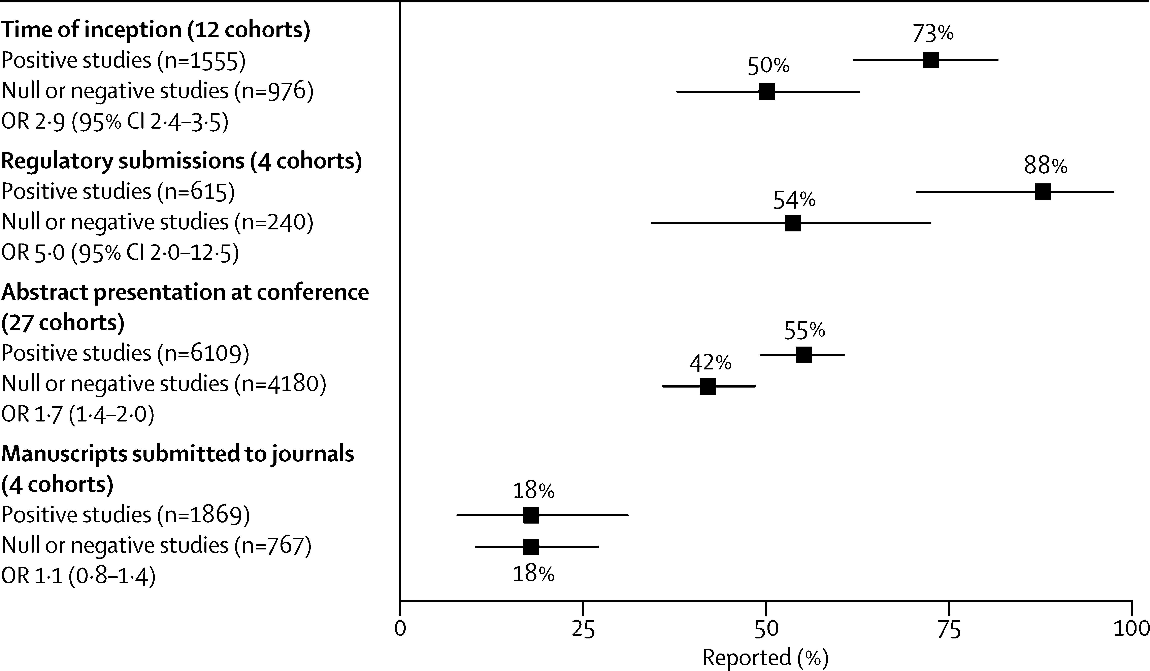
Evidence for selective non-publication of studies
Source: Chan A-W, Song F, Vickers A, Jefferson T, Dickersin K, Gøtzsche PC, et al. Increasing value and reducing waste: addressing inaccessible research. The Lancet. 2014;383(9913):257-66.
Notes:
There is evidence to demonstrate this effect at work. In this review, Chan and colleagues looked for cohorts of clinical studies that were identified at inception (for example, those submitted for ethics approval, or registered in trials registers), or studies submitted for regulatory approval, presented at conferences, or submitted to journals. They then followed up all studies to see which ones ended up being published, and what type of results the studies found: positive or null or negative.
Looking at the top panel, we see that 73% of studies with positive results were published compared with only 50% of studies with null or negative results. A similar pattern was observed when examining regulatory submissions and conference abstracts. However, there didn’t appear to be any difference in the rate of publication of positive or negative studies submitted to journals. This suggests that journal editors are not necessarily biased in favour of positive studies, and that authors (who decide not to submit null or negative studies for publication) may be more responsible for non-reporting biases than journal editors are.

Slide 7
Evidence for selective non-reporting of results
Notes:
Selective non-reporting or incomplete reporting of results occurs commonly for both benefit and harm outcomes. Examining the studies included in a sample of 283 Cochrane Reviews, Kirkham and colleagues found 712 studies with results missing for the primary benefit outcome of the review, and suspected that results were missing due to selective non-reporting for 50% of these studies. This estimate was slightly higher (63%) in 393 studies with results missing for the primary harm outcome of 322 systematic reviews examined by Saini and colleagues

Slide 8
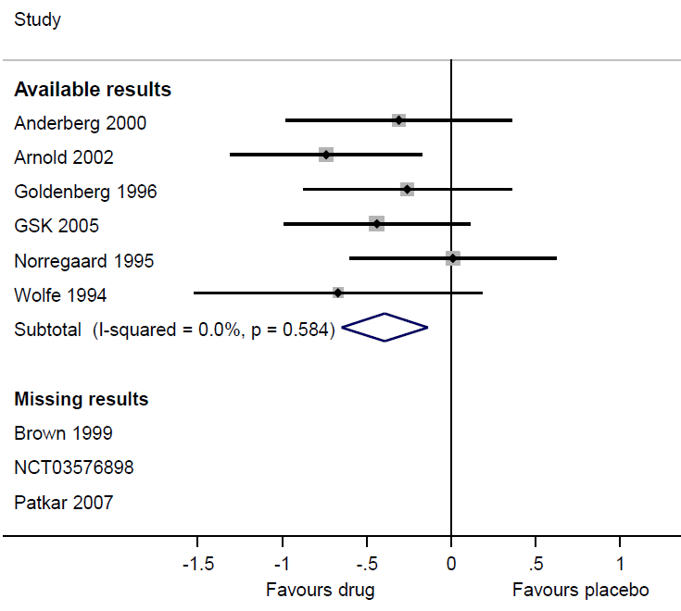
Non-reporting biases
  selective non-publication of studies or selective non-reporting of study results can lead to bias due to missing results in a synthesis (e.g. meta-analysis)
  may lead to overestimated or underestimated effects
Notes:
The reason why non-reporting biases are of concern is because they can lead to bias in the results of a synthesis which fails to include the missing studies or results. And given the results missing are likely to be systematically different (in terms of P value, magnitude or direction) than the results included in the synthesis, the summary estimate observed might over- or underestimate the true intervention effect.

Slide 9
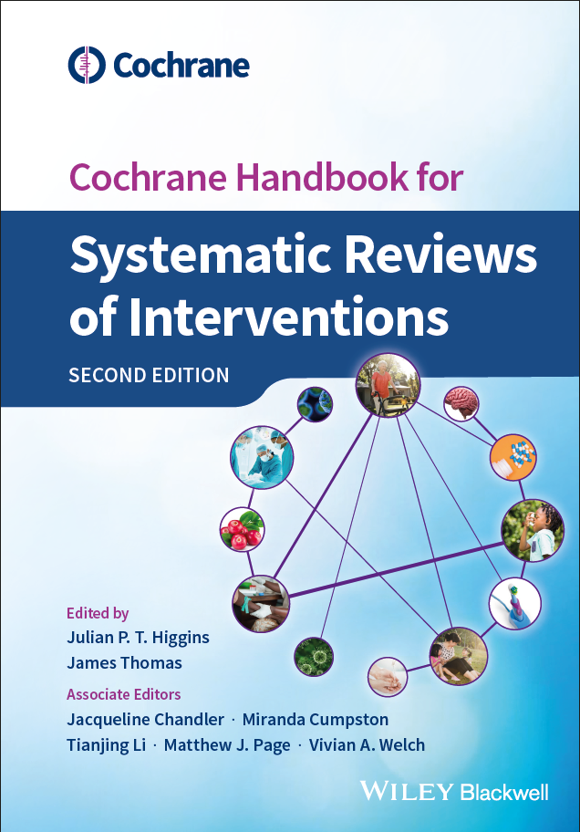
Session outline
understanding non-reporting biases
minimising risk of bias due to missing results in a synthesis
assessing risk of bias due to missing results in a synthesis
See Chapter 13, Section 13.2 of the Handbook
Notes:
Fortunately, there are some steps we can take to minimize risk of bias due to missing results from affecting the findings of our review.

Slide 10
Minimising risk of bias
Include results from sources other than published reports
  comprehensive search to identify published articles, trials register entries, clinical study reports, dissertations, preprints, government reports, non-English literature
  Restrict syntheses to studies that could be identified before their results became known (e.g. prospective meta-analysis)
  enables identification of all eligible studies regardless of the P value, magnitude or direction of any result
  avoids possibility of missing eligible studies, but there is still potential for missing results in these studies, so an assessment of risk of bias is still necessary
Notes:
Searching only for studies published in journals means we are likely to have an unrepresentative sample of all the studies addressing our review question. To minimise risk of bias due to missing results in our syntheses, we should strive to do our best to find all the eligible studies that have been conducted, by running a comprehensive search, attempting to find literature published in journal articles as well as in other formats, such as trials register entries, clinical study reports submitted to regulators, dissertations, preprints, government reports and other unpublished manuscripts. Extending the search to articles written in a language other than English could help minimize language bias; in some fields there is a tendency for researchers to submit null or negative studies to non-English language journals.
Alternatively, review authors can sometimes reduce the risk of bias due to missing results by limiting the type of studies that are eligible for inclusion. Authors may decide to include only studies that could be identified before their results became known. For example, a clinical trial collaborative group may prospectively plan to undertake multiple trials using similar designs, participants, interventions and outcomes, and synthesize the findings of all trials once completed, which is known as a ‘prospective meta-analysis’. Using this approach means identifying all eligible studies regardless of the P value, magnitude or direction of any result. Limiting inclusion to prospectively registered studies avoids the possibility of missing any eligible studies. However, there is still the potential for missing results in these studies. Therefore, review authors would need to assess the availability of results for each study identified. If none of the prospectively registered studies suffer from selective non-reporting of results, then none of the syntheses will be at risk of bias due to missing results.

Slide 11
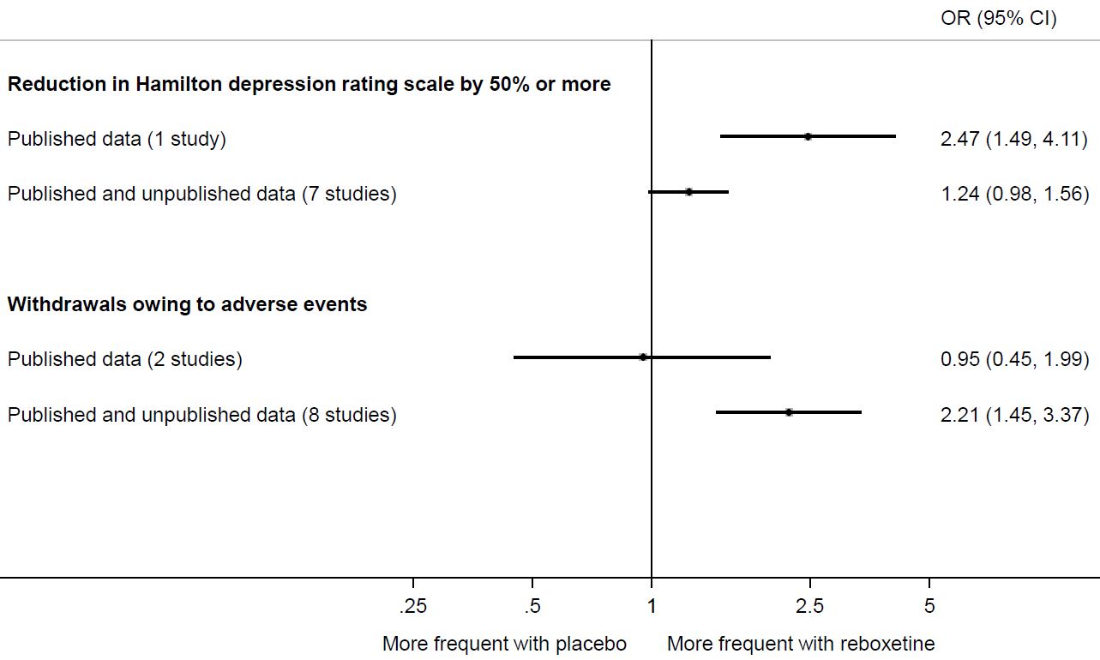
Value of adding unpublished data to a meta-analyses of reboxetine versus placebo for acute treatment of major depression (data from Eyding et al. BMJ 2010)
Source: Chapter 13, Section 13.2.1 of the Handbook
Notes:
Eyding and colleagues provide a striking example of the value of searching beyond the published literature. They sought data from published trials of reboxetine versus placebo for major depression, as well as unpublished data from the manufacturer. Of 13 trials identified, data for only 26% were published. A far more positive picture of the effects of reboxetine was observed when the meta-analysis was restricted to the published data. For example, in the top panel we see that the between-group difference in the number of patients with an important reduction in depression was much larger in the published trial compared with a meta-analysis of 7 published and unpublished trials.
Similarly, the bottom panel shows that a meta-analysis of two published trials suggested a negligible difference between reboxetine and placebo in the number of patients who withdrew because of adverse events. However, when six unpublished trials were added, the summary estimate suggested that patients on reboxetine were more than twice as likely to withdraw.

Slide 12
Session outline
understanding non-reporting biases
minimising risk of bias due to missing results in a synthesis
assessing risk of bias due to missing results in a synthesis
See Chapter 13, section 13.3 of the Handbook
Notes:
The strategies outlined in the previous slides are designed to minimize bias due to missing results in systematic reviews. However, neither strategy is completely foolproof. For example, review authors may have been able to include results from ClinicalTrials.gov for several unpublished trials, yet unable to obtain unreported results for other trials. Unless review authors can eliminate the potential for bias due to missing results, for example through prospective meta-analysis with no missing results, they should formally assess the risk of this bias in their review.

Slide 13
ROB-ME framework
ROB-ME = “Risk Of Bias due to Missing Evidence”, a new framework for integrating assessment of risk of bias in syntheses due to:
missing studies (selective non-publication of studies)
missing study results (selective non-reporting of results)
Development informed by
review of existing tools (Page et al. BMJ Open 2018)
expert consensus
Only a framework at this stage (see Chapter 13 of the Handbook for more details). A structured tool is currently in development.
Notes:
Chapter 13 of the Cochrane Handbook describes a new framework for considering non-reporting biases in systematic reviews. It has recently been named ROB-ME, which stands for “Risk Of Bias due to Missing Evidence”, with the implication being that non-reporting biases tend to “rob” systematic reviewers of all the evidence they are seeking.
This framework consolidates and extends existing tools and guidance for assessing risk of bias in syntheses due to missing studies and missing study results. A structured tool is currently being developed which will help users conduct their assessments, and link with other risk of bias tools such as RoB 2.

Slide 14
ROB-ME framework
Select which syntheses will be assessed for risk of bias
Consider which study results would be eligible for inclusion in each synthesis
Record whether any of the studies identified are missing from each synthesis because results known (or presumed) to have been generated are unavailable: the ‘known unknowns’
Consider whether each synthesis is likely to be biased because of the missing results in the studies identified
Consider whether results from additional studies are likely to be missing from each synthesis: the ‘unknown unknowns’
Reach an overall judgement about risk of bias due to missing evidence in each synthesis
Notes:
The ROB-ME framework consists of 6 steps. We’ll go through each of these steps now, and illustrate them with an example review.

Slide 15
ROB-ME framework: Step 1
Select which syntheses (e.g. meta-analyses) will be assessed for risk of bias
May not be feasible to assess all syntheses in the review
Strive to assess syntheses of patient-important outcomes (typically those in ‘Summary of findings’ tables)
Notes:
Doing a thorough assessment of risk of bias due to missing results requires considerable time and resources, particularly when many eligible studies are identified. So it may not be feasible to assess risk of bias due to missing results in all syntheses (e.g. meta-analyses) in a review. Therefore, we suggest you aim to assess, at a minimum, syntheses of patient-important outcomes, such as the 7 outcomes included in your ‘Summary of findings’ tables.

Slide 16
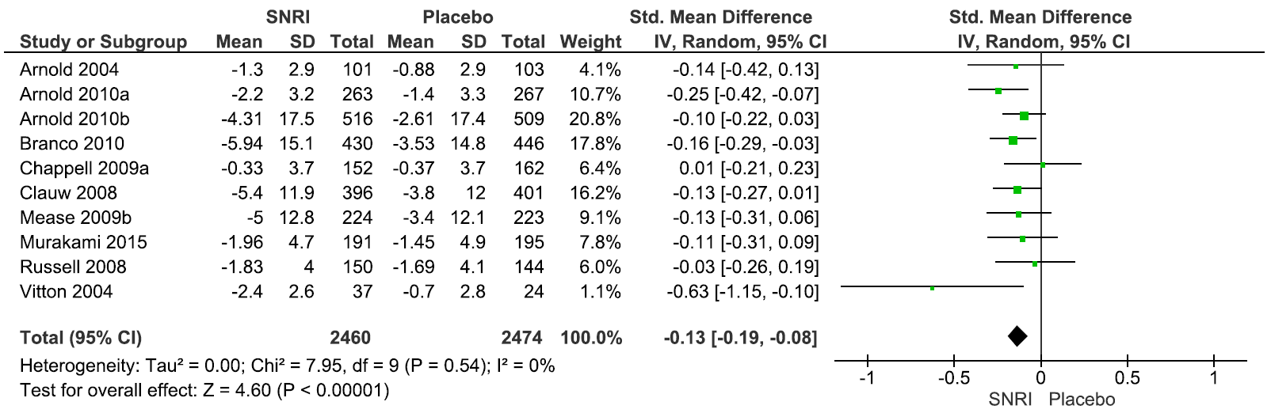
Synthesis 1: A meta-analysis of self-reported fatigue at the end of treatment SMD -0.13, 95% CI -0.19, -0.08; 10 trials
Adapted from Welch P, et al. Serotonin and noradrenaline reuptake inhibitors (SNRIs) for fibromyalgia. Cochrane Database of Systematic Reviews 2018(2):CD010292
Notes:
For example, in a review of the effects of serotonin and noradrenaline reuptake inhibitors (or SNRIs) for fibromyalgia, we might choose to assess risk of bias due to missing results in one of the critical outcomes of the review, which is self-reported fatigue at the end of treatment. By the end of our assessment, we’ll have made a judgement of risk of bias in the summary estimate of this meta-analysis, which includes 10 trials comparing SNRI with placebo.
Please note that this meta-analysis presented on the slide is a modification of the one presented in the review by Welch, and so when I refer to this review in future slides, just remember this is somewhat made-up example.

Slide 17
ROB-ME framework: Step 2
Consider which study results would be eligible for inclusion in each synthesis. That is, indicate whether the synthesis is restricted to particular:
Intervention comparisons
Measurement instruments
Time points
Methods of analysis (e.g. final versus change from baseline values; adjusted versus unadjusted estimates)
Sources (e.g. journal articles, register entries)
Notes:
Next, you need to consider what type of results are eligible for inclusion in each synthesis. In particular, you need indicating whether the synthesis was restricted to particular outcome definitions (e.g. measurement instruments, metrics, time points) and to particular methods of analysis (e.g. crude or adjusted estimates). It’s best to pre-define eligibility criteria for all of these elements, although the measurement instruments, timing and analysis metrics used in studies identified can be difficult to predict, so plans may need to be refined. The main reason why this step is needed is because it’s really difficult to assess which results are missing from a synthesis if you’re not clear about which results you want to find.

Slide 18
Eligible study results for the meta-analysis of fatigue
Between-group comparisons of any SNRI versus placebo
Any instrument measuring fatigue. Common scales include:
Fibromyalgia Impact Questionnaire (FIQ) fatigue subscale score
Multidimensional Fatigue Inventory (MFI)
Mean change from baseline to end of treatment
Any source (e.g. journal articles, register entries, etc.)
Notes:
Going back to our meta-analysis of fatigue, the review authors were interested in finding results for any between-group comparison of any SNRI versus placebo, as estimated using any measurement instrument for fatigue, but they were only interested in mean change from baseline scores until the end of treatment. They were also willing to include results regardless of the source, so data in journal articles, clinical study reports, trials registers were eligible.

Slide 19
ROB-ME framework: Step 3
Assemble various sources of information about each study meeting the inclusion criteria of the review
trials register entry
protocol
journal articles
clinical study reports (CSRs) and other regulatory documents
info from authors or sponsors
Notes:
After completing Steps 1-2, it’s time to do some detective work to identify any evidence of selective non-reporting of results.
To do this, we advise you to assemble as much information about each study as possible. That is, rather than just relying on the journal article for a study, try and locate the trials register entry, protocol, statistical analysis plan, regulatory documents if it’s a regulated intervention like a drug or device, and, if necessary, contact the study authors or sponsor for missing or unclear information. Accessing all of this information is particularly helpful when trying to determine whether particular outcomes were assessed, but results not reported.

Slide 20
ROB-ME framework: Step 3
For each study meeting the inclusion criteria of the review:
Compare information about what outcomes were measured with results that were available
Record whether the particular results sought were available for the study
If unavailable, consider whether this is because of the nature of the findings (e.g. statistical non-significance, unfavourable direction of effect)
Notes:
Then, for each study meeting the inclusion criteria of the review, we suggest you compare information about what outcomes were measured (for example, in the trials register entry or study protocol) with what results were actually available. Then, record whether the results you want for the synthesis are available for the study. And if results are unavailable, consider why this may be. Is it for some innocuous reason, such as the trialists never measured the outcome? Or is it because the study authors have chosen to withhold the results because they were statistically non-significant, or favoured the comparator.
We call these cases the ‘known unknowns’ because by doing this evaluation, we can know (or at least be highly confident) that results are missing.

Slide 21
ROB-ME framework: Step 3
May be reasonable to suspect selective non-reporting if:
outcome was pre-specified yet no result is available, and no explanation for its absence is provided
results were incompletely reported when the between-group difference was statistically non-significant
outcome is almost certain to have been recorded but no results are available (refer to core outcome sets)
authors have conflicts of interest that might have led them to withhold unfavourable results (refer to TACIT)
Notes:
We’ve collated a list of different scenarios that we think should raise suspicion that selective non-reporting of results has occurred. These include when the outcome was pre-specified yet no result is available, and no explanation for this is provided, either in the paper or after contacting the authors for clarification. I’d also be concerned if results were incompletely reported when the difference was statistically non-significant. For example the authors might present a very clear table with summary statistics, effect estimates and confidence intervals for results that are statistically significant, yet for results that are non-significant, just report something like “there was no difference, P>0.05”, without presenting any summary statistics that we can include in the meta-analysis.
I’d also be concerned if results are missing for one of two outcomes that tend to be measured together. For example, results are available for cause-specific mortality and are favourable to the experimental intervention, yet results for all-cause mortality, which must have been assessed given cause-specific mortality was, are missing. To get an idea about which outcomes are typically measured in a particular research area, consider searching the COMET initiative database for core outcome sets.
Another thing I’d be concerned if results were not available in a study, and the authors of that study had conflicts of interest that might influence them to withhold unfavourable results. The Tool for Assessing Conflicts of Interest in Trials, or TACIT, provides a structured approach for determining conflicts of interest of study authors.

Slide 22
ROB-ME framework: Step 3
Results might be unavailable for a reason other than selective non-reporting, e.g.
the outcome was clearly not measured (based on an examination of the protocol or statistical analysis plan)
the instrument or equipment needed to measure the outcome were not available at the time the study was conducted
the outcome was measured but data were not analysed owing to a fault in the measurement instrument, or substantial missing data
Notes:
It’s important to realise that results might be unavailable in a study for reasons other than selective non-reporting. For example, as noted previously, the authors may not have measured the outcome required to generate the result you’re seeking. Accessing the study protocol or register entry can help determine what was measured, but it’s not always necessary; in some cases, you might judge that results aren’t available for a particular study because the measurement instrument or equipment needed to measure the outcome were not available at the time the study was conducted. Also, study authors might report in the paper that they chose not to report results for an outcome they measured, since the data weren’t analysed because of a fault in the measurement instrument (such as when a measuring device broke down during the testing sessions), or because a substantial number of participants chose not to complete the measure, which might be the case when collecting highly personal information.

Slide 23
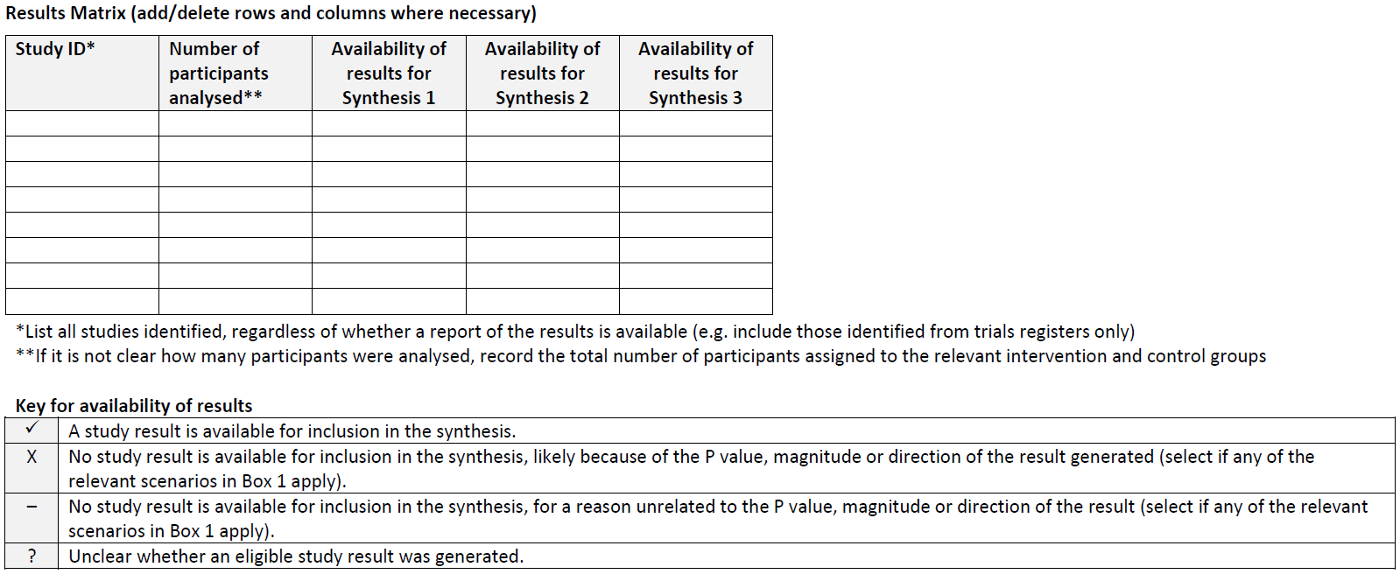
ROB-ME framework: Step 3
Matrix template modified from Kirkham et al. BMJ 2018;362:k3802
Notes:
We think a helpful way of recording which studies have results available and which do not is to construct a results matrix, where studies are listed as rows and the syntheses that you’re going to assess for risk of bias are listed as columns. You can then indicate using ticks and crosses whether a result is available from each study for inclusion in each synthesis or not.

Slide 24
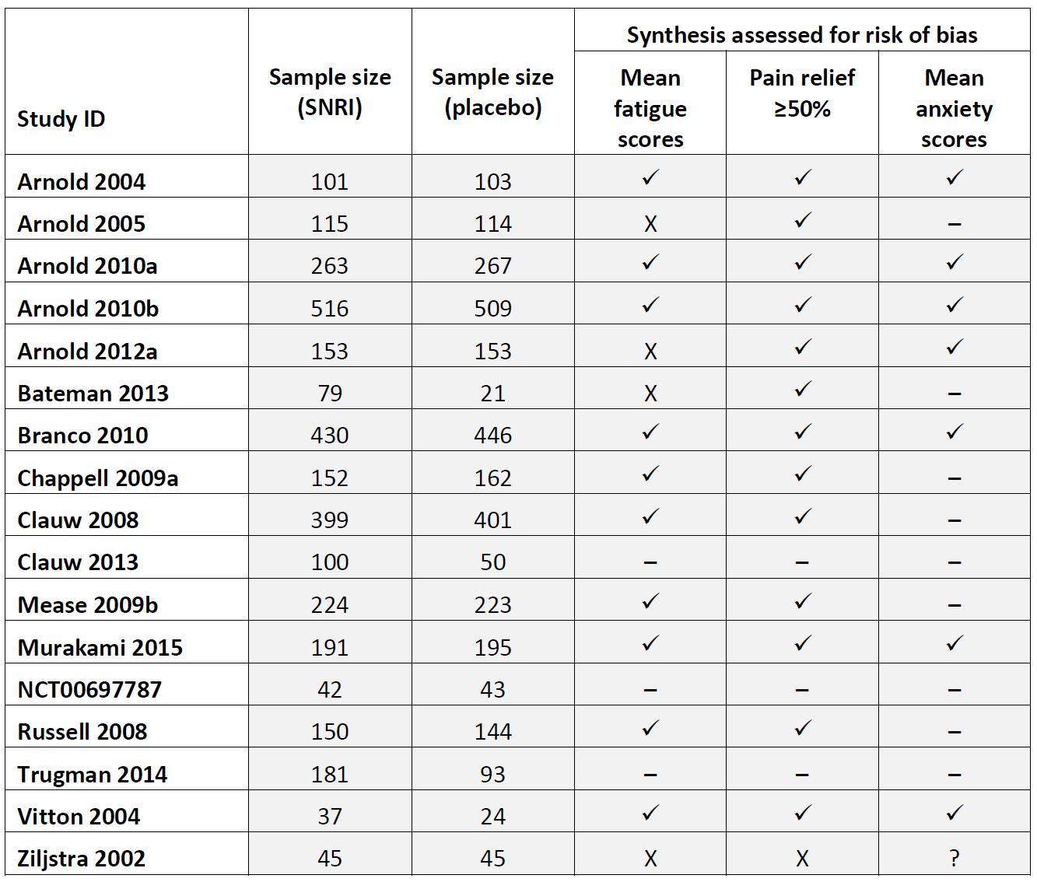
Notes:
For example, this is a results matrix for our review of SNRIs versus placebo for fibromyalgia. Here we see all the studies that were identified listed in rows, followed by information about the sample size of each, which I’ll come back to later. Then, the availability of results is indicated for 3 syntheses that will be assessed for risk of bias due to missing results.
Looking at the first synthesis, mean fatigue scores, we see 4 studies have an ‘X’, which means that the review authors have judged that results were missing from these studies due to selective non-reporting of results. There are 3 studies with a ‘-’ symbol, which means that no result is available from those studies, but this was for a reason other than selective non-reporting.

Slide 25
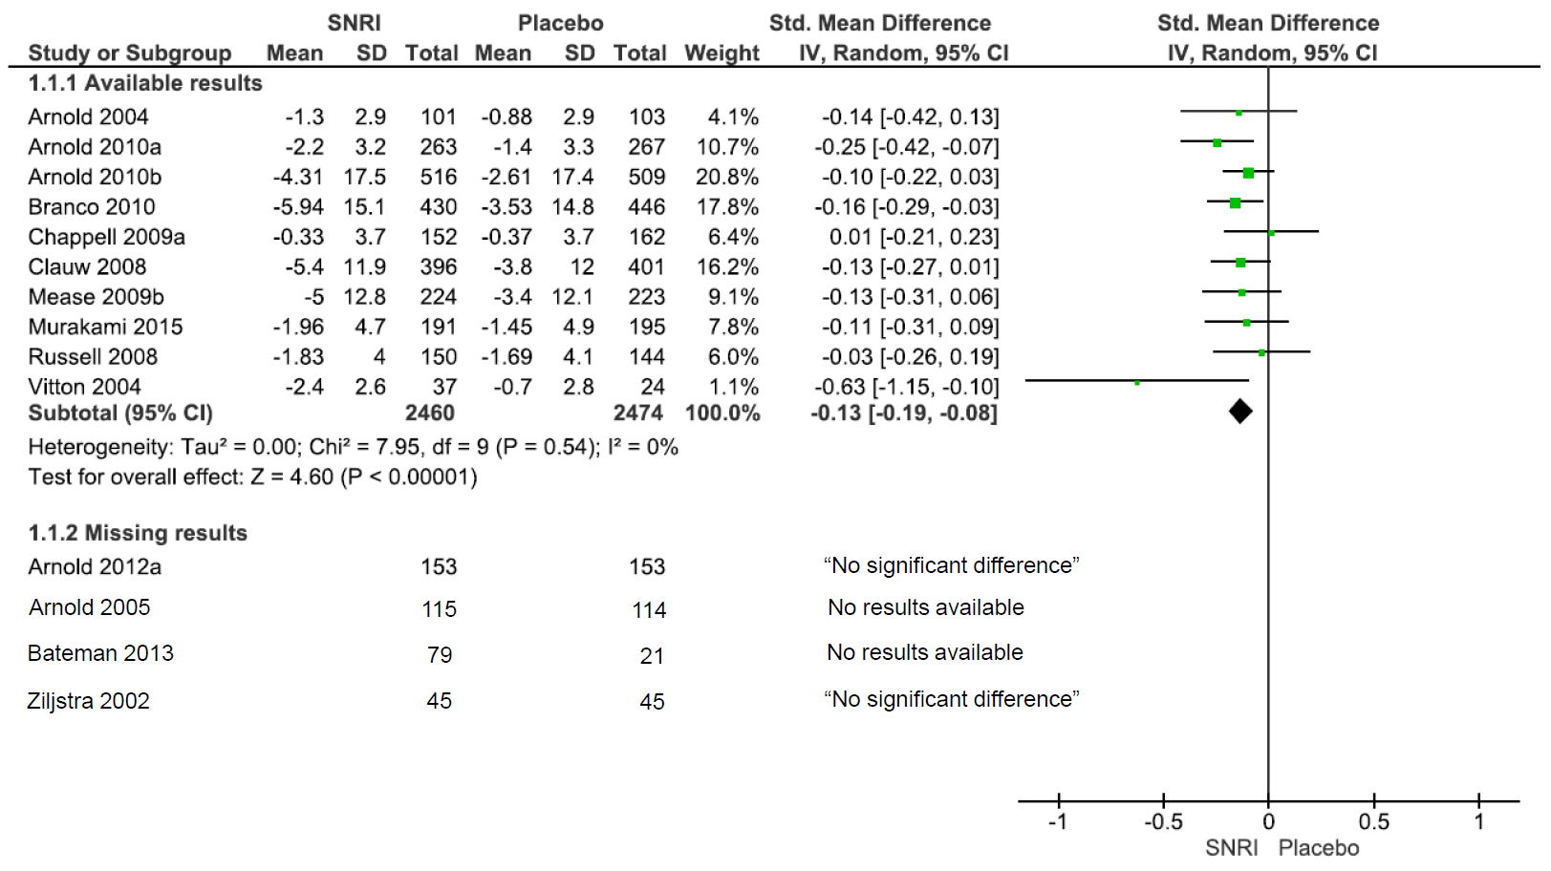
Notes:
Coming back to the forest plot for this meta-analysis, we could display these 4 studies with missing results at the bottom of the plot, to draw readers attention to the fact that the meta-analysis is missing these studies. Alternatively, you could create a table listing the missing studies and place it next to the forest plot.

Slide 26
ROB-ME framework: Step 4
Impact of known missing results:
Data from 4934 participants included in the meta-analysis
Data from 725 participants missing
725/(4934+725) = 13% of total participant data known to be missing from the meta-analysis
Consider performing sensitivity analysis (see Chapter 13 of the Handbook for more details)
Notes:
Given that we know that 4 studies are missing from the meta-analysis due to selective non-reporting of results, we need to then consider the potential impact of the missing results on the meta-analysis. We could evaluate the sample sizes of the trials with available and missing results, and determine that the amount of participant data is missing across all known studies is 13%. We then might consider performing sensitivity analyses to assess how robust the synthesis was to various assumptions about the nature of the missing results. Such sensitivity analyses should be done in consultation with a statistician, and are now applicable to all circumstances. More details are available in Chapter 13 of the Handbook.

Slide 27
ROB-ME framework: Step 5
There may be no evidence of selective non-reporting of results in the studies meeting the inclusion criteria…
…but that doesn’t guarantee the synthesis is free of bias.
Additional results may be missing from the synthesis
studies that have been undertaken but not reported in any form
classic ‘publication bias’
Notes:
By this point, review authors might have judged that the synthesis they are assessing is likely to be biased because results are missing systematically from a considerable proportion of studies identified. Alternatively, it might be clear that results for some of the studies identified are definitely missing, but the potential impact on the synthesis is considered to be minimal. This does not necessarily mean that the synthesis is free of bias due to missing results.
It is possible that additional results are missing from the synthesis, particularly studies that have been undertaken but not reported at all because of the nature of their results, and so review authors are unaware of them – we call these the ‘unknown unknowns’.

Slide 28
ROB-ME framework: Step 5
Consider whether circumstances indicate potential for there to be additional studies that were not identified because of the P value, magnitude or direction of results generated
Less concerned when reviewing set of studies known to have been initiated, irrespective of their results (e.g. prospective meta-analysis)
More concerns if:
research area is not one for which all studies are expected to have been prospectively registered
no trials registers were searched
search strategy designed to retrieve studies only if they reported a particular outcome
Notes:
The ROB-ME framework recommends various strategies to help review authors judge whether a synthesis is at risk of bias because of additional studies that have been undertaken but not reported at all because of the nature of their results.
Firstly, consider whether circumstances indicate potential for there to be additional studies that were not identified because of the nature of the results. There is less reason for concern about a synthesis which is restricted to studies known to have been initiated, irrespective of their results, for example, a prospective meta-analysis.
On the other hand, there is more reason for concern if the research area is not one for which all studies are expected to have been prospectively registered; for example, there’s evidence that trials of non-regulated interventions, such as psychotherapy, diet, and physical therapy, are less likely to be registered than trials of regulated interventions (e.g. drugs and devices), and hence there is greater chance for trials of such non-regulated interventions to remain hidden. There’s also more concern if no trials registers were searched, or if the search was strategy designed to retrieve studies only if they reported a particular outcome. Given not all outcomes are likely to be reported in a study abstract, and those that are reported tend to be the most favourable to the experimental intervention, including particular outcomes as search terms in the search strategy means that studies that refer to outcomes with unfavourable results in the main text only are likely to be missed.

Slide 29
ROB-ME framework: Step 5
Consider findings of graphical and statistical methods, when appropriate
contour-enhanced funnel plots
tests for funnel plot asymmetry
sensitivity analyses
Notes:
In addition, it can be helpful to use graphical and statistical methods, such as contour-enhanced funnel plots and test for funnel plot asymmetry, which may reveal a tendency for the intervention effects estimated in smaller studies to differ from those estimated in larger studies.

Slide 30
Funnel plots
  plot effect size against study size
    study size usually indicated by a measure like standard error
  studies will be scattered around the effect estimate
    larger studies at the top, smaller studies further down
    small studies expected to scatter more widely
  a symmetrical plot will look like an inverted funnel or triangle
Notes:
Funnel plots are a tool available to take the results of a meta-analysis and plot the results of each individual study against a measure of the study’s size (usually represented by a measure of variance like standard error). If the study’s size is not associated with the results, then the plot should represent an inverted funnel – larger studies will be at the top in the centre of the plot, close to the meta-analysed estimate of effect, and smaller studies will progressively scatter more widely either side towards the bottom of the plot.
RevMan can generate these plots for you, but it should be emphasised that funnel plots will not give meaningful results if you have fewer than 10 studies in your meta-analysis, or if they are all the same size.

Slide 31
Symmetrical funnel plot
0
1
Standard Error
2
3
0.1
0.33
0.6
1
3
10
Source: Matthias Egger & Jonathan Sterne
Effect
Notes:
This is what a funnel plot looks like. You can see that the standard error has been used as the measure of size. The scale is reversed so that studies with low SE (i.e. large studies) will be at the top of the plot, and studies with high SE (i.e. small studies) will be at the bottom. So, the studies at the point of the funnel will be the large studies, and the smaller studies gradually scatter wider and wider towards the bottom.
Note that the important vertical line on this plot is not the line of no effect, in this case 1, as it would be on a forest plot. The important vertical line that we want to be in the centre of the triangle is the overall effect estimate from the meta-analysis. For ratio measures, just like in a forest plot, a logarithmic scale is used for the measure of treatment effect so that the scale is symmetrical.

Slide 32
Asymmetrical funnel plot
0
1
Standard Error
Unpublished studies
2
3
0.1
0.33
0.6
1
3
10
Source: Matthias Egger & Jonathan Sterne
Effect
Notes:
On our hypothetical plot, this is what it might look like if we have small-study effects. You can see that we have large studies at the top, close to the overall effect estimate, but we don’t have a nice even scatter of smaller studies either side – our smaller studies appear to be consistently estimating lower odds ratios than the larger studies. This is called funnel plot asymmetry, and indicates that we have some kind of small-study effect at work.
This might be because these small studies were not published, and couldn’t be found for the review.

Slide 33
Asymmetrical funnel plot
0
1
Standard Error
Small studies all finding positive effects
2
3
0.1
0.33
0.6
1
3
10
Source: Matthias Egger & Jonathan Sterne
Effect
Notes:
Alternatively, it might be that the small studies are consistently finding different results to the large studies, and so there are no studies with results up the other end of the scale.

Slide 34
Reasons for funnel plot asymmetry
  chance
  artefact
    some statistics are correlated to SE, e.g. OR
  clinical diversity
    different populations different in small studies
    different implementation different in small studies
  methodological diversity
    greater risk of bias in small studies
  reporting biases
Source: Egger M et al. Bias in meta-analysis detected by a simple, graphical test. BMJ 1997; 315: 629
Notes:
It’s important not to jump to conclusions about the causes of funnel plot asymmetry and small-study effects. There are many different reasons why this might occur, and you will need to put some thought into distinguishing between these different effects. Knowing your intervention, and the circumstances in which it was implemented in different studies, can help identify causes of funnel plot asymmetry. It’s also important to remember that your review may suffer from some of these problems even if the funnel plots are symmetrical and the tests negative, so you will always be required to explore and understand your results, and consider each of these issues for yourself.
The first reason you might find asymmetry is chance – it may just be random chance that the small studies found different effects, particularly in reviews with few studies – which applies to most Cochrane Reviews. Secondly, it may be artefactual – some statistics are naturally correlated with their standard errors, for example odds ratios, and in these cases some funnel plot asymmetry is to be expected.
It may be due to clinical diversity, or the heterogeneity in your study populations and intervention. For example, you may have different underlying populations in the smaller studies that obtain different benefits from the intervention. Early, small, exploratory studies may have been conducted in high-risk populations, who might receive more benefit from the intervention – in that case you might have a correlation between the effect and the size of the study.
This can also apply to the delivery of the intervention – e.g. if larger studies deliver the intervention with different levels of fidelity and monitoring, or at a lower intensity than smaller studies, which may lead to differing results. It may be that you are already planning subgroup analyses which can clarify these differences in effects.
In some cases, methodological diversity may be at work. Small studies may be consistently overestimating the effect due to bias, e.g. poor allocation concealment, lack of blinding, etc. Concern about this is the reason we assess the risk of bias in our included studies in the first place, and the risk of bias assessment in your review may indicate whether these factors may be impacting on your results. If this is occurring in your review, and you have not done so already, you may wish to consider excluding studies at high risk of bias from your analysis.
Finally, asymmetry may be caused by reporting biases, otherwise known as publication bias – we’ll come to that later.

Slide 35
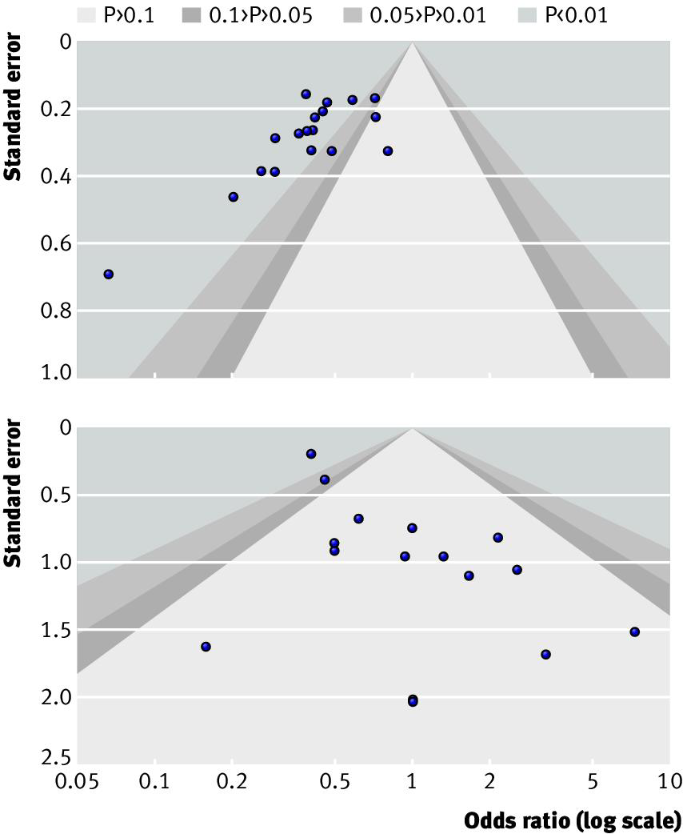
Contour-enhanced funnel plots
Source: Sterne JAC, Sutton AJ, Ioannidis JPA et al. Recommendations for examining and interpreting funnel plot asymmetry in meta-analyses of randomised controlled trials. BMJ 2011;342:d4002 doi: 10.1136/bmj.d4002
Notes:
Contour-enhanced forest plots can help us differentiate asymmetry that is due to non-reporting biases from that due to other factors.
In the plot on the left, rather than an even spread of studies, we see most falling on the left hand side; clear evidence of funnel plot asymmetry. It also appears that the missing studies, if found, may have been those with non-significant findings, and would appear in the lighter centre of the plot.
Looking at the plot on the right, the asymmetry suggests some missing studies over to the left side, crossing into the area of statistical significance. This is not consistent with our understanding of reporting bias – it would mean that the non-significant studies had been published, whereas the statistically significant studies were not. It’s much more likely in this right-hand plot that there is some other reason for the asymmetry.
If there are no statistically significant studies at all, then it’s very unlikely that reporting bias is the cause of the asymmetry.

Slide 36
ROB-ME framework: Step 5
Consider findings of graphical and statistical methods, when appropriate
contour-enhanced funnel plots
tests for funnel plot asymmetry
sensitivity analyses
Consult a statistician before proceeding with tests and sensitivity analyses
Notes:
Aside from funnel plots, it’s also possible to conduct statistical tests to determine whether there is a greater association between study size and effect than we would expect to occur by random chance. There are a range of different tests available, although they have advantages and disadvantages. Sensitivity analyses (such as selection models) can also be used to explore how robust the meta-analysis is to assumptions about the extent and nature of missing results, but require expertise and careful application.
You should definitely get statistical advice before deciding to use any of these methods.

Slide 37
ROB-ME framework: Step 6
Consider the findings of each approach to reach an overall judgement of risk of bias due to missing results. For example, if:
selective non-reporting of results was not detected in any of the studies identified…
…but the search for evidence was not comprehensive, or a contour-enhanced funnel plot suggests the synthesis is likely to be missing results that were systematically different from those observed…
…there may be reason for concern
Notes:
Those are just a couple of ways of assessing the potential for additional missing studies. We need to consider the information from such assessments with our earlier assessment of selective non-reporting of results, to reach an overall judgement of the risk of bias due to missing results in the synthesis. For example, if selective non-reporting of results was not detected in any of the studies identified, but the search for evidence was not comprehensive (for example, theses or articles written in a language other than English, while available, were missed by the review authors), or a contour-enhanced funnel plot suggests the synthesis is likely to be missing results that were systematically different from those observed, then it would be reasonable to judge the synthesis at high risk of bias due to missing results.

Slide 38
What to include in your protocol
planned methods for minimizing risk of bias due to missing results
planned methods for assessing risk of bias due to missing results
Notes:
Bringing all this back to your protocol, you will need to pre-specify any planned methods minimizing risk of bias due to missing results, and also planned method for assessing risk of bias due to missing results.

Slide 39
Take home message
Clear evidence of non-reporting biases in health research
ROB-ME provides a framework for considering risk of bias due to missing results in syntheses included in your review
A structured ROB-ME tool (in development) will integrate with other risk of bias tools (RoB 2) and facilitate appropriate interpretation of results
Notes:
There is clear evidence that selective dissemination of study reports and results leads to an over-estimate of the benefits and under-estimate of the harms of interventions in systematic reviews and meta-analyses. However, overcoming, detecting and correcting for bias due to missing results is difficult. ROB-ME provides a framework for considering such bias in the syntheses included in your review. To help review authors carry out such an assessment, a structured ROB-ME tool is currently being developed, which will integrate with other risk of bias tools such as RoB 2, and help authors draw appropriate interpretations of their results.

Slide 40
References
Page MJ, Higgins JPT, Sterne JAC. Chapter 13: Assessing risk of bias due to missing results in a synthesis. In: Higgins JPT, Thomas J, Chandler J, Cumpston M, Li T, Page MJ, et al., editors. Cochrane Handbook for Systematic Reviews of Interventions. Version 6.0 (updated July 2019). Available from https://training.cochrane.org/handbook: Cochrane; 2019.
Acknowledgements
Updated by Matthew Page
Based on materials by Miranda Cumpston, Jonathan Sterne, Matthias Egger, Julian Higgins, David Moher, the Cochrane Bias Methods Group, and Cochrane Australia

