Slide 1
Assessing the certainty of evidence

Slide 2
Steps of a Cochrane Review
define the question
plan eligibility criteria
plan methods
search for studies
apply eligibility criteria
collect data
assess studies for risk of bias
analyse and present results
interpret results and draw conclusions
improve and update review
Notes:
When the analysis is complete, and you have all the results of your review ready, it’s time to bring those results together and present your readers with your interpretation and conclusions – a guide to what the results mean.
Assessing the certainty of evidence is a key step in interpreting results and drawing conclusions.

Slide 3
Session outline
a reminder on how to read and understand meta-analysis results
GRADE approach to assessing certainty of evidence
factors affecting certainty
See Chapters 14 & 15 of the Handbook
Notes:
In this session, we will start with a reminder on how to read and understand the results of an meta-analysis. We will then describe the GRADE approach to assessment of the certainy of evidence and explain its central role in interpreting the findings of your systematic review.
We will also look in more detail at factors leading to downgrading or upgrading the certainty of evidence.

Slide 4
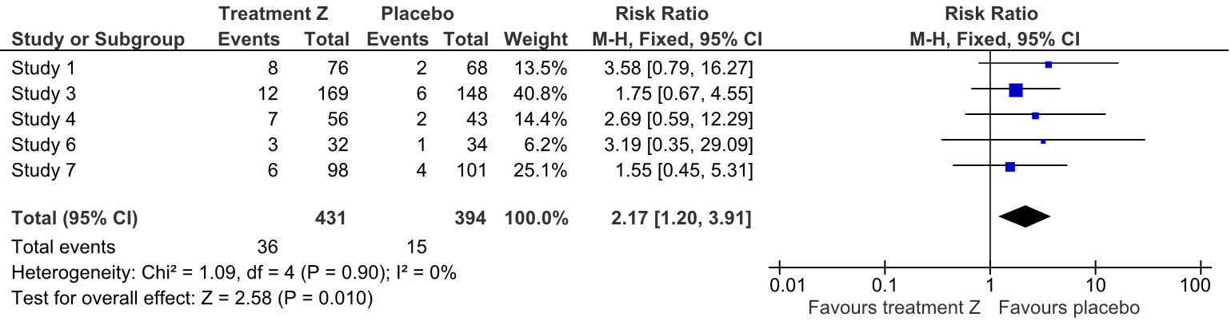
Understanding dichotomous outcomes
Outcome: nausea
What does this Risk Ratio (RR) mean?
The risk of nausea with treatment Z is 2.17 times the risk when taking placebo. The effect could range from 1.2 to 3.91 times.
Notes:
Before we explain the GRADE approach to assessing the certainty of evidence, let’s remind ourselves how to read the results of a meta-analysis. Here we have a dichotomous outcome, with Risk Ratio as the effect measure. [ASK] How would you understand this RR – what does it mean? Answer: The risk of nausea with treatment Z is 2.17 times the risk when taking placebo. The effect could range from 1.2 to 3.91 times.

Slide 5
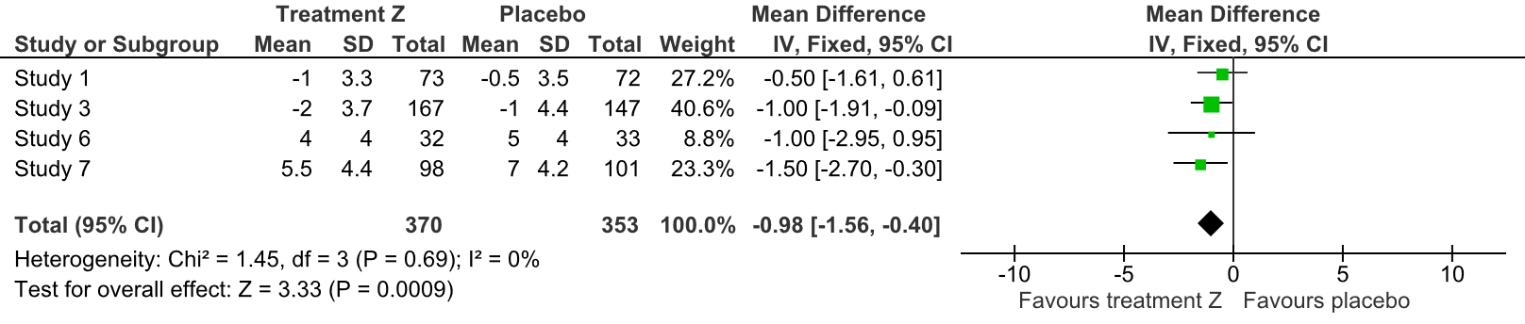
Understading continuous outcomes
Outcome: pain, on a scale from 1 (no pain) to 10 (severe pain)
What does this Mean Difference (MD) mean?
Pain may be reduced by 0.98 points when taking treatment Z in comparison to taking placebo. The effect could range from reduction by 1.56 points to 0.40 points.
Notes:
[NOTE TO TRAINERS: This slide is optional, as understanding continuous outcomes has been covered in a previous presentation on ‘Continuous outcomes’. If you have enough time for this session, it may be worth using it.]
And here we have a continuous outcome, with Mean Difference as the effect measure. [ASK] How would you understand this MD – what does it mean?
Answer: Pain may be reduced by 0.98 points when taking treatment Z in comparison to taking placebo. The effect could range from reduction by 1.56 points to 0.40 points.

Slide 6
NARRATIVE SYNTHESIS
when synthesising results is appropriate
but statistical analysis cannot be performed
Example:
Three studies found that the risk of headaches is increased when taking the intervention compared to no intervention.
Notes:
Remember that sometimes it may not be possible to do a statistical analysis – for example when suitable numerical data are not available or studies are not similar enough. Even then the study results should be reported, for example: ‘Three studies found that the risk of headaches is increased when taking the intervention compared to no intervention’.

Slide 7
Session outline
a reminder on how to read and understand meta-analysis results
GRADE approach to assessing certainty of evidence
factors affecting certainty
See Chapters 14 & 15 of the Handbook
Notes:
Now let’s move on to the GRADE approach itself.

Slide 8
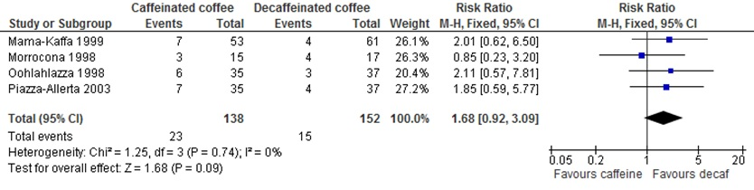
An example: Caffeine review
Outcome: sleep disruption
What was the effect size? What does it mean?
How certain you are that this is the true result?
What would you consider when deciding whether you are confident in the result of this meta analysis?
Notes:
When we’re thinking about the results of systematic reviews, there are a number of factors that could affect how we interpret them, and how confident we are that the result of the meta-analysis is correct. Let’s see how this works on an example.
In our review of ‘Caffeine for daytime drowsiness’, we included randomized trials comparing caffeinated to decaffeinated coffee. One of the outcomes we measured in this review is sleep disruption – in this case, measured as a dichotomous outcome: the number of people who experienced sleep disruption during the trial.
The first thing is to look at the result.
ASK: What was the effect size found for this outcome? What does it mean?
ANSWER: RR = 1.68 – which means we observed a 68% increase in sleep disruption with caffeine. This could range from 8% decrease to 309 increase in sleep disruption.
ASK: Did anyone look at the statistical significance?
ANSWER: The results is not statistically significant (as the confidence interval crosses the line of no difference), however we shouldn’t be concluding that caffeine has no effect on sleep disruption! [NOTE TO TRAINERS: It is important to emphasize this point]
ASK: How certain you are that this is the true result? What would you consider when deciding whether you are confident in the results of this meta analysis? [NOTE TO TRAINERS: Allow the participants to discuss this in pairs and share their thoughts]
POSSIBLE ANSWERS:
How big was the effect?
How precise was the effect (width of confidence interval)?
How many studies were included in the meta analysis?
How many people were in the interventions and the control groups?
Where were the studies conducted, and in what kind of population?
How much heterogeneity was there – did all the studies observe different effects, or were they consistent?
Were the included studies at high or low risk of bias?

Slide 9
People typically use some criteria to assess the certainty of results …but often used different criteria …and it was not systematic

Slide 10

GRADE approach
Ensures:
systematic process
transparency
Considers:
effect estimate: direction and size
certainty of evidence: confidence in the effect estimate
each outcome separately
www.gradeworkinggroup.org
Notes:
GRADE approach helps those conducting and interpreting systematic reviews to systematically and transparently consider the direction and size of effect estimates and the factors that affect our confidence in those estimates.
Note that the grading of evidence is done for each outcome separately. This means that the same comparison between an intervention and a control can have very different levels of the certainty of evidence, depending on the observed outcome. This becomes obvious when looking at the ‘Summary of findings’ tables; we will talk about this in another session, when we get to the topic of integrating and presenting the findings throughout the review.

Slide 11
HOW DO WE EXPRESS HOW CERTAIN WE ARE IN THE RESULTS? GRADE: Four levels of certainty
Certainty level | Current definition | Grade
High | We are very confident that the true effect lies close to that of the estimate of the effect | ⊕⊕⊕⊕
Moderate | We are moderately confident in the effect estimate: The true effect is likely to be close to the estimate of the effect, but there is a possibility that it is substantially different | ⊕⊕⊕⊝
Low | Our confidence in the effect estimate is limited: The true effect may be substantially different from the estimate of the effect | ⊕⊕⊝⊝
Very low | We have very little confidence in the effect estimate: The true effect is likely to be substantially different from the estimate of effect | ⊕⊝⊝⊝
Notes:
Before we consider individual factors affecting certainty of evidence, it’s useful to get a picture of levels used in the GRADE approach. Certainty of evidence can be high, moderate, low, or very low. Each of these levels are defined in terms of our confidence in the effect estimate and how likely the true effect is close to this estimate. GRADE levels of certainty are visually represented by up to four pluses in small circles.

Slide 12
Session outline
a reminder on how to read and understand meta-analysis results
GRADE approach to assessing certainty of evidence
factors affecting certainty
See Chapters 14 & 15 of the Handbook
Notes:
Now, let’s have a look in more detail at factors affecting the certainty of evidence.

Slide 13
Where the certainty of evidence starts depends on study design
BODY OF EVIDENCE FROM RCT
4 – high
3 – moderate
2 – low
1 – very low
BODY OF EVIDENCE FROM NON-RANDOMIZED STUDIES*
*Different for ROBINS-I tool
Notes:
The first thing to consider is the study design. Different study designs are appropriate for different research questions. For questions regarding interventions or management strategies, randomized trials provide, in general, far stronger evidence than non-randomized studies. This is based on the assumption that randomisation is the best method to control for unknown variables that influence effects estimates. On the other hand, rigorous non-randomized studies provide stronger evidence than uncontrolled case series. Therefore, in the GRADE approach, a body of evidence from randomized trials without important limitations start out at high certainty and body of evidence from non-randomized studies without special strengths or important limitations start at low certainty.
[CLICK] Limitations or special strengths can, however, modify the certainty of the evidence of both randomized trials and non-randomized studies. This is called downgrading or upgrading the level of evidence.
Some tools to assess risk of bias of non-ramdomized studies assess the study according to whether it is a good non-randomized study and the level of evidence from that body would start at low certainty. But there is a new tool – ROBINS-I – that assesses non-randomized studies by comparing it to the ideal radomized study. So if using this tool, the body of evidence would start at high certainty. And then the risk of bias is rated down – usually by two levels due to very serious or critical concerns – so the evidence ends up being low certainty after assessing risk of bias. The importance of this distinction will become clear in the next slide, where we list the domains of consideration in GRADE approach.

Slide 14
Certainty of evidence: rating down
risk of bias
imprecision
inconsistency
indirectness
publication bias
BODY OF EVIDENCE FROM RCT
4 – high
3 – moderate
2 – low
1 – very low
Notes:
There are five factors that can lead to downgrading the level of evidence provided by randomized trials:
Risk of bias – were the studies valid, and likely to produce an accurate estimate of the ‘true’ effect?
Inconsistency – how consistent were the results across studies?
Imprecision – how wide were the confidence intervals? Can we be confident that the true effect occurs in only one particular direction?
Indirectness – do the characteristics of the included studies directly match our review question, in terms of patients and setting, intervention, or outcomes measured?
Publication bias – do we think we have found all the studies addressing this particular question?
If there are concerns around any of these factors, the level of evidence will go down.

Slide 15
Certainty of evidence: rating down
rating down 1 level for serious concerns
rating down 2 levels for very serious concerns
some (minor) concerns on more than one domain can amount to one full level rated down
reducton for individual domains add up to generate the final rating for the outcome
not possible to go below ‘very low’
Notes:
So how exactly this works? If you have a serious concern in any of the domains, you rate down a full level. If you have very serious concern, you rate down two levels.
It is possible to have some concern about more than one domain which amount to one full level rated down. For example, you could have a small concern with risk of bias of the studies and small concern with the inconsistency across studies and then go from high certainty to moderate certainty for the final rating – almost like a half level for each of the two domains.
The reduction for each individual domain is added together with the other domains to generate the final rating of the certainty of evidence. Note that it’s not possible to go below a ‘very low’ rating, no matter how many problems there are with your included studies.

Slide 16
An example: Caffeine review
Outcome: sleep disruption
Notes:
So let’s go back to our Caffeine review example and explore in more detail the individual domains to be considered in the GRADE assessment. The outcome we’re looking at is sleep disruption.

Slide 17

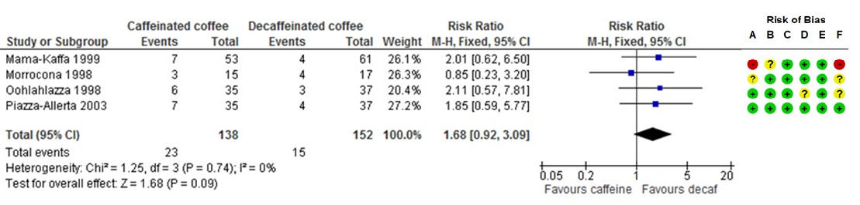
Risk of bias
for studies that provided data for each outcome:
what is the overall risk of bias of these studies
does the risk of bias reduce our confidence in the effect?
consider the relative importance of each domain for the particular outcome
Notes:
First of all, let’s look at the risk of bias, which we can do by looking at our detailed risk of bias assessment for the studies contributing to this outcome. Using the ‘Risk of bias summary’ figure generated by RevMan, you can refer to the judgements for the four studies contributing to this outcome. If you are using RoB 2, the overall risk of bias for each result is determined as part of the assessment. If you are using the original (2008 or 2011) tool, you should look at the detailed ‘Risk of bias’ tables, and come to an overall conclusion about the risk of bias for this outcome based on your pre-specified definition of what constitutes an overall “high risk” or “low risk” study.
If most of the evidence comes from studies at low risk of bias, then you can generally conclude that there is no important problem in this area. This doesn't mean there are absolutely no concerns, but that your overall judgement is that the risk of bias for this outcome is low. You might be more concerned if some of your studies have critical limitations, or several limitations across the risk of bias domains. Note that risk of bias in studies providing more weight to the analysis should be considered more.
ASK: Overall, do you think we should be concerned about study limitations for the sleep disruption outcome in this example? Would you downgrade the certainty of evidence due to risk of bias?
[NOTE TO TRAINERS: Let the participants talk in pairs or small groups for a few minutes and allow them to reach their own conclusion. There may be concerns about the randomisation methods. There may also be concerns around the effect of blinding, as this outcome – sleep disruption – is self-reported. You may ask the learners to suggest how to deal with a study at high risk of bias (Mama-Kaffa 1999) – a possible approach is to do a sensitivity analysis with the high risk of bias study excluded. Note that this should have been planned in the protocol. Is the proportion of information from this study large enough to affect the meta-analysis? If the participants are undecided (‘sitting on the fence’) about the seriousness of the risk of bias domain, they could just remember that there were some concerns and add up with some concerns that might appear in other domains to downgrade for a full level.]

Slide 18
Is the risk of bias…
Not serious
Serious
Very serious
…enough that my confidence in the result is reduced?
Notes:
NOTE TO TRAINERS: Note down the group’s decision.
Suggest the evidence should be downgraded one level (or at least half a level) due to risk of bias.

Slide 19
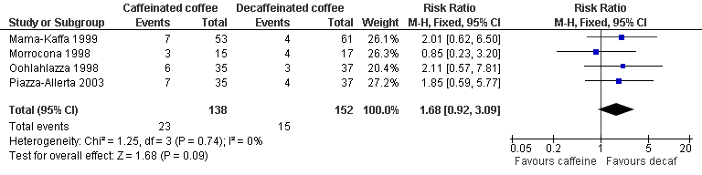
Imprecision
A) sample size and number of events
Optimal Information Size - a sample size sufficient for one adequately powered study
rule of thumb – min. 400 events (dichotomous), 400 people (continuous)
Notes:
The next factor that can lead to downgrading the certainty of evidence is imprecision. The first important issue around imprecision is whether we have enough information to make a precise estimate. The information we are looking at is the total number of patients and the number of events. For the total number of patients, we have to consider what would be a conventional sample size calculated for a single adequately powered trial. This is called the Optimal Information Size (OIS) and if we don’t have at least that number of patients in our meta-analysis, the estimate may not be precise enough. Also, if there were only a few events observed in the included studies, we may conclude that the evidence is imprecise.
Authors can also use rules of thumb for the minimum sample size and minimum numbers of events needed for precision, although these should be used with caution and may not be appropriate for the outcome you are measuring. If an analysis has less than approximately 400 events (for dichotomous outcomes) or 400 people (for continuous outcomes) in total across both the intervention and control groups, one should consider rating down for imprecision.
ASK: Considering the confidence interval and the number of patients and events in this example, how would you rate the precision of this estimate? Would you downgrade the certainty of evidence due to imprecision?
[NOTE TO TRAINERS: Allow the group to reach their own conclusion. The level of evidence should be rated at least one level for imprecision – discussion may go around whether to downgrade by one or two levels. The concerns are about the conflicting messages conveyed by the confidence interval (including both appreciable harm and no effect) and also about very few events across the studies. Discussion may also lead to question of what number of events and participants is sufficient for precise estimate.]
[ADDITIONAL NOTE TO TRAINERS: For more detailed explanation of OIS, you may refer the learners to additional resources: GRADE online learning module on imprecision (https://youtu.be/XAf_eE-Mdtw?list=PLGaL88PiuG8B-MSE931JPAXpKT97Vl8un), GRADE Guidelines 6 from the JCE series (http://www.jclinepi.com/article/S0895-4356(11)00206-X/fulltext), and GRADE Handbook, Ch. 5.2.4 (http://www.guidelinedevelopment.org/handbook).

Slide 20
Imprecision
B) confidence intervals
do they include contradictory conclusions?
i.e. no effect AND an appreciable benefit or harm
But what is an appreciable harm or benefit?
Notes:
The second thing to look at is the confidence interval around our effect estimate. We’re not just interested here in whether the result is statistically significant or not. What we want to know is, does the confidence interval encompass consistent, or conflicting messages?
ASK: Look at both ends of the confidence interval – if either of these were the true effect, would this be giving you the same message? POSSIBLE ANSWER: One end of the confidence interval indicates an appreciable benefit, and the other no effect, or even a small (maybe not important) harm.
An obvious question is – what is an appreciable harm or benefit?

Slide 21
Determine appreciable benefit or harm
Relative effects
use rules of thumb, risk ratio <0.75 and >1.25
means 25% reduction or increase in an outcome
Absolute effects
calculate the effects using the pooled estimate and a common baseline risk
Example
using baseline risk of 10 per 100, the RR 1.68 (0.92 to 3.09) translates to 7 more people (1 fewer person to 21 more people)
Do these CIs include important harm or benefit and no effect?
Notes:
A rule of thumb may be that a risk ratio of <0.75 and >1.25 may indicate an appreciable benefit or harm. This means a 25% reduction or increase in an outcome. For more serious outcomes, like death, even smaller changes may be considered important.
Even better than using the rules of thumb is to calculate the absolute effects using the pooled estimate and a common baseline risk. For example, using a baseline risk of 10 per 100, the risk ratio of 1.68 (95% CI 0.92 to 3.09) translates to 7 more people (1 fewer person to 21 more people). Looking at the absolute numbers makes it easier to make conclusions about the importance of benefit or harm.

Slide 22
A meaningful difference: your cut-off is 10 more people
MID (harm)
MID (benefit)
APPRECIABLE BENEFIT - PRECISE
APPRECIABLE BENEFIT BUT ALSO SMALL BENEFIT – SOMEWHAT IMPRECISE
SMALL BENEFIT - PRECISE
NO BENEFIT AND APPRECIABLE BENEFIT- IMPRECISE
NO BENEFIT AND NO SMALL OR APPRECIABLE BENEFIT OR HARM - PRECISE
SMALL HARM AND APPRECIABLE HARM – SOMEWHAT IMPRECISE
NO EFFECT, ALSO APPRECIABLE HARM OR BENEFIT - IMPRECISE
-20
- 10
0
10
20
40
Notes:
This is how you might interpret the results of various meta-analyses, considering the width of confidence interval in relation to the minimally important difference (MID) for benefit and harm.
[NOTE TO TRAINERS: This picture can be presented without an indication of which results are precise and which are not, so that learners can try to figure it out themselves, either individually or in small groups.]
ASK: Where are the results from our caffeine review meta-analysis on sleep disruption outcome? ANSWER: It’s the green one. With the cut-off value of 10 people making the difference, this result is imprecise, as it includes both no benefit and appreciable harm.
ASK: What would happen if our cut-off for importance is 25 out of 100. Would the result be precise or imprecise?
ANSWER: The results would be precise, as the estimate shows no effect and the confidence intervals do not include important harm or benefit.

Slide 23
Is the imprecision…
Not serious
Serious
Very serious
…enough that my confidence in the result is reduced?
Notes:
NOTE TO TRAINERS: Note down the group’s decision.
Suggest the evidence should be downgraded one or two levels, due to serious – or even very serious – imprecision.

Slide 24
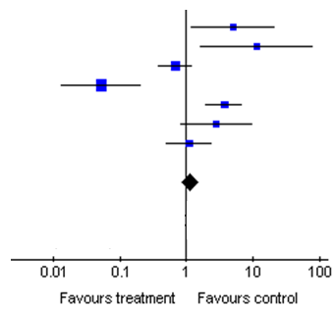
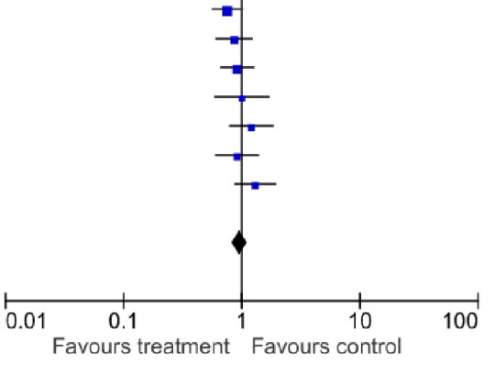
Inconsistency (heterogeneity)
Forest plot A
Forest plot B
Notes:
The next consideration is inconsistency, or heterogeneity. We have ways to detect heterogeneity, particularly if our results are meta-analysed on forest plots. What we’re looking for is widely differing estimates of the effect across studies.
ASK: Which of these forst plots do you think show more heterogeneity? (ANSWER: Forest plot B)
The first step you should always take is to visually examine your forest plots, and look to see whether all your studies are reporting consistent results. Look for overlap in the confidence intervals, not just differences in the effect estimate. For example, in Forest plot B, the studies on the left of the plot are not consistent with some of the studies on the right, not necessarily because their blue dots don’t’ line up, but because their confidence intervals don’t overlap – it’s not likely that each study is measuring the same true effect.
It’s also important to note that the presence of heterogeneity is not about which side of the line of no effect the results are on. It’s possible to have very consistent studies whose results are slightly one side of the line or the other (as in Forest plot A), and it’s possible to have studies that are very inconsistent even thought they are all showing different degrees of a positive effect, all on one side of the line, as in the Forest plot C on the next slide.

Slide 25
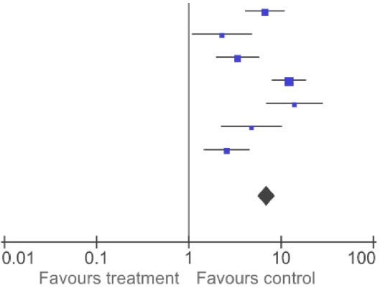
Inconsistency (heterogeneity)
Forest plot B
Forest plot C
Notes:
Having said that, whether the results are either side of the line of no effect may influence our assessment of whether the heterogeneity matters.
[CLICK] For example, it affects our understanding more in the case of Forest plot B, where the heterogeneity is around the null effect and we have studies going in each direction. If all the studies were showing different degrees of positive effect (as in the Forest plot C), we would be more confident that the intervention is effective, and we would know how to act, even if we were uncertain about the exact size of the effect.

Slide 26
Inconsistency (heterogeneity)
Other tools for identifying heterogeneity:
Chi-squared (χ², or Chi²) test, also known as the Q test
I² statistic
<30-40% - low or unimportant heterogeneity
30-60% - moderate heterogeneity
50-90% - substantial heterogeneity
75-100% - considerable heterogeneity
Only a guide, not a definitive proof of heterogeneity!
Notes:
Another tool available to help detect heterogeneity is the Chi² test, which is added automatically to every forest plot created in RevMan (and can also be calculated by other statistical software). This test assumes the null hypothesis that all the studies are homogeneous, or that each study is measuring an identical effect, with some random variation. The test gives you a P value to test this hypothesis. If the P value is very low, it means it is very unlikely that the assumption of homogeneity is true – the studies are too different for them all to be truly measuring the same effect, so you can conclude that heterogeneity is high. However, the test is not very reliable – when there are few studies, which is the case with most Cochrane Reviews, then the test is not sensitive enough, and can wrongly conclude that there is no heterogeneity.
An alternative to the Chi² test that can be more informative is the I² statistic, which tells you what percentage of the observed variability in effect estimates is due to heterogeneity across studies, and more than you would expect to see from random chance or sampling error alone. To interpret the I² statistic, there are no absolute cut-off points or rules, but you can use a rough guide shown on this slide.
It’s important that I² is only taken as a guide, and not definitive proof that you do or don’t have heterogeneity at a particular level. Like any statistic, I² has a level of uncertainty, so it shouldn’t be used alone.

Slide 27
Inconsistency (heterogeneity)
Cautious exploration of possible causes:
differences in patients?
interventions?
outcome definitions?
methodological diversity?
Notes:
Having identified the presence of heterogeneity, the next step is to explore the reasons for it. It is important to note that the focus is on unexplained heterogeneity. If we have a high level of heterogeneity, but a convincing and complete explanation for it, then this does not cause us concern in the interpretation of the results. But we would be concerned if we had wide variability in effects, without a plausible explanation. Heterogeneity may, for example, be explained by differences in participant characteristics (e.g. stage of disease, comorbidities), intervention (e.g. dose, way of delivery), outcome (varying definitions, methods of measurement), or quality of design and execution of included studies.

Slide 28
Inconsistency (heterogeneity)
Notes:
Back to our caffeine example, we have a forest plot to help us assess heterogeneity.
ASK: What would you say about the consistency of the evidence for this outcome? Is there a reason to downgrade the certainty of evidence for inconsistency?
[NOTE TO TRAINERS: Allow the group to reach their own conclusion. Note that although not all the studies estimated the same direction of effect, this is not an important factor in heterogeneity – it doesn’t matter whether the blue dot is on one side of the line of no effect or the other. It is more useful to look at the confidence intervals (do they overlap?) and statistical measures of heterogeneity. In this example, based on I² (0%) and high amount of overlap between confidence intervals, there is no observed heterogeneity in this case.]

Slide 29
Is the inconsistency…
Not serious
Serious
Very serious
…enough that my confidence in the result is reduced?
Notes:
NOTE TO TRAINERS: Note down the group’s decision.
Suggest not to downgrade for inconsistency.

Slide 30
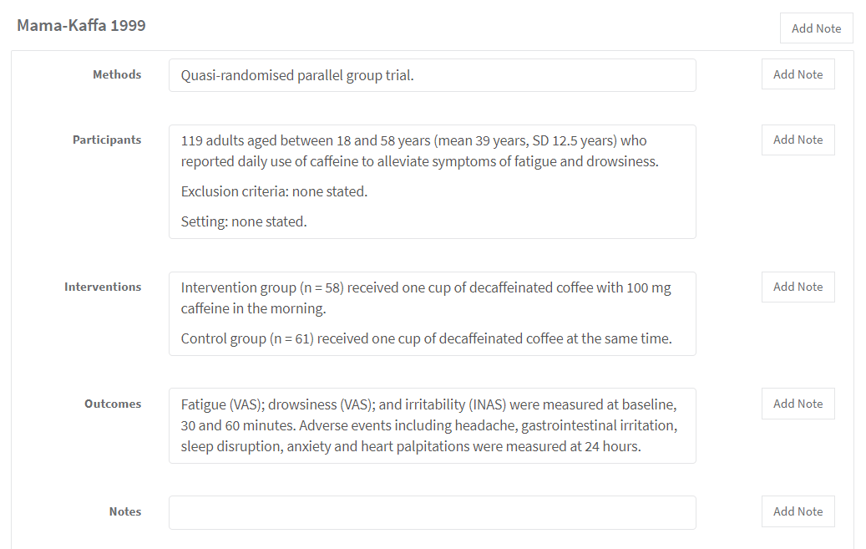
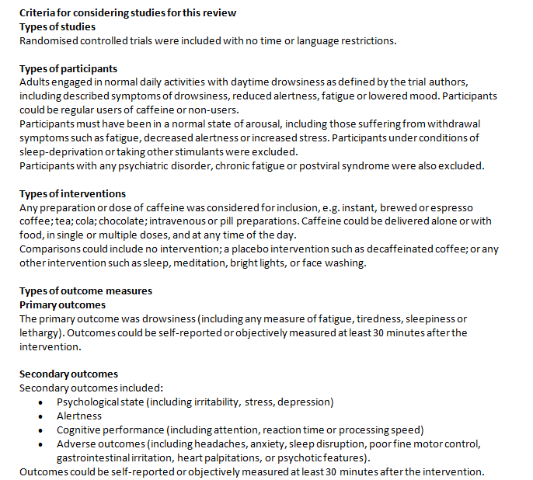
Indirectness
how well do the included studies address your review question?
compare your eligibility criteria to the ‘Characteristics of included studies’ tables
NOT generalisability to other populations
Notes:
Direct evidence consists of research that directly compares the interventions which we are interested in, delivered to the populations in which we are interested, and measures the outcomes important to patients. To judge the directness of the evidence, consider the original scope of the review – the question you set out to investigate at the very beginning. Can the evidence you have found be used to answer your broad review question? It may be useful to compare your eligibility criteria to the ‘Characteristics of included studies’ tables.
Note that indirectness is different from generalisability to other populations. For example, if the population of interest in your review were adults and you find studies including adults, your evidence will be direct. However, these results may not be generalizable to children, which you may note in the discussion section of your review.

Slide 31
Indirectness
EVIDENCE IS INDIRECT IF:
indirect comparisons
studies in your review only addressed a restricted aspect of your review question (PICO),
e.g.:
special populations
specific versions of the intervention
less applicable comparisons
surrogate outcomes
Notes:
There are several sources of indirectness. Your review question may be answered only by indirect comparisons – for example, if you wanted to directly compare a drug versus exercise for a particular condition, but you could only found studies comparing drugs to placebo, and exercise to placebo separately.
Another scenario, and one very commonly found in Cochrane Reviews, is that you may have found only a limited number of studies, and these studies examined only restricted aspects of your review question.
For example:
studies looking at limited or special populations, such as only people with high risk or comorbidities. Consider if there is a reason why the evidence would not apply to some patients (e.g. based on individual biologic differences as well as settings).
studies looking at specific versions of the intervention, e.g. implemented by highly trained specialists.
studies looking at less applicable comparisons, e.g. something less effective than the current standard of care.
studies measuring less useful outcomes – e.g. surrogate outcomes used.
In this example, the adults in the four included caffeine studies were all heavy caffeine users, and the studies all tested the same brand of coffee.
ASK: Assuming your review was aimed to explore the effect of caffeine in general adult population and with all brands of coffee, what do you think about the directness of your body of evidence?
[NOTE TO TRAINERS: Allow the group to reach their own conclusion. One view might be that these results may not apply to a population who were not regular coffee drinkers, but may be considered applicable to other drinks with similar levels of caffeine to coffee.]

Slide 32
Is the indirectness…
Not serious
Serious
Very serious
…enough that my confidence in the result is reduced?
Notes:
NOTE TO TRAINERS: Note down the group’s decision.
Suggest to downgrade the level of evidence for half a level on this domain.

Slide 33
Publication bias
is there a high probability of publication bias?
small studies with mostly positive results, especially with industry sponsorship
many of your included studies fail to report this outcome
Did you conduct a comprehensive search of multiple sources? Were all published studies found?
Did you search trial registries and it appears that you are not missing results from some studies due to bias?
Did you contact experts in the field and seem to have the data available?
Notes:
Our final consideration is publication bias. The question here is: have we found all the studies conducted on this question, or are we missing the results of inconclusive or negative studies that never made it to widespread publication?
Some factors that might lead us to suspect publication bias include:
if your set of included studies is mostly small, and with mostly positive results, especially if you know there is industry sponsorship of the studies.
if many of your included studies fail to report this outcome of interest.
The best thing we can do to prevent publication bias is to do our best to find all the studies that have been conducted, by running a comprehensive search, attempting to find unpublished and grey literature, contacting authors in the field, etc.
Trials registries are an important initiative – as they grow internationally, and more journals require registration before publication, registries have the potential to make an important difference in publication bias (although there are still limitations on the completeness of the data in the registered trials, and the application of requirements by journals for registration). Still, we may not be completely successful in preventing publication bias.

Slide 34
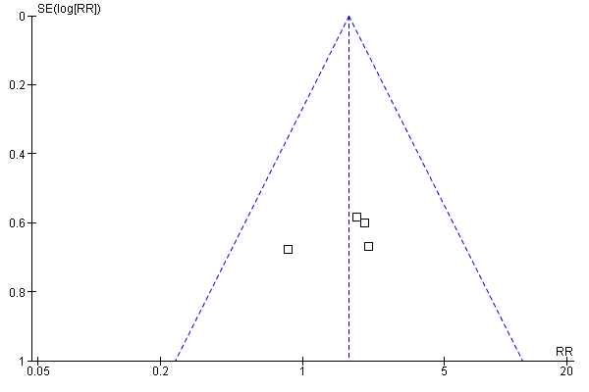
Publication bias
need at least 10 studies
interpret with caution
downgrade by maximum of one level
Notes:
If we have the results of a meta-analysis, we can detect the possibility of publication bias by visual inspection and test for asymmetry of funnel plots. This topic has been covered in another presentation (Bias due to missing results in a synthesis). In brief, funnel plots are generated by plotting effect size against study size, which can be done in RevMan. Studies included in the funnel plot will be scattered around the effect estimate and if there is no sign of publication bias, the result will be a symmetrical plot in the shape of an inverted funnel or triangle. Asymmetry of the funnel or triangle may raise a suspicion about the publication bias.
Funnel plots and statistical tests can help us identify small-study effects, and sensitivity analyses, such as comparing fixed- and random-effects meta-analyses, can help us measure how great the impact of the small studies might be. Even where we do identify small-study effects, we have to remember the range of possible causes of these effects. If we do explore those effects and conclude that publication bias is the most likely cause, there is no cure. Nonetheless, authors will be expected to comment on both of these issues – small-study effects and the possibility of publication biases - in their review.
In this example, we have four studies included in the funnel plot.
ASK: What can be concluded about the risk of publication bias?
ANSWER: Nothing, as there is too few studies to create a meaningful funnel plot. As a rule-of-thumb, funnel plot and statistical tests for asymmetry should be used to detect publication bias if there are at least 10 studies included in the meta-analysis. But we still can consider the other factors that might increase our suspicion of reporting or publication bias.
ASK: Are there other reasons to suspect publication bias in this case?
[NOTE TO TRAINERS: Allow the group to reach their own conclusion. One view might be that in this case, we have no particular reason to suspect publication bias. Although the product could be sponsored by industry, the results are not showing a benefit to the product and are unlikely to be the result of publication bias in the product’s favour.]
Regardless of which test is used to assess the publication bias, review authors should be aware that such tests can be prone to error and their results should be interpreted with caution. It is extremely difficult to be confident that publication bias is absent and almost as difficult to place a threshold on when to rate down certainty of evidence due to the strong suspicion of publication bias. For this reason GRADE suggests rating down certainty of evidence for publication bias by a maximum of one level.

Slide 35
Is the publication bias…
Undetected
Strongly suspected
…that my confidence in the result is reduced?
Notes:
Note that this domain is worded diferently – you have to have a serious suspicion in order to rate down.
NOTE TO TRAINERS: Note down the group’s decision.
Suggest that, assuming that the literature search has been thorough, the level of evidence should not be downgraded for publication bias.

Slide 36

Caffeine example: overall judgement
risk of bias
imprecision
inconsistency
indirectness
publication bias
4 – high
3 – moderate
2 – low
1 – very low
What if there was no meta-analysis?
The GRADE assessment shoud still be done!
Notes:
[NOTE TO TRAINERS: At this point you can revisit the group’s decisions for each of the factors (risk of bias, imprecision, inconsistency, indirectness, publication bias) and make the overall grading for the caffeine review example. It’s likely the grading will be low certainty, due to imprecision (1 level down) and some concerns around risk of bias and indirectness (half level down each). If participants are suggesting that the level of evidence should be very low, you can point out that people who begin using GRADE often have very severe concerns about the body of evidence they are assessing, but this is usually too severe.]
ASK: Do you think GRADE approach can be used even when there is no meta-analysis?
ANSWER: Yes! Users and readers of your systematic review want to know how certain the evidence is for all outcomes, regardless of whether there is a meta-analysis. You should still assess each domain. How you assess the domain will depend on the method you use to conduct the narrative synthesis.

Slide 37
Certainty of evidence: upgrading
large effect
dose response effect
all the plausible biases affecting the result would tend to underestimate an apparent intervention effect or vice versa
4 – high
3 – moderate
2 – low
1 – very low
Non-randomized
risk of bias, indirectness, inconsistency, imprecision, publication bias
Notes:
We have described the five factors that can lead to downgrading the certainty of evidence, and it has to be pointed out that those factors apply both for RCTs and non-randomized studies. So if you include non-randomized studies in your review, they begin as the low certainty of evidence and can be downgraded to very low (but not lower!) for any of the aforementioned issues: risk of bias, indirectness, inconsistency, imprecision, and publication bias. However, in some – fairly uncommon – circumstances, non-randomized studies can also be upgraded.
The evidence from non-randomized studies can be upgraded:
it there is a large effect
if there is a dose-response effect
all the plausible biases affecting the result would tend to underestimate an apparent intervention effect
The evidence should be upgraded only if other domains are not rated down, i.e. there is no risk of bias, the results are precise etc.
[NOTE TO TRAINERS: For more detailed explanation of these factors, you can point the learners to the GRADE online learning module (https://cebgrade.mcmaster.ca/upgrading/index.html), or GRADE handbook (https://gdt.gradepro.org/app/handbook/handbook.html)

Slide 38
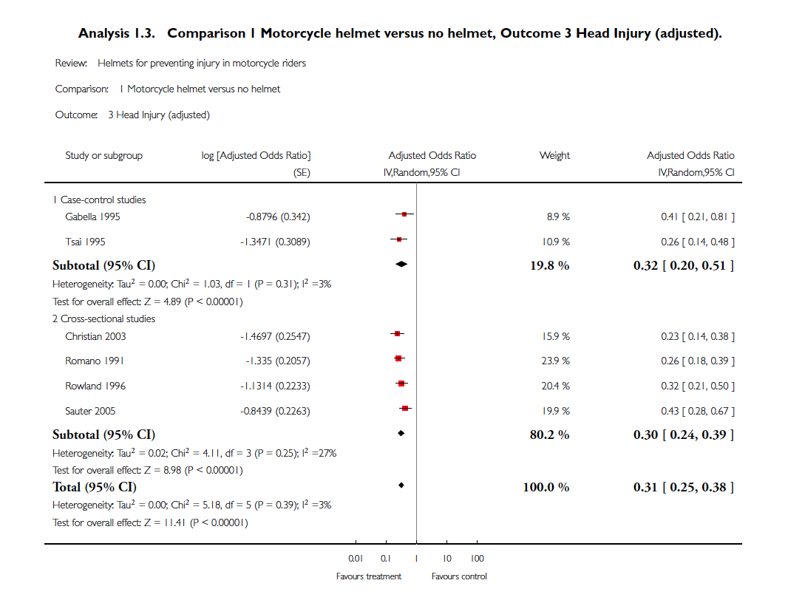
Upgrading example: large effect
Notes:
[NOTE TO TRAINERS: Depending on the time available, you can show the following additional examples of rating up the certainty of evidence for non-randomized studies.]
The meta-analysis of the effectiveness of wearing motorcycle helmets for preventing head injuries is an example of how the level of evidence can be upgraded based on a large effect, consistently oberved in different studies.

Slide 39
Upgrading example: dose response
Example: childhood lymphoblastic leukemia
risk for CNS malignancies 15 years after cranial irradiation
no radiation: 1% (95% CI 0% to 2.1%)
12 Gy: 1.6% (95% CI 0% to 3.4%)
18 Gy: 3.3% (95% CI 0.9% to 5.6%)
Notes:
[NOTE TO TRAINERS: Depending on the time available, you can show the following additional examples of upgrading the certainty of evidence for non-randomized studies.]
In this example, the risk of central nervous malignancies within 15 years after cranial irradiation for the treatment of childhood lymphoblastic leukemia increases with the dose of radiation applied during the treatment. When there is such a clear dose-response relationship, one may rate up the certainty of evidence.

Slide 40
Upgrading example: effect of confounding
Example: Metformin
Hypoglycaemic drug phenformin causes lactic acidosis
The related agent metformin is under suspicion for the same toxicity.
Large non-randomized studies have failed to demonstrate an association even though clinicians would be more alert to lactic acidosis in the presence of the agent
Notes:
[NOTE TO TRAINERS: Depending on the time available, you can show the following additional examples of upgrading the certainty of evidence for non-randomized studies.]
In this example, the question is whether hypoglycemic drug metformin causes lactic acidosis. It is known that a related agent – phenformin – causes such adverse effect, so one may assume that clinicians would be more alert to lactic acidosis when administering metformin to their patients. Despite this hightened alertness, large non-randomized studies have failed to demonstrate an association between metformin and lactic acidosis. Under such circumstances, we may decide to rate up the certainty of evidence.

Slide 41
What to include in your protocol
add a subheading in RevMan Methods section
e.g. ‘Assessment of the certainty of the evidence’
that you will use the GRADE approach to assess the important outcomes in your review
that two authors will independently conduct GRADE assessments, and how you will resolve disagreements
that you will report the GRADE assessment in the ‘Results’ and ‘Discussion’ section, and include in the ‘Summary of findings’ table

Slide 42
Take home message
consider your results in the context of the overall certainty of the evidence
GRADE is a structured system to help you consider certainty

Slide 43
References
Schünemann HJ, Higgins JPT, Vist GE, Glasziou P, Akl EA, Skoetz N, Guyatt GH. Chapter 14: Completing ‘Summary of findings’ tables and grading the certainty of the evidence.
Schünemann HJ, Vist GE, Higgins JPT, Santesso N, Deeks JJ, Glasziou P, Akl EA, Guyatt GH. Chapter 15: Interpreting results and drawing conclusions.
In: Higgins JPT, Thomas J, Chandler J, Cumpston M, Li T, Page MJ, Welch VA (editors). Cochrane Handbook for Systematic Reviews of Interventions version 6.1 (updated September 2020). Cochrane, 2020. Available from www.training.cochrane.org/handbook.
www.tech.cochrane.org/revman/gradepro
Acknowledgements
Compiled by Dario Sambunjak, Nancy Santesso, Miranda Cumpston and Sue Brennan
Based on materials by Nancy Santesso, the Cochrane GRADEing Methods Group and Cochrane Australia

