Slide 1
Assessing risk of bias in included studies

Slide 2
Steps of a Cochrane Review
  define the question
  plan eligibility criteria
  plan methods
  search for studies
  apply eligibility criteria
  collect data
  assess studies for risk of bias
  analyse and present results
  interpret results and draw conclusions
  improve and update review
Notes:
After you’ve selected the studies to be included in you review, you need to assess the risk of bias in each of them.

Slide 3
Session outline
  risk of bias in systematic reviews
  assessing sources of bias : the RoB 2 tool
  putting it into practice
  incorporating risk of bias in a review
Notes:
We try to minimize bias throughout the review process. For example, we try to establish objective inclusion criteria so that potentially eligible studies aren’t unfairly excluded. And we conduct a rigorous search to minimize the risk of missing some eligible studies.
As well as minimizing bias introduced by our own methods, systematic reviews depend for their results on the results of the individual included studies. If the included studies are affected by bias, then the review results will be biased – ‘garbage in, garbage out’.
Here we introduce the tool that Cochrane Review authors are expected to use when they include randomized trials: RoB 2.
We will describe the tool, show how it’s put into practice, and discuss how the RoB 2 assessments should be incorporated into the review.
Note that this presentation provides only an overview of the methodology for assessing risk of bias in included studies using RoB 2. More guidance on how to assess risk of bias, and on each of the specific topics we discuss, is available in the Handbook. Full, detailed guidance is available at riskofbias.info. Authors should be encouraged, at minimum, to read Handbook Chapter 8 in full before proceeding. Fully informed assessments of risk of bias using RoB 2 require reference to the full guidance document.

Slide 4
What is bias?
Systematic error or deviation from the truth
  a study may systematically overestimate or underestimate the effect of intervention
    beyond random error (sampling variation)
  our focus is on internal validity
    whether the result reflects what the study aims to estimate
    distinct from external validity (generalizability): the relevance of the study to external situations
Notes:
We define “bias” as a systematic error or deviation from the truth. This means that the results of the study do not provide a good estimate of the true effect(s) of the experimental intervention. Either the estimate is overestimating the truth or it is underestimating the truth. Note that we are talking about systematic errors (overestimating or underestimating on average) and not random errors (overestimating or underestimating by chance.)
There are two considerations that affect whether the findings of a study can be applied. One is internal validity, or how well the study estimates the effect it is trying to measure. The second is external validity, or the applicability of the study to the situation in which it is to be applied (this is called indirectness in GRADE). Our definition of bias targets internal validity. If a study is affected by bias, the results may be misleading, and not doing a good job of telling the ‘truth’ about the real effect of the experimental intervention compared with the comparator.

Slide 5
Bias is not the same as…
Low quality
Poor reporting
Imprecision
bias can occur in well-conducted studies
not all methodological flaws introduce bias
good methods may have been used but not well reported
inappropriate methods may have been used but not clearly described
error due to sampling variation
reflected in
the confidence interval
Notes:
Bias is not the same as low quality of study conduct
Quality: Did they do the best they could do?
Bias: Do I believe the result?
These terms are often used interchangeably. However, we are more interested in the believability of the result than criticizing the efforts made by study authors. Even a well-conducted study can be at risk of bias. For example, in studies where blinding is impossible (e.g. swimming versus running, where participants can’t be blinded; or surgical trials where the surgeon can’t be blinded), we cannot criticize the authors. But we should still acknowledge the possibility that the study results may be affected by peoples’ awareness of which intervention group they are in.
Similarly, not all methodological flaws are relevant to bias. For example, failure to perform a sample size calculation, or to obtain ethical approval, are important markers of study quality, but they do not have direct implications for bias.
Bias is not the same as the poor quality of reporting
Studies rarely report the methods used in exhaustive detail and may often have used rigorous methods even if they are not described in the published paper. The detail of methods reporting is improving with initiatives like the CONSORT statement. It is important not to discriminate against older trials that were published before these initiatives, and to be clear when decisions are based on reported methods, and when the details are actually unclear.
Bias is not the same as imprecision
Imprecision refers to random error. Each time we take a sample and measure outcomes, we will get natural variation from the ‘true’ values in the whole population. The smaller the sample, the more variability we will get. The imprecision that results from high variability is reflected in the confidence interval around the result we present.

Slide 6
Quality scales and checklists
  many scales and checklists are available
    but many include criteria not related to bias
  different scales lead to different conclusions
  numerical scales are not justified
    There is no empirical basis for weighting different items
Quality scales should not be used in Cochrane reviews
Notes:
There are many published scales and checklists that aim to summarize and simplify the assessment of bias and quality in clinical trials.
[NOTE FOR TRAINERS: You can ask the participants if anyone used one of these checklists or scales before. Examples they might mention include the Cochrane risk of bias tool, the Jadad scale, the PEDro scale. CONSORT would be an inappropriate answer, since it addresses only what is reported and not whether the trial was done well.]
Each scale incorporates different components. Some include things like sample size that are (in themselves) not causes of bias.
A number of studies have been done looking into these kinds of tools, looking at their findings across large numbers of studies. These show that using different scales to select the ‘best’ studies can lead to different conclusions.
Some of these tools calculate numerical scores for quality. But because there is no empirical evidence that can tell us precisely how each factor has affected the results in any individual study, it is difficult to decide how much numerical weighting each element should have. Another difficulty with summarizing quality scores as numbers is that these are difficult for readers to interpret. Giving a study a score of ‘7’, for example, doesn’t explain what the specific concerns were, or how this study differs from the next study that also scored a ‘7’.
It’s recommended that numerical scales or simple checklists are not used in Cochrane Reviews.

Slide 7
Risk of bias
  assess key results from each included study for risk of bias
    can’t measure the presence of bias
    look for methods shown to minimize risk
    … and evidence that the study ran successfully
  risk of bias is a property of a result
    rather than of a study, or an outcome
    if there is no result from a study, the result of the synthesis (meta-analysis) may be at risk of bias because of
    Missing Evidence
      see presentation Bias due to missing results in a synthesis (incl. ROB ME tool)
Notes:
Cochrane has adopted the notion of risk of bias as the way to think about bias in the results of the included studies, i.e. whether we should believe the results.
We can rarely know for sure whether a result is biased, but we can look at the methods used by the study, at what happened during the study, and at how the data were analysed and reported, to see if the study has features that put the result at risk of bias.
We know about features that are important through methodological research – so-called ‘meta-epidemiology’. Meta-epidemiological studies look across large numbers of trials and meta-analyses, identifying which factors appear to be associated with systematically different results. We should look for these features in the design – and check that they were correctly implemented in practice.
An important point is that risk of bias is a property of a result. When we talk about risk of bias, it is in relation to an estimate of the effect of an intervention. We avoid talking about “risk of bias in a study”, because different outcomes examined in the study might have different risks of bias. For example, the assessment of an outcome such as ‘clinical impression of improvement’ in an unblinded study might be subject to a lot more bias than the assessment of all-cause mortality. Similarly, we should avoid talking about “risk of bias in an outcome”, because different ways of analysing the data for an outcome may have different risks of bias. For example, if the trial investigators inappropriately excluded participants from an analysis, then they may produce a result that is at higher risk of bias than a result based on all randomized participants for the same outcome.
If a trial does not contribute a result to a particular meta-analysis, then there is nothing to assess for risk of bias at the level of the study. However, that does not mean we should not be concerned about bias. It is possible that the lack of a result is due to a decision by the trial investigators to withhold that result because they did not like it - so-called selective outcome (non)reporting. RoB 2 does not address this problem. The problem should be addressed at the level of the meta-analysis. A new tool, ROB ME, aims to assess risk of bias in a meta-analysis due to missing results from one or more studies.

Slide 8
Recommended tool for new Cochrane Reviews: RoB 2
  fixed set of five bias domains
    all are mandatory, and none can be added
    (there is an additional domain in versions for cross-over trials and cluster-randomized trials)
  includes an overall risk of bias
    used to guide analysis and interpretation
  important distinction between effects of interest
    see later
  funding and vested interests should be examined separately, and used to inform RoB 2 assessments
    TACIT (Tool for Addressing Conflicts of Interest in Trials) will address this issue
Notes:
Rather than a score or checklist, Cochrane Reviews assess the risk of bias in results of included studies using a domain-based approach. Review authors are required to assess each study against the main bias-related concerns affecting the results of studies. They then summarize these to reach an overall judgement on risk of bias in the result.
An important feature for the RoB 2 tool is a distinction between whether we are assessing the effect of assigning participants to interventions, or the effect of participants adhering to their assigned interventions. More about this later.
It is important to examine who funded the included trials, and any conflicts of interest among the trial investigators. However, this should not be assessed as a risk of bias, but should be used as a basis for reaching judgements about the domains included in the tool. A new tool (TACIT) has been designed to examine them.
[NOTE TO TRAINERS: Participants often ask about funding and why it is not included in the tool. There are very good reasons why it is not included in RoB 2. Conflicts of interest can affect trials in various ways. They may (i) influence the question addressed by the trial; (ii) influence how the trial is conducted; and (iii) influence whether and how the trial is reported. These problems are broader than the issue of bias in a specific result from a trial (the remit of RoB 2). Information about conflicts of interest (ideally examine using TACIT, once it is available) should be used to influence assessments of risk of bias. However, the impact of the conflicts on bias in a trial result will operate through one of the fixed domains of the RoB 2 tool.]

Slide 9
RoB 2 process
For each outcome (each key synthesis in the review)
For each study
Risk of bias assessment for a specific result
1. Specify result being assessed
2. Specify effect of interest
3. List sources of information used to inform assessment
4. Answer signalling questions
5. Judge risk of bias for each domain
6. Judge overall risk of bias for the result
For the synthesis
Integrate judgement(s) into results and conclusions
e.g. stratify meta-analysis by overall risk of bias judgement
Notes:
The process of implementing RoB 2 is as follows. We first need to determine which results to assess. For each of the key syntheses in the review, we first identify which studies potentially contribute to it.
[CLICK]
1. Then we identify the result from each study that we would like to use in the synthesis.
2. We’ll discuss the effect of interest later in the session. For now, all that is important is that there are two versions of RoB 2, and we need to know which one we will use.
3. For transparency, it is useful to note which sources (journal articles, protocols, registry entries, correspondence with trial investigators etc) have been used to inform the risk of bias assessment.
4-6. The RoB 2 tool includes questions to answer, judgements to make for each bias domain, and a judgement to make overall, as we shall see.
[CLICK] Finally, we need to use the risk of bias judgements to draw our conclusions from the synthesis. For example, we might use the judgements to stratify studies, or to restrict attention to those at lower risk of bias. We will also need to integrate the judgements across the studies contributing to the synthesis (or meta-analysis). This integrated judgement feeds into one of the factors (Risk of bias) in a GRADE assessment of certainty in the evidence.

Slide 10
Signalling questions and judgements
  signalling questions increase transparency
    ‘Yes’, ‘Probably yes’, ‘Probably no’, ‘No’, ‘No information’
    support each one with evidence/quotes/explanation
  algorithms map answers to signalling questions onto risk of bias judgements
    ‘Low risk of bias’, ‘Some concerns’, ‘High risk of bias’
    “Probably yes” = “Yes”, and “Probably no” = “No”
    algorithms can be overridden
  a ‘High risk of bias’ judgement in any one domain puts the result at high risk of bias
    see next slide
Notes:
Within each domain, RoB 2 includes a set of “signalling questions”. These are reasonably factual questions about what was done or what happened in the trial, although some of them do require some judgements.
The possible answers to all the questions are ‘Yes’, ‘Probably yes’, ‘Probably no’, ‘No’ and ‘No information’. Note that the questions are phrased in the most natural way for each issue addressed. This means that sometimes ‘Yes’ is a good thing and sometimes ‘No’ is a good thing. Each answer should be supported with quotes or comments to explain why it was given. This is particularly important when the answers reflect ‘bad’ things.
The tool incorporates algorithms, so that once the signalling questions have been answered, risk of bias judgements are suggested. The user will then need to decide whether to agree with these or override them (providing an explanation). Almost all of the time, we expect users to follow the suggestion in the algorithm.
The algorithms aim to propose a ‘High risk of bias’ judgement only if the problems in the domain are such that the result as a whole should be deemed to be at ‘High risk of bias’. In other words, ‘High risk of bias’ in any one domain is sufficient to determine the overall risk of bias. Again, this rule can be overridden.

Slide 11
Suggested overall risk of bias judgement
Domain 1 | Domain 2 | Domain 3 | Domain 4 | Domain 5 |  | Overall
Low | Low | Low | Low | Low |  | ?
Low | Some concerns | Low | Low | Some concerns |  | ?
Low | Low | High | Low | Low |  | ?
High | Low | Some concerns | High | High |  | ?
Some concerns | Some concerns | Some concerns | Low | Some concerns |  | ?
Notes:
Here we will illustrate the rules for getting to the three levels of judgement across domains for a specific result.
[NOTE TO TRAINERS: ASK: what do you think would be a reasonable judgement of overall risk of bias for each row?]

Slide 12
Suggested overall risk of bias judgement
Domain 1 | Domain 2 | Domain 3 | Domain 4 | Domain 5 |  | Overall
Low | Low | Low | Low | Low |  | Low
Low | Some concerns | Low | Low | Some concerns |  | Some concerns
Low | Low | High | Low | Low |  | High
High | Low | Some concerns | High | High |  | High
Some concerns | Some concerns | Some concerns | Low | Some concerns |  | High?
Discretionary override
Notes:
Here are the correct rules for RoB 2.
To get to ‘Low risk of bias’, we need to have a ‘Low risk of bias’ in all domains.
If there is a mixture of ‘Low risk of bias’ and ‘Some concerns’ across the domains, then the result is at ‘Some concerns’ overall.
If any domain is at ‘High risk of bias’, then the result is at ‘High risk of bias’ overall.
If several domains have ‘Some concerns’ you might judge that the accumulation of concerns is sufficient to call the overall result as at ‘High risk of bias’. This is a judgement that the user must make.
Note that the RoB 2 framework allows users to override the rules specified in this table, providing that the reason for the overriding is explained.

Slide 13
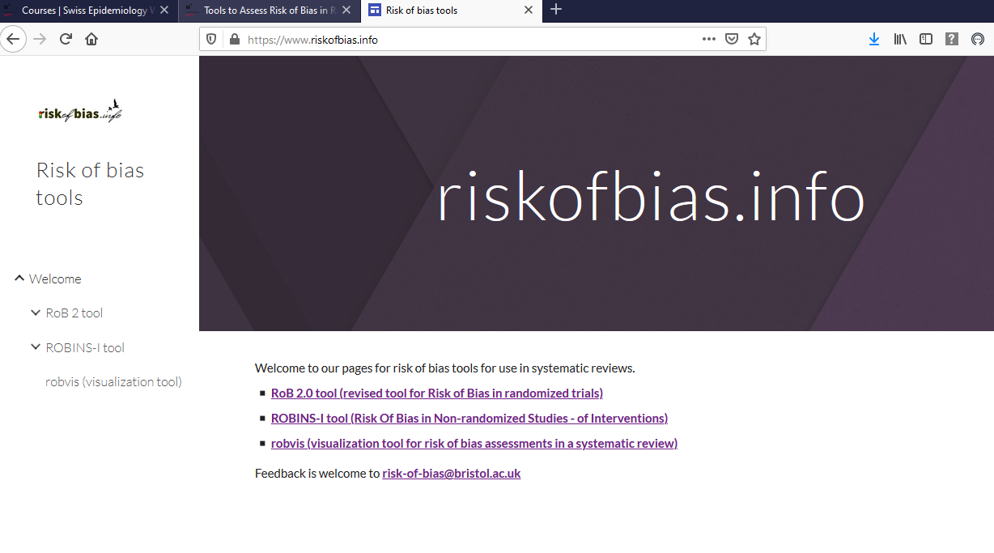
riskofbias.info
Notes:
For the latest version of RoB 2, tools for implementation, and the latest version of the full guidance, look at www.riskofbias.info

Slide 14
Session outline
  risk of bias in systematic reviews
  assessing sources of bias : the RoB 2 tool
  putting it into practice
  incorporating risk of bias in a review
Notes:
We’re now going to introduce version 2 of Cochrane’s tool to assess risk of bias in randomized trials, which was published in 2019. This major revision of the original tool, which was first published in 2008, incorporates many new features and was based on extensive feedback on the original tool.

Slide 15
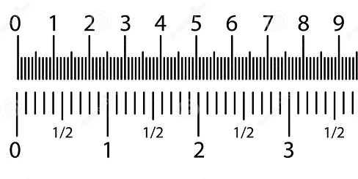




Risk of bias in randomized trials
Bias arising from the randomization process
Bias due to deviations from intended intervention
Bias due to missing outcome data
Bias in measurement of the outcome
Experimental
Outcome
Comparator
Outcome
Bias in selection of the reported result
1.02 3.87
2.20 4.32
1.38 5.44
Notes:
This is a depiction of a basic randomized trial. Different kinds of bias can arise throughout both the conduct of a trial and the dissemination of its results. The key domains we’re looking for in a ‘Risk of bias’ assessment occur at different stages during the trial. There are particular features we’re looking for that minimize the risk of bias at each stage. These stages are…
[CLICK] the process of randomizing participants into intervention groups;
[CLICK] during the trial, whether there were deviations from the planned interventions (which should not be a problem if everyone is unaware of the intervention assignments - i.e. in the presence of ‘blinding’);
[CLICK] the possibility that participants drop out, or do not have outcome data measured for some other reason;
[CLICK] the methods of measuring the endpoints (or outcomes) of participants
[CLICK] the reporting of the results.
Empirical research and theory indicate that these are the components likely to have an important impact on study results, leading to inaccurate (often exaggerated) estimates of the effect of an intervention. Although many of these domains might seem familiar, it’s important to consult Chapter 8 of the Handbook before completing a ‘Risk of bias’ assessment. Detailed information on appropriate assessments, along with examples and the evidence behind these domains and their impact on study results, is found in the full RoB 2 guidance document on riskofbias.info.
We’ll go through each of these domains, and how risks of bias arise in trials, in detail. Note that these are the key domains relating to randomized trials. If a review is incorporating non-randomized study designs additional factors will need to be considered, particularly relating to selection bias and confounding. The recommended tool for assessing risk of bias in non-randomized studies of interventions is the ROBINS-I tool.
There are also additional issues in cross-over trials and cluster-randomized trials, which we will not cover in this session. Different versions of RoB 2 have been developed for these designs.

Slide 16
Risk of bias in randomized trials
Bias arising from the randomization process
Bias due to deviations from intended intervention
Bias due to missing outcome data
Bias in measurement of the outcome
Experimental
Outcome
Comparator
Outcome
Bias in selection of the reported result
1.02 3.87
2.20 4.32
1.38 5.44
Notes:
The first stage of a trial, after recruitment of participants, is the random allocation of experimental and comparator interventions to the participants. If randomization is not undertaken properly, we can end up with systematic differences between baseline characteristics of the groups that are compared, which can affect the results of the trial.

Slide 17
Random allocation sequence
  allocation of participants to interventions occurs at the start of a trial
    based on random assignment of participants into experimental or comparator intervention groups
    avoids systematic differences in known or unknown prognostic factors between groups
Notes:
There are two issues here that we need to consider separately: generating a random sequence of allocations, and concealing this sequence.
The first issue is the generation of the sequence used to allocate people into groups. We want this to be a random sequence.
Allocating participants to interventions based on a random sequence avoids systematic differences between the intervention groups by ensuring that prognostic factors do not influence intervention assignment.
Prognostic factors are things that predict the outcome of interest. For example, older patients are more likely to suffer cardiovascular (heart-related) events, so age is a prognostic factor for this outcome. If we are looking at a drug that aims to reduce the risk of cardiovascular events, we do not want older patients to be more likely to get the drug, since then we won’t know whether it’s the older age or the taking of the drug that causes any difference in event rates between drug and non-drug groups.
Importantly, randomization offers the only way of balancing both prognostic factors we know about, and those we don’t know about.
[NOTE TO TRAINERS: ASK: Can you suggest good ways of generating a random sequence? How about inadequate ways? Examples of the correct answer are on the next slide.]

Slide 18
Random allocation sequence
Adequate - unpredictable sequence
  these days, almost always computer-generated
  low tech - coin toss, shuffling cards or envelopes, throwing dice, drawing lots, random number tables
  minimization
Inadequate – predictable sequence
  ‘quasi-random’: alternate allocation, date of birth, day of visit, ID or record number
  non-random: choice of clinician or participant, test results, availability
Notes:
To be considered adequate, the sequence should be truly random and unpredictable.
Simple random sequences can be generated by computers, or using old-fashioned methods like tossing a coin or using published random number tables.
We also consider minimization to be fine in relation to sequence generation. Although it is not totally random, it includes a random element.
Most trials described a “randomized” should have used a random allocation sequence, but this is not always the case. Non-random sequences fall into two main categories.
Some methods are known as ‘quasi-random’, such as alternating allocation, or allocation based on a seemingly irrelevant detail, such as the participant’s date of birth, the day they visit the clinic or their ID number. These methods can often be considered similar to random allocation, and are sometimes called “random” in published papers. We might include these studies in Cochrane Reviews as ‘controlled clinical trials’. However, there remains the possibility that a non-random factor may be influencing allocation. For example, patients that visit a clinic on Wednesday morning, during working hours, may be different from those visiting the clinic on Saturday morning. ID numbers may be related to the participant’s age, location or gender. These methods are not considered random.
Beyond this, there are clearly non-random methods, such as allocation based on the patient or the doctor’s choice, or based on whether an imaging device is available on that day. We would generally expect such studies to be treated as non-randomized studies of interventions, for which the recommended risk of bias tool is ROBINS-I.
[NOTES TO TRAINERS:
1. Randomization may be performed within blocks. For example, a block of allocations of size 6 might include 3 allocations to experimental intervention and 3 allocations to comparator intervention. The order of these would be random within each block of 6. This is fine in terms of it being a random sequence (although there may be problems in implementing it because of allocation concealment).
2. Minimization can be implemented in different ways. Usually always there is a random element, because the very first allocation is generated randomly (also, when all factors are balanced, a random allocation is made). Sometimes it is implemented with an additional random component, such that the allocations cannot be predicted with certainty. We regard all forms of minimization as equivalent to random in relation to sequence generation. Minimization is defined in Cochrane Glossary v4.2.5 as: “A method of allocation used to provide comparison groups that are closely similar for several variables. The next participant is assessed with regard to several characteristics, and assigned to the treatment group that has so far had fewer such people assigned to it. It can be done with a component of randomization, where the chance of allocation to the group with fewer similar participants is less than one. Minimization is best performed centrally with the aid of a computer program to ensure concealment of allocation.” ].

Slide 19
Allocation sequence concealment
  occurs at the point of allocating participants to interventions
    it is essential that when a person is recruited to the study, no-one can predict which group they will be allocated to
  ensures that the random sequence is implemented by preventing knowledge of the next allocation from:
    changing the order of enrolment
    affecting selection of who to enrol
Notes:
Allocation concealment occurs at the start of the trial, before participants are allocated to their groups or receive any intervention, as they are being enrolled into the study. Allocation concealment is often confused with blinding, but they are not the same. Allocation concealment is almost always possible, even in studies where blinding is impossible.
If allocation is concealed, then when a participant is recruited to the study neither the participant nor the study personnel can predict which group the participant will be allocated to.
This protects the random sequence, and makes sure it is applied exactly as it was generated without interference. Study personnel cannot change the order of allocation so that particular participants end up in a chosen group. And they cannot decide not to recruit particular patients based on knowledge of their allocation.
[NOTE TO TRAINERS: ASK: Can you suggest good ways of concealing allocation? How about inadequate methods? The examples of the correct answer are on the next slide.]
[NOTE TO TRAINERS: In the past, Cochrane used the term “selection bias” in relation to the methods of randomization. “Selection bias” is now used in epidemiology for a specific problem that is not the same as the problems introduced by inadequate randomization methods. Furthermore, to many people “selection bias” suggests problems in how participants are selected into a study, rather than how they are selected into intervention groups. For these reasons, to avoid confusion, we no longer use this term.]

Slide 20
Allocation sequence concealment
Adequate – cannot foresee
  central allocation (phone, web, pharmacy)
  sequentially numbered, sealed, opaque envelopes
  sequentially numbered, identical drug containers
Inadequate – can foresee
  random sequence known to staff in advance
  envelopes or packaging without all safeguards
  deducing last allocation(s) in fixed size blocks
  any non-random, predictable sequence
Notes:
Adequate concealment of the allocation sequence is anything that ensures the unpredictable nature of the random sequence has been protected and cannot be known up until the point of allocation. A good example include central randomization (e.g. by computer or a separate office not involved in recruitment) where the allocation is only revealed after the participant is irreversibly enrolled into the trial. Alternatively, a sound method is to use coded packages (e.g. identical drug containers prepared by an independent pharmacy, or sealed, opaque envelopes) to be opened or distributed in a numbered order.
Allocation concealment is inadequate if the sequence is in any way known in advance, or if it can be predicted. Sometimes the last allocations in a block can be predicted by study personnel, which can undermine random allocation.

Slide 21
Evidence from baseline imbalance
  Occasionally, baseline imbalance provides evidence that randomization was not performed adequately
    e.g. substantial differences between intervention group sizes (compared with intended allocation ratio)
    e.g. substantial excess in statistically significant differences in baseline characteristics, clearly beyond that expected by chance
      a few instances of “P <0.05” is not considered a substantial excess
Imbalances in baseline variables that have arisen due to chance do not lead to bias
Notes:
Baseline imbalance was one of the most frequently added items in the original Cochrane risk of bias tool (which allowed authors to add domains). Unfortunately, most of the time it was used inappropriately.
Baseline imbalance is considered in RoB 2 because many trials have not reported randomization methods in sufficient detail to assess whether there was a random allocation sequence and allocation sequence concealment. In the absence of good information about randomization methods, some clues can sometimes be found from the observed baseline characteristics of participants in the different intervention groups.
Imbalances in baseline variables will always arise due to chance. These chance imbalances are not evidence of a problem, and should not be used to reach judgements that a study is at high risk of bias.
However, sometimes the baseline characteristics are so remarkable that they indicate that something went wrong with the randomization. This is the sort of thing we are looking for in RoB 2. An example is a large difference in group sizes when the intended randomization ratio was 1:1.
Another example is when a lot more baseline differences in participant characteristics are significantly different then we would expect by chance alone.
[NOTE TO TRAINERS: Students sometimes get confused by this point, because they have been taught (rightly) that statistical tests of baseline differences are inappropriate in the context of a properly randomized trial. Nonetheless, such tests are a reasonable thing to do if we want to test whether the study was truly randomized. The null hypothesis here is “there was random allocation”. If we find substantial evidence against this null hypothesis, we can conclude that the study was not appropriately randomized.]
Another situation in which we might conclude that the randomization was not performed adequately is imbalance in key prognostic factors, or baseline measures of outcome variables, that are unlikely to be due to chance.
Imbalances in baseline variables will always arise due to chance. These chance imbalances are not evidence of a problem, and should not be used to reach judgements that a study is at high risk of bias.
[NOTE TO TRAINERS: This important point cannot be over-emphasized]

Slide 22
Illustration of signalling questions: Domain 1
Bias arising from the randomization process
  1.1 Was the allocation sequence random?
    Yes / Probably yes / Probably no / No / No information
  1.2 Was the allocation sequence concealed until participants were enrolled and assigned to interventions?
    Yes / Probably yes / Probably no / No / No information
  1.3 Did baseline differences between intervention groups suggest a problem with the randomization process?
    Yes / Probably yes / Probably no / No / No information
Notes:
We will not show all of the signalling questions in the tool, but here is an illustration of the three signalling questions for Domain 1 (bias arising from the randomization process).
The first two questions ask directly about the main two processes, generating a truly random sequence, and concealing this sequence until participants are irreversibly enrolled into the trial.
[IMPORTANT NOTE TO TRAINERS: Note the wording of the third question, which is misinterpreted by many users of the tool. It is NOT asking whether there was baseline imbalance: there will always be some imbalance due to chance. Nor is it asking whether there was statistically significant imbalance in one prognostic variable. It is asking whether there was such SUBSTANTIAL imbalance that there is evidence that there was a problem with the randomization process. In most cases, the answer will be ‘No’ or ‘Probably no’.]
Please also note that it is not essential to control for baseline imbalances in analyses, although doing so can have advantages. This issue is discussed in the guidance.
Note that in some implementations of RoB 2, text formatting is used to indicate which answers reflect ‘good’ features and which reflect ‘bad’ features. Here we use green, underlined, text for the former, and red text for the latter.

Slide 23
Illustration of algorithm: Domain 1
1.1 Allocation sequence random?
Y/PY/NI
1.3 Baseline imbalances suggest a problem?
N/PN/NI
Low risk
N/PN
Y/PY
Y/PY
1.2 Allocation sequence concealed?
1.3 Baseline imbalances suggest a problem?
Some concerns
NI
N/PN/NI
N/PN
Y/PY
High risk
Notes:
Here is an illustration of an algorithm for mapping answers to signalling questions onto judgements.
The algorithms are not always drawn chronologically according to questions (instead they are drawn as efficiently as possible).
Here we start with whether the allocation sequence was concealed.
[CLICK] If it wasn’t, then the result will be at ‘High risk of bias’.
[CLICK] If it was, and the sequence was random, and there were no substantial imbalances at baseline, then the result will be at ‘Low risk of bias’.
[CLICK] Rarely, major imbalances at baseline imply that the randomization was not done properly despite our impression from the methods. Then we would have ‘Some concerns’ (or possibly worse)
[CLICK] We might also have ‘Some concerns’ if the underlying sequence was not random, even if the sequence was concealed. We wouldn’t expect to be in this situation very often.
[CLICK] Quite often we don’t have enough information to judge whether there was allocation concealment. Then we would not be able to say ‘Low risk of bias’…
[CLICK] But we can use the information at baseline to decide whether the randomization methods look problematic (‘High risk of bias’) or not (‘Some concerns’).

Slide 24
Risk of bias in randomized trials
Bias arising from the randomization process
Bias due to deviations from intended intervention
Bias due to missing outcome data
Bias in measurement of the outcome
Experimental
Outcome
Comparator
Outcome
Bias in selection of the reported result
1.02 3.87
2.20 4.32
1.38 5.44
Notes:
The second domain is called ‘Bias due to deviations from intended intervention’.

Slide 25







What are deviations from intended intervention?
Intervention provider
Participant
Intended intervention protocol:
1. Additional interventions given
3. Non-adherence by trial participants
£$!
2. Failure to implement as intended
Images by iStock and OpenClipart-Vectors from Pixabay
Notes:
Three key types of deviation from the intended intervention are addressed in RoB 2, because they can lead to bias in the estimated effect of intervention. They are all defined in terms of the trial protocol, which review authors should consult if necessary.
This top picture depicts the protocol for the intervention that is intended to be administered by trial personnel in one of the intervention groups.
[CLICK] The first type of deviation arises when the intervention provider gives addition interventions that were not intended in the protocol. We call these non-protocol interventions.
[CLICK] The second type of deviation arises when the intervention provider fails to implement the intervention it was intended she provide.
[CLICK] The third type of deviation arises when the participant does not adhere to the intended intervention. Either he may fail to implement it (e.g. missing doses of a drug) or he may add non-protocol interventions (eg taking additional drugs that are excluded bv the intervention protocol).

Slide 26
Deviations from intended intervention
  administration by trial staff of additional interventions that are inconsistent with the trial protocol (non-protocol interventions)
    if possible, specify potential non-protocol interventions in the review protocol
  failure by trial staff to implement the protocol interventions as intended
  non-adherence to assigned intervention by trial participants
NB Trial protocols may not fully specify the interventions that are intended
Specify potential non-protocol interventions in the review protocol if possible
Notes:
This slide summarises the three types of deviation from intended intervention that are addressed in RoB 2 and were depicted in the previous slide.
The first two types of deviation are defined in relation to the trial protocol. Unfortunately, trial protocols may not fully document the intended interventions: for example they may not be clear about additional interventions that are and are not permitted.
Therefore, if possible, review authors should specify potential non-protocol interventions in advance (at the review protocol writing stage). They may be identified through the expert knowledge of members of a Cochrane group (if you are working with a Cochrane group to develop your review), via initial (scoping) reviews of the literature, and through discussions with health professionals.

Slide 27
Changes to intervention
  It is often intended that the intervention will change over time
  For example, trial investigators may intend that:
    participants experiencing severe toxicities should receive additional care and/or switch to an alternative therapy
    participants whose disease progresses should switch to a second-line intervention
Such changes to intervention
are consistent with the trial protocol
do not cause bias, and
should not be considered to be deviations from intended intervention
Notes:
Review authors often worry about whether changes to intervention during a trial lead to bias. It is important to realise that such changes are not necessarily deviations from the intended intervention, although trial protocols are not always explicit about this. In the examples given here, the changes are intended: they are (at least implicitly) part of the trial protocol. They do not cause bias, and should not be considered to be deviations from intended intervention.
Only changes to intervention that are inconsistent with the trial protocol should be considered deviations from the intended intervention.
Again, trial protocols may not clearly distinguish between changes to intervention that are consistent with the investigators’ intentions and those changes that are inconsistent with the protocol. For example, a cancer trial protocol may not define progression, or specify the second-line drug that should be used in patients who progress. It may therefore be necessary for users of RoB 2 to document changes to intervention that they do and do not consider to be consistent with the trial protocol.

Slide 28
The role of blinding
Blinding of participants and trial personnel should prevent knowledge of intervention assignment from influencing:
  contamination (application of one of the interventions in participants intended to receive the other)
  switches to non-protocol interventions
  non-adherence by trial participants
Notes:
Blinding is an important component of many trials. This term refers to implementation of mechanisms to ensure that participants, carers and trial personnel (i.e. people delivering the interventions) are unaware of the interventions received.
Blinding of participants and trial personnel should prevent knowledge of intervention assignment from influencing changes to intervention, including contamination (application of one of the interventions in participants intended to receive the other), switches to non-protocol interventions and non-adherence by trial participants.
Successful blinding during the trial may also mean that outcome assessors are not influenced by knowledge of the intervention received. Bias in assessment of outcomes is addressed in a separate RoB2 domain.

Slide 29
The role of blinding
Blinding of participants and trial personnel:
  essential in trials that aim to eliminate placebo effects and isolate specific effects of protocol interventions
  not appropriate in pragmatic trials whose goal is to compare interventions in individuals who are aware of their care
Blinding of outcome assessors is considered separately in RoB 2 (see domain 4)
Notes:
Blinding is an essential component of some trials. For example, trials of acupuncture to treat pain tend to find benefit when it is compared with no treatment, but no important benefit when the comparison is with sham acupuncture and the participants and carers (other than those delivering the intervention) are blinded. Similarly, a blinded comparison of a drug with placebo allows estimation of the pharmacological effect of the compound concerned, whereas the effect estimated from a comparison of the drug with no intervention combines the effect of the compound with that of the whole treatment process.
However, blinding is not essential, and results from ‘open’ (unblinded) trials may be at low risk of bias. Such studies may take other measures to avoid deviations from intended intervention, such as treating participants according to strict criteria that prevent administration of non-protocol interventions.
Regardless of whether it is appropriate, blinding trial participants is difficult or impossible in some contexts – for example in a trial comparing a surgical with a non-surgical intervention.

Slide 30
The effect of interest
Scenario: large RCT of screening for colorectal cancer
    patients individually randomized to receive an invitation to attend screening
    55% of patients in the intervention arm attended screening
    all patients were followed up for 10 years after randomization
We could be interested in either or both of:
  the effect of assignment to intervention
    the ‘intention-to-treat’ (ITT) effect
    may be of most interest to a policymaker considering whether to introduce a screening programme
  the effect of adhering to intervention as specified in the trial protocol
    the ‘per-protocol’ effect
    may be of most interest to a patient deciding whether to be screened
Cochrane Reviews usually address the effect of assignment to intervention (the ‘intention-to- treat’ [ITT] effect)
Notes:
Let’s consider a large individual-randomized trial of screening for colorectal cancer, in which 55% of intervention group patients (those who received an invitation to be screened) actually attended screening.
[NOTE TO TRAINERS: If you have time, pause before clicking and ask: “What could we learn from this trial? Who would be interested in the results?]
[CLICK] We may be interested in either or both of:
1. The effect of assignment to the interventions at baseline (regardless of whether the interventions are received during follow-up). This is sometimes known as the ‘intention-to-treat effect’). In the screening trial example, this effect may be of most interest to a policymaker considering whether to introduce a screening programme, because they want to know the overall effect at population level
2. The effect of adhering to intervention as specified in the trial protocol. This is sometimes known as the ‘per-protocol effect’. In the screening trial example, this may be of most interest to a patient deciding whether to be screened.
Risk of bias assessment is simplest when we address the effect of assignment to intervention (the ‘intention-to- treat’ [ITT] effect). This effect is addressed in most Cochrane Reviews.
IMPORTANT POINT: At this point we have not discussed the analyses that should be used to estimate these two effects. If participants raise this issue, you can comment that we use an ‘intention-to-treat’ analysis to estimate the effect of assignment to intervention, and that Cochrane Reviews usually address the effect of assignment to intervention. The per-protocol effect may be of great interest, but it is usually hard to estimate, and some commonly used estimators may be seriously biased. We address these issues in subsequent slides.

Slide 31
Adherence with screening was 63%
  10-year risk absolute difference in colorectal cancer incidence:
    Intention-to-screen effect: −0.22% (95% CI −0.38% to -0.06%)
    Per-protocol effect (adherence-adjusted analysis using an instrumental variable approach): −0.42% (95% CI −0.69% to -0.15%)
Notes:
Here is a real example from a randomized trial of the effect of flexible sigmoidoscopy screening on colorectal cancer incidence and mortality conducted in Oslo city and Telemark County, Norway (JAMA 2014; 312(6): 606-615, doi:10.1001/jama.2014.8266). Of 98 792 participants included in the intention-to-screen analyses, 20 572 (screening group) were invited to undergo screening and 78 220 (the control group) were not invited.
[CLICK] As expected, the incidence of colorectal cancer was higher early in the follow up period, because screening detects cancers earlier. However, the incidence of cancer was subsequently lower in the screening group, and in an intention-to-screen analysis the hazard ratio (averaged across 13 years of follow up) was 0.80 (95% CI 0.70 to 0.92).
[CLICK] This corresponds to the 10 year incidence of colorectal cancer being 0.22% lower in those invited to undergo screening (95% CI −0.38% to -0.06%). In addition, the authors used an instrumental variable analysis to estimate the effect of screening in people who accepted the invitation (an ‘adherence-adjusted’ analysis). This analysis estimated that the per-protocol effect (the effect of being screened compared with not being screened) was a reduction of 0.42% in the 10-year incidence of colorectal cancer (95% CI −0.69% to -0.15%).

Slide 32
Estimating the effect of assignment to intervention
Cochrane Reviews usually assess the effect of assignment to intervention (the ITT effect)
  we should use an ‘intention-to-treat’ (ITT) analysis:
    analyse participants in the intervention groups to which they were randomized, regardless of the intervention received
    include all randomized participants in the analysis
    measure outcome data on all participants
  providing that the analysis is appropriate:
    in blinded trials, risk of bias due to deviations from intended intervention will be low
    in unblinded trials, risk of bias due to deviations from intended intervention will usually be low
Notes:
We’ve already said that Cochrane Reviews usually address the effect of assignment to intervention. You are probably aware that the primary analysis of a randomized trial should usually be an ‘intention-to-treat’ (ITT) analysis. In such analysis we:
analyse participants in the intervention groups to which they were randomized, regardless of the intervention received
include all randomized participants in the analysis
measure outcome data on all participants
Of course, outcome data may not be available on all participants. Bias due to missing outcome data is assessed in a separate domain, so missing outcome data do not affect the assessment of bias due to deviations from intended interventions.
Providing that the analysis is appropriate (which means that we analyse participants in the intervention groups to which they were randomized, regardless of the intervention received AND that we include all randomized participants in the analysis), assessing the risk of bias due to deviations from intended intervention should be straightforward. In summary:
in blinded trials, risk of bias due to deviations from intended intervention will be low
in unblinded trials, risk of bias due to deviations from intended intervention will usually be low

Slide 33
Bias due to deviations from intended intervention
(effect of assignment to intervention)
In RoB 2 we assess only deviations that arose because
of the trial context:
  whether the process of recruiting and engaging with participants affected their behaviour
    e.g. participants assigned to the comparator group may feel unlucky and therefore seek the experimental intervention
  whether trial personnel undermined trial comparisons by implementing non-protocol interventions or failing to implement the protocol interventions
    unconscious processes (e.g. lack of equipoise leading to administration of non-protocol interventions in one group
    conscious processes (e.g. arising from a conflict of interest)
Notes:
When we assess the effect of assignment to intervention, most deviations from the protocol interventions are not relevant to risk of bias assessments. In RoB 2 we assess only deviations that arose because of the trial context. By “trial context”, we mean specifically related to the fact that interventions were delivered in a randomized trial, in which the requirement for informed consent can influence participants’ behaviour, and it is possible that trial personnel undermine trial comparisons, for conscious or unconscious reasons.
We therefore ask:
Whether the process of recruiting and engaging with participants affected their behaviour. For example, participants assigned to the comparator group may feel unlucky and therefore seek the experimental intervention. Importantly, non-adherence to assigned intervention by trial participants does not cause bias in the effect of assignment to intervention unless it is related to the process of recruiting and engaging participants.
Whether trial personnel undermined trial comparisons by implementing non-protocol interventions or failing to implement the protocol interventions. This could happen through unconscious processes (for example, trial personnel lack equipoise, leading them to administer non-protocol interventions in one group) or through conscious processes (for example, a conflict of interest means that trial investigators use non-protocol interventions more in the group that they favour).
Importantly, no other types of deviation from the protocol interventions are relevant in assessing bias in the effect of assignment to intervention.

Slide 34
Bias due to deviations from intended intervention
(effect of adhering to intervention)
  For details of assessing risk of bias in the effect of adhering to intervention, refer to the RoB 2 guidance
Notes:
Because of time constraints, this presentation does not discuss how to assess bias in the effect of adhering to intervention (the per-protocol effect). This is discussed in the detailed RoB 2 guidance document.
[NOTE TO TRAINERS: You may also encourage the learners to watch the recording of a webinar explaining the domain 2 ‘Bias due to deviations from intended intervention’ in more detail: https://training.cochrane.org/resource/rob-2-domain-2-bias-due-deviations-intended-interventions]

Slide 35
Risk of bias in randomized trials
Bias arising from the randomization process
Bias due to deviations from intended intervention
Bias due to missing outcome data
Bias in measurement of the outcome
Experimental
Outcome
Comparator
Outcome
Bias in selection of the reported result
1.02 3.87
2.20 4.32
1.38 5.44
Notes:
The third RoB 2 bias domain addresses bias due to missing outcome data.

Slide 36
Missing outcome data
When outcome data are not available for all participants
  possible reasons:
    ?
    ?
    ?
Notes:
It is often not possible to measure or ascertain the outcome for all participants who were randomized. When this happens, we say that outcome data are missing. There are several possible reasons for this.
[NOTE TO TRAINERS: ASK: What are possible reasons for outcome data to be missing? The most common reasons are listed on the next slide]

Slide 37
Missing outcome data
When outcome data are not available for all participants
  possible reasons include:
    participants withdraw from the study or cannot be located
    participants do not attend a study visit at which the outcome should have been measured
    participants can no longer experience the outcome (e.g. died)
  exclusions from analysis for reasons other than missing data are not addressed in this domain
    see domain 2 (deviations from intended intervention)
Notes:
There are several possible reasons for missing outcome data:
Participants may be lost to follow-up, or they may choose to withdraw from the study.
The outcome may be missing because participants missed the study visit when it should have been measured, even though they did not withdraw from the trial.
Participants may die, which means that a non-mortality outcome cannot be measured.
It is also possible that trial authors choose to exclude some participants from analyses, even though their outcomes were measured. This issue is not considered within the missing outcome data bias domain. This is because it is covered within domain 2 (bias due to deviations from intended intervention).

Slide 38
How much is too much missing outcome data?
There is no sensible threshold for ‘small enough’ in relation to the proportion of missing outcome data
    in situations where missing outcome data lead to bias, the extent of bias will increase as the amount of missing outcome data increases
  the potential impact of missing data on estimated intervention effects depends on:
    the number of participants with missing data
    the type of outcome
      e.g. continuous, dichotomous, time-to-event
    (for dichotomous outcomes) the risk of the event
Notes:
It would be great if there was a simple threshold for the proportion of participants with missing outcome data below which the risk of bias is low.
Unfortunately, there is no such threshold. But when missing outcome data lead to bias, the extent of bias will increase as the amount of missing outcome data increases.
The reason there is no simple threshold is that the potential impact of missing data on estimated intervention effects depends on:
1. The number of participants with missing data. The more participants with missing outcome data, the greater the potential impact.
2. The type of outcome (e.g. continuous outcome, dichotomous outcome, time-to-event outcome). For the same proportion of participants with missing outcome data, the impact may be greater for dichotomous than continuous outcomes.
3. For dichotomous outcomes, the risk of the event. When the outcome is rare, missing outcomes can have a big impact on the estimated effect of intervention. This happens if the participants with missing outcome data tend to be those who experienced the event.

Slide 39
When do missing outcome data lead to bias?
  we need to consider the true value of the outcome in participants with missing outcome data
    this is the value of the outcome that should have been measured but was not
  example: trial of cognitive behavioural therapy compared with usual care for depression
    if participants who are more depressed (true value of the outcome) are less likely to return for follow-up, then whether the depression outcome is missing depends on its true value
    this implies that the measured depression outcomes will differ systematically from the true values of the missing depression outcomes
Notes:
Statistical theory tells us the circumstances in which missing outcome data lead to bias. To understand this, we need to think about the true value of the outcome in participants with missing outcome data. This sounds strange. It means the value of the outcome that we would have measured, if we had been able to measure it.
For example, consider a trial of cognitive behavioural therapy compared with usual care for depression. Participants may not attend clinic for the follow up visit where their outcome should have been measured. The true value of their outcome is the value (depression scale score) that we would have measured if we had been able to administer the measuring instrument.
In such an example, the likelihood that the outcome is missing depends on its true value. This implies that the measured depression outcomes will differ systematically from the true values of the missing depression outcomes.

Slide 40
When do missing outcome data lead to bias?
Experimental intervention | Participants with measured outcomes
 | Participants with missing outcomes | ?
Comparator intervention | Participants with measured outcomes
 | Participants with missing outcomes | ?
refer to this as “missingness” in the outcome variable
More depression symptoms
Less depression symptoms
Notes:
The following graphs illustrate the circumstances in which missing outcome data lead to bias. The trial compares an experimental intervention with a comparator intervention. In each group, the outcome variable is missing for some participants. We refer to this as ‘missingness in the outcome variable’. We can plot the distribution of the measured outcomes in each group. However, we do not know the distribution of the missing outcomes.

Slide 41
No bias: missingness unrelated to true values
Experimental intervention | Participants with measured outcomes
 | Participants with missing outcomes
Comparator intervention | Participants with measured outcomes
 | Participants with missing outcomes
  e.g. data missing because automatic measuring device failed for a subset of participants
Notes:
If missingness in the outcome if unrelated to its true value (in each group) then there is no bias. This would plausibly be the case, for example, if outcomes were missing because of failure of an automated measuring device. There would be no bias even if a substantial proportion of outcome measurements were missing. The graphs show that in each intervention group the distribution of the true value of the missing outcomes is similar to that of the measured outcomes

Slide 42
Bias: missingness depends on true values and on intervention group
Experimental intervention | Participants with measured outcomes
 | Participants with missing outcomes
Comparator intervention | Participants with measured outcomes
 | Participants with missing outcomes
  e.g. (1) more withdrawals in experimental group due to side effects and (2) those with continuing symptoms more likely to withdraw
Notes:
If missingness in the outcome depends on both the true value of the outcome and on the intervention group then there will be bias. This would be the case if, for example, there were more withdrawals in the experimental intervention group because of side-effects caused by the experimental intervention and participants with continuing symptoms were more likely to withdraw from the study.
You can see that in the graphs the distributions of missing outcomes differ from the distributions of the measured outcomes and that there is much more missing outcome data in the experimental intervention group. Therefore the mean difference comparing observed outcomes will differ from the mean difference if we had measured all outcomes.

Slide 43
No bias: missingness depends on true values, but things are identical in both intervention groups
Experimental intervention | Participants with measured outcomes
 | Participants with missing outcomes
Comparator intervention | Participants with measured outcomes
 | Participants with missing outcomes
  e.g. (1) those with continuing symptoms more likely to drop out
  and (2) the experimental intervention has no effect
Notes:
It is important to note that that even when missingness in the outcome depends on its true value, there will be no bias if the effects of the experimental and comparator interventions are the same. The graph shows that in this case, the distribution of the missing outcomes differs from the distribution of the measured outcomes. However the difference is the same in the two intervention groups, so the mean difference between the measured outcomes is the same as we would have observed if we had measured the outcome in all participants.

Slide 44
Bias likely: missingness depends on true values, and effects of experimental and comparator intervention differ
Experimental intervention | Participants with measured outcomes
 | Participants with missing outcomes
Comparator intervention | Participants with measured outcomes
 | Participants with missing outcomes
  e.g. (1) those with continuing symptoms more likely to drop out and (2) the experimental intervention has an effect
It’s a bit more complex than this (more details in the RoB 2 guidance)…
Notes:
Bias is likely if missingness in the outcome depends on its true value and the effects of the experimental and comparator interventions differ. The graph shows that in this case, the impact of the missing outcome data differs between the intervention groups, because in the experimental group the missing values are more different from the measured values than in the comparator group. This implies that the mean difference between the measured outcomes differs from what we would have observed if we had measured the outcome in all participants.
The graphs we have shown you provide broad guidance, but there are exceptions and additional complexities. These are discussed in the RoB 2 guidance.

Slide 45
How do we know whether there is bias?
  unfortunately it is not possible to examine directly whether missingness in the outcome depends on its true value
  but, we can infer that missingness may depend on the true value if:
Experimental intervention | Participants with measured outcomes
 | Participants with missing outcomes | ?
Comparator intervention | Participants with measured outcomes
 | Participants with missing outcomes | ?
    there were differences
    between intervention
    groups in the proportions of missing outcome data
    reported reasons for missing outcome data provide evidence that missingness in the outcome depends on its true value
    reported reasons for missing outcome data differ between the intervention groups
Notes:
Unfortunately it is not possible to examine directly whether missingness in the outcome depends on its true value, because we do not know the values of the missing outcomes.
However, we can use indirect evidence to infer that missingness in the outcome may depend on its true value. Three potential pieces of evidence are:
there were differences between intervention groups in the proportions of missing outcome data
reported reasons for missing outcome data provide evidence that missingness in the outcome depends on its true value
reported reasons for missing outcome data differ between the intervention groups
If any of these is the case, then it is likely that missingness in the outcome depends on its true value.

Slide 46
Looking at sensitivity analyses
  The important consideration is whether a sufficiently wide range of plausible values for the missing outcome data have been considered in the sensitivity analyses
    this is usually more important than which methods have been used
  multiple imputation is commonly used to address bias and other problems caused by missing data
    but in trials, multiple imputation will usually not remove or reduce the bias that occurs when missingness in the outcome depends on its true value
    see RoB 2 guidance
Notes:
Sensitivity analyses examine how the findings change in response to different assumptions about the process leading to missing outcome data. They can be very helpful in telling us whether it is plausible that missing outcome data led to material bias.
Various sensitivity analysis methods have been proposed. Regardless of the method use, the important consideration is whether a sufficiently wide range of plausible values for the missing outcome data have been considered in the sensitivity analyses.
Multiple imputation is commonly used to address bias and other problems caused by missing data. However, you should not assume that use of multiple imputation reduces the risk of bias. In randomized trials, multiple imputation will usually not remove or reduce the bias that occurs when missingness in the outcome depends on its true value. This is discussed in more detail in the RoB 2 guidance.

Slide 47
Bias due to missing outcome data
Low risk of bias
  outcome data are available for all or nearly all participants
  there is evidence (e.g. from sensitivity analyses) that the result is not biased by missing outcome data
  missingness in the outcome does not depend on its true value
High risk of bias
  it is likely that missingness in the outcome depended on its true value
Notes:
This slide summarizes how the risk of bias due to missing outcome data is assessed in RoB 2.
Risk of bias will be low when:
1. outcome data are available for all or nearly all participants, OR
2. there is evidence (e.g. from sensitivity analyses) that the result is not biased by missing outcome data, OR
3. missingness in the outcome does not depend on its true value
Risk of bias will be high when it is likely that missingness in the outcome depended on its true value. We address this by considering indirect evidence, as discussed a couple of slides ago.

Slide 48
Risk of bias in randomized trials
Bias arising from the randomization process
Bias due to deviations from intended intervention
Bias due to missing outcome data
Bias in measurement of the outcome
Experimental
Outcome
Comparator
Outcome
Bias in selection of the reported result
1.02 3.87
2.20 4.32
1.38 5.44
Notes:
Bias may arise from systematic differences in the way the outcome of interest is measured or detected. This source of bias can be minimized by blinding outcome assessors to intervention assignments.

Slide 49
Bias in measurement of the outcome
Need to consider:
  whether method of measuring the outcome is appropriate
  whether measurement or ascertainment of outcome differs between intervention groups
  who is assessing the outcome
  whether outcome assessor is blinded to intervention assignment
  whether assessment of outcome is likely to be influenced by knowledge of intervention assignment
Notes:
Here are the various issues we should consider.
It perhaps goes without saying that the measurement method should be appropriate. We’d expect this to be the case for pre-specified outcomes in a randomized trial. However, we need to look out for situations where methods just aren’t capable of giving us reliable information, particularly for adverse outcomes that are collected spontaneously.
It’s also important that how the outcomes are measured or ascertained in the same in the two groups. Again, most trials ensure that this is the case, but sometimes there are more opportunities to observe outcomes in one group than the other group (e.g. more clinic visits), leading to over-ascertainment in one group compared with the other.
The main issues we consider in this domain are (i) who is assessing the outcome; (ii) whether the outcome assessor is aware of intervention assignments (a form of blinding) and (iii) the nature of the outcome.

Slide 50
Blinding of outcome assessment
  avoids knowledge of intervention received affecting measurement of the outcome
  assess carefully
    blinding of outcome assessors may be feasible even where blinding of participants and care providers is not
    remember that participants and carers may also be outcome assessors
    is it likely that blinding was broken?
    the terms “single-blind” and “double-blind” do not tell us who was blinded
Notes:
If possible, outcome assessments should be made blinded to intervention assignments.
If an outcome assessor knows which group a participant is in, they may change the way they measure the outcome. For example, they may look more carefully for small changes on an x-ray, or interpret borderline measures differently.
It is often possible to blind outcome assessors, even if it is not possible to blind participants during the trial.
Don’t forget that participants may also be outcome assessors. For example, if someone knows they have been taking a placebo, they may misreport their results and undermine the trial comparison, particularly for subjective outcomes such as pain or quality of life.
[NOTE TO TRAINERS: ASK: Can the group think of any examples of where lack of blinding can cause changes in the outcome measurement? Examples might include things like a physiotherapist measuring range of motion after they have performed rehabilitation therapy. If they have a preference for one intervention over the other, they may exaggerate their measurements for this intervention.]
Blinding can be reported ambiguously. Look carefully at who was blinded and judge whether you think the blinding was successful, and remember that blinding of outcome assessment may be feasible even where blinding of participants and care providers is not.

Slide 51
Blinding of outcome assessment
Low risk of bias
  blinding implemented, and unlikely that the blinding could have been broken
  no blinding, but measurement unlikely to be influenced by knowledge of the intervention assignment
High risk of bias
  no blinding or broken blinding, and measurement likely to be influenced
Notes:
These are the situations that would get us to a ‘Low risk of bias’ and a ‘High risk of bias’ judgement in RoB 2.
Sometimes we know that assessors could have been influenced by knowledge of intervention assignment, but we have no evidence that they were. In such situations, the RoB 2 algorithm will map us to a judgement of ‘Some concerns’.

Slide 52
Risk of bias in randomized trials
Bias arising from the randomization process
Bias due to deviations from intended intervention
Bias due to missing outcome data
Bias in measurement of the outcome
Experimental
Outcome
Comparator
Outcome
Bias in selection of the reported result
1.02 3.87
2.20 4.32
1.38 5.44
Notes:
Once the trial has been completed, there is still one further source of bias we need to assess.
[NOTE TO TRAINERS: ASK: Does anyone know what ‘publication bias’ or ‘reporting bias’ is? Can you explain it?]
When reporting their trial, an author can introduce a form of bias by deliberately reporting only the positive or statistically significant outcome measures (“cherry picking”), or by modifying their planned analysis to make the results more positive or significant.
There is evidence that statistically significant results more likely to be reported, and more likely to be reported in sufficient detail for them to be included in a meta-analysis.

Slide 53
Selective reporting vs selective non-reporting
1 result reported from among 3 scales used for the same clinical outcome
Study 1
Study 2
Study 3
Potential bias in selection of the reported result: Domain 5 in RoB 2
Study 4
Study 5
Not reported,
because “P > 0.05”
Study 6
?
Potential bias in the meta-analysis: ROB ME tool
Notes:
This diagram illustrates two different problems, which we need to separate.
[CLICK] In the study at the top, we have a result for the outcome we are looking at, but we can tell by looking at the report(s) of the trial that the trial investigators measured and analysed three different rating scales to assess the some outcome domain. But they reported only one, and it had a confidence interval that excluded the null. We are therefore suspicious of selective reporting because of the nature of the results.
[CLICK] In the study at the bottom, we don’t have a result at all. At least, we don’t have one that we can include in the meta-analysis. All we know from the trial report(s) is that the result was “not statistically significant” (i.e. that P > 0.05). Here we also have a suspicion of selecting reporting because of the nature of the results.
[CLICK] There is an important difference between these two scenarios. In the first, we have a result, so we can apply RoB 2 to judge whether there is a risk of bias in this result. There is potential for bias in selection of the reporting result, which we assess in Domain 5 of RoB 2.
[CLICK] In the second scenario, there is no result to assess, so we do not go to the trouble of doing a RoB 2 assessment. That doesn’t mean we don’t need to worry about bias, however. But instead we are worried about bias in the meta-analysis because the result for this study is missing. The ROB ME tool addresses this bias (Risk Of Bias due to Missing Evidence in a synthesis).
[NOTE TO TRAINDERS: this is an important difference between RoB 2 and the earlier version of the Cochrane Risk of Bias tool (from 2008, modified slightly in 2011). In the original tool, there was a domain called “Selective outcome reporting”, which looked for any evidence of selective reporting or non-reporting in the trial, so covered both of the problems in this slide. In contrast, RoB 2 covers only the first problem.]

Slide 54
Bias in selection of the reported result
May arise when results are selected based on their magnitude, direction or P value, from:
  multiple outcome measurements within the outcome domain, e.g.
    multiple scales
    multiple definitions of/criteria for an event
    multiple time points
  multiple analyses of the outcome measurement, e.g.
    unadjusted vs adjusted models
    different sets of covariates in adjusted models
    final values vs change from baseline vs analysis of covariance
    continuous scale converted to categorical data with different cut-points
Notes:
We are basically worried about multiplicity. This is when there are multiple possible results that could be generated from the trial, each of which are eligible for the synthesis we want to undertake.
Here are some examples of the types of multiplicity that might put us at risk of bias if the trial investigators look at the results and decide which ones to report.
The first is that we may have multiple outcome measurements within the outcome domain. The “outcome domain” is the outcome that is the focus of the synthesis. The review authors need to define this. It might be, for example, a general outcome such as “depression”. Or possibly the review authors will define it more narrowly for the purposes of a particular synthesis, e.g. “depression measured as change from baseline to 12 months using the Hamilton rating scale”. Often the definition may be somewhere between these two extremes.
Examples of the sorts of multiplicity we can see for outcome measurements are (i) multiple scales; (ii) multiple definitions of an event; and (iii) multiple time points.
The second type of multiplicity is that we may have multiple analyses of the same outcome measurements.
Examples of the sorts of multiplicity we can see for analyses are (i) unadjusted vs adjusted models (e.g. accounting for baseline covariates vs not); (ii) different sets of covariates in adjusted models; (iii) final values vs change from baseline vs analysis of covariance when we have baseline measures of the outcome variable; or (iv) converting a continuous scale to categorical data using a series of different cut-points.

Slide 55
How to spot bias in selection of the reported result
  ideally, we have a pre-specified analysis plan
    a trial protocol (even a registry record) may be sufficient
    date stamped before (unblinded) data set available
    outcome measures changed? statistics changed?
  what if there is no pre-specified analysis plan?
    compare ‘Methods’ with ‘Results’ – look for:
      outcomes measured (or likely to be measured) but not reported
      reporting that cannot be used in a review
      (e.g. stating non-significance without numerical results)
Notes:
The best way to look for selective reporting of a result is to find the study’s original analysis plan. This is a publicly available document that specifies, in detail, how the analyses will be conducted. It should be published in advance of unblinded outcome data being available, although this is often not done.
Sometimes the protocol is sufficiently detailed, and occasionally a trial registry record includes details of all outcome measures and plans for statistical analysis. These are increasingly available online, and study protocols are more often published these days, and you should generally take the time to try to find these.
It is important to check the date of the analysis plan. This should be before the results could have been generated. Or at least before results could have been generated in a way that we know which intervention is favoured (sometimes analyses are performed with the interventions anonymized, i.e. ‘blinded’ to intervention status; it’s fine to do this, especially if it will be necessary to examine some aspects of the data to finalize the analysis strategy, for example to check skewness in the data).
If there is an analysis plan, check that the trial report agrees with it. Has the outcome measure changed? Have the analysis methods changed?
In the absence of a pre-specified plan, it may be possible to identify selective reporting. First, compare the ‘Methods’ section of the published paper with the ‘Results’ section. Sometimes it will be clear that the authors are presenting only a subset of the outcome measures or analyses that they have performed. Note whether the analysis reported matches what was described in the ‘Methods’, or have different statistics been reported? Have new outcomes been added that were apparently not planned? Are the outcomes reported for all participants, or only some, or for separate subgroups only?
Think about the outcomes that are commonly measured in this field – have the authors reported everything that would usually be expected? This is easier in fields where a clear set of expected outcomes can be identified.

Slide 56
Bias in selection of the reported result
Low risk of bias
  prespecified trial analysis plan is available
  review authors’ preferred outcome measures (and analyses) reported according to trial analysis plan, irrespective of the results
Some concerns
  many trials will be judged in this category
High risk of bias
  evidence (or strong hint) that the reported outcome measure (or analysis) was selected on the basis of the results
Notes:
In most cases, we can only be confident that a study is free of bias due to selection of the reported result if we have a pre-specified analysis plan. As a result, we can expect a lot of trials to be rated as ‘Some concerns’ for this domain.

Slide 57
Session outline
  risk of bias in systematic reviews
  assessing sources of bias : the RoB 2 tool
  putting it into practice
  incorporating risk of bias in a review
Notes:
We will now look at putting all this into practice.

Slide 58
Completing the assessments
  at least two assessors
    include content and methods experts
    ensure all understand the methodological issues
  define in advance the process for resolving disagreements
  pilot on 3-6 studies to check consistency of assessment
  look for missing information
    study protocol
    contact authors
Notes:
At least two review authors should perform the risk of bias assessment. It is useful for them to possess methodological and content expertise between them. All assessors need to have a good grasp of the methods.
A plan will be needed for how to address disagreements between authors. It’s highly likely that different authors will initially reach different answers to signalling questions and different judgements – for example, content and methods experts may notice different aspects of the included studies. The process of discussing those differences will ensure the assessment is rigorous and fair.
Piloting the risk of bias assessment on a small number of studies is wise. This may identify some initial areas of disagreement and ensure all the authors have the same understanding of what needs to be assessed for each domain.
As for any other aspects of the data collection from an included study, you should consider contacting the authors to clarify any missing or unclear information. Don’t forget that, if it’s available, the study protocol can be an important source for this assessment.
[NOTE TO TRAINERS: Blinded assessment is possible in theory, concealing the names of the authors, institutions and journals, but this is difficult and time consuming, and may not be possible when the authors are very familiar with the papers. Knowledge of who did the study may legitimately provide clues for answering signalling questions. For example, if the trial is run by a clinical trials unit which routinely uses sound, computer-based randomization methods, then it may be reasonable to assume that a trial from that unit used the same methods even if they are not reported. Any such assumptions must be declared, of course.]

Slide 59
Implementation of RoB 2
  options for performing the assessment
    Excel tool is available
    Word template
    online tool (forthcoming)
  in RevMan Web
    RoB 2 assessments are attached to results within studies
    input risk of bias judgements (for each domain and overall), plus support for each judgement, to create a table
    answers to signalling questions (consensus version) can be included as a supplement
  The information in this slide is subject to change as tools are developed. Check riskofbias.info for the latest implementation tools
Notes:
The RoB 2 tool is best assessed using an electronic system that has the algorithms implemented.
An Excel tool is available from riskofbias.info
A Word template is also available, but the algorithms would need to be implemented manually.
An online system is in development: check riskofbias.info to see if it is available.
RevMan Web has the facility to present RoB 2 assessments. They are attached to results within studies rather than the studies.

Slide 60
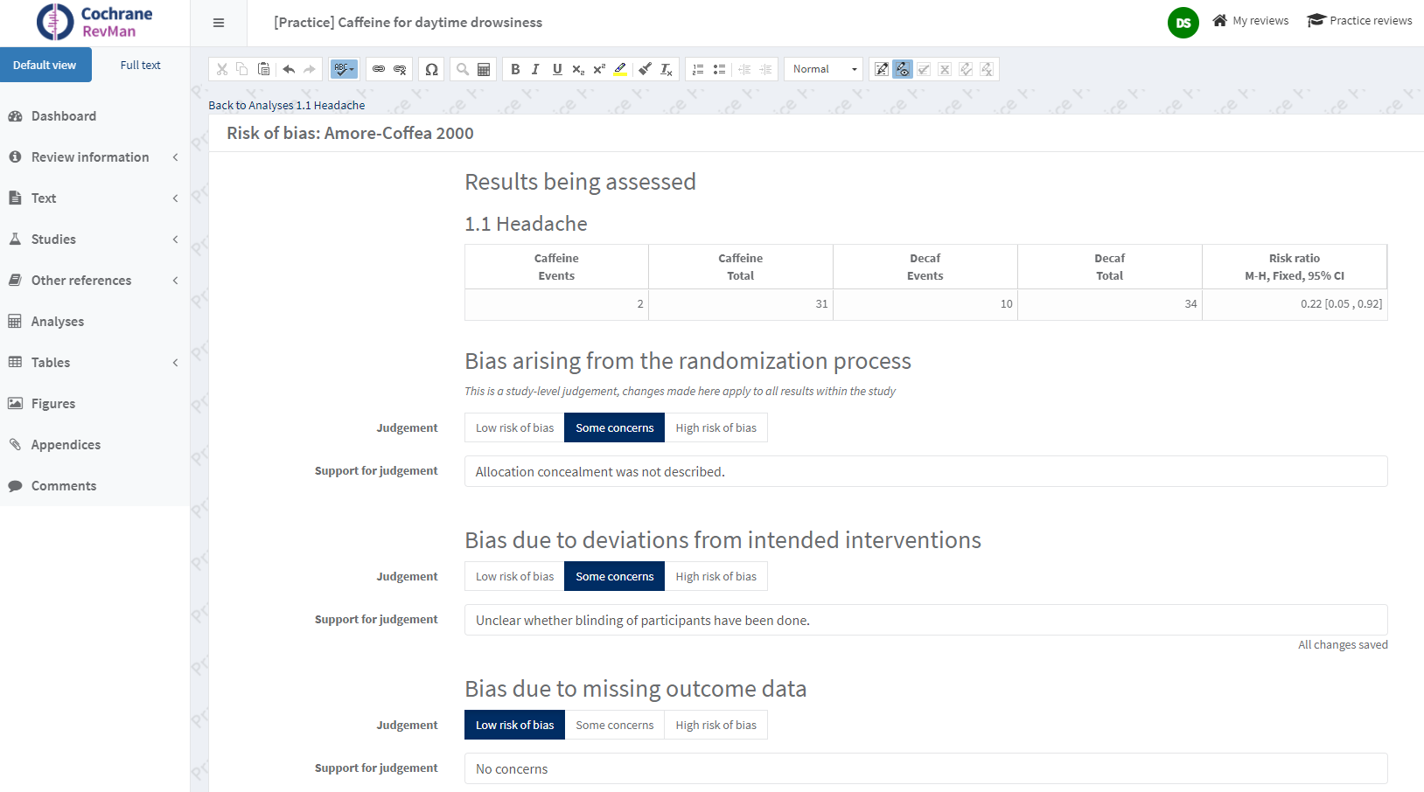
https://documentation.cochrane.org/revman-kb/risk-of-bias/risk-of-bias-2-in-revman-web
Notes:
This is a snapshot of what the risk of bias data input looks like in RevMan Web for one study (Amore-Coffea 2000) for one outcome (Headache). It’s important that authors include both the domain judgement and the support for judgment for each assessment as this data creates the risk of bias tables.
Detailed information about using RoB 2 tool in RevMan Web is available at https://documentation.cochrane.org/revman-kb/risk-of-bias/risk-of-bias-2-in-revman-web

Slide 61
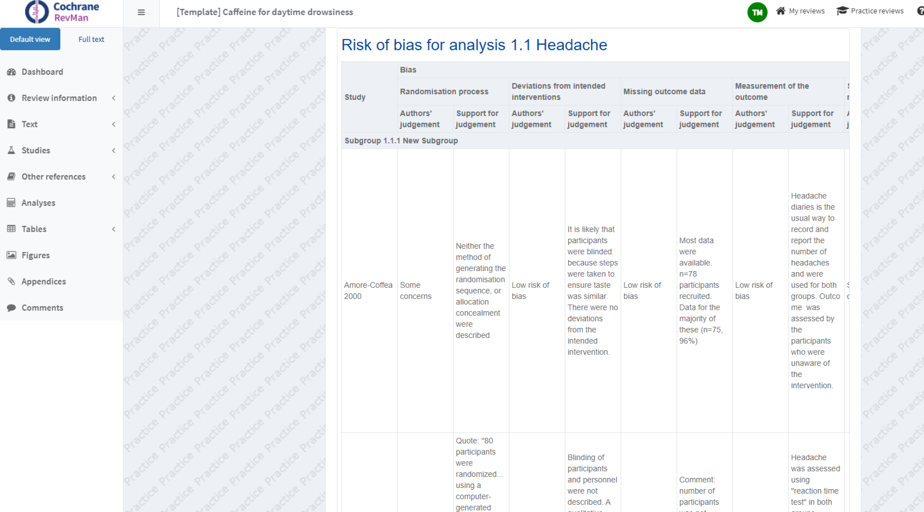
Notes:
This is what the RoB 2 risk of bias table looks like in RMW.

Slide 62
Session outline
  risk of bias in systematic reviews
  assessing sources of bias : the RoB 2 tool
  putting it into practice
  incorporating risk of bias in a review

Slide 63
Incorporating findings into a review
Options include
  give a brief narrative summary
    but it may be missed by readers
    and it does not address impact on results
  present a stratified analysis
  restrict primary analysis to studies at low risk (or ‘low risk’ and ‘some concerns’)
    conduct sensitivity analysis
  explore the impact further if sufficient studies are available
    subgroup analysis
    meta-regression - get statistical advice
Address risk of bias outcome by outcome
Notes:
It is not appropriate, and is misleading to readers, to ignore risks of bias in the included studies. You should not present the results without reference to the ‘Risk of bias’ assessments.
A narrative summary of the risk of bias assessments will need to be provided in the ‘Results’ section of the review. However, readers may miss these if they look straight at the numerical results, and a narrative description does not directly address the concern that the results may be altered by bias.
Several options are available to consider the impact of potential biases in a meta-analysis (or other synthesis). Ideally we want to give reduced weight to studies at high risk of bias, but we don’t currently have convenient methods for determining exactly what weights should be used.
One option is to present results stratified by risk of bias, so that readers can see the results for themselves. Stratification of forest plots by risk of bias is encouraged. Setting up forest plots is discussed further in a separate presentation on Introduction to meta-analysis.
Alternatively, one might restrict the analysis to those studies at low risk of bias (or those at low risk of bias or with some concerns). A trade-off is involved here. Restricting to the stronger studies may reduce bias but increase imprecision because of the smaller amount of information. Including all the available studies decreases imprecision but with higher risk of bias. Sensitivity analysis should be done to examine the impact of restricting, or not restricting, the analysis to the stronger studies.
[Note that sensitivity analysis does not mean presenting multiple versions of your results. It may be useful to discuss the difference between the result including all studies and the result including only the low risk studies, but remember that presenting multiple answers may be confusing for readers needing to make a decision about the intervention. The primary analysis strategy ought to be chosen in advance and specified in the protocol.]
Further techniques are available to try to explore the impact of risk of bias studies on the size of intervention effect across the studies: subgroup analysis and meta-regression. Subgroup analysis is available in RevMan, and is addressed in more detail in a separate presentation on Heterogeneity. Meta-regression is a more complex technique that is not available in RevMan. Statistical expertise will be needed to undertake meta-regression.
Because risk of bias assessments are specific to results (and therefore to outcomes), the assessments should be presented and discussed alongside the meta-analysis (or other synthesis) results for each outcome.
[NOTE TO TRAINERS: Bayesian methods for incorporating considerations of bias into meta-analyses are available, by adjusting the results of individual studies using external information (or beliefs) about the size of the bias. These are challenging to implement and not necessarily widely accepted.]

Slide 64
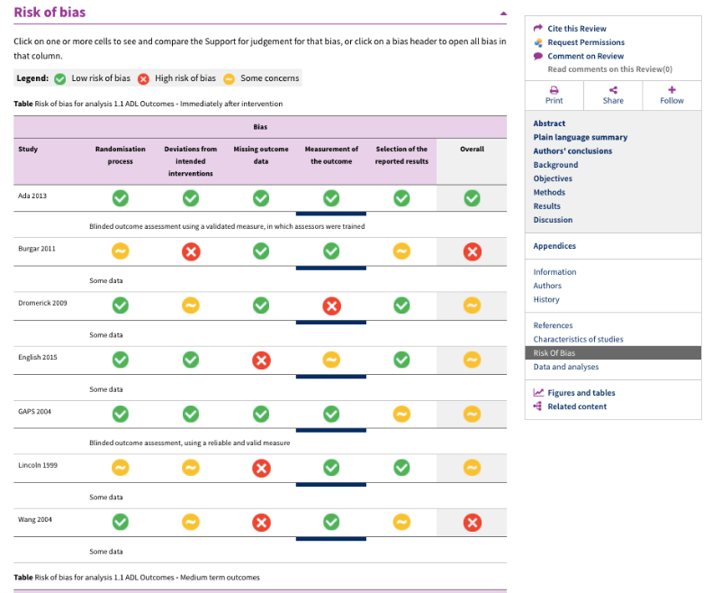
Risk of bias summary
Notes:
RevMan provides some tools to summarize risk of bias assessments information. This is an interactive table in a published review that is created using risk of bias data from RevMan Web (the RevMan Web view of this table is on slide 61).
In this table, located in the ‘Risk of Bias’ section after the ‘Characteristics of studies section, we have each study listed down the left side, and each bias domain along the top of the table. How each study addressed each domain is shown using a traffic light system – green for low risk, yellow for some concerns, and red for high risk. By clicking on parts of the table, the written text providing support for each judgement can be displayed.

Slide 65
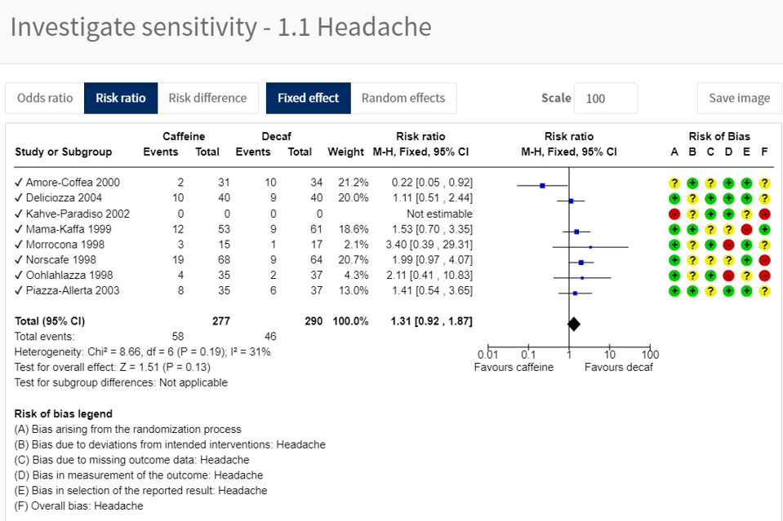
Risk of bias in a forest plot
Notes:
We encourage you to present forest plots with risk of bias assessments, as in this Analysis from RevMan Web.
Ideally these should be stratified by overall risk of bias.

Slide 66

GRADEing the evidence
  ‘Risk of bias’ assessment is also incorporated into a GRADE assessment of the certainty of evidence
  for studies that contribute data for each outcome:
    what is the overall risk of bias of these studies?
    does the risk of bias reduce our confidence in the effect?
to be continued…
www.gradeworkinggroup.org
Notes:
Risk of bias assessments feed into one of the five GRADE considerations: “Study limitations” or “Risk of bias”
This will be done at the synthesis (meta-analysis) level, so this will involve aggregating assessments across studies.
The GRADE framework describes how to do this.

Slide 67
What to include in a protocol
  check with Cochrane group for standard text
  state risk of bias assessment tool(s) to be used
    new Cochrane intervention reviews should use RoB 2
    state the effect of interest (effect of assignment to intervention or of adhering to intervention) - usually the former
    refer to Handbook Chapter 8 or another source
  which results will be assessed for risk of bias?
  how many people will assess risk of bias?
    how will disagreements be handled
  how will findings be incorporated into the analysis?
Notes:
Thinking back to the protocol stage, it will be important to specify what methods will be used in the review. If you are working with a Cochrane group to develop your review, seek advice on standard text the group prefers authors to use.
State what tool will be used. RoB 2 should be used in all new Cochrane Reviews.
Be clear what is the intended effect of interest: whether interest is in the effect of assignment to intervention (the ‘intention-to-treat effect) or the effect of adhering to intervention (the ‘per protocol’ effect). In most cases it will be the former. Refer the reader to information about it using a reference, either to a paper or to Handbook Chapter 8.
Does this mean we need to do a risk of bias assessment for every outcome (or every result) from each study? That is a lot of assessments!
No - the expectation is that only key results will be assessed for risk of bias: typically only those feeding into the ‘Summary of findings’ table.
In practice, most assessments from the same trial will be similar, and it won’t be a lot of work to do more than one assessment for a trial. For example, the first domain, which covers randomization methods, will be identical for all results from the same trial.
[Background note to trainers: the nature of the process described above means it is may not be appropriate to perform full risk of bias assessments while doing the main data extraction from trial reports. We need to know which results to assess first, so that we can target them when assessing risk of bias, and these decisions may not be made until all studies have been examined. However, most of the factual information used to inform the risk of bias assessments can be collected during data extraction, such as randomization methods and use of blinding.]
Some logistical information should also be given. State that two authors will independently assess each study, and describe how disagreements will be addressed.
A plan should be described for how the assessments will be incorporated into the analyses. Although they are fun to do, risk of bias assessments are not just an arbitrary exercise: they need to feed into the findings and conclusions from the review.

Slide 68
Take-home message
  biased studies may lead to misleading reviews
  RoB 2 examines five domains of bias
  leads to a judgement about risk of bias in a result, with supporting evidence to justify it
  consider the possible impact of risk of bias on syntheses and use appropriate caution in drawing conclusions

Slide 69
References
  Higgins JPT, Savović J, Page MJ, Elbers RG, Sterne JAC. Chapter 8: Assessing risk of bias in a randomized trial. In: Higgins JPT, Thomas J, Chandler J, Cumpston M, Li T, Page MJ, Welch VA (editors). Cochrane Handbook for Systematic Reviews of Interventions version 6.0 (updated July 2019). Cochrane, 2019. Available from www.training.cochrane.org/handbook.
  Sterne JAC et al. RoB 2: a revised tool for assessing risk of bias in randomised trials. BMJ 2019; 366: l4898; doi: 10.1136/bmj.l4898.
  Cochrane RoB 2 webinar series
  training.cochrane.org/rob-2-learning-live-webinar-series
  Full guidance available at www.riskofbias.info
  Risk of Bias 2 Cochrane Review Starter Pack (and other resources) – available at https://methods.cochrane.org/risk-bias-2

Slide 70
Acknowledgements
  Slides by Julian Higgins and Jonathan Sterne
  Using material from a previous version of the presentation by Miranda Cumpston, Cochrane Bias Methods Group and the Cochrane Australia

