Slide 1

About Cochrane
January 2020
“We’re a knowledge organization built on the capabilities and passion of our collaborators; and the good news is that people from around the world are flocking to contribute and support our work.“
Mark Wilson
Cochrane Chief Executive Officer
Trusted evidence.
Informed decisions.
Better health.

Slide 2

Who we are
Cochrane is for anyone interested in using high-quality information to make health decisions. Whether you are a doctor or nurse, patient or carer, researcher or funder, Cochrane evidence provides a powerful tool to enhance your healthcare knowledge and decision making.
Cochrane’s 12,600 members and over 79,300 supporters come from more than 130 countries, worldwide. Our global independent network gathers and summarizes the best evidence from research to help you make informed choices about treatment.
We do not accept commercial or conflicted funding. This is vital for us to generate authoritative and reliable information, working freely, unconstrained by commercial and financial interests.

Slide 3
Who we are
The most respected, independent producer and publisher of systematic reviews of health and healthcare interventions in the world.
We have published over 10,300 Cochrane Systematic Reviews (over 8,000 still ‘live’) & 1,900 Cochrane Clinical Answers
Over 1.5 million trials are registered in Cochrane’s Central Register of Controlled Trials (CENTRAL) database
Over 2,000 Cochrane Clinical Answers (CCAs)

Slide 4
We are a volunteer-based, independent knowledge-creating organization …
A global independent network of over 12,600 members and 79,300 supporters from over 130 countries
150 Cochrane Groups employ 500+ staff (most only part-time)
Central Executive Team of 100 people
We don’t pay our authors: our authors don’t pay us!
Strictly independent – free from commercial sponsorship and other conflicts of interest – no ties to pharmaceutical & commercial interests; no advertisements ...
Cochrane is trusted!

Slide 5

What is a systematic review?
A systematic review attempts to identify, appraise and synthesize all the empirical evidence that meets pre-specified eligibility criteria to answer a given research question. Researchers conducting systematic reviews use explicit methods aimed at minimizing bias, in order to produce more reliable findings that can be used to inform decision making.

Slide 6
What is a Cochrane Review?
Cochrane Reviews are systematic reviews of research in healthcare and health policy that are published in the Cochrane Database of Systematic Reviews. There are 5 types of Cochrane Review:
Intervention reviews assess benefits and harms of interventions used in healthcare and health policy.
Diagnostic test accuracy reviews assess how well a diagnostic test performs in diagnosing and detecting a particular disease.
Methodology reviews address issues relevant to how systematic reviews and clinical trials are conducted and reported.
Qualitative reviews synthesize qualitative evidence to address questions on aspects other than effectiveness.
Prognosis reviews address the probable course or future outcome(s) of people with a health problem.
Cochrane Reviews base their findings on the results of studies that meet certain quality criteria, since the most reliable studies will provide the best evidence for making decisions about health care.

Slide 7

The Cochrane story
The circle formed by two ‘C’ shapes represents our global collaboration.
The lines within illustrate the summary results from an iconic systematic review. Each horizontal line represents the results of one study, while the diamond represents the combined result, our best estimate of whether the treatment is effective or harmful.
The diamond sits clearly to the left of the vertical line representing “no difference”, therefore the evidence indicates that the treatment is beneficial. We call this representation a “forest plot”.

Slide 8
This forest plot within our logo illustrates an example of the potential for systematic reviews to improve health care. It shows that corticosteroids given to women who are about to give birth prematurely can save the life of the newborn child.
Despite several trials showing the benefit of corticosteroids, adoption of the treatment among obstetricians was slow. The systematic review published by Crowley et al., was influential in increasing use of this treatment. This simple intervention has probably saved thousands of premature babies.
During the past 25 years, Cochrane has progressed the way healthcare decisions are made. And now we’re leading another change, as outlined by Strategy to 2020. A visible expression of this change is our new brand identity.

Slide 9
Our Vision and Mission
Our vision is a world of improved health where decisions about health and health care are informed by high quality, relevant and up-to-date synthesized research evidence.
Our mission is to promote evidence-informed health decision-making by producing high quality, relevant, accessible systematic reviews and other synthesized research evidence.

Slide 10
Principles
1 Collaboration
by fostering global co-operation, teamwork, and open and transparent communication and decision-making.
2 Building on the enthusiasm of individuals
by involving, supporting, and training people of different skills and backgrounds.
3 Avoiding duplication of effort
by good management, co-ordination and effective internal communications to maximize economy of effort.
4 Minimising bias
through a variety of approaches such as scientific rigour, ensuring broad participation, and avoiding conflicts of interest.
5 Keeping up to date
by a commitment to ensure Cochrane Systematic Reviews are maintained through identification and incorporation of new evidence.

Slide 11
Principles
6 Striving for relevance
by promoting the assessment of health questions using outcomes that matter to people making choices in health and health care.
7 Promoting access
by wide dissemination of our outputs, taking advantage of strategic alliances, and by promoting appropriate access models and delivery solutions to meet the needs of users worldwide.
8 Ensuring quality
by applying advances in methodology, developing systems for quality improvement, and being open and responsive to criticism.
9 Continuity
by ensuring that responsibility for reviews, editorial processes, and key functions is maintained and renewed.
10 Enabling wide participation
in our work by reducing barriers to contributing and by encouraging diversity.

Slide 12
Cochrane exists so that healthcare decisions get better.
Over the past 25 years, Cochrane has helped to transform the way health decisions are made.
We produce reviews that summarize the best available evidence generated through research to inform decisions about health.
Our work is recognized as representing an international gold standard for high quality, trusted information.
We want to be the leading advocate for evidence-informed health across the world.

Slide 13
Cochrane’s organizational structure
Cochrane Board
Central Executive Team
8 Networks and 52 Review Groups
17 Methods Groups
43 Centres and Branches
12 Fields
Consumer Network
Notes:
Can we make this more exicting!?

Slide 14
The Strategy2020 has four Goals
Goal 1: Producing evidence
To produce high quality, relevant, up-to-date systematic reviews and other synthesized research evidence to inform health decision-making.
Goal 2: Accessible evidence
To make Cochrane evidence accessible and useful to everybody, everywhere in the world.
Goal 3: Advocating for evidence
To make Cochrane the ‘home of evidence’ to inform health decision-making, build greater recognition of our work, and become the leading advocate for evidence-informed health care.
Goal 4: Building an effective and sustainable organization
To be a diverse, inclusive and transparent international organization that effectively harnesses the enthusiasm and skills of our contributors, is guided
by our principles, governed accountably, managed efficiently, and makes optimal use of its resources.

Slide 15

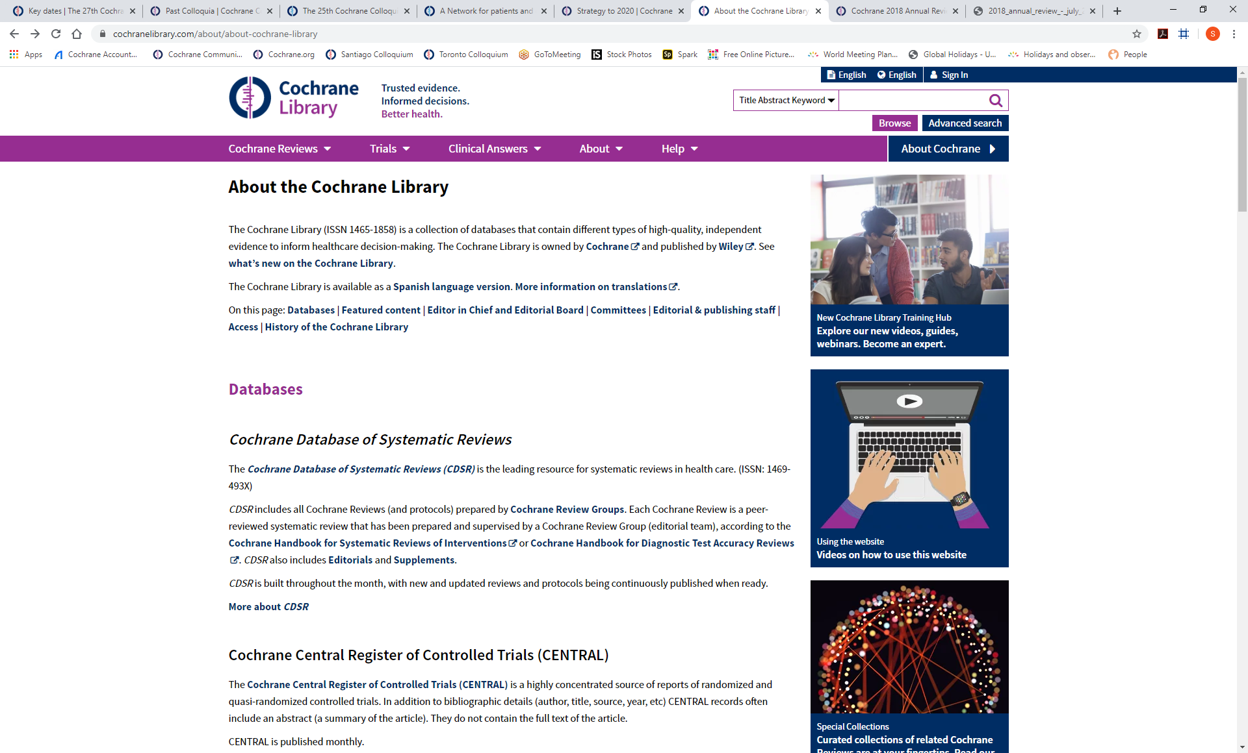
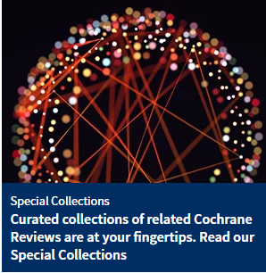
Cochrane Library
The Cochrane Library (ISSN 1465-1858) is a collection of databases that contain different types of high-quality, independent evidence to inform healthcare decision-making. The Cochrane Library is owned by Cochrane and published by Wiley. See what’s new on the Cochrane Library.
The Cochrane Library is available as a Spanish language version. More information on translations.

Slide 16
Contact us
If you require further information about Cochrane’s brand please contact: support@cochrane.org
St Albans House
57–59 Haymarket
London SW1

