Slide 1

About Cochrane
January 2020
“We’re a knowledge organization built on the capabilities and passion of our collaborators; and the good news is that people from around the world are flocking to contribute and support our work.” Mark Wilson Cochrane Chief Executive Officer
Trusted evidence.
Informed decisions.
Better health.

Slide 2

Who we are
Cochrane is for anyone interested in using high-quality information to make health decisions. Whether you are a doctor or nurse, patient or carer, researcher or funder, Cochrane evidence provides a powerful tool to enhance your healthcare knowledge and decision making.
Cochrane has over 12,600 members and 79,300 supporters from more than 130 countries, worldwide. Our global independent network gathers and summarizes the best evidence from research to help you make informed choices about treatment. We do not accept commercial or conflicted funding. This is vital for us to generate authoritative and reliable information, working freely, unconstrained by commercial and financial interests.

Slide 3
Who we are
The most respected, independent producer and publisher of systematic reviews of health and healthcare interventions in the world.
We have published over 10,300 Cochrane Systematic Reviews (over 8,000 still ‘live’) & 1,900 Cochrane Clinical Answers
Over 1.5 million trials are registered in Cochrane’s Central Register of Controlled Trials (CENTRAL) database
Over 2,000 Cochrane Clinical Answers (CCAs)

Slide 4
We are a volunteer-based, independent knowledge-creating organization …
A global independent network of over 12,600 members and 79,300 supporters from over 130 countries
150 Cochrane Groups employ 500+ staff (most only part-time)
Central Executive Team of 100 people
We don’t pay our authors: our authors don’t pay us!
Strictly independent – free from commercial sponsorship and other conflicts of interest – no ties to pharmaceutical & commercial interests; no advertisements ...
Cochrane is trusted!

Slide 5

What is a systematic review?
A systematic review attempts to identify, appraise and synthesize all the empirical evidence that meets pre-specified eligibility criteria to answer a given research question. Researchers conducting systematic reviews use explicit methods aimed at minimizing bias, in order to produce more reliable findings that can be used to inform decision making.

Slide 6
What is a Cochrane Review?
Cochrane Reviews are systematic reviews of research in healthcare and health policy that are published in the Cochrane Database of Systematic Reviews. There are 5 types of Cochrane Review:
Intervention reviews assess benefits and harms of interventions used in healthcare and health policy.
Diagnostic test accuracy reviews assess how well a diagnostic test performs in diagnosing and detecting a particular disease.
Methodology reviews address issues relevant to how systematic reviews and clinical trials are conducted and reported.
Qualitative reviews synthesize qualitative evidence to address questions on aspects other than effectiveness.
Prognosis reviews address the probable course or future outcome(s) of people with a health problem.
Cochrane Reviews base their findings on the results of studies that meet certain quality criteria, since the most reliable studies will provide the best evidence for making decisions about health care.

Slide 7

The Cochrane story
The circle formed by two ‘C’ shapes represents our global collaboration.
The lines within illustrate the summary results from an iconic systematic review. Each horizontal line represents the results of one study, while the diamond represents the combined result, our best estimate of whether the treatment is effective or harmful.
The diamond sits clearly to the left of the vertical line representing “no difference”, therefore the evidence indicates that the treatment is beneficial. We call this representation a “forest plot”.

Slide 8
This forest plot within our logo illustrates an example of the potential for systematic reviews to improve health care. It shows that corticosteroids given to women who are about to give birth prematurely can save the life of the newborn child.
Despite several trials showing the benefit of corticosteroids, adoption of the treatment among obstetricians was slow. The systematic review published by Crowley et al., was influential in increasing use of this treatment. This simple intervention has probably saved thousands of premature babies.
During the past 25 years, Cochrane has progressed the way healthcare decisions are made. And now we’re leading another change, as outlined by Strategy to 2020. A visible expression of this change is our new brand identity.

Slide 9
Our Vision and Mission
Our vision is a world of improved health where decisions about health and health care are informed by high quality, relevant and up-to-date synthesized research evidence.
Our mission is to promote evidence-informed health decision-making by producing high quality, relevant, accessible systematic reviews and other synthesized research evidence.

Slide 10
Principles
1 Collaboration by fostering global co-operation, teamwork, and open and transparent communication and decision-making. 2 Building on the enthusiasm of individuals by involving, supporting, and training people of different skills and backgrounds. 3 Avoiding duplication of effort by good management, co-ordination and effective internal communications to maximize economy of effort. 4 Minimising bias through a variety of approaches such as scientific rigour, ensuring broad participation, and avoiding conflicts of interest. 5 Keeping up to date by a commitment to ensure Cochrane Systematic Reviews are maintained through identification and incorporation of new evidence.

Slide 11
Principles
6 Striving for relevance by promoting the assessment of health questions using outcomes that matter to people making choices in health and health care. 7 Promoting access by wide dissemination of our outputs, taking advantage of strategic alliances, and by promoting appropriate access models and delivery solutions to meet the needs of users worldwide. 8 Ensuring quality by applying advances in methodology, developing systems for quality improvement, and being open and responsive to criticism. 9 Continuity by ensuring that responsibility for reviews, editorial processes, and key functions is maintained and renewed. 10 Enabling wide participation in our work by reducing barriers to contributing and by encouraging diversity.

Slide 12
Cochrane exists so that healthcare decisions get better.
Over the past 25 years, Cochrane has helped to transform the way health decisions are made.
We produce reviews that summarize the best available evidence generated through research to inform decisions about health.
Our work is recognized as representing an international gold standard for high quality, trusted information.
We want to be the leading advocate for evidence-informed health across the world.

Slide 13
Cochrane’s organizational structure
12 Fields
8 Networks and 52 Review Groups
Central Executive Team
Cochrane Board
Consumer Network
17 Methods Groups
90 Centres, Associate Centres, Affiliates and Networks
Notes:
Can we make this more exicting!?

Slide 14
The Strategy2020 has four Goals
Goal 1: Producing evidence To produce high quality, relevant, up-to-date systematic reviews and other synthesized research evidence to inform health decision-making.
Goal 2: Accessible evidence To make Cochrane evidence accessible and useful to everybody, everywhere in the world.
Goal 3: Advocating for evidence To make Cochrane the ‘home of evidence’ to inform health decision-making, build greater recognition of our work, and become the leading advocate for evidence-informed health care.
Goal 4: Building an effective and sustainable organization To be a diverse, inclusive and transparent international organization that effectively harnesses the enthusiasm and skills of our contributors, is guided by our principles, governed accountably, managed efficiently, and makes optimal use of its resources.

Slide 15
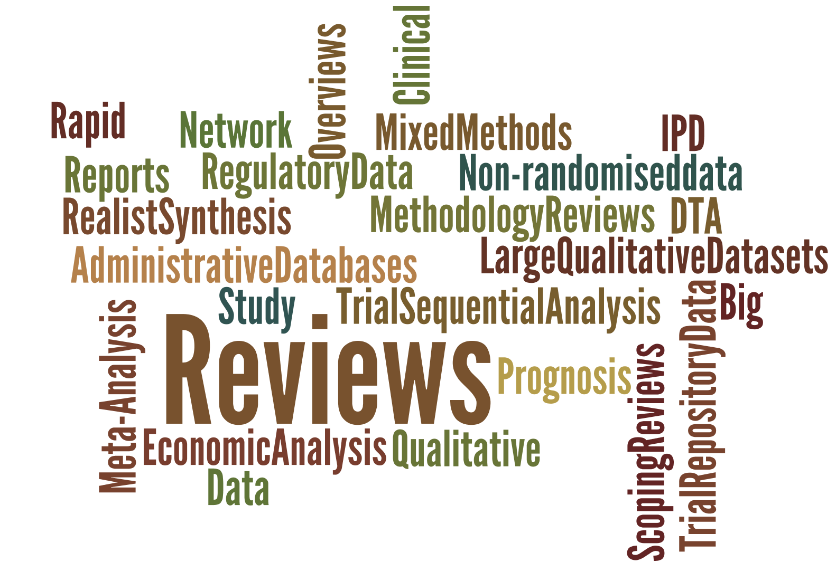
The challenge of producing new high-quality content …
Goal One: Producing evidence
Changing User needs … means changing Cochrane content
A new Cochrane Content Strategy:
New journal submission process
Fast Track for completed reviews
‘Living’ Systematic Reviews
Rapid Reviews
Network Meta-Analyses
Prognosis Reviews
IPD/Clinical Study Reports & Large Data Sets

Slide 16

Keeping Cochrane as the international standard setter for synthesized evidence …
Final publication in 2019
The revised edition of the handbook offers the only guide on how to conduct, report and maintain a Cochrane Review

Slide 17
New cutting edge technology …
to support more efficient synthesized evidence production/dissemination
All of these initiatives improve the author experience.
Their true power comes when combined into a new, more efficient workflow for producing Cochrane Reviews.
Centralised Search / Crowd
Machine Classifier
Covidence
RevMan Web
CRS

Slide 18








New Review Group Networks
The new face of Cochrane evidence!
Eight new Networks incorporating 52 Cochrane Review Groups
Networks are:
Engaging with external stakeholders;
Establishing key evidence priorities;
Increasing production efficiencies through improved processes & shared resourcing
New Editorial Board
New Scientific Committee

Slide 19
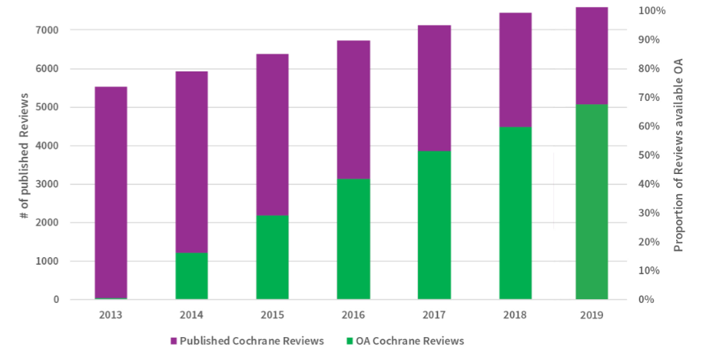
Open Access
3.66 billion people worldwide have free at the point of use access

Slide 20

The challenge of ensuring our evidence is actionable and used
Goal 2: Accessible evidence
Cochrane’s Knowledge Translation (KT) is about keeping the needs of the end user, those making decisions about health, at the centre of all what we do.
These are our primary audiences:

Slide 21
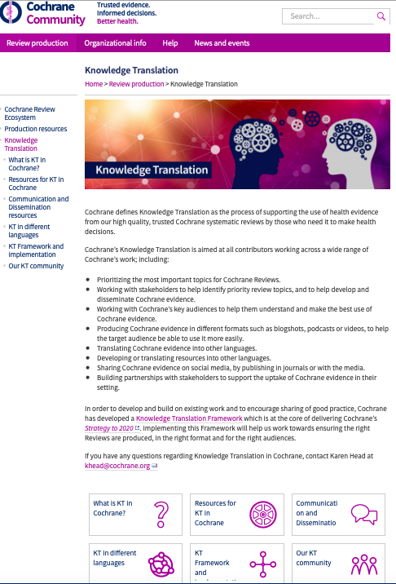
KT Resources in Cochrane
Cochrane defines KT as the process of ensuring that health evidence from Cochrane systematic reviews is used by those who need it to make health decisions.
We’ve produced many ‘state of the art’ resources to help people ‘do’ KT

Slide 22
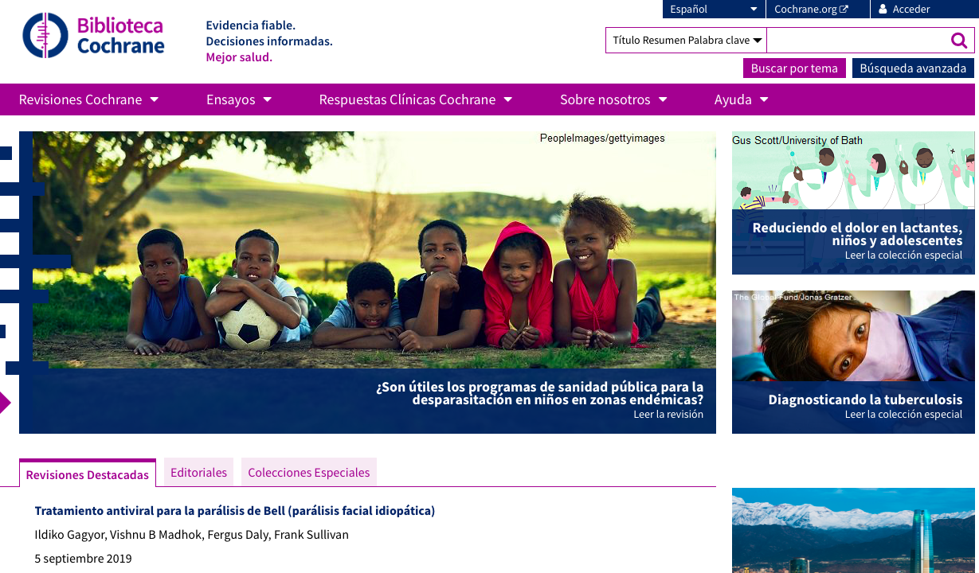
Evidence that speaks many languages
Cochrane Library in Spanish
August 2019: 27,650 translations of Abstracts/Plain Language Summaries in 15 languages available on Cochrane.org
6,375 translations published in 2019
Over 180 podcasts translated into 11 languages
Work beginning on making the Cochrane Library available in French and Chinese in the coming years

Slide 23

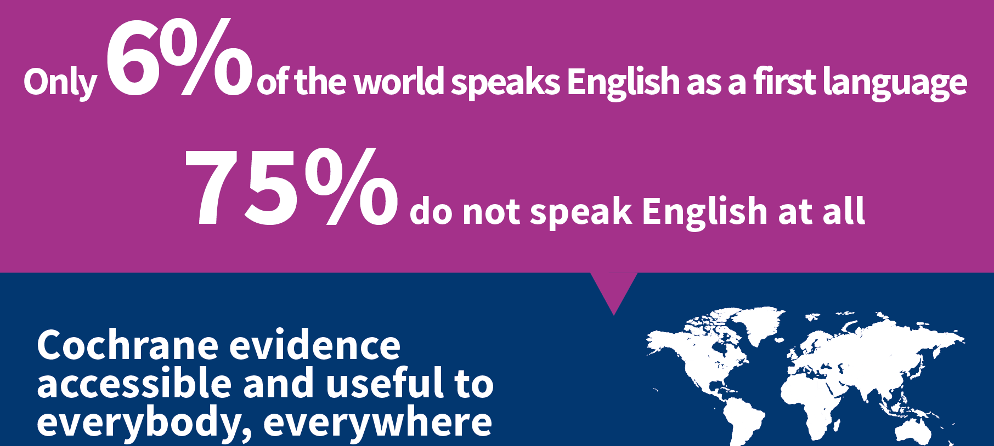
Why translate?
Our vision is a world of improved health where decisions about health and healthcare are informed by high-quality, relevant and up-to-date synthesized evidence.

Slide 24
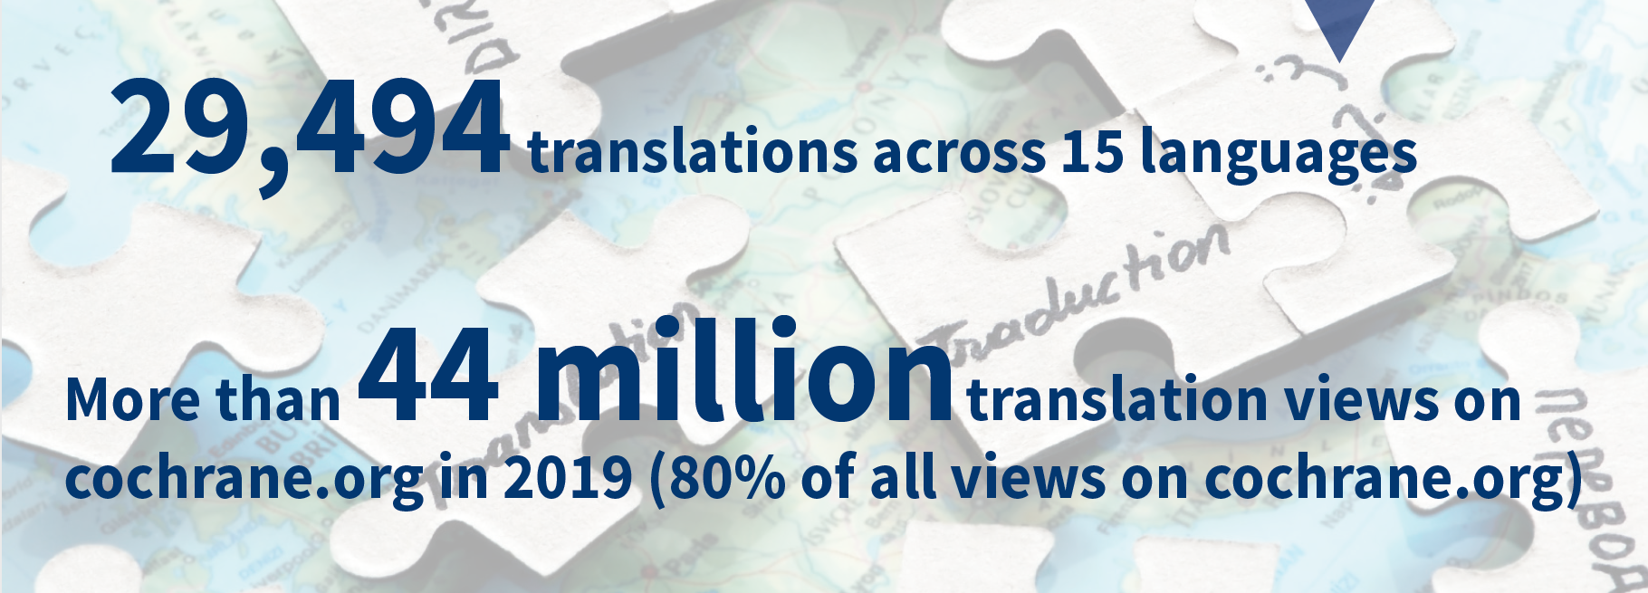
Cochrane translations

Slide 25
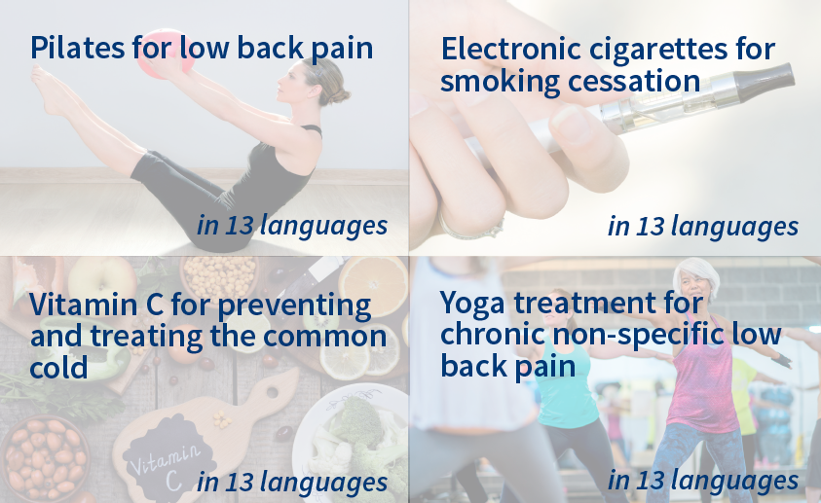
Our 4 most translated Reviews

Slide 26
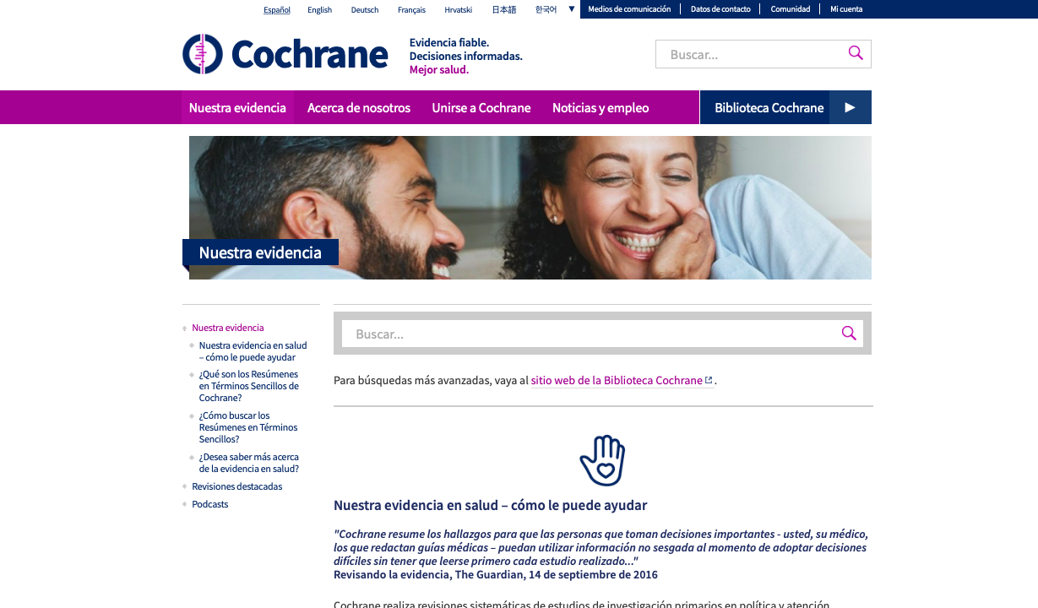
It’s working: millions more people are using our evidence … Cochrane.org
2013: 4 million visits
2017: 22.3 million visits
2018: 37.15 million visits
2019 (Q1&Q2): 42 million visits (226% increase YOY)!
71% of visits to Cochrane.org from non-English browsers in Q2 2019

Slide 27

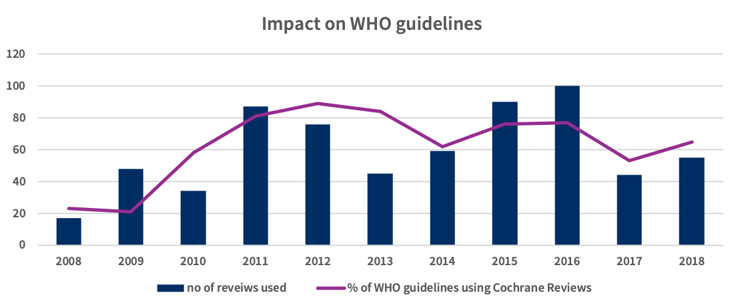
Key partnerships enhancing impact
Goal 3: Advocating for evidence
GES 2: Prague,
Czech Republic
October 2021
2019
World Health Organization

Slide 28




Key Cochrane partnerships
World Health
Organization

Slide 29



Advocating for research integrity

Slide 30
Reaching the public where they go for information - Wikipedia
Wikipedia the most popular source of information on health subjects in the world (10 million visits a day)
Cochrane partnership since 2014
New research shows that the Cochrane Database of Systematic Reviews is the most referenced journal in Wikipedia!
Over 3000 Cochrane Review citations in Wikipedia; with over 40,000 referrals from Wikipedia to the Cochrane Library

Slide 31
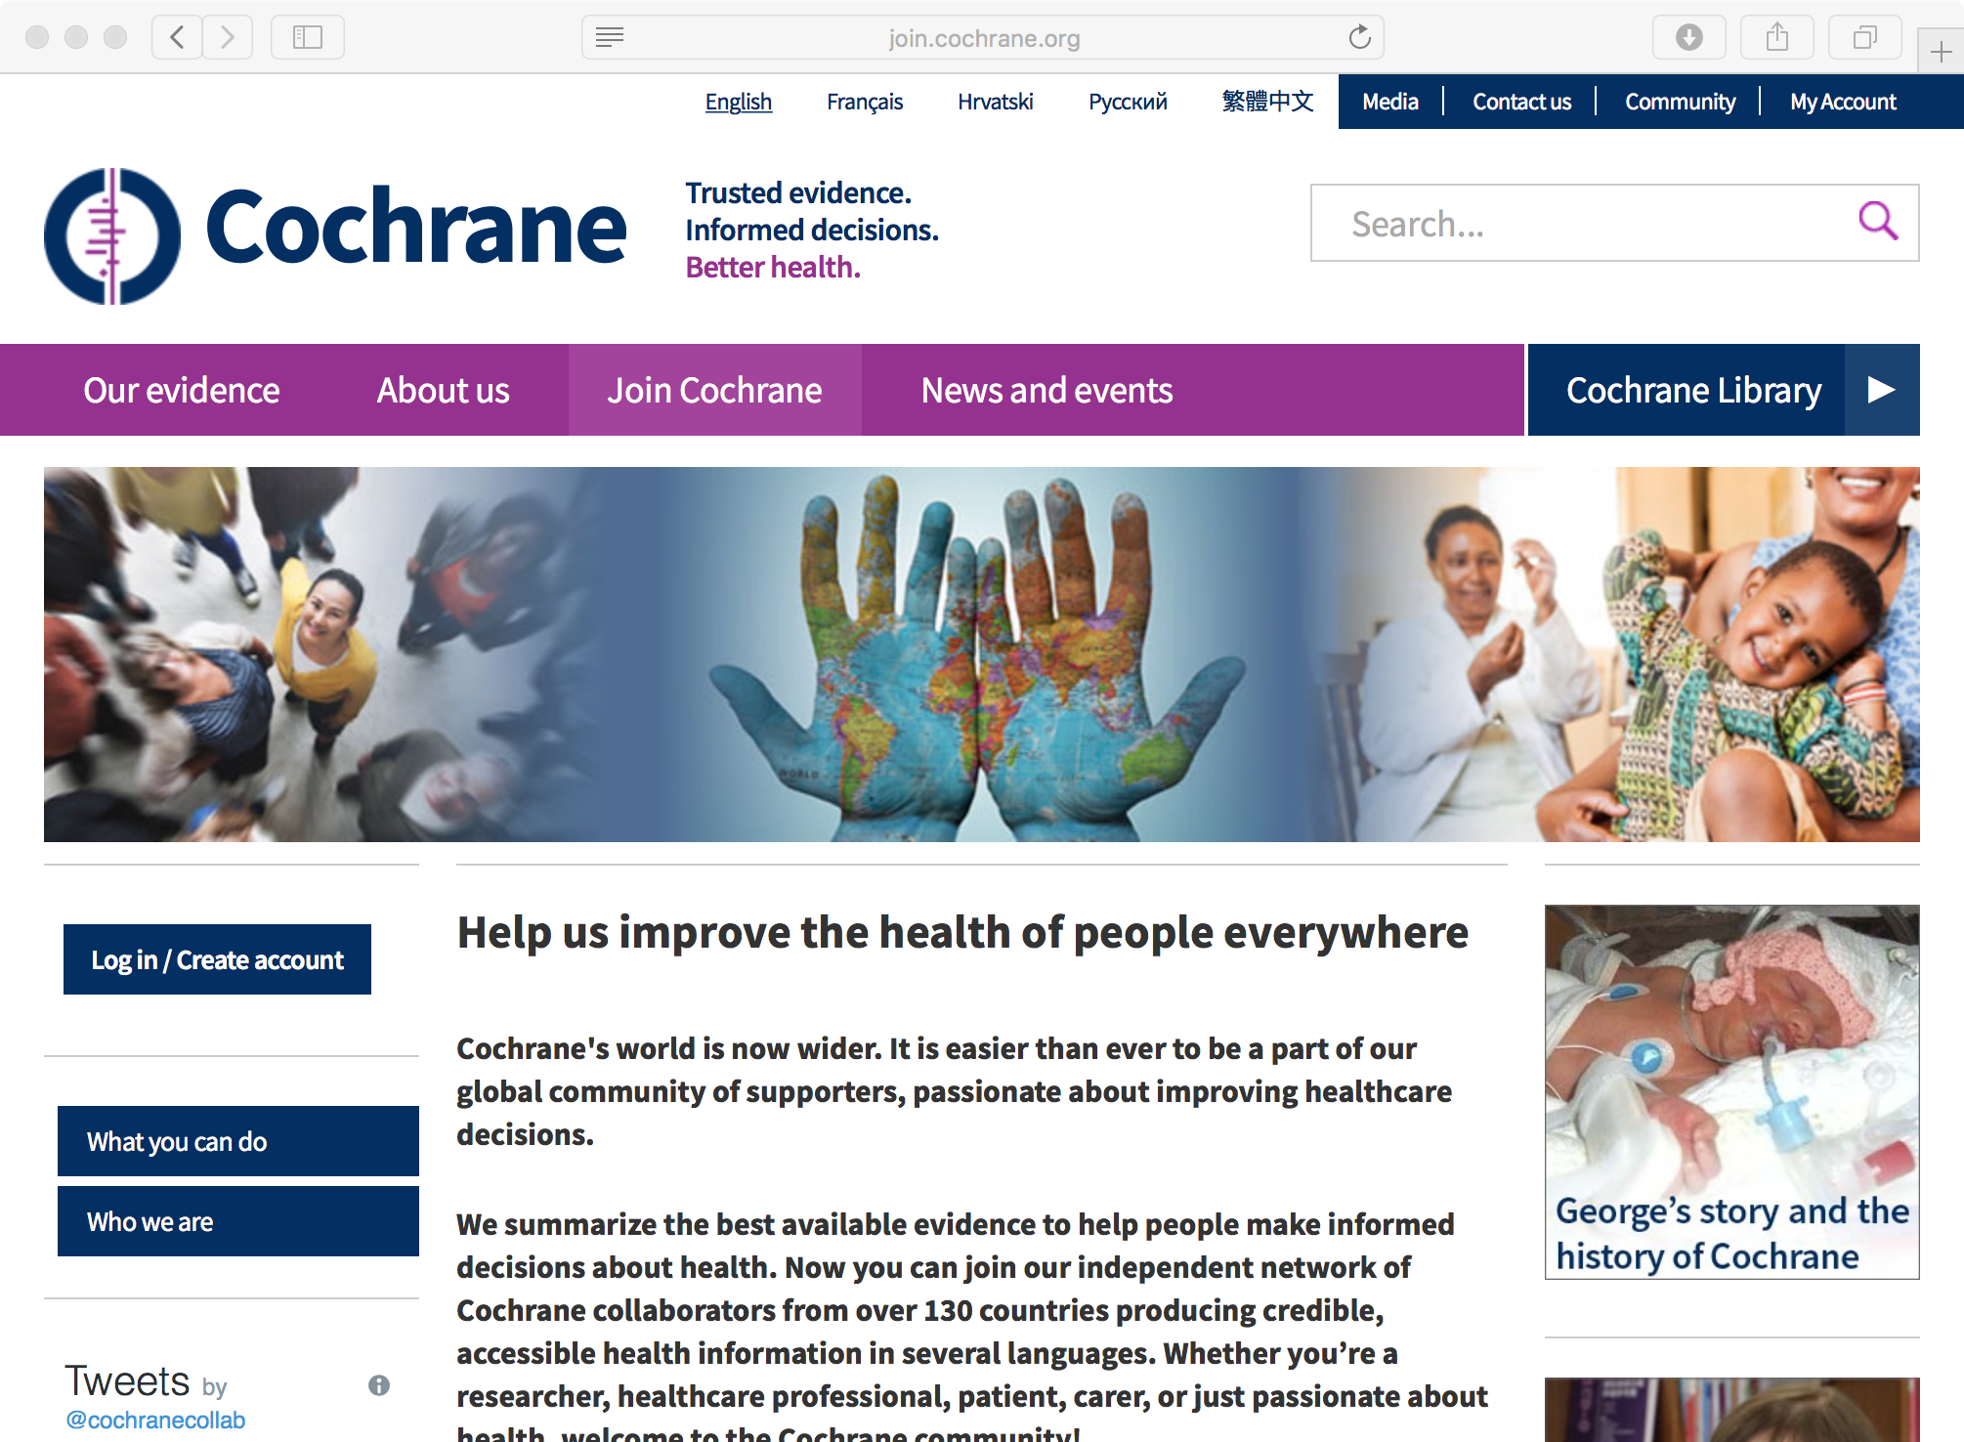
Attracting & Retaining the best people
Goal 4: Building an effective and sustainable organization

Slide 32
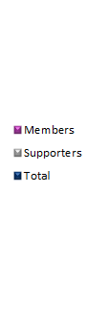
Rapid Growth in Cochrane Collaborators …
Numbers of members and supporters

Slide 33
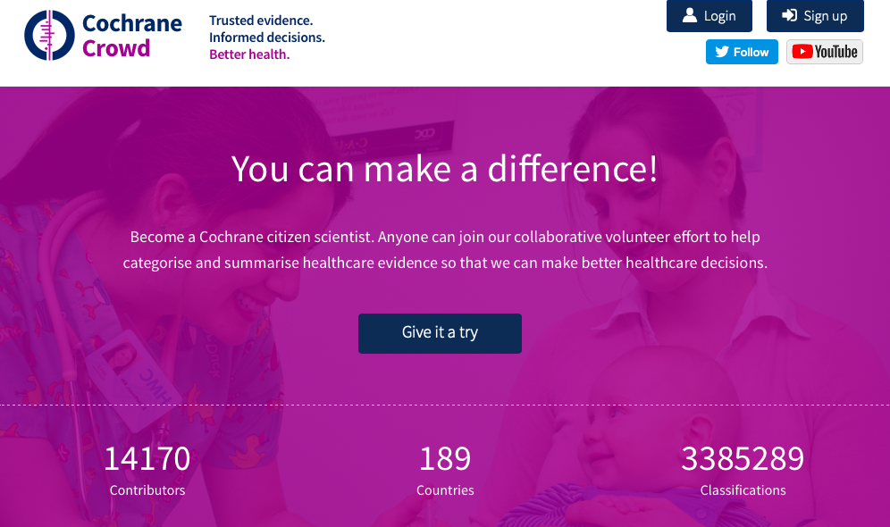
Anyone can make a difference …
Cochrane Crowd now has over 14,100 citizen scientists in 189 countries and over 3,385,000 classifications

Slide 34
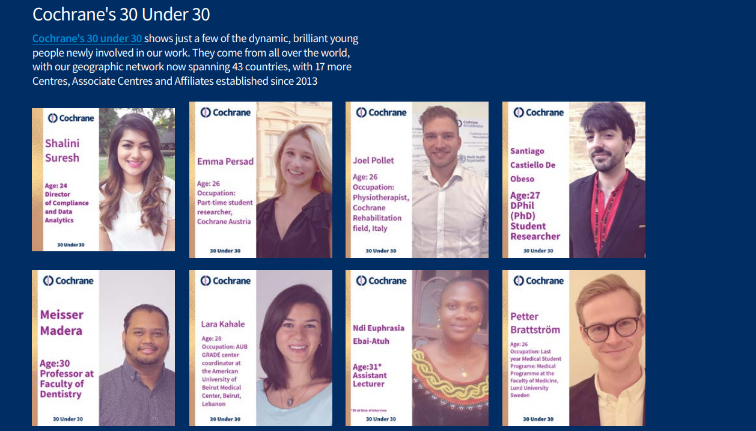

Slide 35

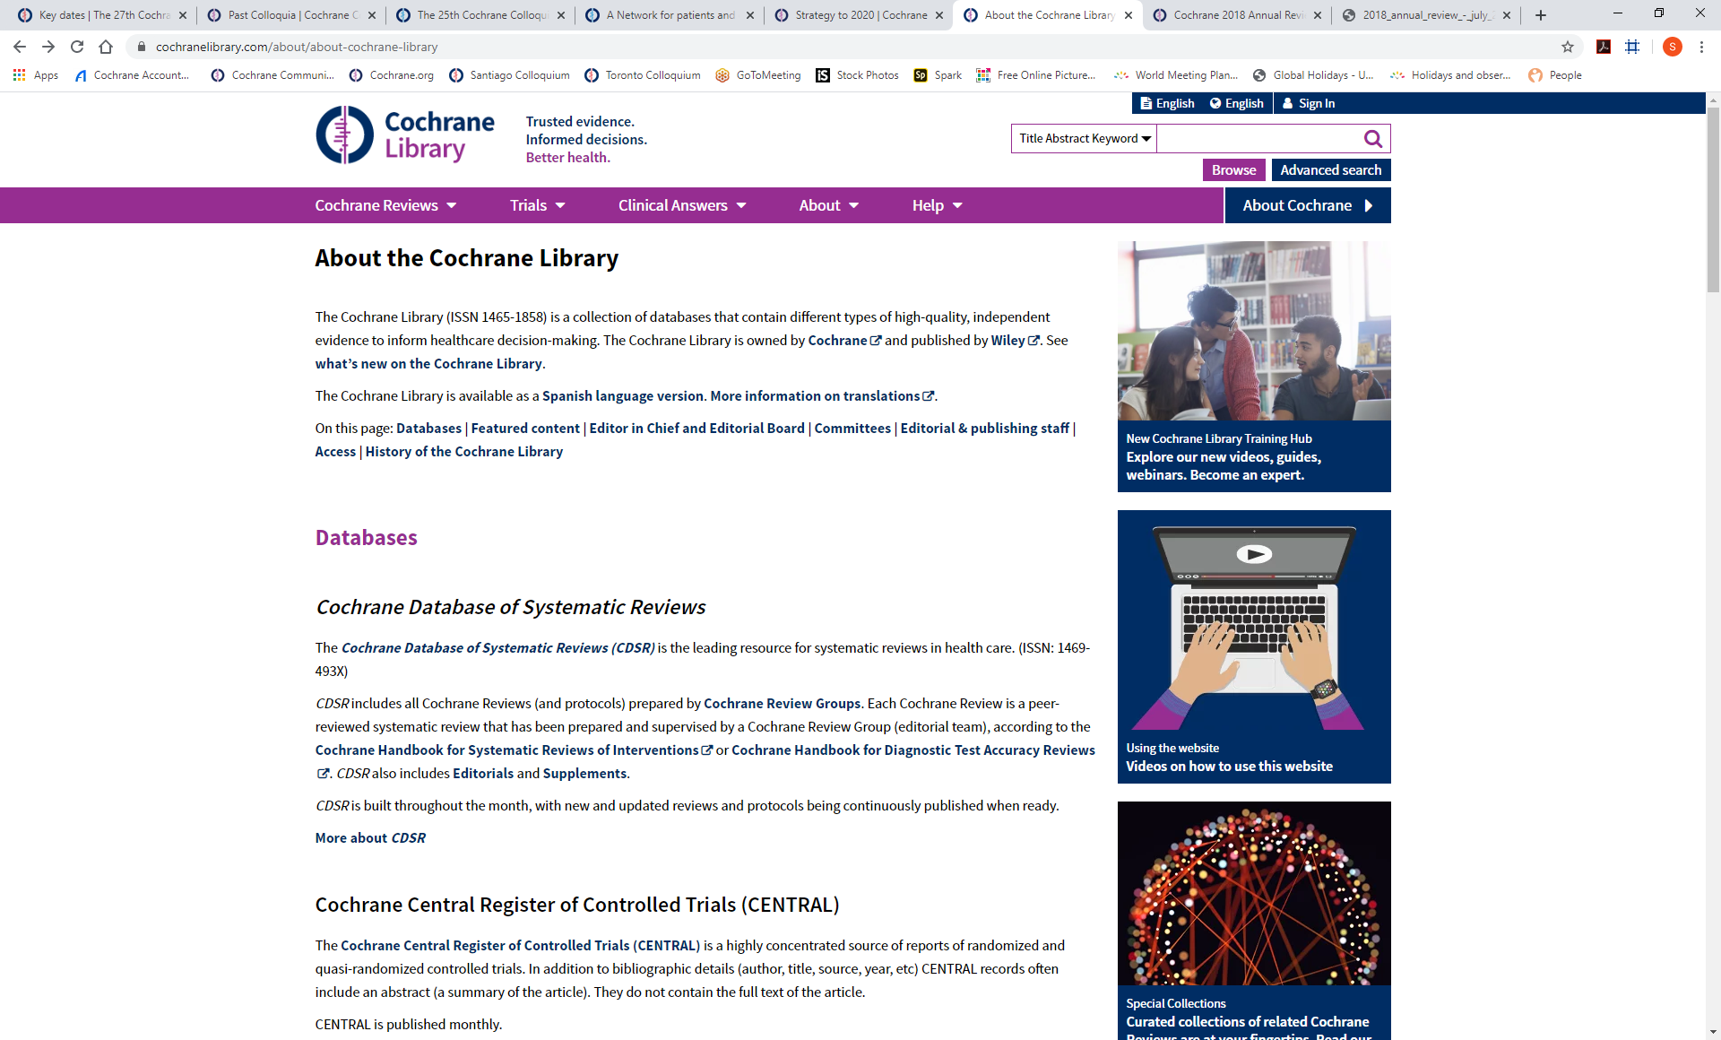
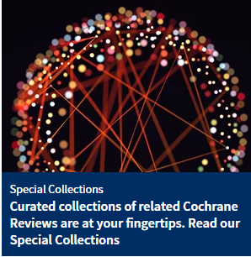
Cochrane Library
The Cochrane Library (ISSN 1465-1858) is a collection of databases that contain different types of high-quality, independent evidence to inform healthcare decision-making. The Cochrane Library is owned by Cochrane and published by Wiley. See what’s new on the Cochrane Library.
The Cochrane Library is available as a Spanish language version. More information on translations.

Slide 36
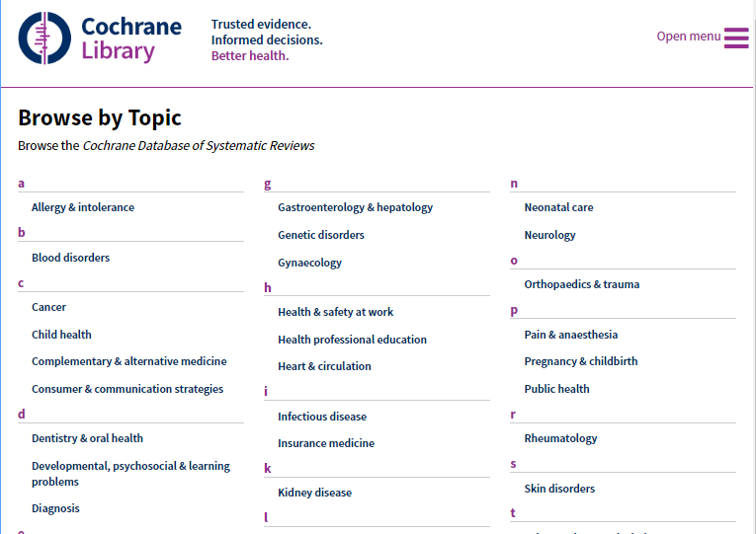
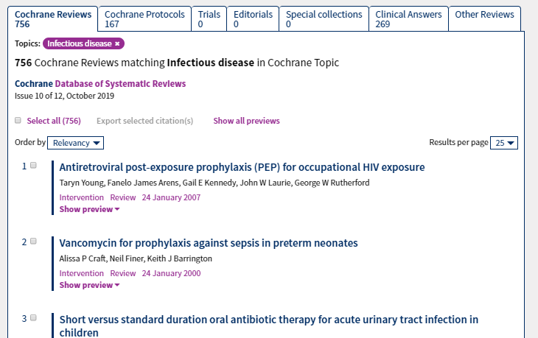
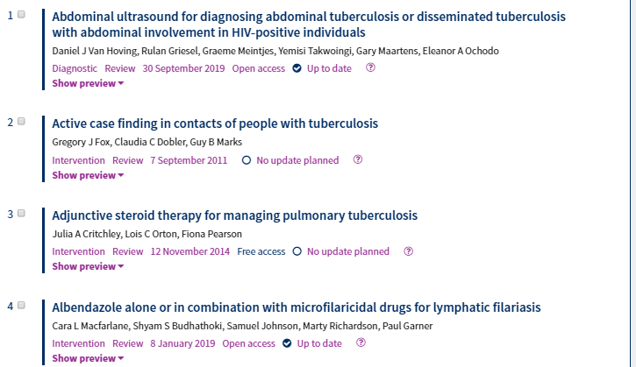
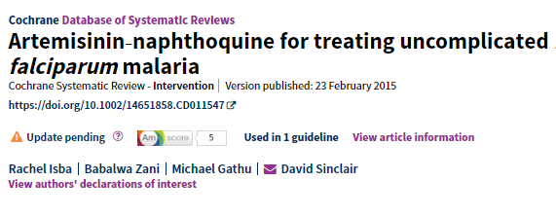
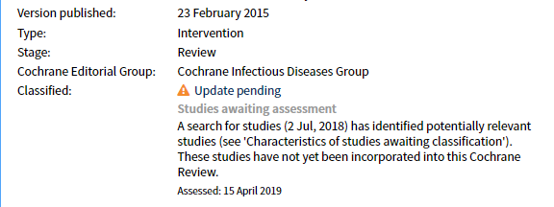
Browse by Topic/Cochrane Review Group
Readers can choose to browse or search content from specific Topics or Cochrane Review Groups across all relevant Cochrane content
Update Classification Statuses guide readers as to whether a review is up to date, likely to be updated in future, or does not currently need updating
Notes:
And here we have examples of curated and additional content: these are Special Collections of reviews that have some connection to one another and which we bring together with a short commentary, and in many cases make the reviews freely available for a period of time.

Slide 37
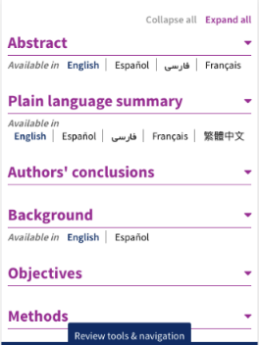
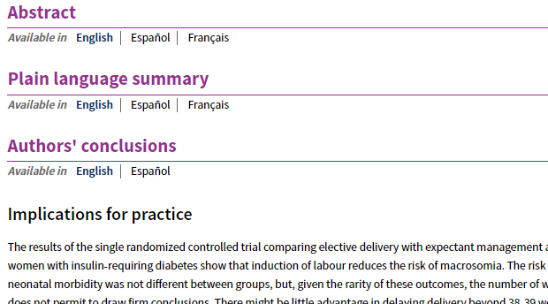
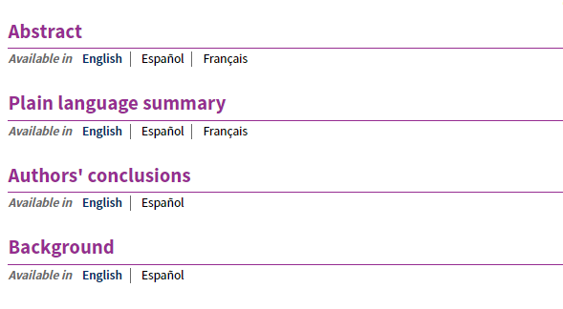
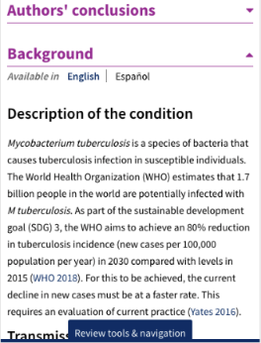
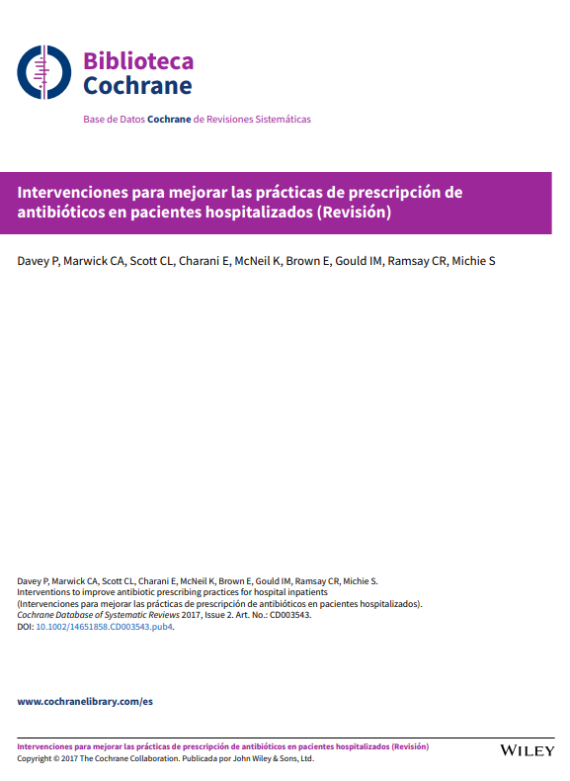
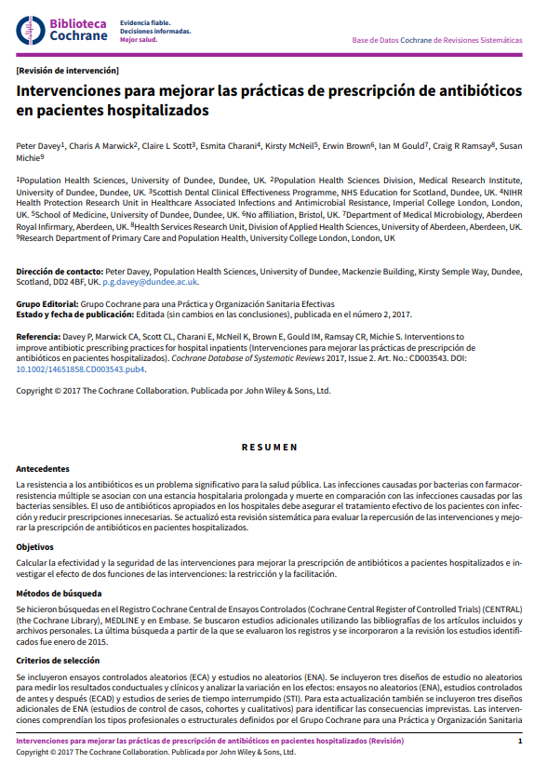
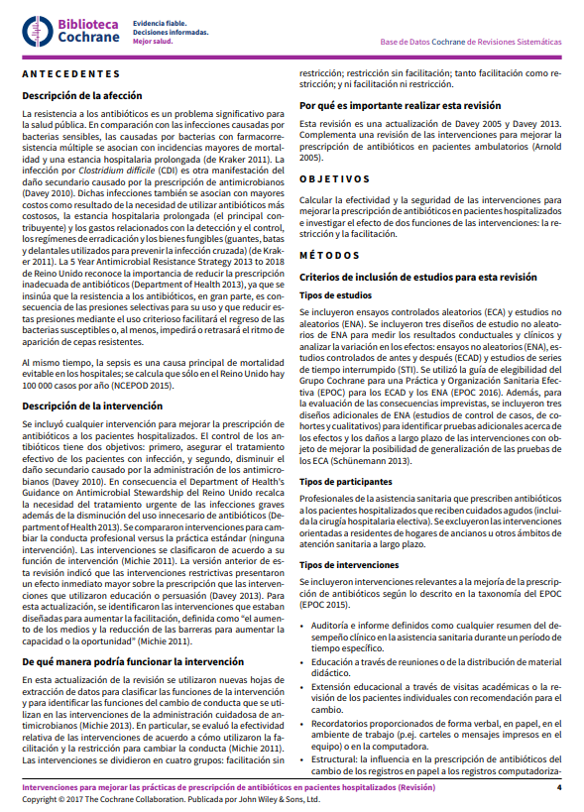
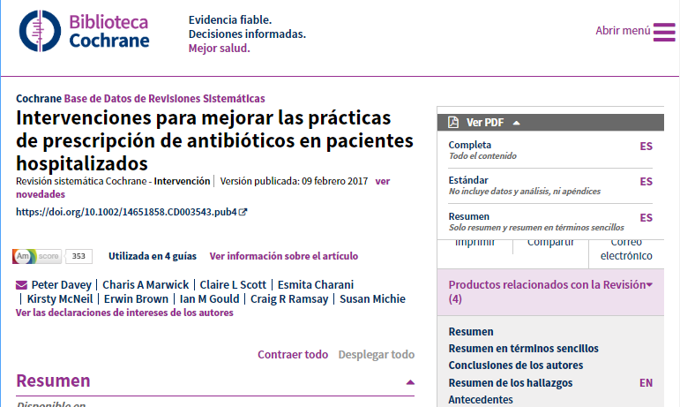
Collapsible article sections
Individual article sections can be collapsed and expanded for easier navigation of Cochrane Reviews and Protocols; ideal for mobile readers
Spanish language PDFs are now available for over 5000 Cochrane Systematic Reviews
Notes:
Holly – can we find a better map to show our reach and access

Slide 38

Cochrane PICO search ^{BETA}?
Cochrane Reviews are incredibly rich sources of information – but it can be hard to find evidence to match your clinical or research questions.
PICO Search ^{BETA} makes it easier to find exactly the information you need.
Notes:
These would be optional slides about open access – can we make this more on-brand?

Slide 39
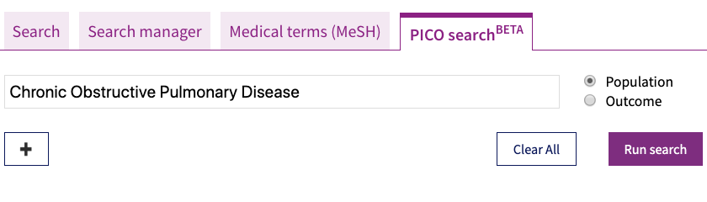
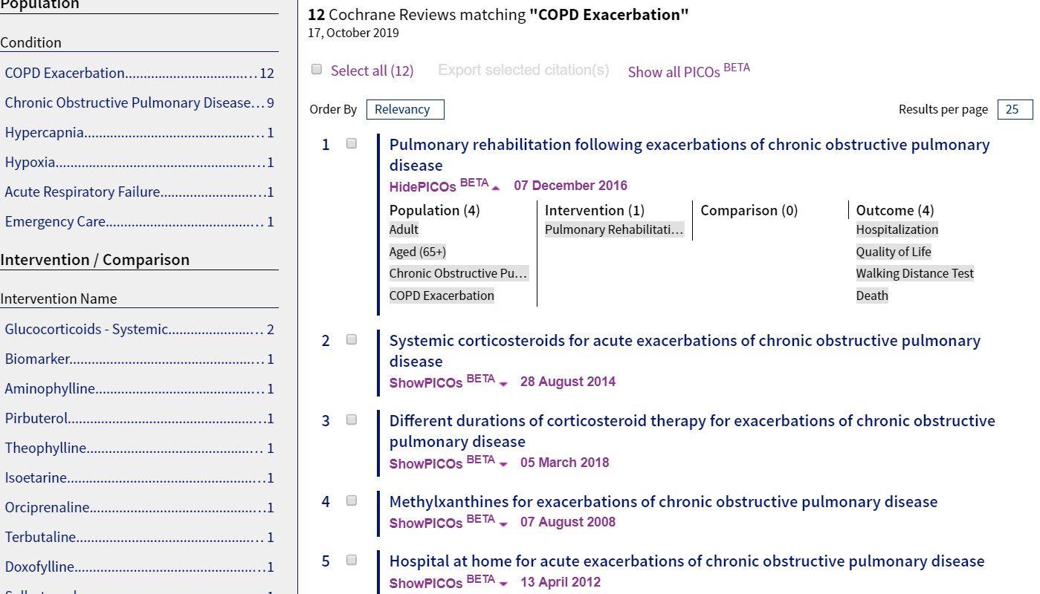
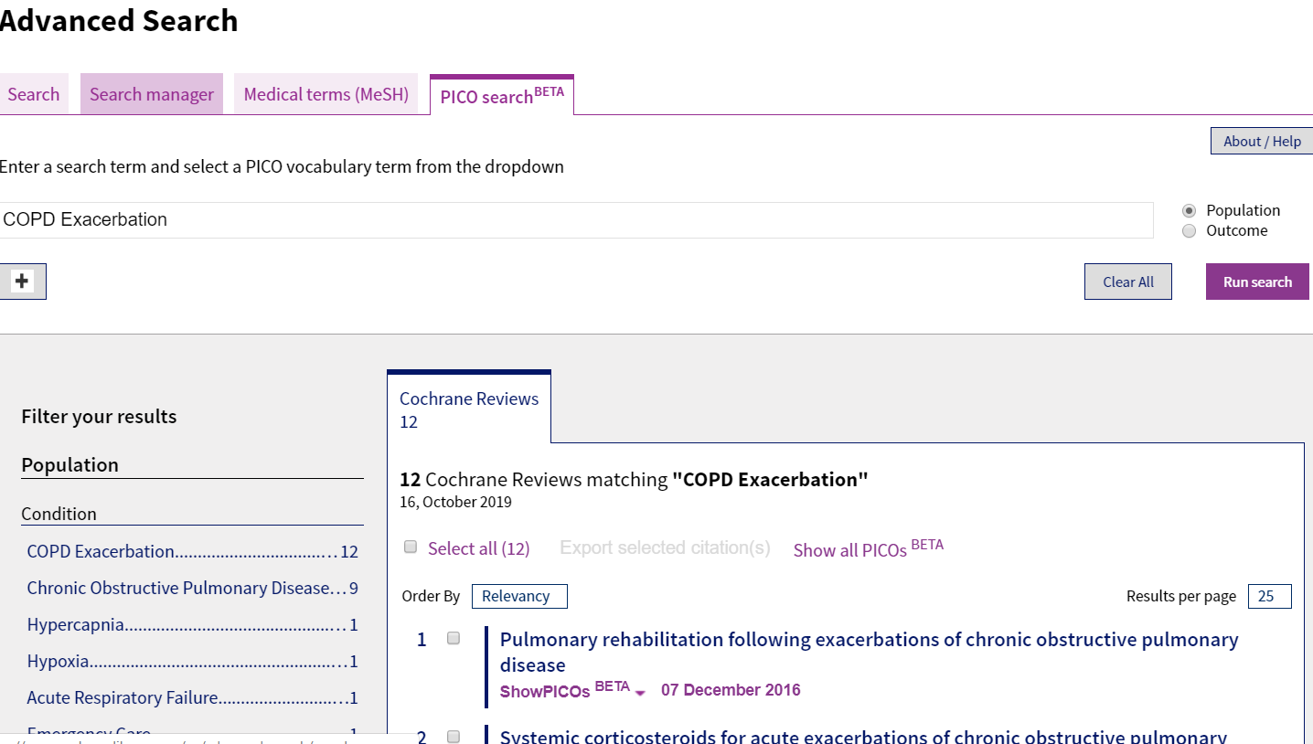
PICO search ^{BETA} Live on The Cochrane Library
Notes:
Our strategy to 2020 covers 4 areas, but the first two of these reflect our primary purpose: to produce and maintain high quality, relevant systematic reviews, and to do everything we can to ensure that they impact on health care across the world.
The Cochrane Database of Systematic Reviews, which is the Journal, is one of the databases within the Cochrane Library – which also includes the CENTRAL register of controlled trials.
The CDSR comprises over 6000 reviews and each month we publish around 40 new reviews and 45 updates. Parenthetically, in 2013 we moved to a continuous publication model from the monthly cycle I introduced shortly after arriving. Looking back now, I am pleased we did it – at the time I might not have been quite so positive! Each publication has an update associated with an issue – based on the old monthly cycle.

Slide 40

Cochrane Training Website
Notes:
Our strategy to 2020 covers 4 areas, but the first two of these reflect our primary purpose: to produce and maintain high quality, relevant systematic reviews, and to do everything we can to ensure that they impact on health care across the world.
The Cochrane Database of Systematic Reviews, which is the Journal, is one of the databases within the Cochrane Library – which also includes the CENTRAL register of controlled trials.
The CDSR comprises over 6000 reviews and each month we publish around 40 new reviews and 45 updates. Parenthetically, in 2013 we moved to a continuous publication model from the monthly cycle I introduced shortly after arriving. Looking back now, I am pleased we did it – at the time I might not have been quite so positive! Each publication has an update associated with an issue – based on the old monthly cycle.

Slide 41
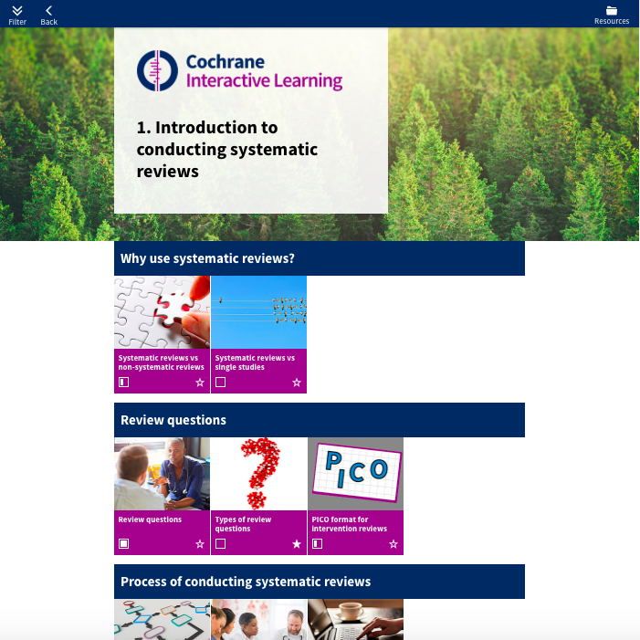

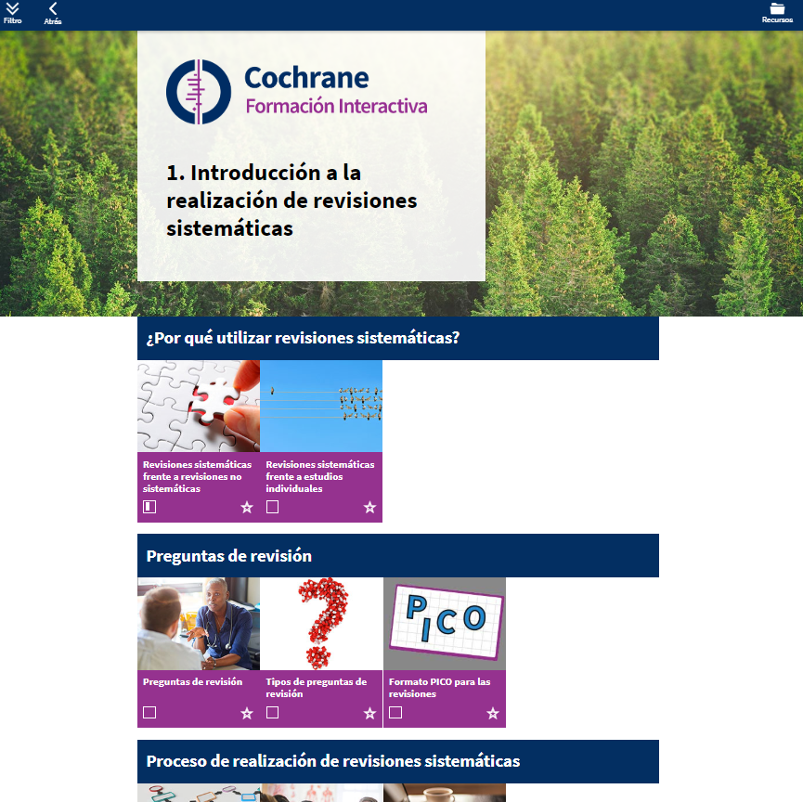

Cochrane Interactive Learning Now available in Spanish!
Cochrane Formación Interactiva ¡Ahora disponible en español!
training.cochrane.org/es/interactivelearning

Slide 42

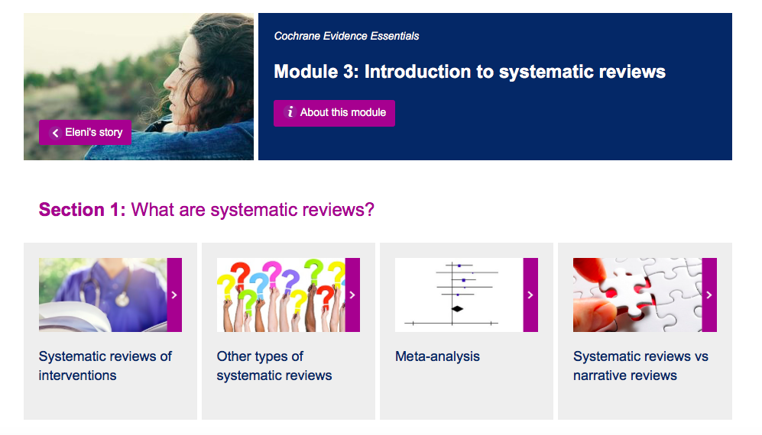
Cochrane Evidence Essentials
New suite of four online learning modules, free to all users
Introducing evidence based medicine, clinical trials and systematic reviews
Co-produced with consumers
Told through the story of Eleni, a fictional consumer
Plans for 2020: accompanying workshop materials for trainers
training.cochrane.org/essentials

Slide 43

*New* Training Support Programme including:
Train-the-trainer workshop: improving and enhancing pedagogical skills for Cochrane’s Trainers
Online training skills course (2020)
Latest methodological training materials: updated standard author training materials (2020)

Slide 44

Cochrane Learning Live
Flagship webinar programme on methods, tools and current issues
*New* in 2020: webinar series’ on:
knowledge translation
network meta-analysis
*New* in 2020: learner-driven format, ‘An hour with…’
training.cochrane.org/cochrane-learning-live

Slide 45
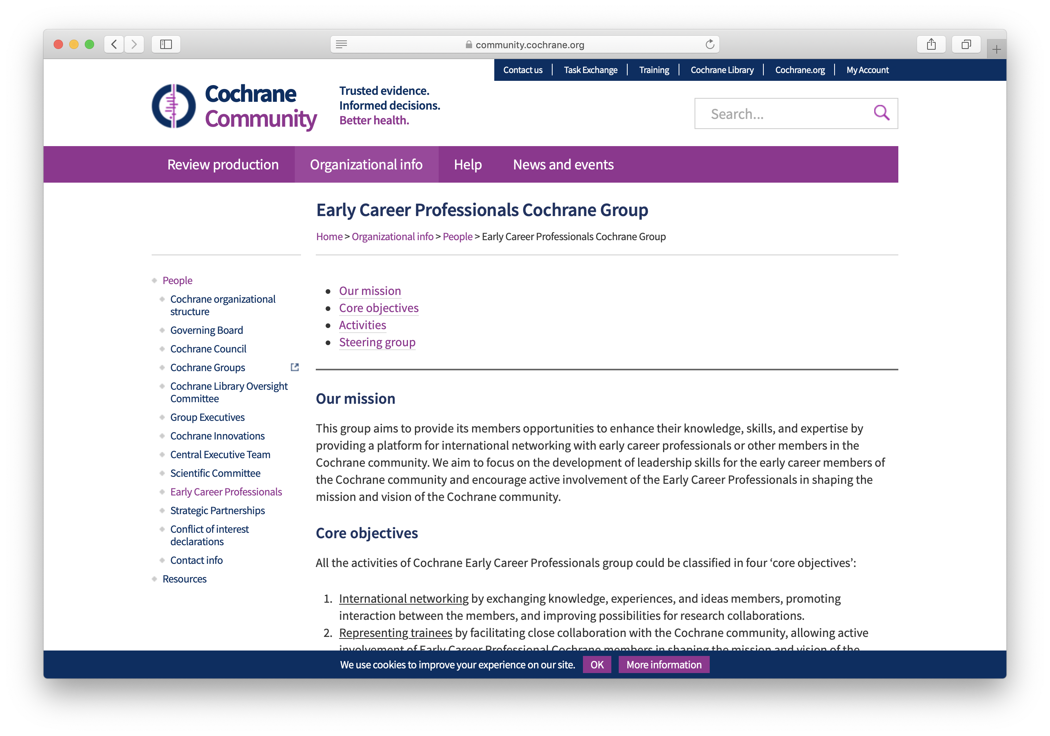
Cochrane Early Career Professionals

Slide 46
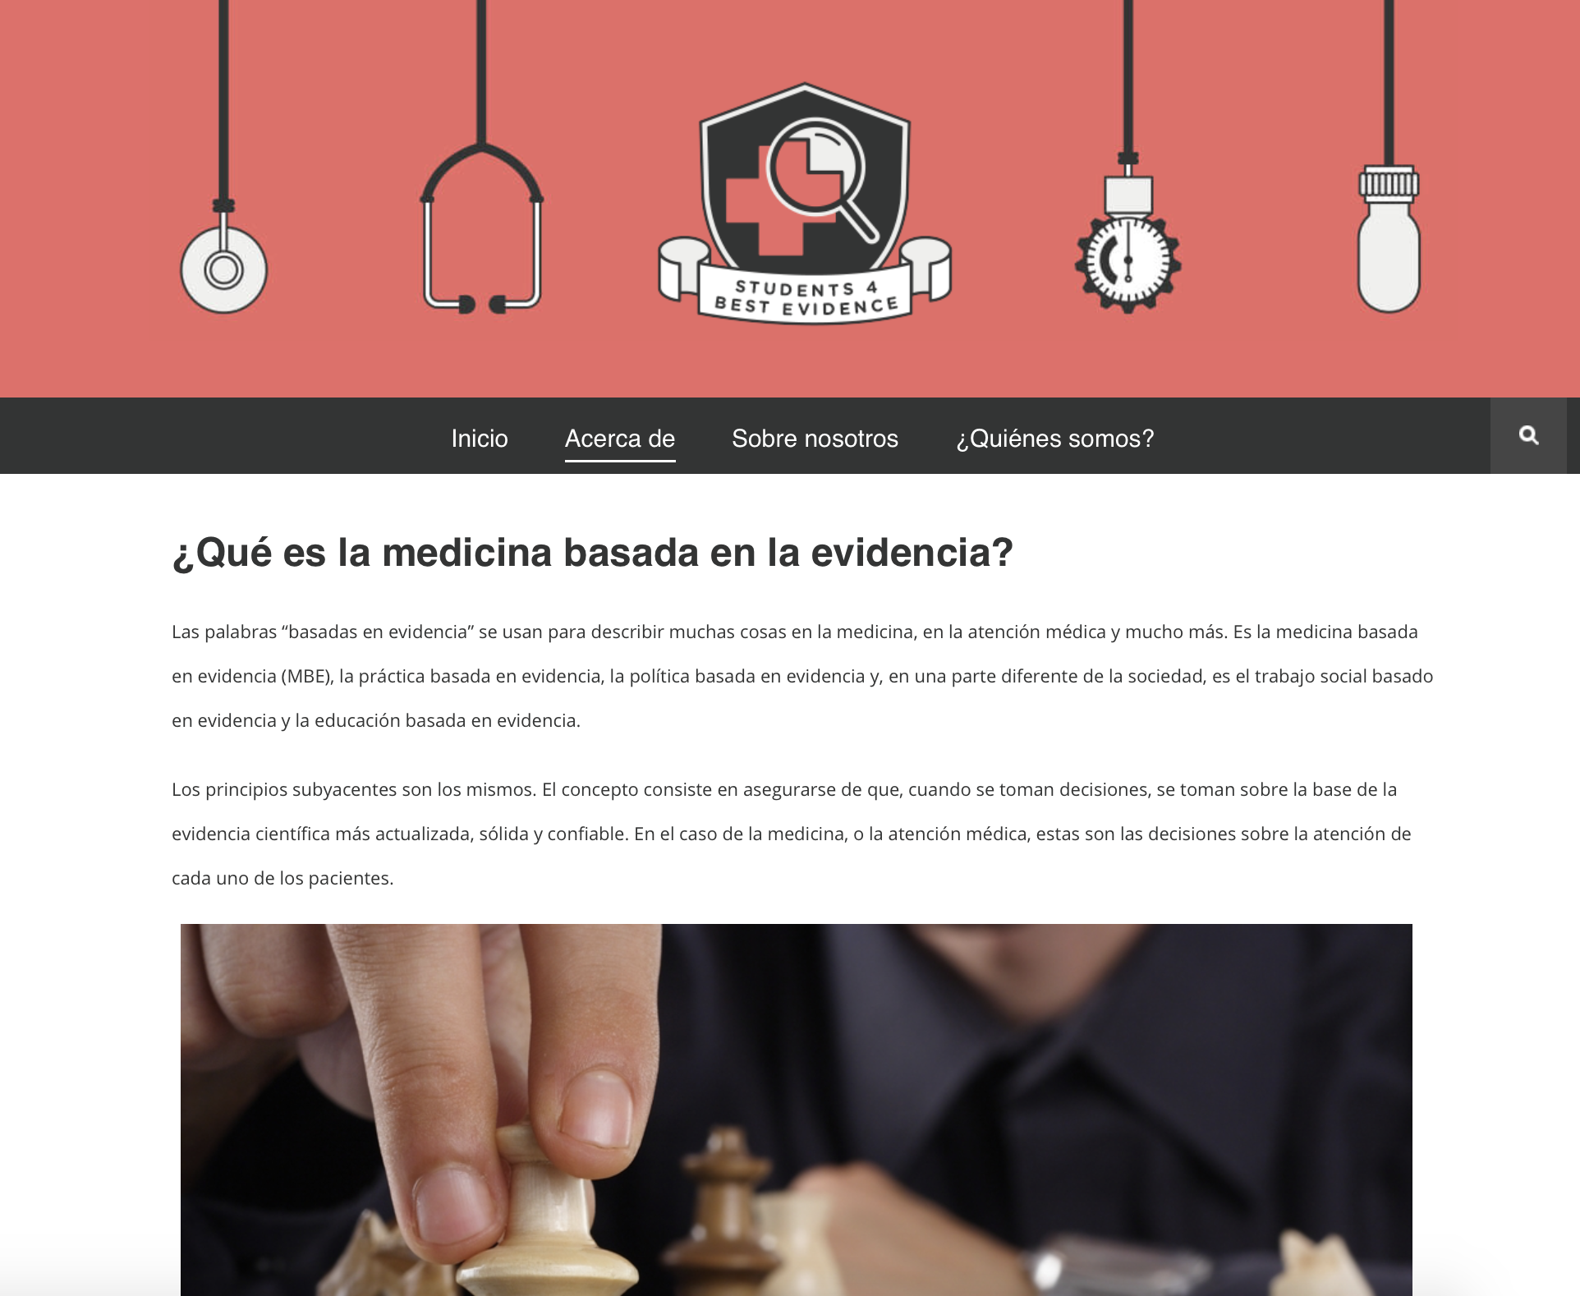
Students 4 Best Evidence Estudiantes x la Mejor Evidencia

Slide 47
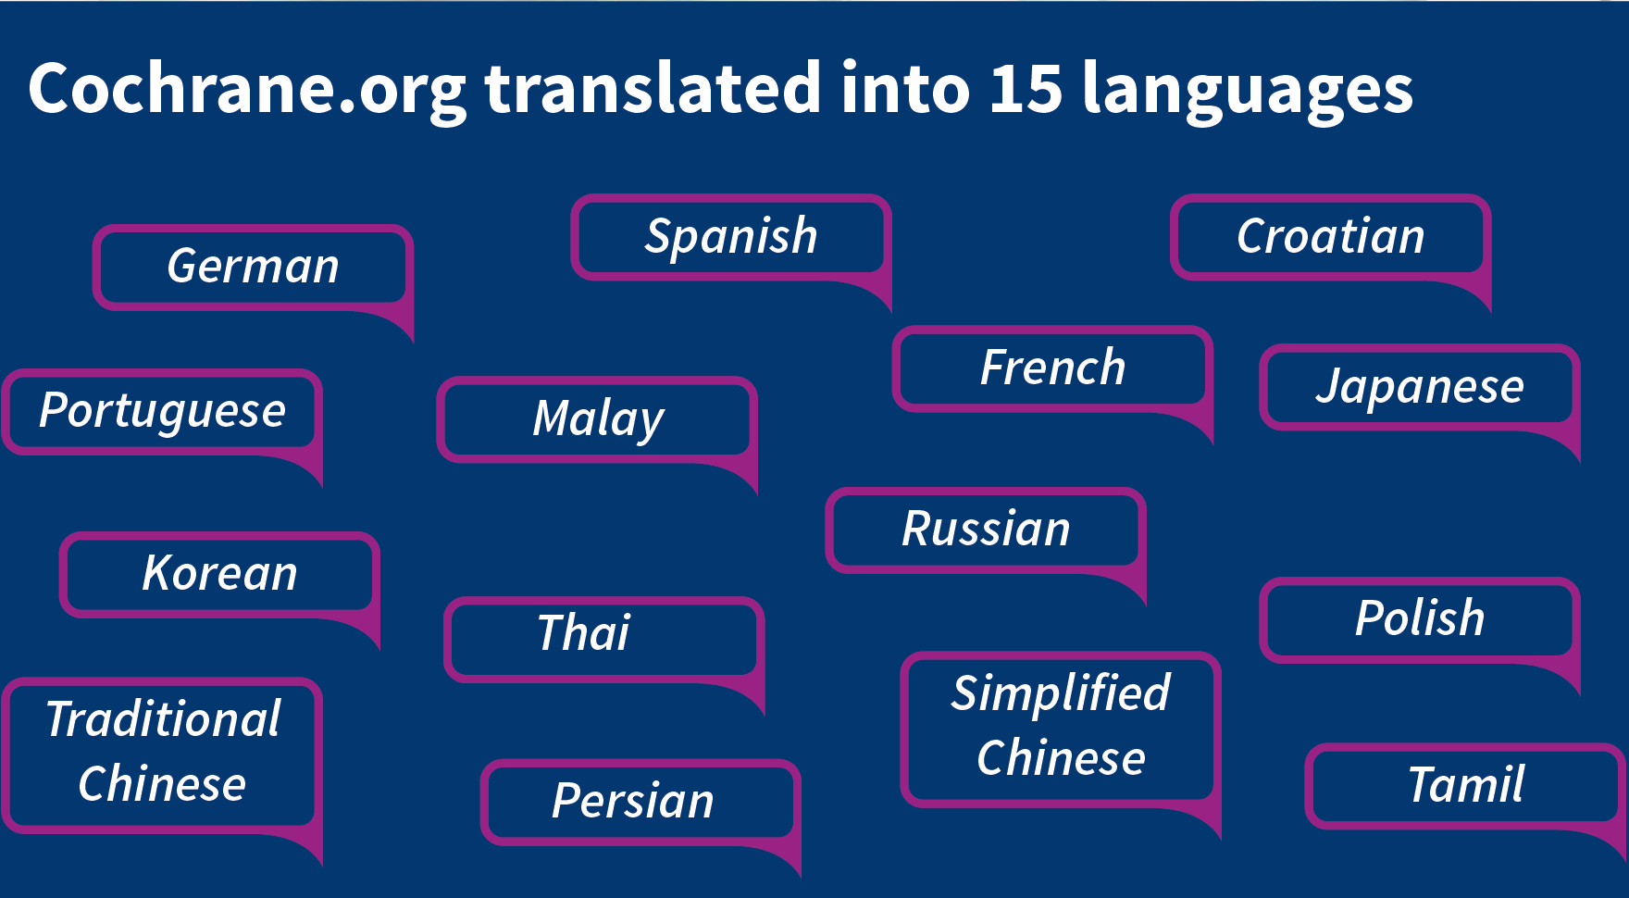

Slide 48
Contact us
If you require further information about Cochrane’s brand please contact: support@cochrane.org
St Albans House 57–59 Haymarket London SW1

